Slide 1
APIC 2018 Conference in Minneapolis, Minnesota
Highlighting the Posters Presented by Members of APIC Chapter 13
Presented by
Angela Gabasan, RN, MSN, CIC
Mount Sinai West/Mount Sinai St. Luke’s

Slide 2

Disclaimer Alert
Angela is not presenting the abstract
My aim is to highlight the excellent work/project of the APIC Chapter 13 members
My hope is for all of us to learn and maybe apply these projects in our own hospitals
For complete information about the abstracts, please contact the authors
Therefore…no questions to the presenter

Slide 3
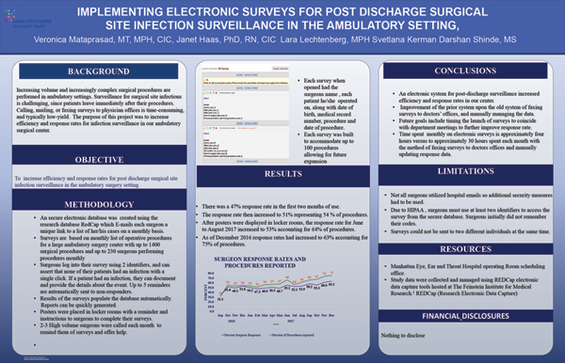

Slide 4
Key Points of the abstract
Project is to increase efficiency and response rates of surgeons for post discharge SSI surveillance in Ambulatory settings (electronic vs traditional way of faxing)
An electronic database was created which e-mails surgeons a unique link to a list of her/his cases on a monthly basis
Surgeons log into their survey using identifiers and affirm whether their patients have infections
Up to 5 reminders are automatically sent to non-responders
Excellent response from the surgeons
Time spent for electronic survey 4 hours vs. 30 hours per month to manage faxing

Slide 5
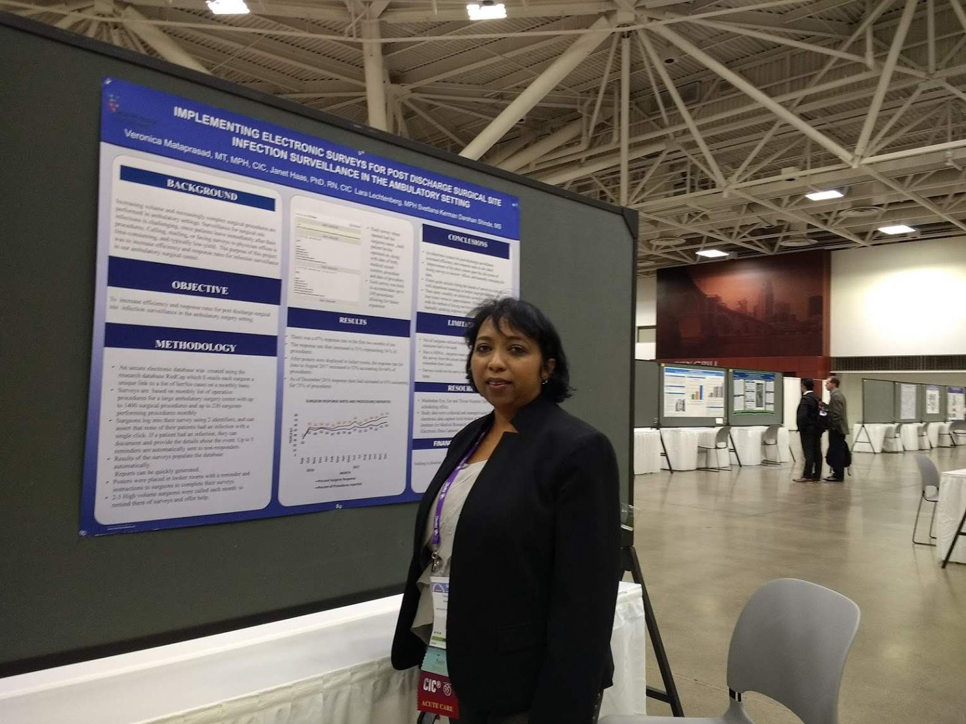

Slide 6
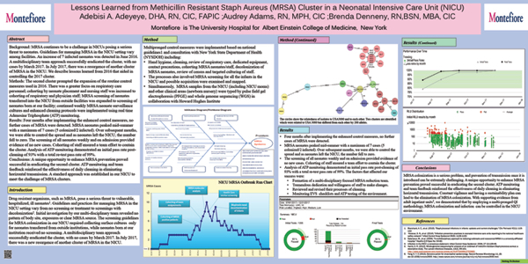

Slide 7
Key Points of the abstract
Described the lessons learned from their 2016 NICU MRSA outbreak that helped them to successfully eradicate their 2017 cluster
Focused on expanding the routine IC measures
  greater focus on respiratory personnel
  cohorting of neonate and staff was increased to cohorting of respiratory staff and physicians
  MRSA screening expanded from infants transferred from outside facilities to infants born in the facility
  continued weekly surveillance
  enhanced cleaning protocol

Slide 8
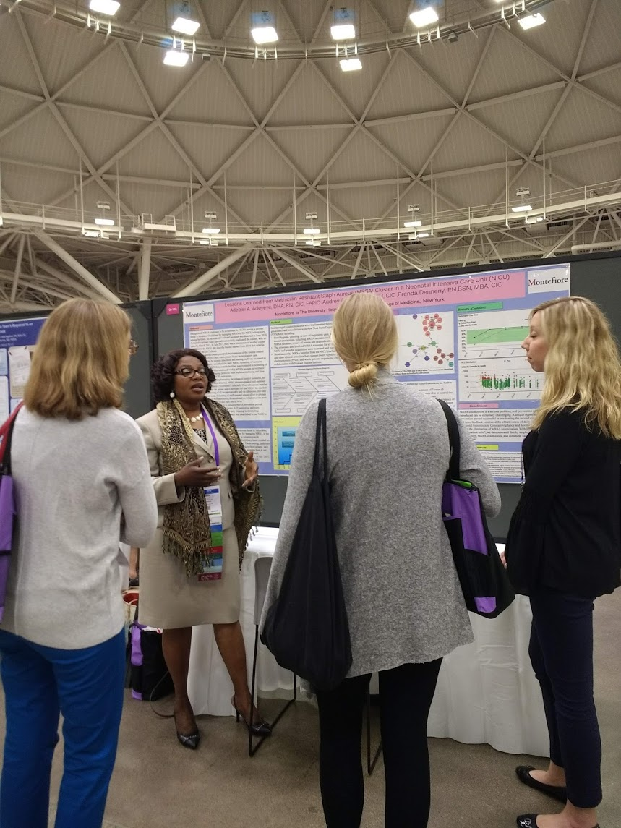

Slide 9
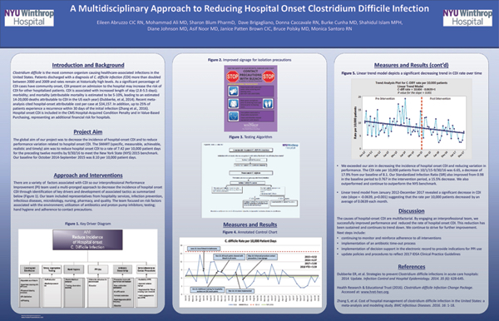

Slide 10
Key Points of the abstract
The abstract demonstrated their efforts to decrease HO-CDI from a baseline of 8.1 per 10,000 patient days
Multi-pronged approach through identification of key drivers and development of associated tactics; team included
  IP, ID, Micro, Nursing, Pharmacy, Quality and Hospitality services
  Focused on risk factors associated with the environment; use of antibiotics and PPI, testing, HH, and adherence to Contact Precautions
The results
  HO-CDI decreased to 5.90 per 10,000 patient days a remarkable decrease of 27% from baseline outperforming the NYS benchmark

Slide 11
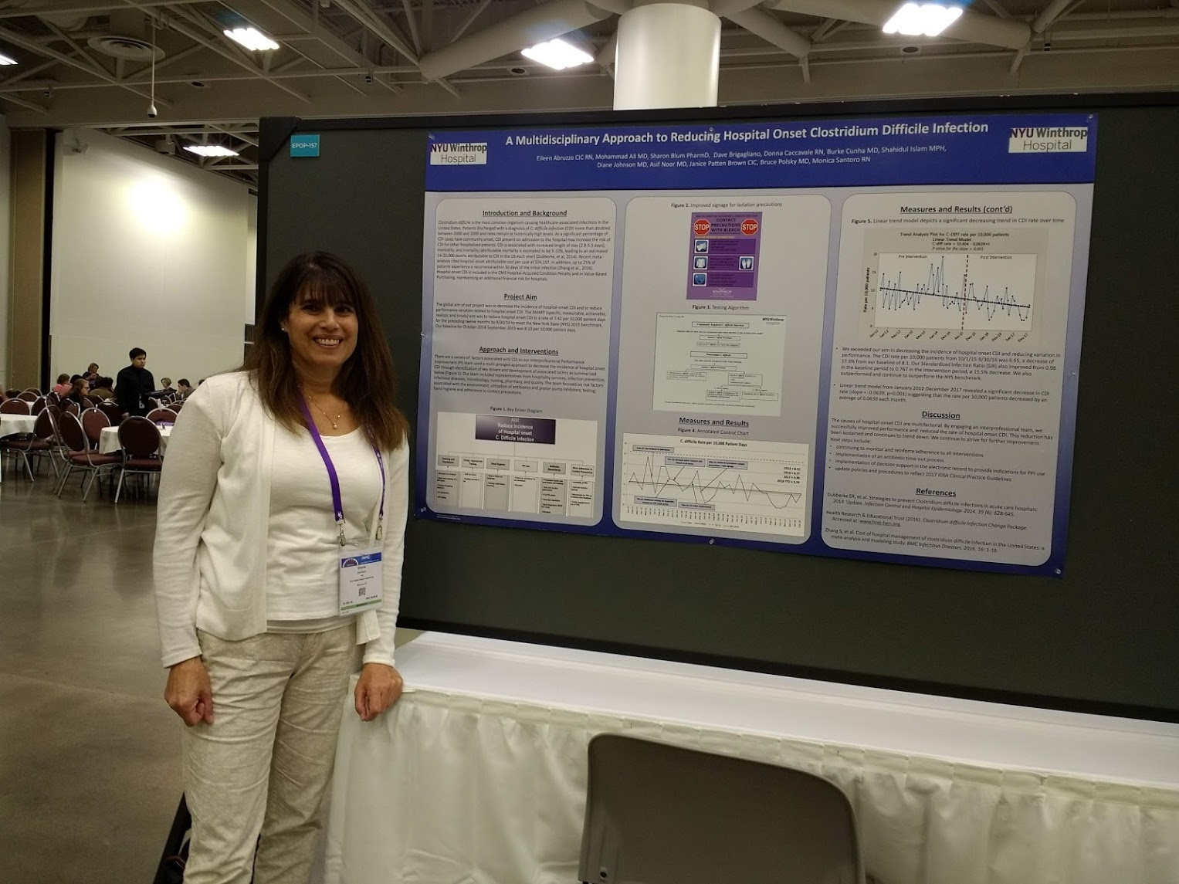

Slide 12
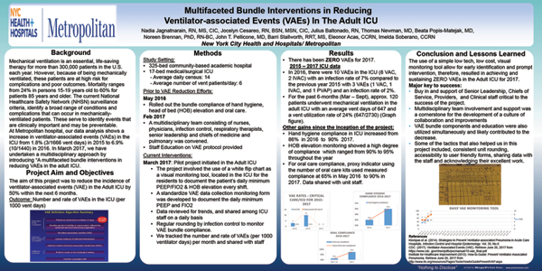

Slide 13
Key Points of the abstract
The aim of the project was to reduce the incidence of VAEs in the adult ICU by 50% in 6 months. 2016 rate was 6.9%
Pilot project in a 17 bed ICU
  multidisciplinary team
  staff education on the NHSN VAE protocol
  use of white flip chart to document daily PEEP and FIO2 and HOB elevation every shift
  daily data reviewed for trends, and data transcribed into a computerized VAE monitoring form for tracking and trending
Results of the 6 months pilot:
  Zero VAEs, surpassing their goal of 50% reduction

Slide 14
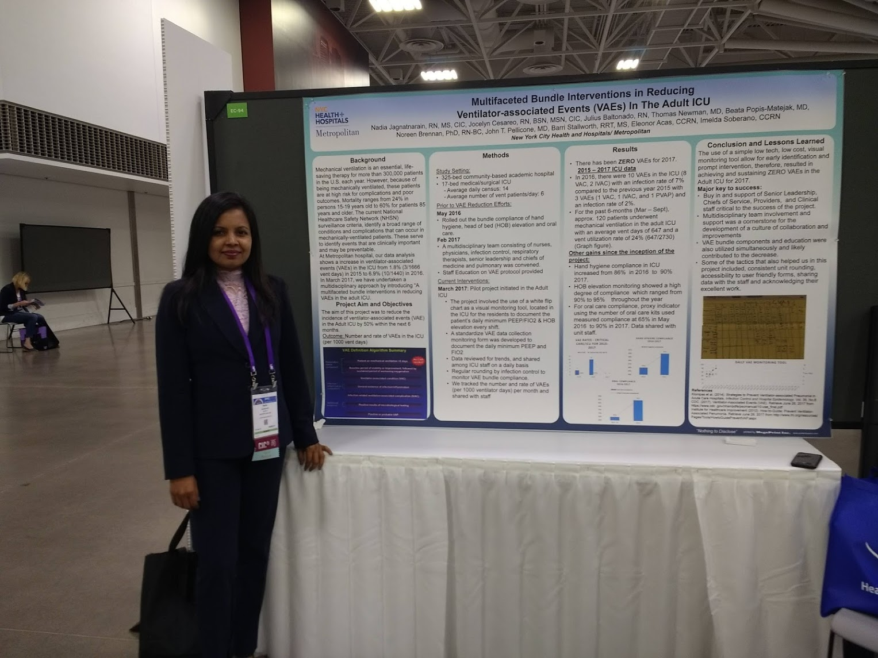

Slide 15
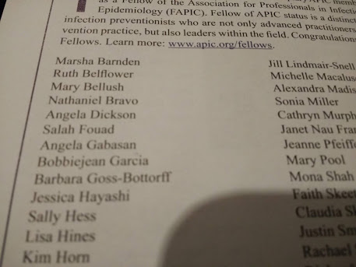
Congratulations to New FAPICs from
Greater NY APIC Chapter 13

Slide 16


Slide 17


Slide 18


Slide 19
Lastly, proud to be member of APIC Chapter 13
Thank you

