Slide 1
NYULH Ambulatory IPC
Faith Skeete MS, RN, CIC, FAPIC
Director - Ambulatory IPC
APIC Greater NY Chapter 13 Meeting
December 14, 2022

Slide 2
Presentation Objective
To understand the layout of the ambulatory sites, role of the Infection Preventionist, and areas of opportunity for ambulatory Infection Prevention and Control, at NYU Langone Health (NYULH).

Slide 3

Scope
Staff: 5 FTEs
Locations
  DB with >1500 entries
  Brooklyn, Queens, Bronx, Manhattan, Staten Island
  Long Island
  Westchester
  New Jersey, Hawaii, Florida, Nevada…
Types
  Article 28 (including FHCs (includes schools, senior centers, daycares, homeless shelters, dental))
  Faculty Group practices (includes dental, PT)
  Radiology (NYU staff, non NYU Radiologists)
  Other (Voluntary MD practices)

Slide 4

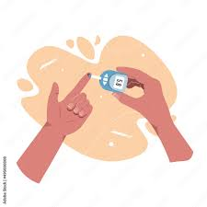
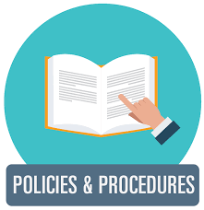
What do we do?
  EOC Rounding
    Medication safety
    Cleaning & reprocessing
    Storage
    Clean vs dirty
    Regulatory preparation
    Syndromic surveillance
    Point of care testing
  Education/Information sharing
    Regulatory preparation
    Policy & procedure
  Consultation
    Construction
    New/expanded services to existing locations
    Exposure response/epi events
    High consequence pathogens
  Special Considerations
    Infusion
    Reprocessing
    Dental
    Ambulatory surgery
    Emergency
    Endoscopy

Slide 5
Next Steps
Increase frequency and quality of rounding in high risk locations to provide more support to staff
Increase educational opportunities/resources for IPs covering a wide variety of services
Increase quality improvement participation/opportunities
Get a better understanding/hold on what’s occurring where
Have more involvement up front in new construction
To better prepare for high consequence pathogens in the ambulatory setting
To remove obstacles which may pose challenges for the IP in the field
Resources-vary references. Ensure IPs know how to find information
Partnerships-FGP, Regulatory, Environmental Health and Safety
Data/Technology-IPs need the tools to work

Slide 6

Questions?

