Slide 1
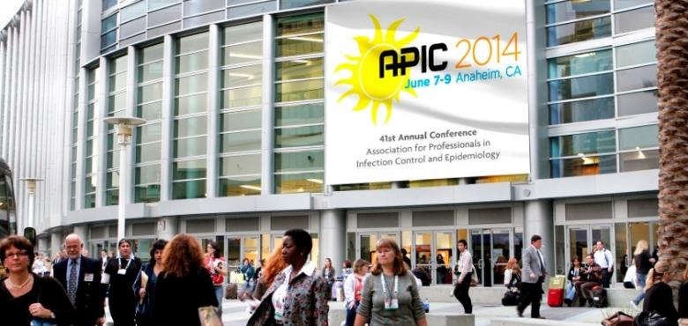
Ranekka Dean, MPA RN CIC
September 17, 2014

Slide 2

APIC 2014: An Experience
Comprehensive meeting
Focused learning sessions
State of the art Expo Hall
Wonderful networking opportunities

Slide 3
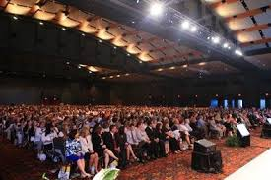
Keynote & Plenary Sessions
Expert, world renowned speakers
Interesting and Pertinent topics

Slide 4
Networking Opportunities
Welcome Reception
CIC Dessert Reception
Exhibit Hall
Poster Gallery

Slide 5
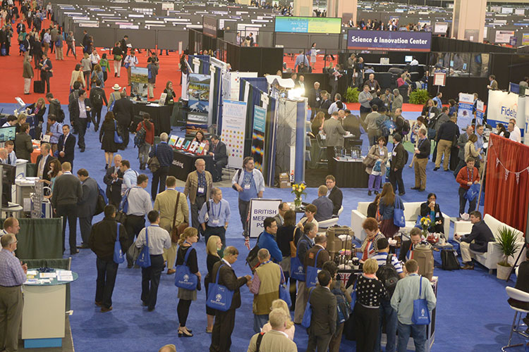
Exhibit Hall

Slide 6
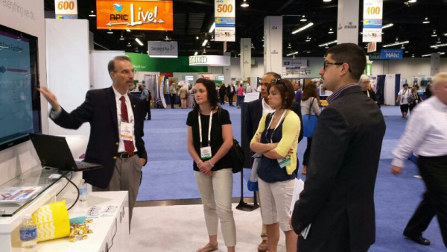
Exhibit Hall

Slide 7
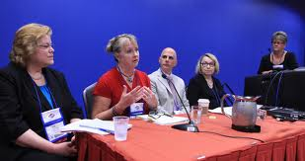
Leadership Opportunity
Moderator – Surveillance session
Responsibilities included:
        Orchestrate the session
        Facilitate discussion during Q&A
        Thank speakers & audience
        Close the session

Slide 8

IP Role Recognition
Documenting the evolution of the IP role
Requires advanced skills
Description of Professional Advancement Ladder

Slide 9
Disinfection and Sterilization:
What’s New
New recommendations, practices and technologies
New practices to reduce role of the environment in disease transmission

Slide 10
Conducting an ICRA
What to look for on ICRA permit
Review dust control techniques
HEPA filters

Slide 11
Infection Prevention in the Kitchen
Real life examples of “do’s & don’ts” in facility kitchens
Develop spot surveillance program for kitchen
Develop collaborative relationship with food services

Slide 12
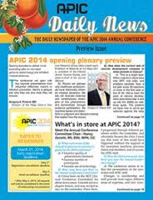
APIC Resources
Conference App
Conference Proceedings
APIC Central
APIC Daily News
APIC Live
      Knowledge Bar
      Photo Booth

Slide 13

APIC Photo Booth

Slide 14
APIC HighlightS VIDEO
http://vimeo.com/97929054

Slide 15
Special Thank You to:
APIC Greater New York Chapter 13
Sherry Chisholm Memorial Support Program

