Slide 1
APIC 2016
Charlotte, N.C.
Presentation by:
Robin Haag, RN, BC, MA
APIC Chapter 13
2016 Carla Alvarado Award Recipient

Slide 2
Choosing Presentations
Shorter conference format
Concurrent sessions
  Many offerings at same time slots
  Overlapping times
  30/30 sessions
Little repetition of topics
Large conference center
  Hard to find rooms
  Inadequate seating for some sessions

Slide 3
Schedule At A Glance
Different perspective
  Retired from acute care
  Beginning a consultation business
  No longer bogged down by regulatory requirements
    Learning and re-learning ever-changing HAI definitions
    Application of definitions
    Trying to find definition loop holes
  No need to fix a problem at work
  No constraints to what I attended

Slide 4
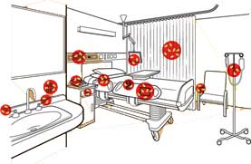

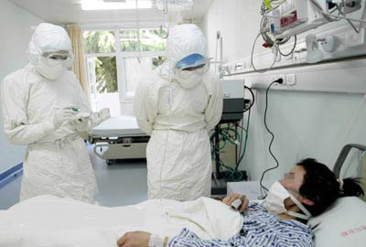


Old Perspective

Slide 5


Self Indulgence

Slide 6

New Focus
My future in Infection Prevention
The future of Infection Prevention
Community
  Primary care
Long term care
Acute care
International

Slide 7
Merging Our Future Across
Settings
Collaboration between long term and acute care
Long term care HAI reporting
Long term Antibiotic Stewardship
Collaboration between dialysis centers and acute and long term care

Slide 8
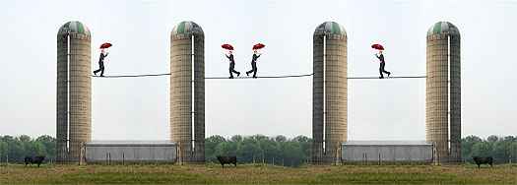
What Did I Learn ??
Territoriality
Little outreach
Working in silos

Slide 9



Slide 10
Patient/Resident/Client Safety
Teamwork
Inter-agency communication
  Meetings
  Seminars
  Share expertise
  Remove barriers
  Work to common goals

Slide 11

The Challenge - The Future

Slide 12


