Slide 1
APIC 2022
In person experience summary
Karen Brody MSN, RN, CIC
Mount Sinai Brooklyn
APIC Greater NY Chapter 13 Meeting
September 21, 2022

Slide 2
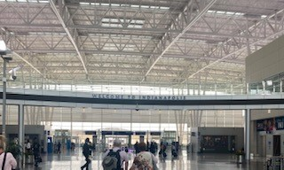
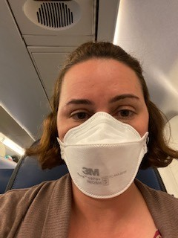
First travel experience in pandemic

Slide 3

Indianapolis, Indiana
June 13-15 2022

Slide 4
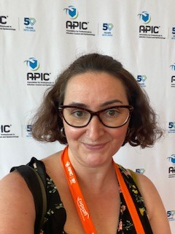
APIC experience

Slide 5
Benefits of Attending in Person
The APIC 2022 Annual Conference provides the opportunity to earn 10 IPUs for attending the conference June 13-15.
After satisfying all evaluation requirements, a certificate of completion will be available to print and/or for your records indicating contact hours-up to 56 CNEs for in-person attendance and up to 54 CNEs for virtual attendance.

Slide 6
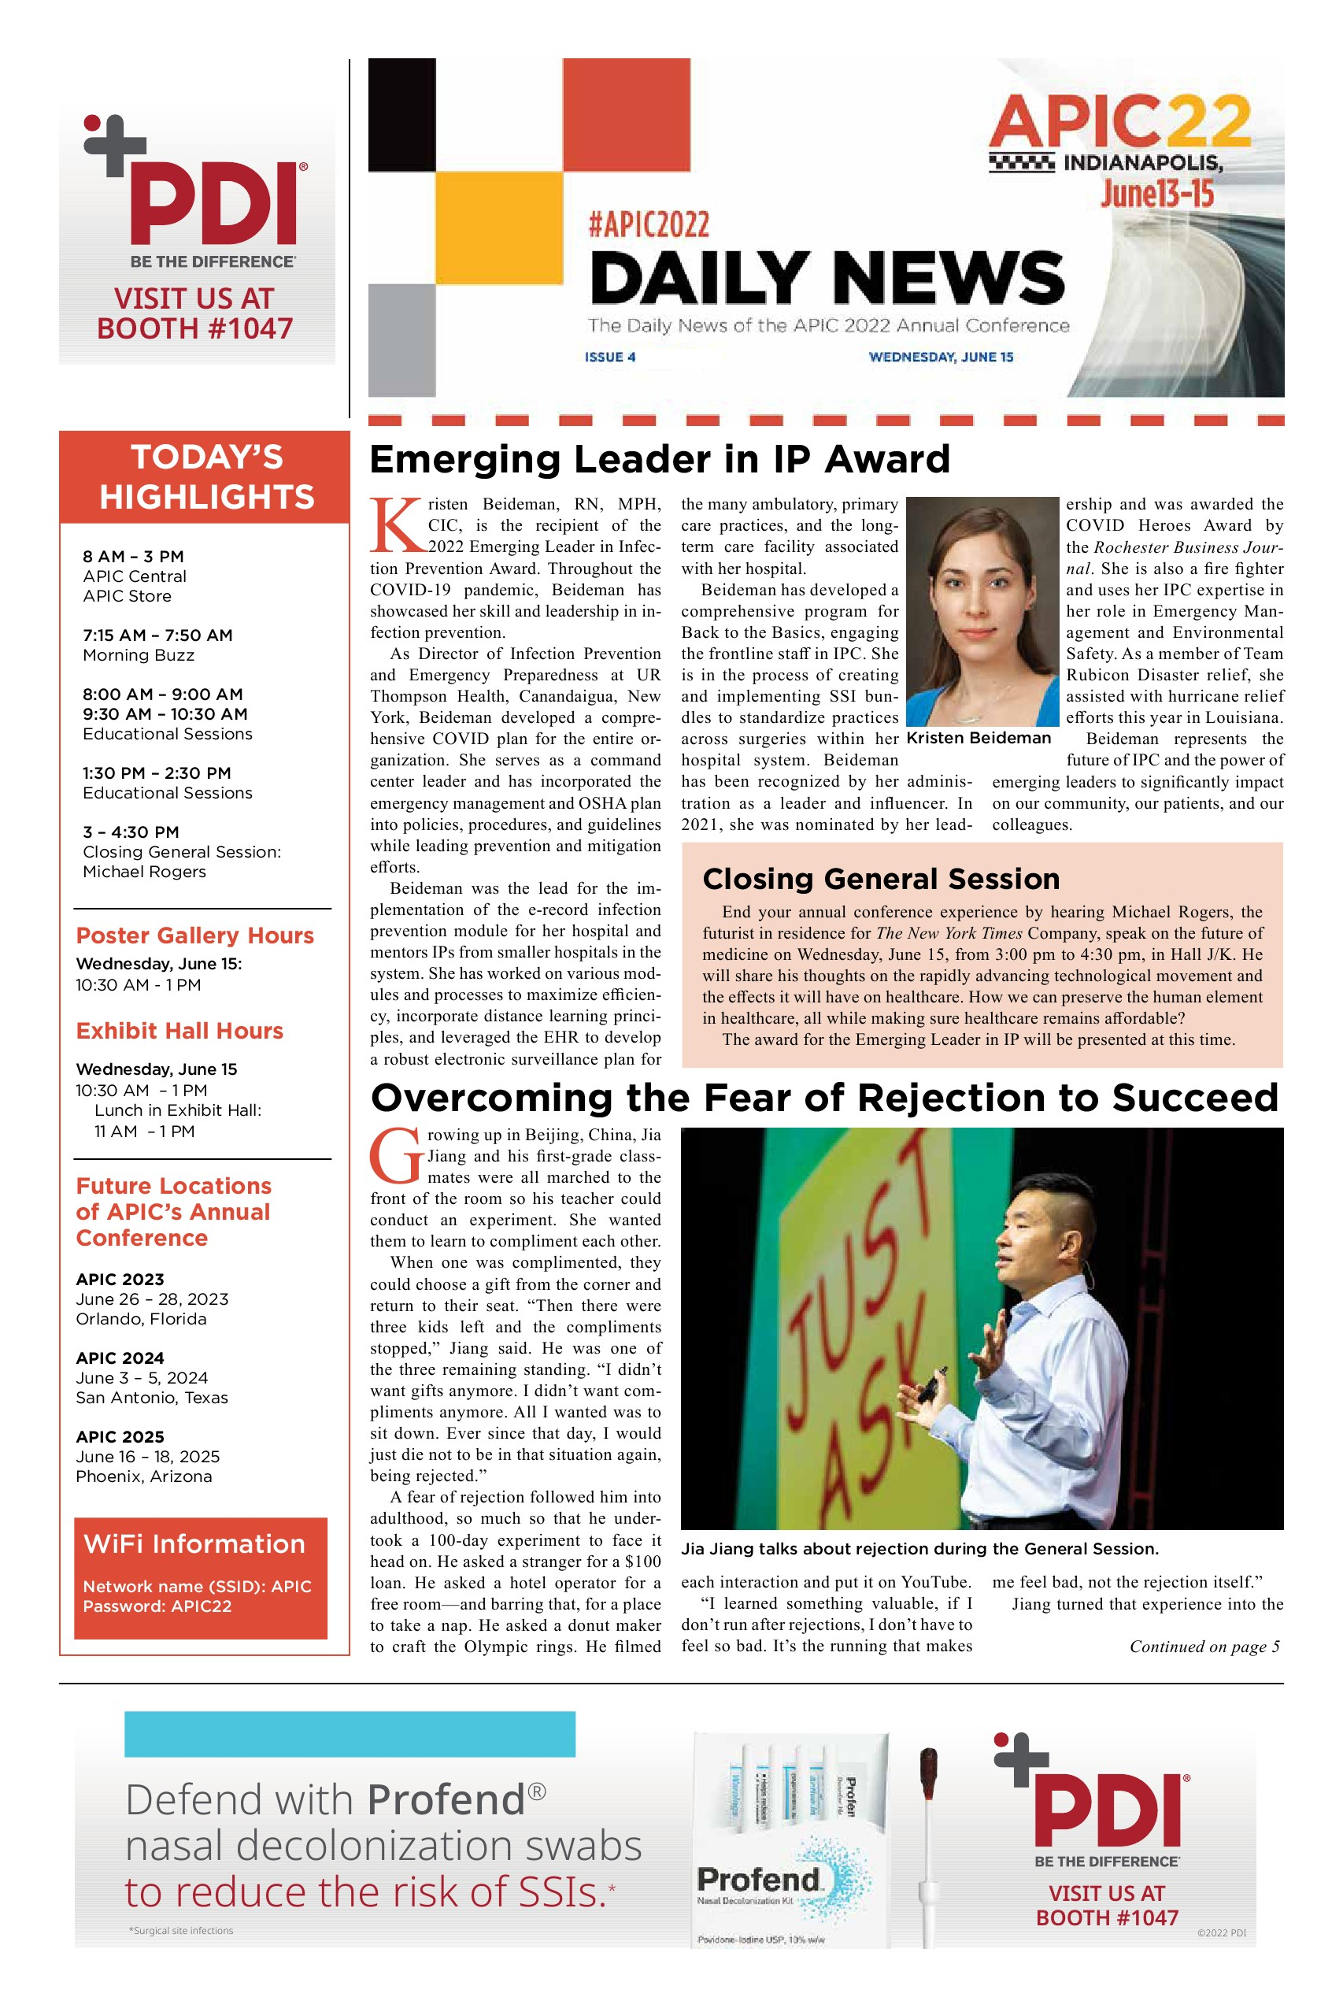
Daily Opening Sessions
Great speakers including Janet Haas – won Carole DeMille award
Inspirational speakers including Col DeDe Halfhill, Jia Jiang, and Michael Rogers
Daily News

Slide 7
Memorable Lectures
Advancing Antibiotic Stewardship Nursing Practice Through Standardized Education
  72% of hospitalized COVID patients received some type of antibiotics despite only 8% being co-infected with bacterial/fungal infection
  Current education programs target physician prescriber training only- Lack of standardized education for nursing on antimicrobial stewardship
  Jefferson health systems designed an online asynchronous CE program with 4 modules to engage nurses
Moving sterilization off- site – Penn Medicine
  Good option to allow needed space and not take space away from patient care
  Very involved process with flow of facility going from drop off dirty trays close to decontam – then through processing and once processed go out to separate clean dock to pickup case carts after processing. Temp and humidity monitoring on trucks
  Generator backup, uses RO system, pressure monitoring in all areas, tracking system
  Benefits include increasing hospital revenue by having more patient beds and standardization of sterilization

Slide 8
Memorable Lectures
Integrating Urology into Your Infection Prevention Program- Emory University hospital
  Partnering with urologists can be very helpful for infection prevention teams particularly for CAUTI reduction and SSI reduction
  Many urology surgeries can occur concurrently or within COLO surgeries
  Procedures or surgeries to occur in Cysto room and questions regarding the cysto room floor drain – plan for flushing and cleaning of this area

Slide 9
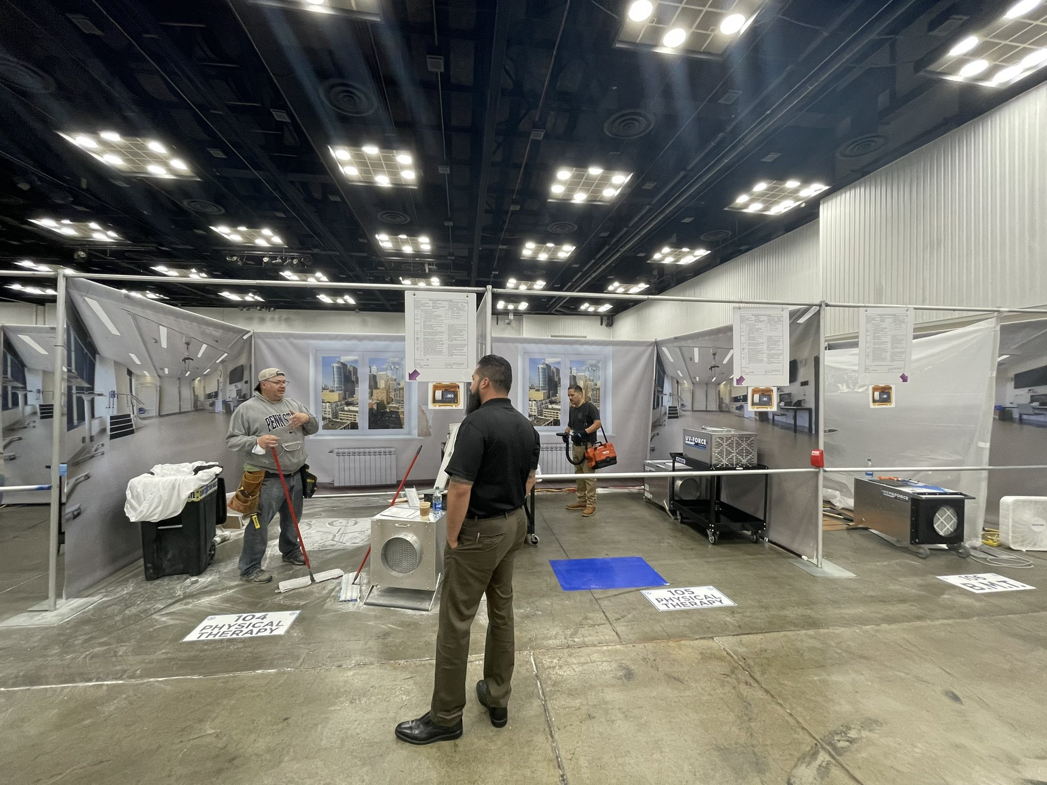
ICRA hospital

Slide 10
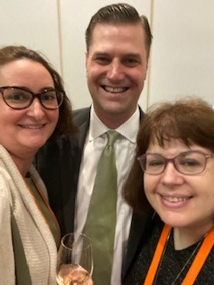
Connecting with other Infection Prevention Professionals

Slide 11

APIC swag
Another great part of coming to these conferences live is to see different products and meeting with vendors who give out samples and other promotional products

