Slide 1

APIC Chapter 13
Journal Club
Hannah Newman, MPH, CIC
Lenox Hill Hospital

Slide 2
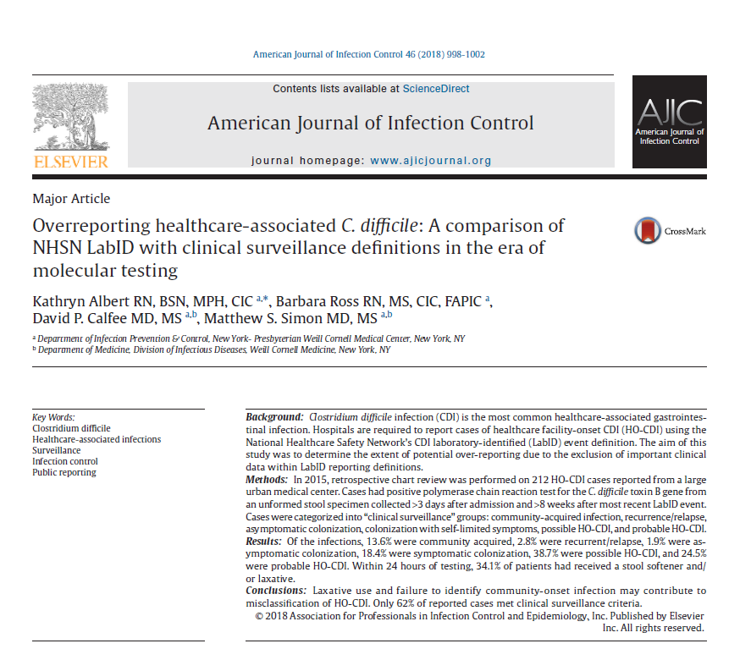

Slide 3
Background
C.difficile is a leading cause of HAIs associated with hospitalizations and antibiotic use responsible for an estimated 250,000 cases, 14,000 deaths, and $5.4 billion cost annually
Mandatory reported infection for CMS participating hospitals as part of the Inpatient Prospective Pay-for-Performance (IPPS) since 2013
  Utilizes NHSN LabID surveillance definitions to lessen the surveillance burden and minimize chart review of clinical symptoms

Slide 4
Objective
Determine the extent of potential overreporting of Hospital Onset-C.Difficile Infection (HO-CDI) using LabID criteria.

Slide 5
Methods
Sample: Patients 18+ identified as HO-CDI per NHSN LabID criteria in a 1-year period (212 cases)
Setting: Large, urban medical center in New York City

Slide 6
Methods
Study protocol
Descriptive statistics recorded using retrospective chart review
  Symptoms of fever, abdominal pain, diarrhea
  Timing and duration of symptoms
  Alternative causes of loose stool (i.e., tube feeding, GI bleeds, inflammatory bowel disease, chemotherapy)
  Past positive results from outside facilities
  MAR- stool softeners/laxative administration within 24 hours of testing
  Antibiotic treatment of CDI (metronidazole, vancomycin, fidaxomicin)

Slide 7
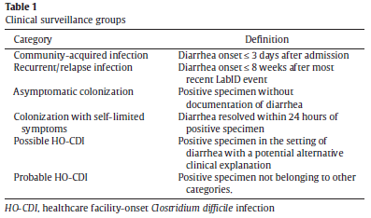
Methods
Patients were categorized into 1 of 6 clinical surveillance groups

Slide 8
Findings
Notes:
24% (n=51) probable HO-CDI
38.2% (n=81) possible HO-CDI
18.4% (n=39) colonized with self-limited symptoms
1.9% (n=4) asymptomatic colonizer
2.8% (n=2) relapse
14.6% (n=31) community acquired

Slide 9
Findings
34.4% (n=73) received stool softeners/ laxatives within 24 hours of testing
99% (n=210) received antimicrobial treatment for CDI
Notes:
100% of colonized (n=39) and 75% of asymptomatic colonized (n=3) treated

Slide 10
Discussion
Overreporting
Only 62.2% of hospital onset cases reported to NHSN were found to align with the clinical picture (categorized as probable or possible HO-CDI)
Misclassifications thought to be due to delays in testing, inappropriate testing, and/or administration of stool softener/laxatives
PCR testing widely used and unable to distinguish active infection from colonization
NHSN surveillance definitions do not address the complicated clinical scenarios that can lead to misclassification of active infection
Notes:
59.4% of NY Hospitals used PCR alone for CDI testing in 2015, 3% increase from previous yr

Slide 11
Discussion
Overdiagnosis
34.1% of reported cases used stool softeners/laxatives shortly before testing
Are clinicians aware of recent administration and/or PCR testing sensitivity?

Slide 12
Discussion
Overtreatment
Positive test results led to liberal treatment of the patient despite possibility of colonization
Antibiotic treatment of colonized patients is NOT a recommended practice and could lead to the development of MDROs

Slide 13
Discussion
Recommendations
Electronic systems to guide testing practices may provide benefit ordering providers
Further studies are needed to validate clinical criteria and improve the accuracy of HO-CDI surveillance
Surveillance definitions could be improved by incorporating clinical criteria, but must be balanced against the labor intensive data collection processes

Slide 14
Evaluation
Limitations
Retrospective chart review , inconsistencies and challenges with documentation of symptoms
One site, sample sicker than the general population
Pediatric population not represented despite being recognized as a growing problem
Evaluation
Level III- non-experimental study
B- consistent results, gateway for further study

Slide 15
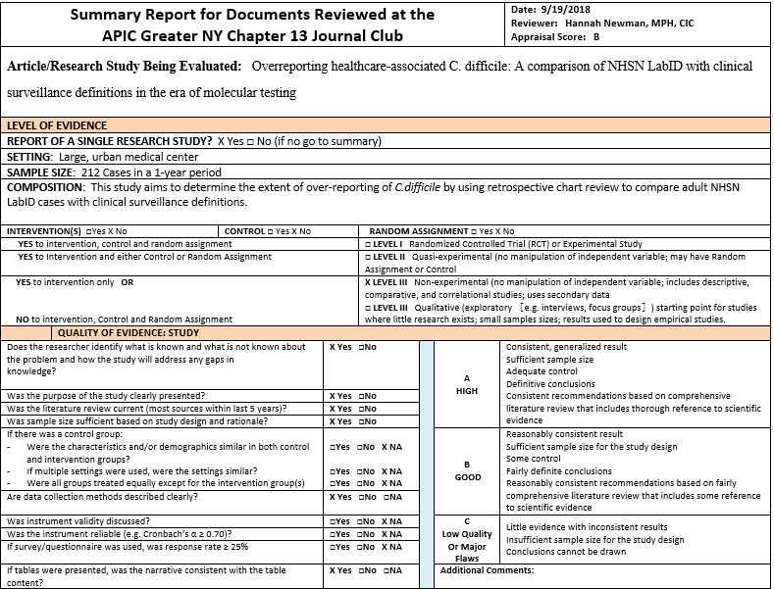
Evaluation

Slide 16
Thank you!

