Slide 1
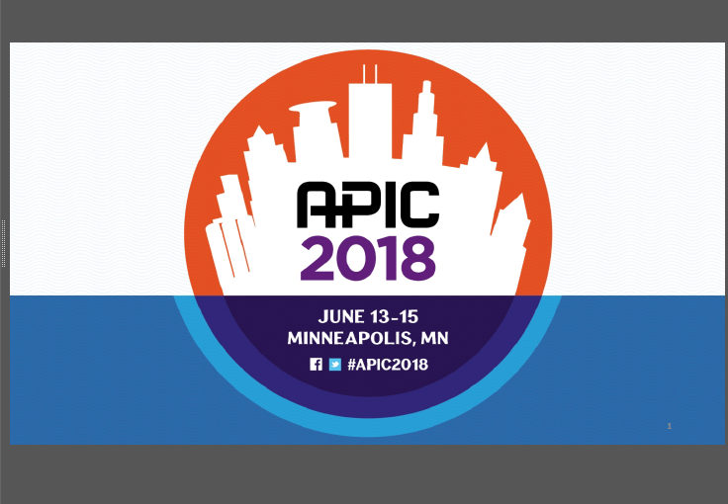
Elsa Santos-Cruz

Slide 2
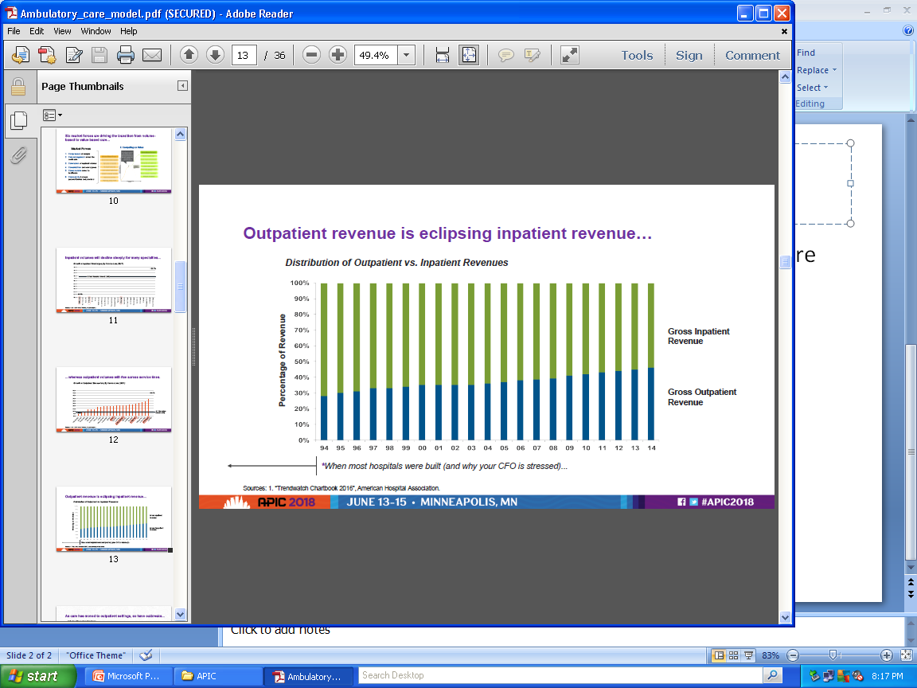
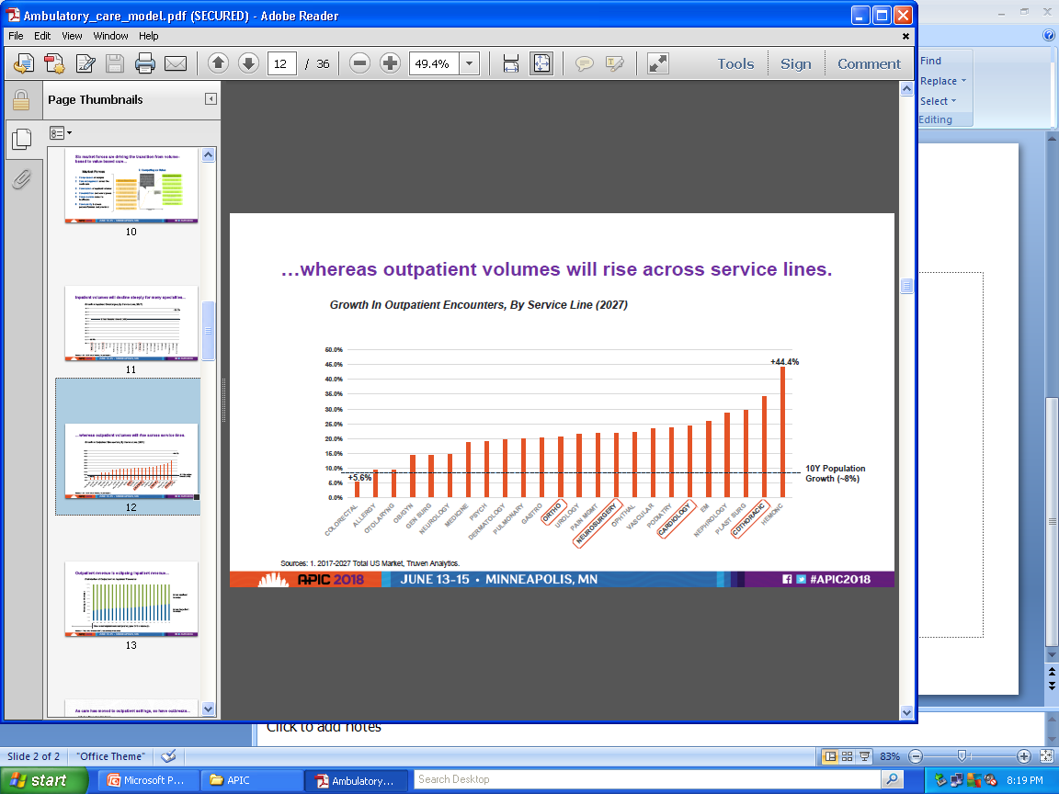
Emerging Models of Ambulatory Care

Slide 3
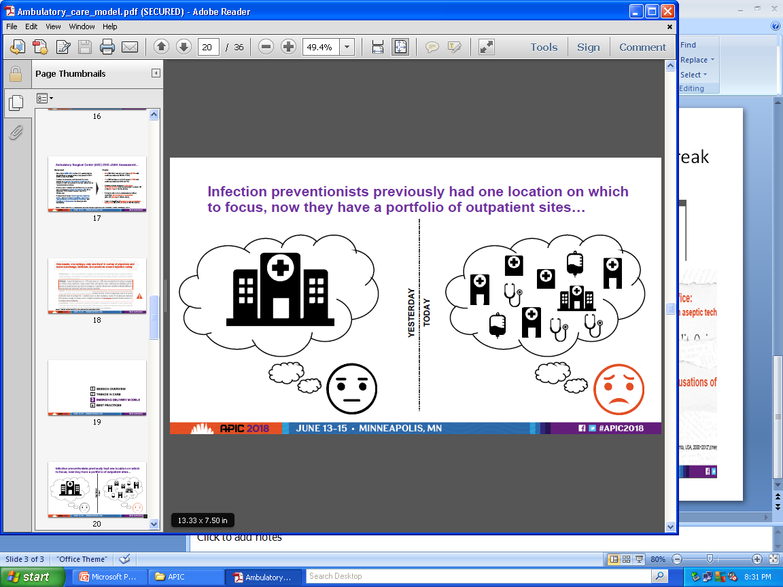

Slide 4
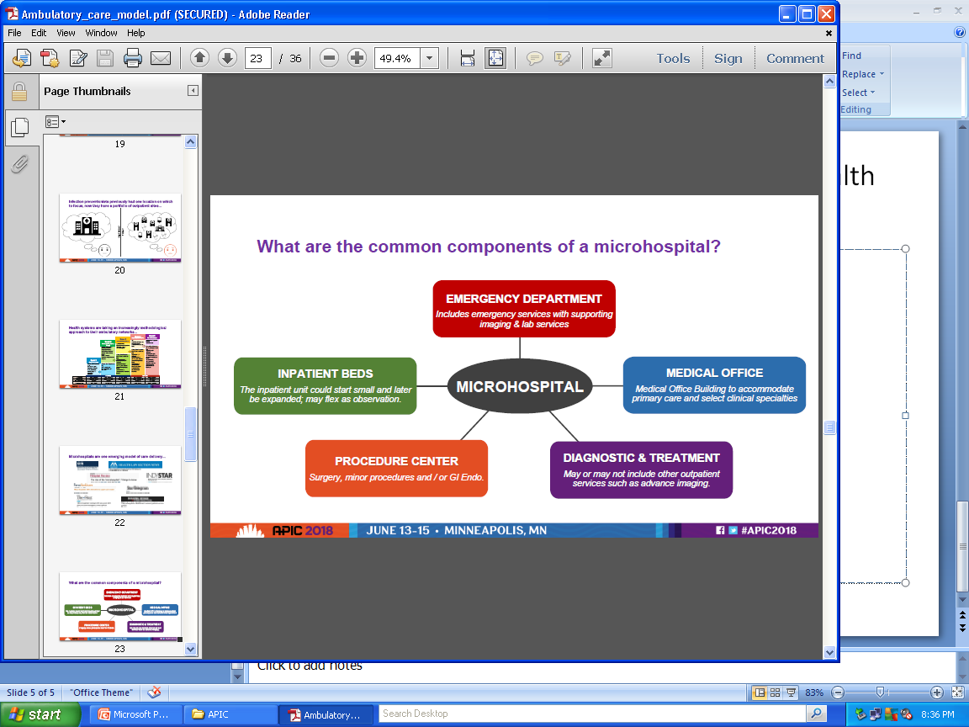
Microhospitals are emerging model of health care system

Slide 5
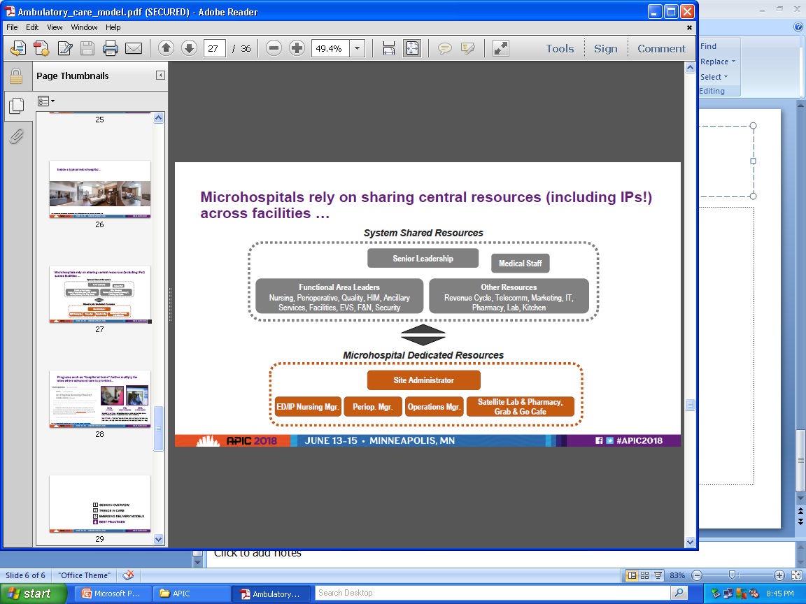
Sharing resources -- including IPs

Slide 6
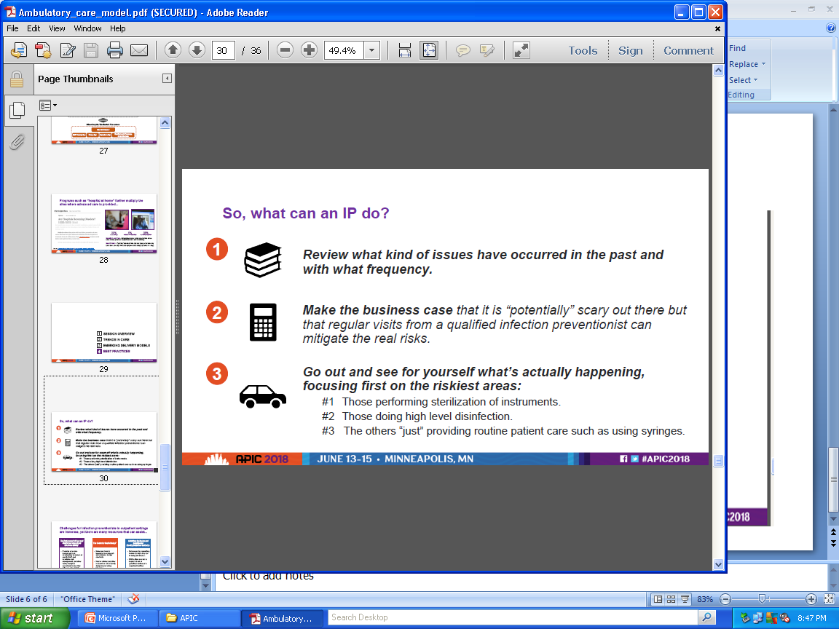
Infection Preventionist -- responsibility

Slide 7
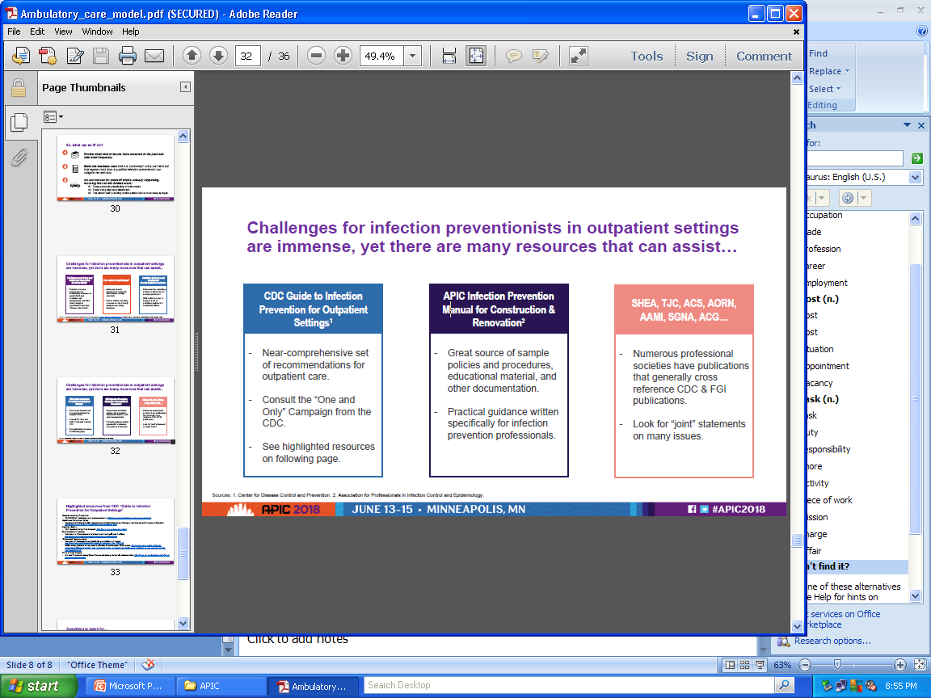
Available Resources

Slide 8
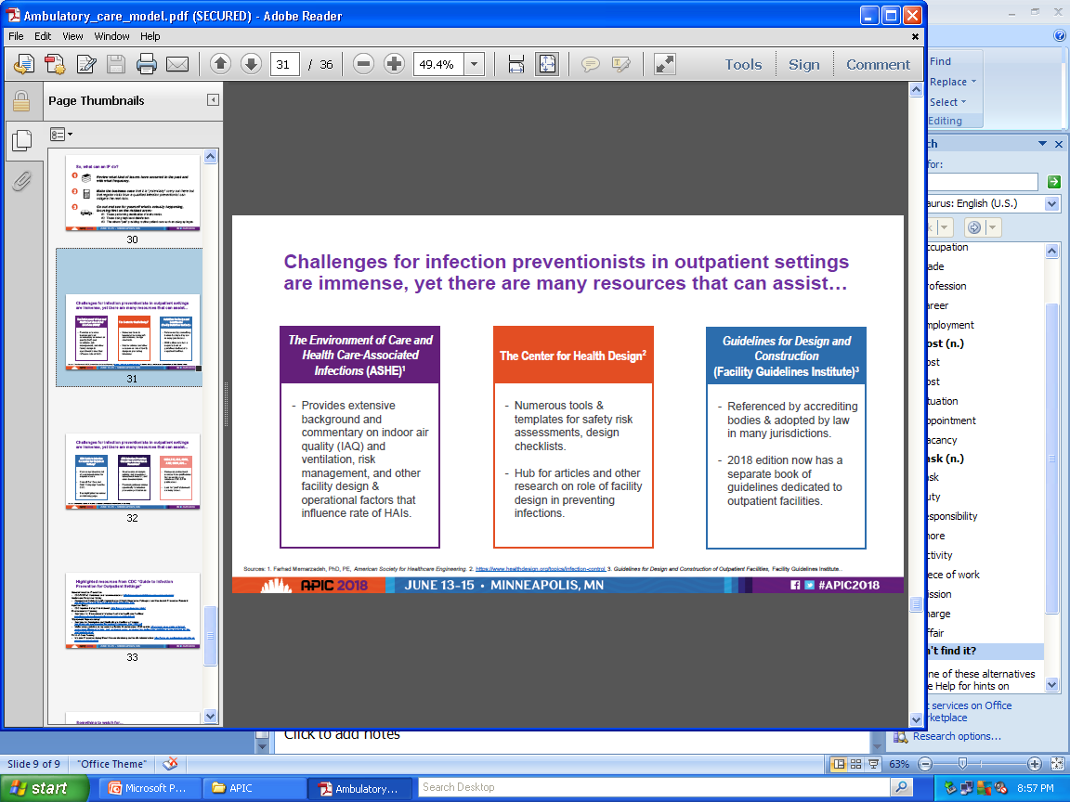
Other resources

Slide 9

Work in progress--

