Slide 1

The expanding threat of antibiotic resistance and the antimicrobial stewardship response
Donald Chen MD
Associate Hospital Epidemiologist, NYULMC
Assistant Professor of Medicine and Microbiology
NYU School of Medicine
March 19, 2014

Slide 2
Antibiotic resistance

Slide 3
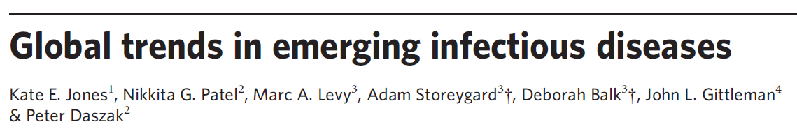
Emerging infectious disease (EID) events:
  Pathogens that have recently entered human populations for the first time
    HIV-1, severe acute respiratory syndrome (SARS) coronavirus
  Pathogens likely present in humans historically, but with recent increase in incidence
    Lyme disease
  Newly evolved strains of pathogens
    Multi-drug-resistant (MDR) tuberculosis (TB) and chloroquine-resistant malaria
Jones, K. E., N. G. Patel, et al. (2008). "Global trends in emerging infectious diseases." Nature 451(7181): 990-993.

Slide 4
335 EID events between 1940 and 2004
  20.9% caused by drug-resistant microbes
    Proportion due to drug-resistant microbes has increased with time
    Correlated with higher human population density, human greater population growth, and higher latitudes
Jones, K. E., N. G. Patel, et al. (2008). "Global trends in emerging infectious diseases." Nature 451(7181): 990-993.

Slide 5
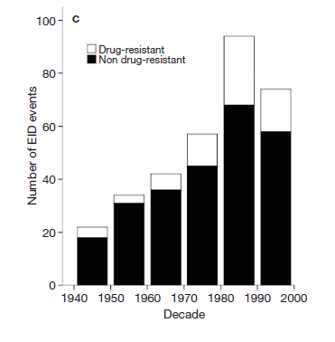
Number of EID events by decade
Jones, K. E., N. G. Patel, et al. (2008). "Global trends in emerging infectious diseases." Nature 451(7181): 990-993.

Slide 6
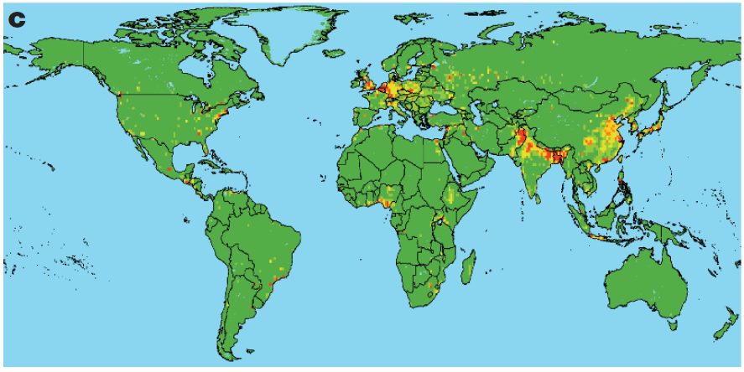
Relative risk of an EID event from a drug-resistant pathogen
Jones, K. E., N. G. Patel, et al. (2008). "Global trends in emerging infectious diseases." Nature 451(7181): 990-993.

Slide 7
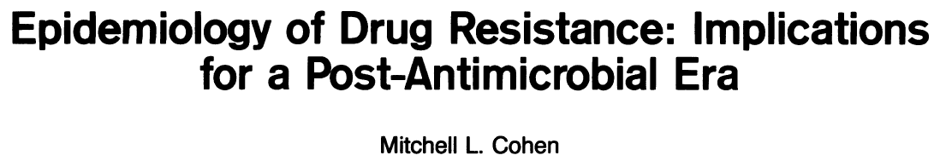
The Pre-antibiotic era:
‘The wards of the pre-antimicrobial era were populated by patients with pneumonia, meningitis, bacteremia, typhoid fever, endocarditis, mastoiditis, syphilis, tuberculosis, and rheumatic fever.’
‘There were few effective therapies for most of these conditions. Many of the patients were young, and most would die of the disease or its complications.’
Cohen, M. L. (1992). Science 257(5073): 1050-1055.

Slide 8
The Antibiotic era:
‘The introduction of antimicrobial agents in the mid-1930s “heralded the opening of an era in which literally millions of people-children, adults, and the elderly, all slated for early death or invalidism-were spared…”’
Cohen, M. L. (1992). Science 257(5073): 1050-1055.

Slide 9
The Post-antibiotic era:
‘Despite this half-century of success, periodic warnings have recurred: the introduction of a new drug was almost always followed by resistance. But there were always newer drugs.’
‘Recent events, however, have questioned the continued general effectiveness of antimicrobial agents.’
Cohen, M. L. (1992). Science 257(5073): 1050-1055.

Slide 10
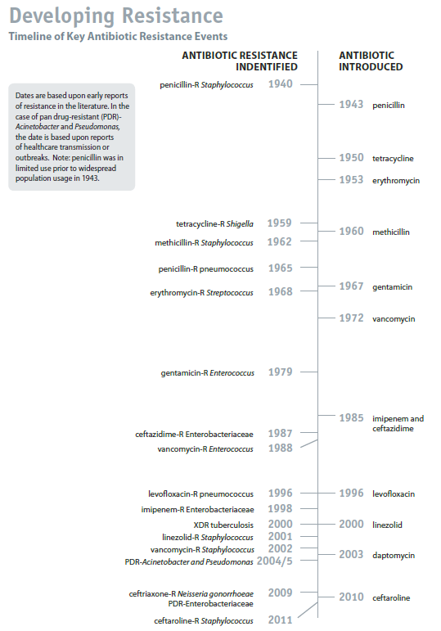
Timeline of Antibiotic Resistance Events
CDC Antimicrobial Threat Report 2013

Slide 11
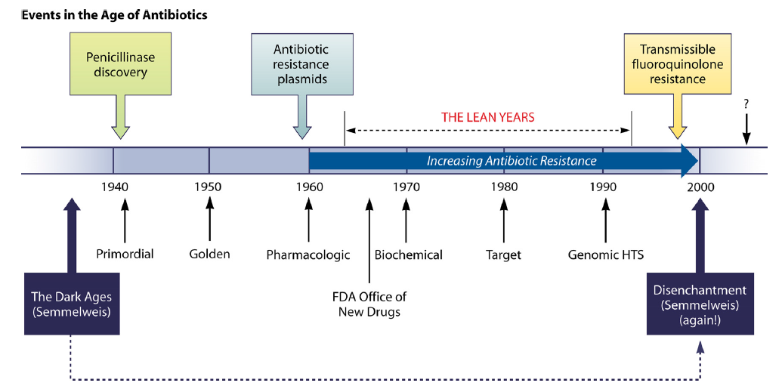
The post-antibiotic era: back to hand hygiene
Davies, J. and D. Davies (2010). "Origins and Evolution of Antibiotic Resistance." Microbiology and Molecular Biology Reviews 74(3): 417-433.

Slide 12
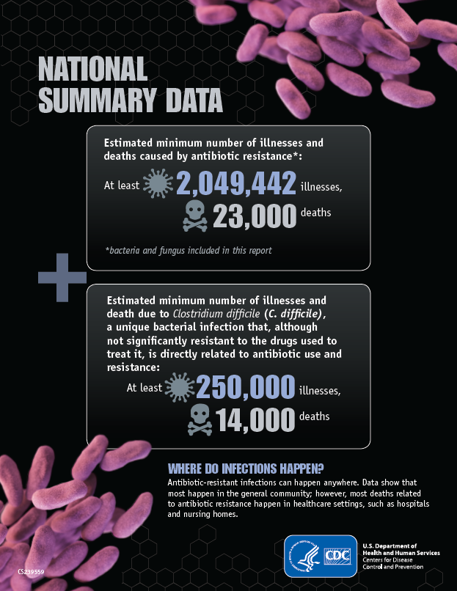
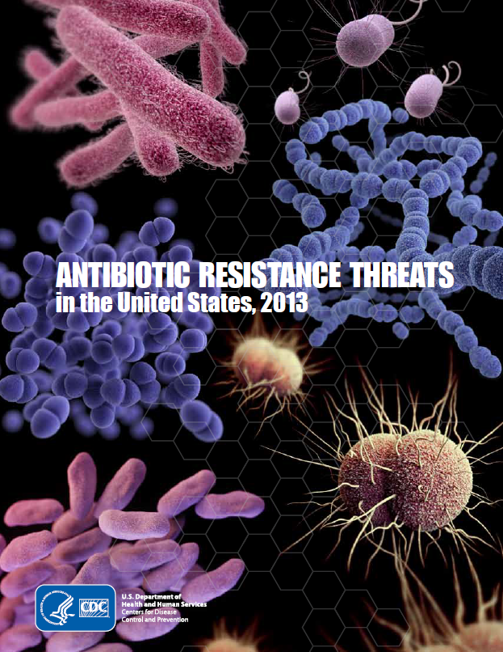

Slide 13
Impact of antimicrobial resistance
Increased morbidity, mortality, and costs
  Use of less-effective antimicrobials
  Delay in appropriate therapy
Drug resistance and virulence
  Certain drug-resistant organisms cause disease only under antibiotic selection pressure. C. difficile; Salmonella
  Certain drug-resistant organisms are intrinsically more virulent. Certain gram-negative bacteria.
  Other drug-resistant organisms are less fit, and only proliferate under drug-selection pressure. Drug resistant HIV strains.

Slide 14
Impact of antimicrobial resistance
Drug resistance and transmission
  If antimicrobial treatment is ineffective, patients harboring the disease can continue to transmit. M. tuberculosis; N. gonorrhoeae
  In individuals colonized with drug-resistant organisms, antimicrobials can kill the competing organisms and allow the resistant organisms to proliferate, persist, and spread. C. difficile; Salmonella

Slide 15
Factors promoting emergence, persistence, and transmission of antimicrobial-resistant bacteria
Microbial characteristics
  Propensity to exchange genetic material
    Plasmids, esp. in gram negative bacteria
  Intrinsic resistance
    Enterococci; C. difficile
  Environmental hardiness
    C. difficile, other bacteria
  Ability to colonize and to infect
    Colonization = persistence
    Infection may promote more efficient transmission
    TB, other bacteria as examples

Slide 16
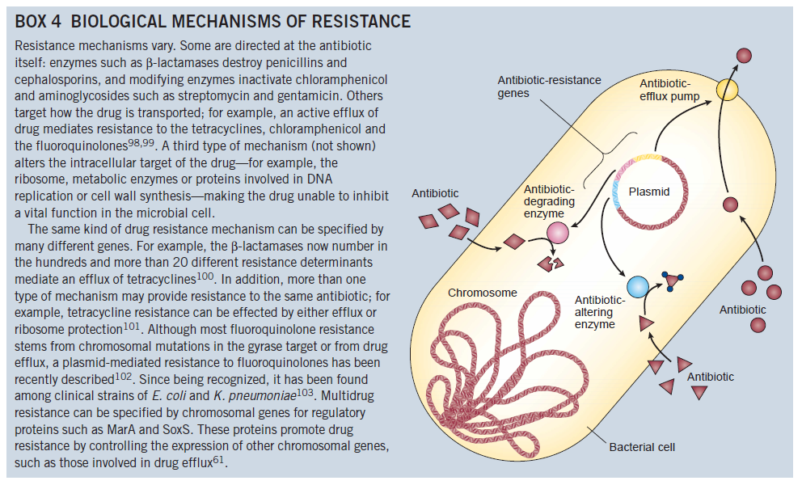
Levy, S. B. and B. Marshall (2004). "Antibacterial resistance worldwide: causes, challenges and responses." Nat Med.

Slide 17
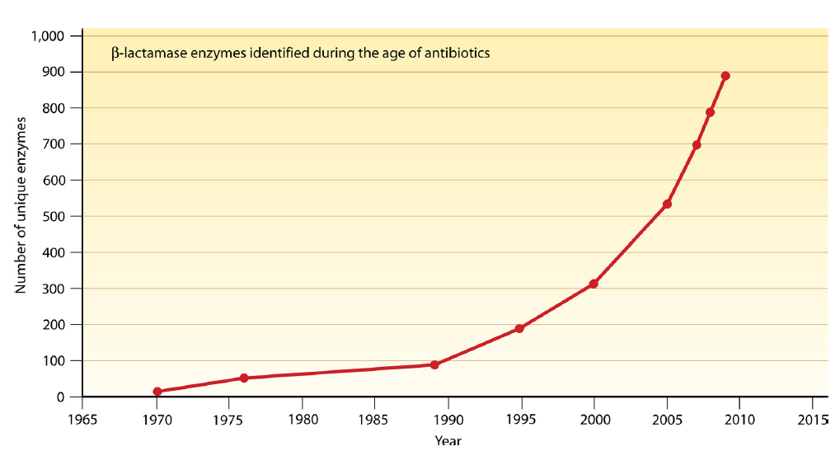
Number of unique β-lactamases identified, since the introduction of β-lactam antibiotics
Davies, J. and D. Davies (2010). "Origins and Evolution of Antibiotic Resistance." Microbiology and Molecular Biology Reviews 74(3): 417-433.

Slide 18
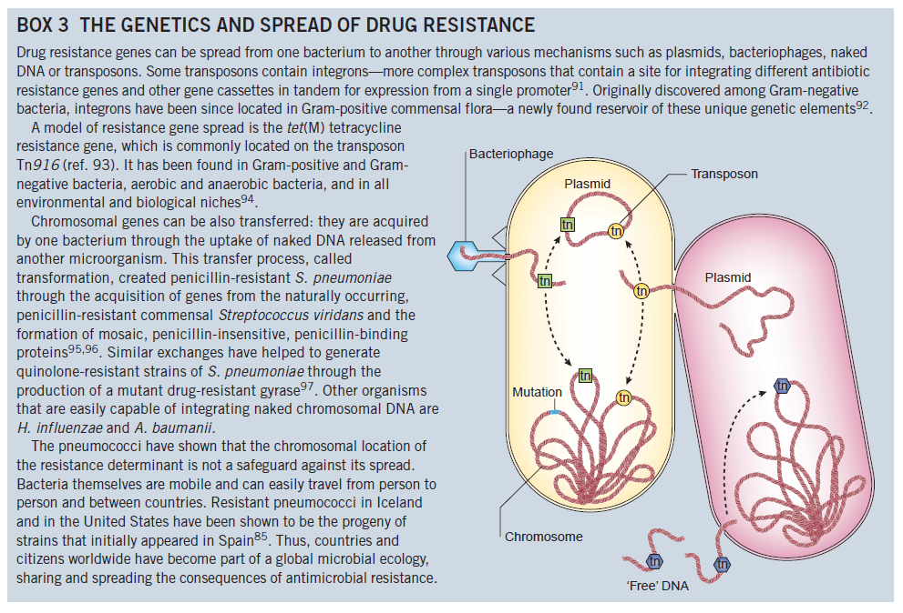
Levy, S. B. and B. Marshall (2004). "Antibacterial resistance worldwide: causes, challenges and responses." Nat Med.

Slide 19
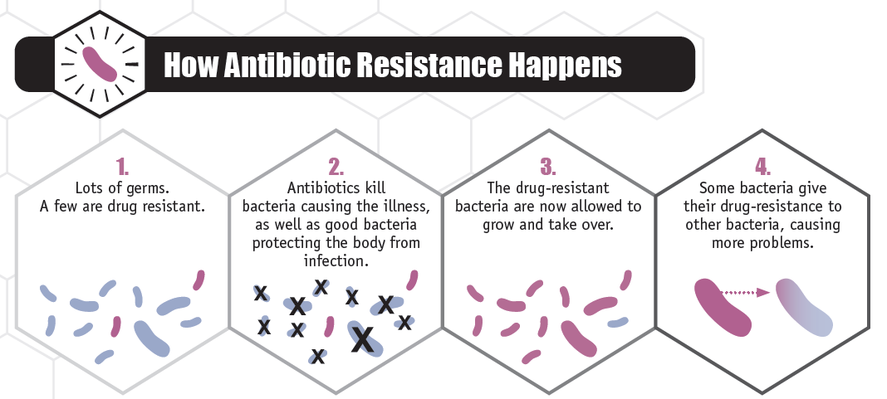
CDC Antimicrobial Threat Report 2013

Slide 20
Factors promoting emergence, persistence, and transmission of antimicrobial-resistant bacteria
Reservoir
  Animate (patients, health care workers) or inanimate (fomites)
  Persistence to transmit
  Development of resistance
    e.g. through exchange of genetic material
Antimicrobial use
  Selection pressure
    Augmented effect with broad-spectrum antimicrobial agents
  Risk varies with antimicrobial agent, dose, duration,

Slide 21
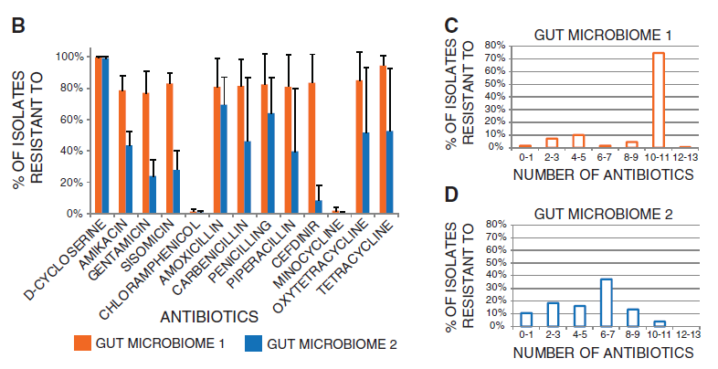
Antibiotic resistance is within us
Saliva and fecal samples from two health human volunteers who had not taken antibiotics for at least 1 year.
The healthy human microbiome serves as an immense reservoir of antibiotic resistance genes.
Sommer, M. O. A., G. Dantas, et al. (2009). "Functional Characterization of the Antibiotic Resistance Reservoir in the Human Microflora." Science 325(5944): 1128-1131.

Slide 22
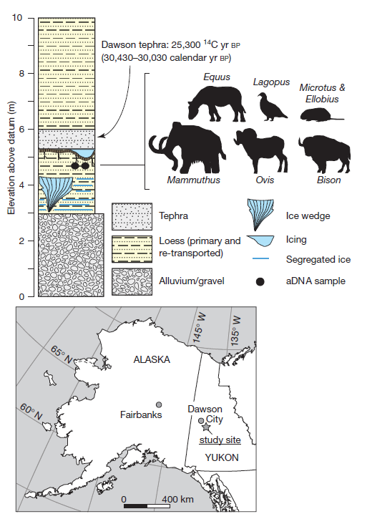

Highly diverse antibiotic resistance genes identified in 30,000 year-old DNA.
Genes encode resistance to tetracycline, B-lactam, and glycopeptide antibiotics.
D'Costa, V. M., C. E. King, et al. (2011). "Antibiotic resistance is ancient." Nature 477(7365): 457-461.

Slide 23
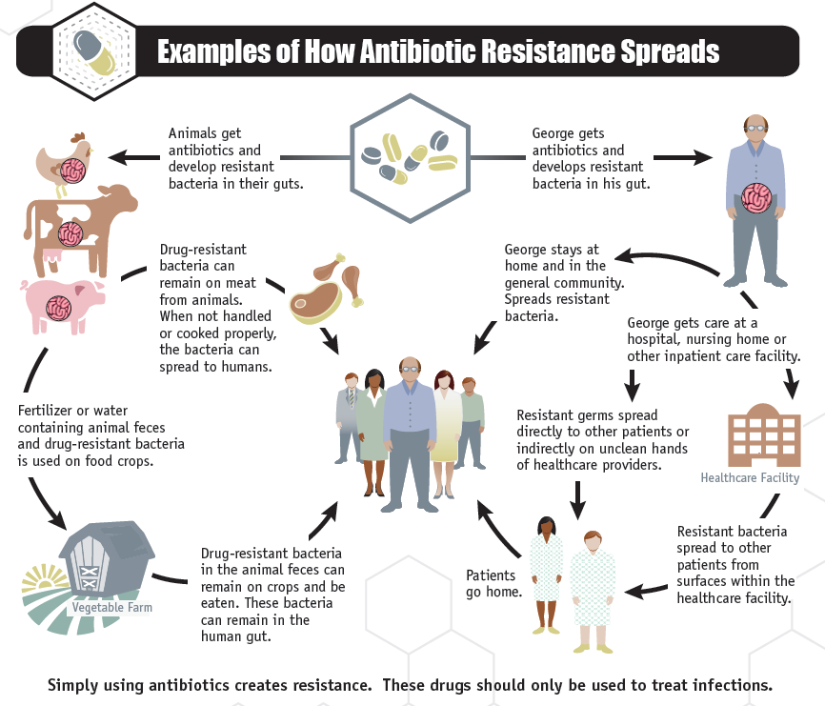
Antibiotic resistance is all around us
CDC Antimicrobial Threat Report 2013

Slide 24
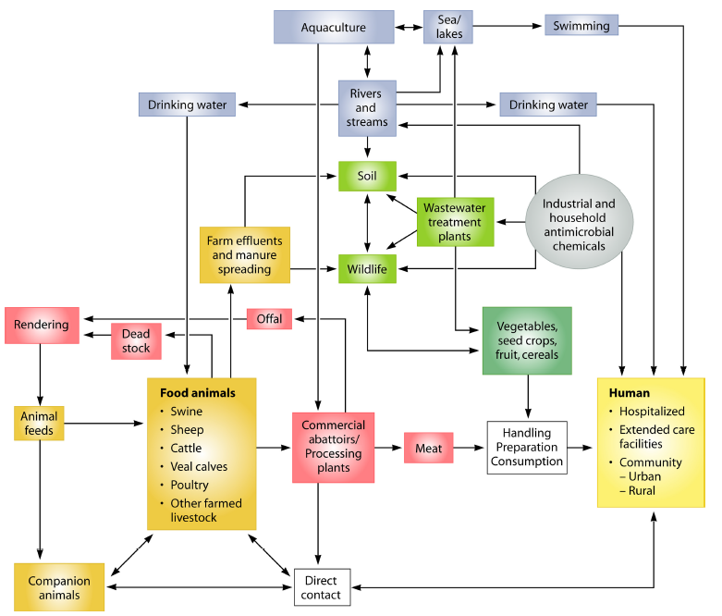
Antibiotic resistance is around us: environmental reservoirs and dissemination
Davies, J. and D. Davies (2010). "Origins and Evolution of Antibiotic Resistance." Microbiology and Molecular Biology Reviews 74(3): 417-433.

Slide 25
Factors promoting emergence, persistence, and transmission of antimicrobial-resistant bacteria
Societal and technological changes
  Transportation and travel
    Foods harboring resistant organisms
    Individuals harboring resistant organisms
      NDM, XDR TB
  Devices, equipment, fomites harboring resistant organisms
  Improved hygiene, sanitation, nutrition, enhanced environmental cleaning
    When not maintainted, opportunity for transmission
      MDR TB and homelessness
  Growth in population at risk of transmission or disease
    Elderly, immune compromised, day care centers
Economic changes – erosion of TB control programs
Behavioral changes – sexually-transmitted diseases

Slide 26
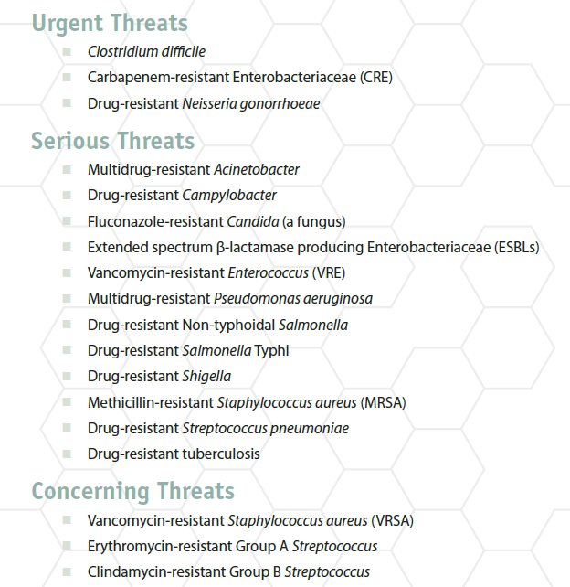
CDC Antimicrobial Threat Report 2013
CDC Antimicrobial Threat Report 2013

Slide 27
Prevention and control of antimicrobial resistance
Healthcare infection control
Prevention of infection
  Vaccines
  Improved sanitation and hygiene in the community
  Agricultural and animal husbandry practices
  System-wide, regional, and global approaches
  Data and surveillance
Rapid diagnosis
  Molecular tests, DNA probes, PCR
  MALDI-TOF
    Matrix-Assisted Laser Desorption/Ionization-Time Of Flight
    i.e., mass spectroscopy for identification of bacteria

Slide 28
Prevention and control of antimicrobial resistance
Combination antimicrobial agents
  HIV, M. tb
New antimicrobial agents for control
  New agents fewer and further between
  Useful for treatment
  Risk of resistance with use
Rapid diagnosis
  Molecular tests, DNA probes, PCR
  MALDI-TOF
    Matrix-Assisted Laser Desorption/Ionization-Time Of Flight
    i.e., mass spectroscopy for identification of bacteria

Slide 29
Prevention and control of antimicrobial resistance
Antimicrobial stewardship
  Limiting inappropriate use of antimicrobials
  Limiting duration of therapy
  Surveillance data
    Guide selection of antimicrobials
    Identify risk factors, areas for intervention

Slide 30
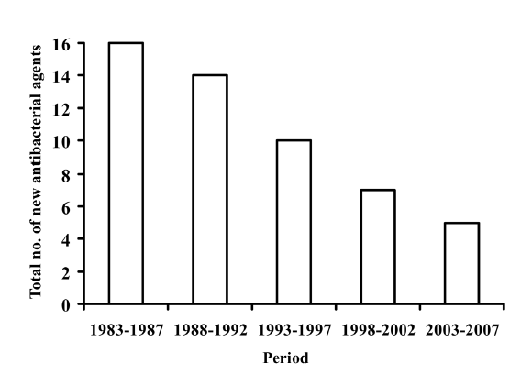
Fewer antibiotics being developed and approved
Spellberg, B., R. Guidos, et al. (2008). "The Epidemic of Antibiotic-Resistant Infections: A Call to Action for the Medical Community from the Infectious Diseases Society of America." Clinical Infectious Diseases 46(2): 155-164.

Slide 31
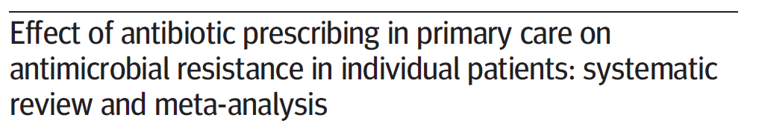
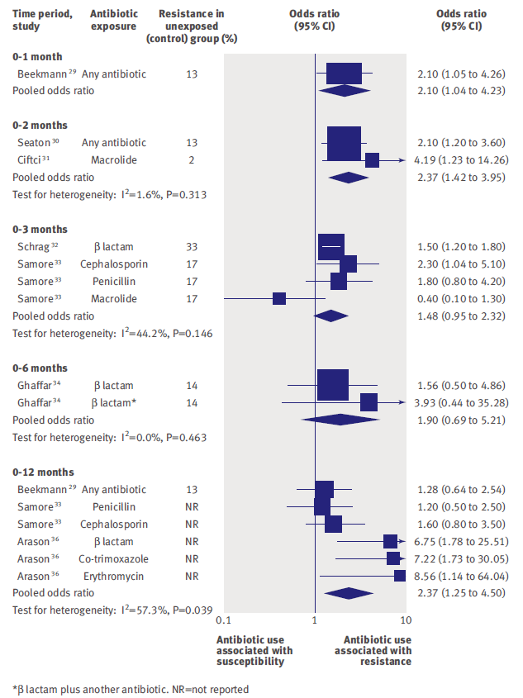
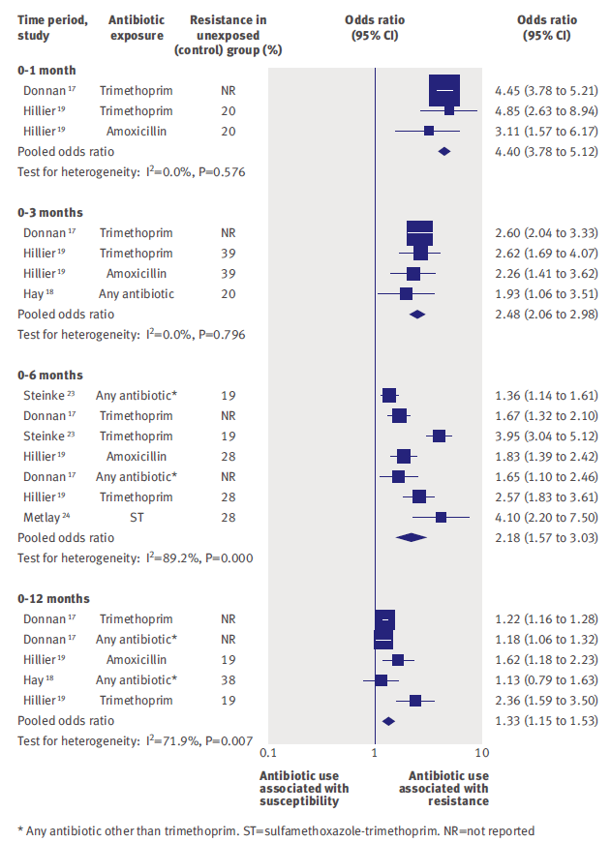
Respiratory tract bacteria
Urinary tract E. coli
Costelloe, C., C. Metcalfe, et al. (2010). "Effect of antibiotic prescribing in primary care on antimicrobial resistance in individual patients: systematic review and meta-analysis." BMJ 340.

Slide 32
Antimicrobial stewardship

Slide 33
NYULMC Antimicrobial Stewardship Program (ASP)
Phone: 212-263-1169
8am to 10pm, 7 days-a-week
(questions, antibiotic approvals)
ASP:
Donald Chen, MD
Marco Scipione, PharmD
Yanina Dubrovskaya, PharmD
John Papadopoulos, PharmD
Infectious Disease Fellows:
Waridibo Allison, MD
Matthew Akiyama, MD
Jason Halperin, MD
Oyebisi Jegede, MD
  Website resources: http://abx.med.nyu.edu
Notes:
Our goals:
Reducing healthcare-associated infections:
C. diff, MRSA, VRE, MDRO Gram (-)’s
Reducing antibiotic-related adverse events
Targeted antibiotic therapy:
“the right antibiotics for the right amount of time”

Slide 34
ASP Roles and expertise
Please call us…
Pre-approval for restricted antibiotics
Audit & feedback of antibiotic use to clinical teams
Dose adjustments
Interpreting peak/trough results
Interpreting MICs on culture sensitivities
Drug-drug interactions
Antimicrobial allergies and cross-reactivity
Resources on dosing, treatment, and prophylaxis

Slide 35
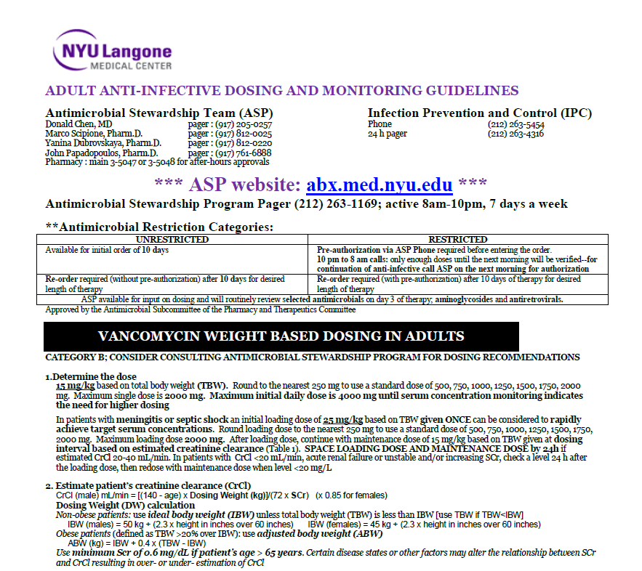
Screen capture of ASP card

Slide 36
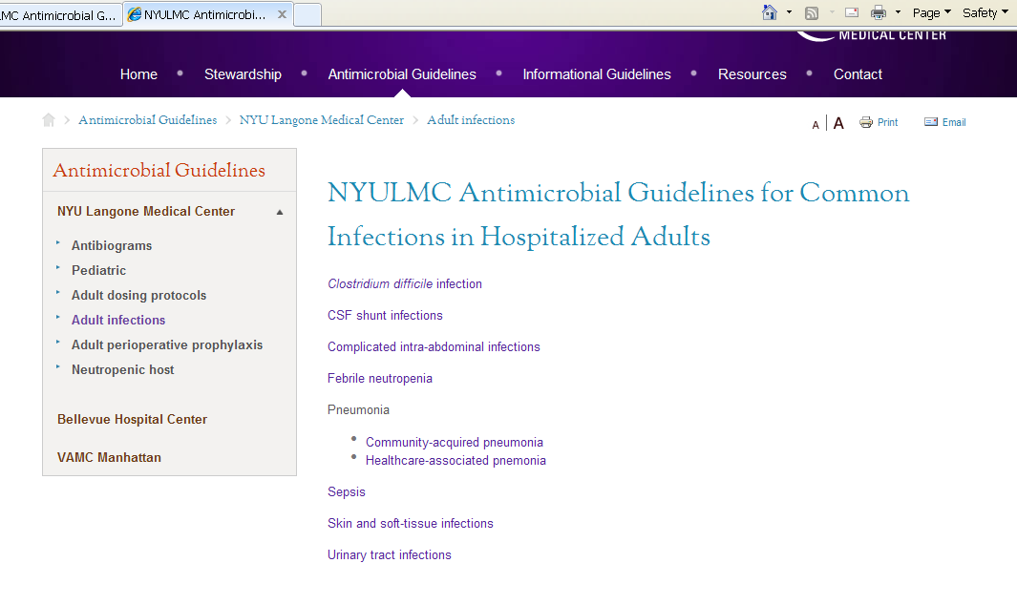
Website support: abx.med.nyu.edu

Slide 37
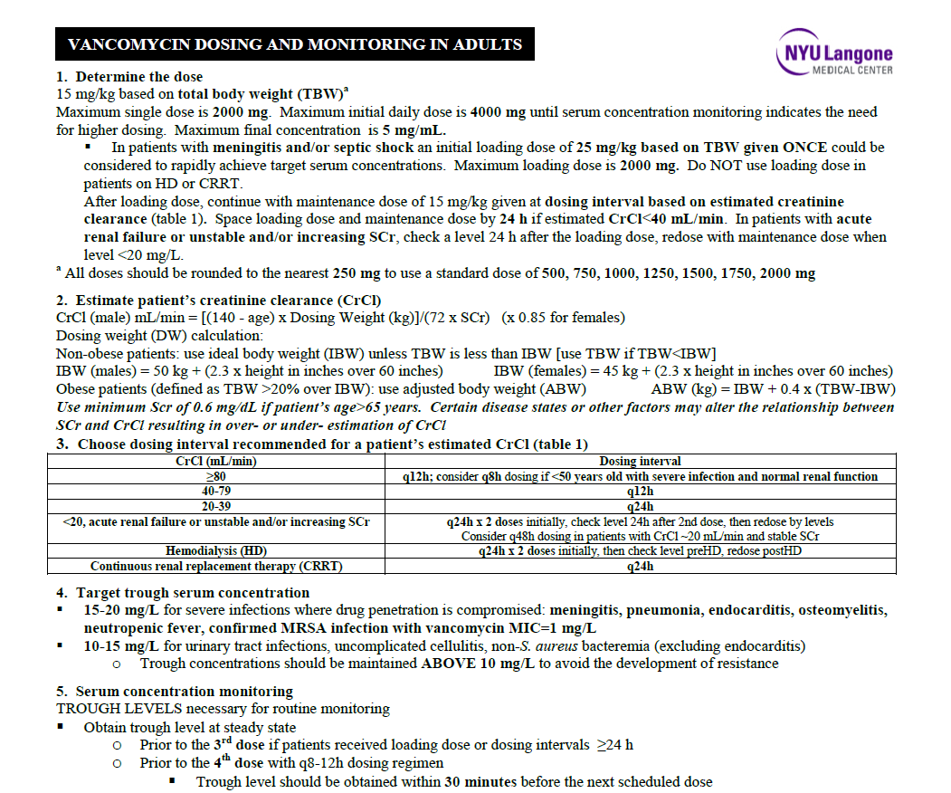
Vancomycin dosing and monitoring

Slide 38
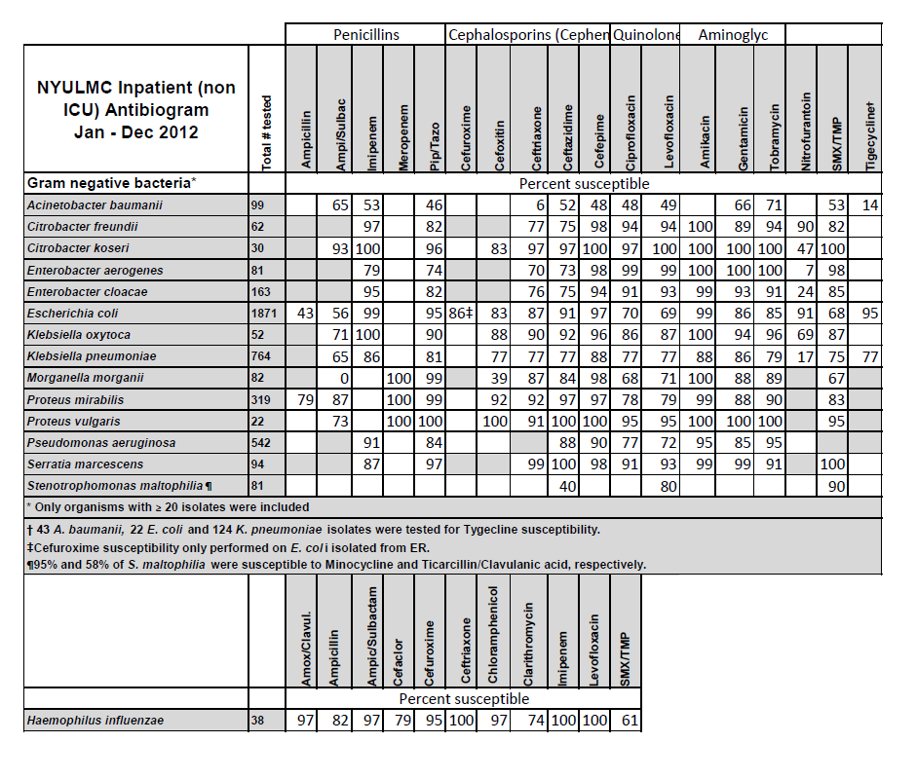

Slide 39
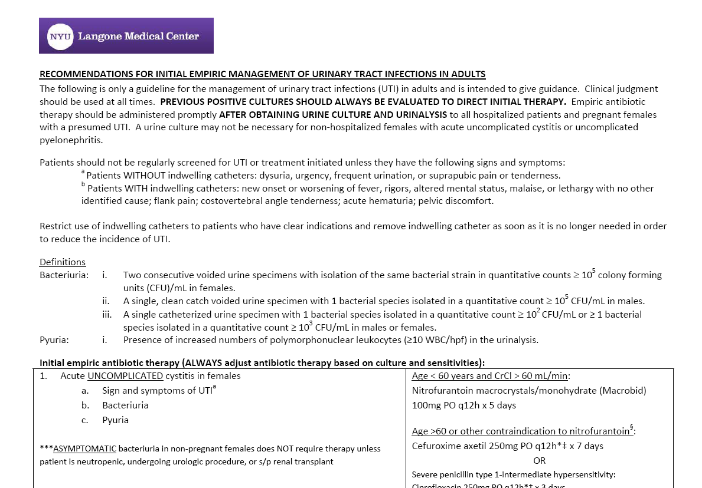
NYULMC UTI guidelines
Highlights:
First line therapy: cephalosporins (ciprofloxacin reserved for PCN allergic patients)
Catheter-associated UTIs: evaluate promptness of resolution of symptoms after catheter removal

Slide 40
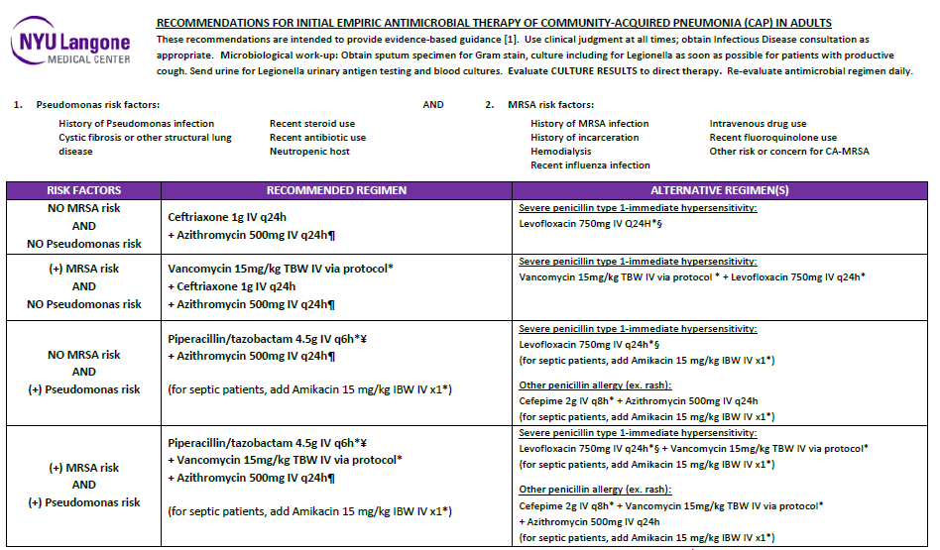
Community-acquired Pneumonia (CAP)

Slide 41
Stewardship measures
Utilization
Interventions
  Duration of therapy
  Choice of antibiotics
  Dosing
  Need for Infectious Disease consult
  Drug interactions

Slide 42
Stewardship outcomes
Infection or resistance rates
Cost

Slide 43
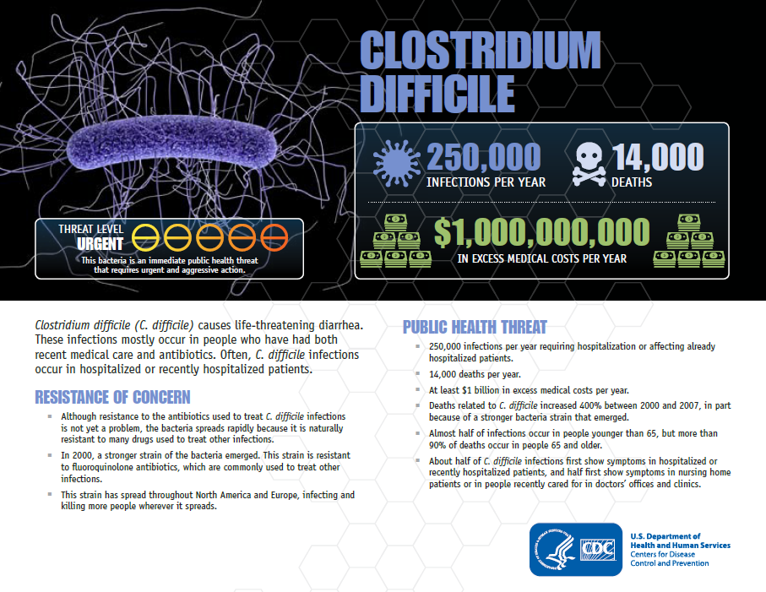

Slide 44
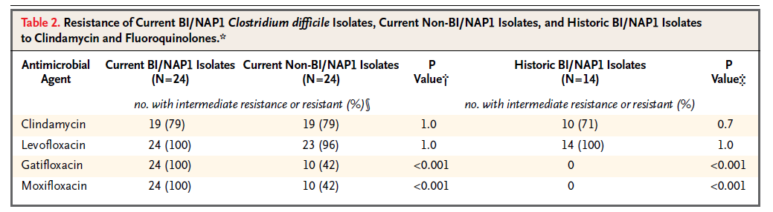
Fluoroquinolone Resistance
McDonald, NEJM 2005;353:2433-41

Slide 45
Fluoroquinolones
Use at NYULMC limited by antimicrobial resistance (30-40% of E. coli isolates are resistant)
Risk of collateral damage:
  C. diff associated diarrhea,
  C. diff hypervirulent NAP1 strain
    more severe, more difficult to treat, intrinsically fluoroquinolone-resistant)
  Selection for resistant gram-negative bacili
  Selection for MRSA

Slide 46
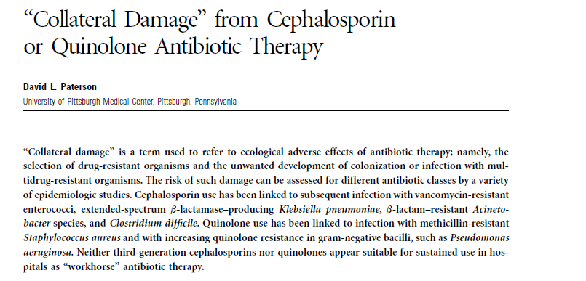
Selection of resistant organisms:
  VRE
  MRSA
  MDRO gram-neg
C. diff colitis
Clinical Infectious Diseases 2004; 38(Suppl 4):S341–5

Slide 47
Antibiotic susceptibility of Tisch Hospital non-ICU E. coli isolates
E. coli accounts for 75-95% of cases of uncomplicated cystitis and uncomplicated pyelonephritis
Antibiotic | Percent susceptible 2008 | Percent susceptible 2009 | Percent susceptible 2010 | Percent susceptible 2011 | Percent susceptible 2012
Ciprofloxacin | 59 | 60 | 70 | 65 | 70
Tmp/smx | 66 | 66 | 67 | 67 | 68
Ceftazidime | 92 | 90 | 91 | 87 | 91
Ceftriaxone |  |  | 92 | 87 | 87
Nitrofurantoin |  | 92 | 92 | 94 | 91

Slide 48
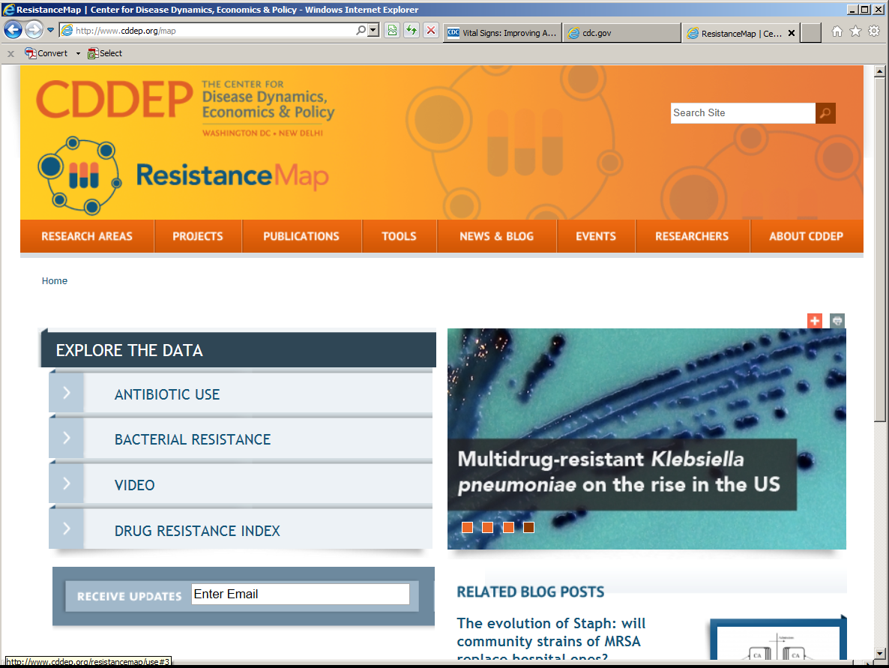
http://www.cddep.org/map

Slide 49
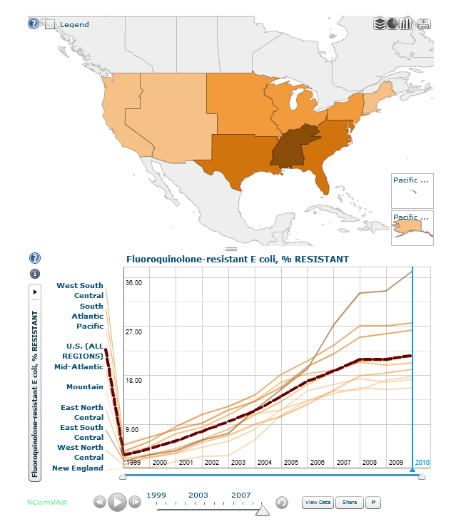
E. coli resistance to fluoroquinolones
http://www.cddep.org/map

Slide 50
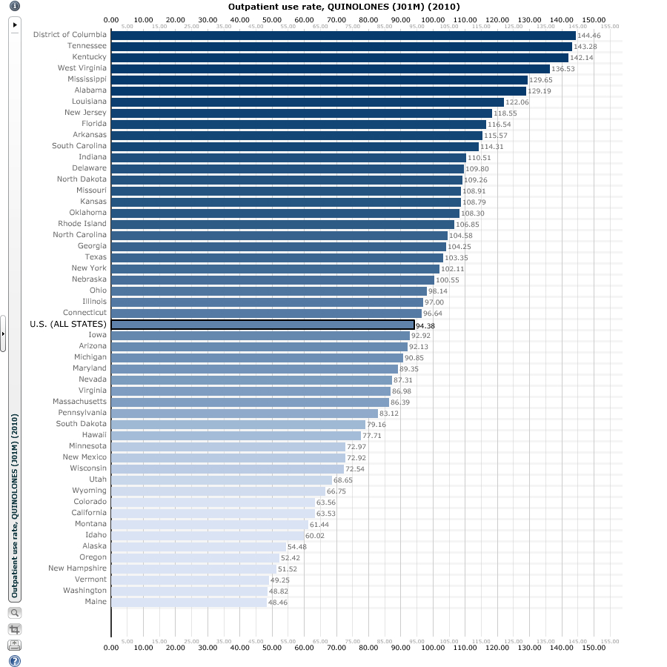
Quinolone outpatient use rate
(# scripts per 1000 inhabitants)
144
48
http://www.cddep.org/map

Slide 51
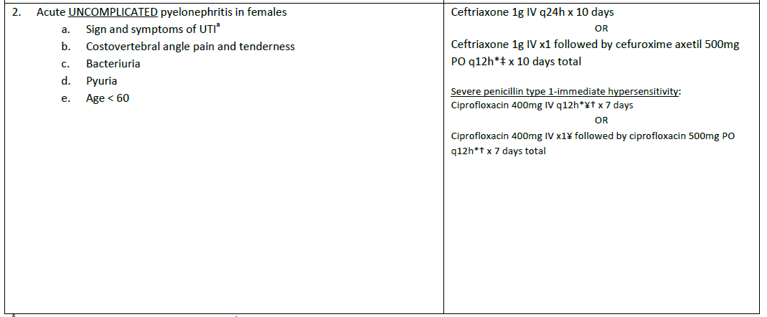
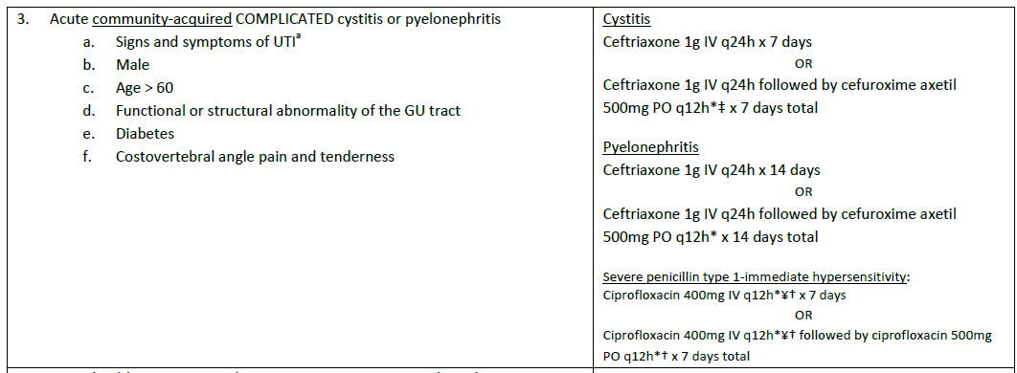
NYULMC UTI guidelines: Cephalosporins as first line
Remember, adjust antibiotics based on culture results and abx susceptibilities!

Slide 52
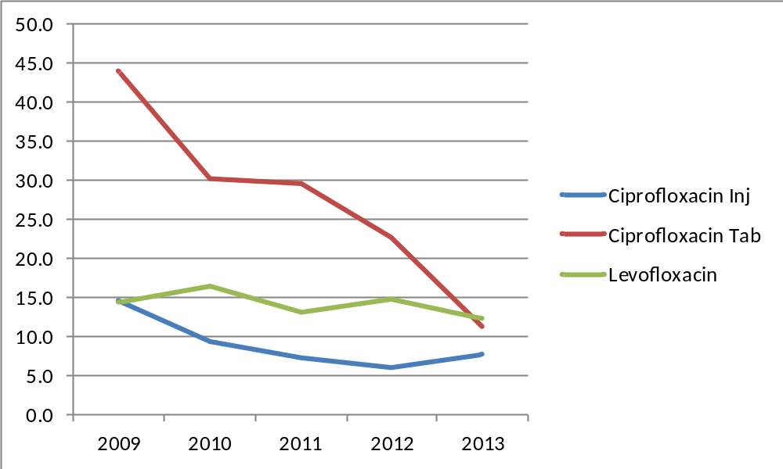
Sustained decrease in fluoroquinolone utilization
Days of therapy per 1000 patient days
Year

Slide 53
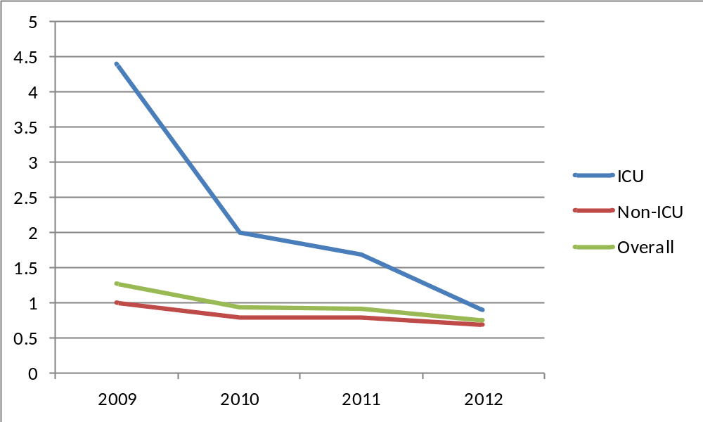
Hospital-associated C. difficile
C. diff cases per 1000 patient days
Year

Slide 54
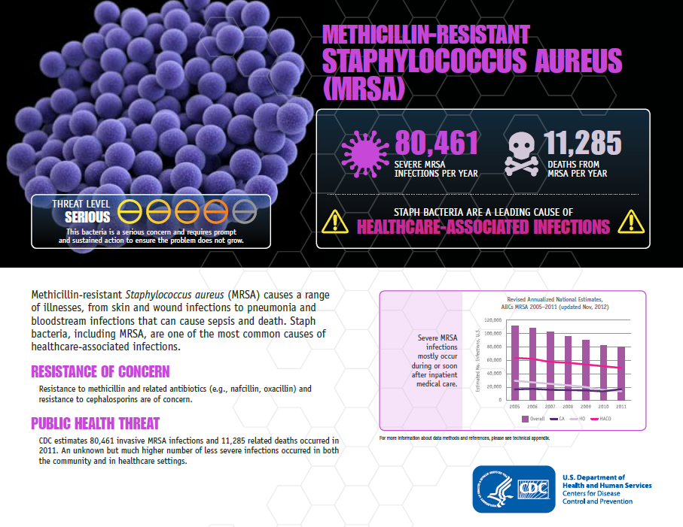

Slide 55
Percentage of MRSA isolates among
S. aureus isolates, 2009-2012

Slide 56
Rate of MRSA per 100 admissions,
2009-2012
Most MRSA is community-associated
(i.e. identified within 72h of admission to the hospital)

Slide 57
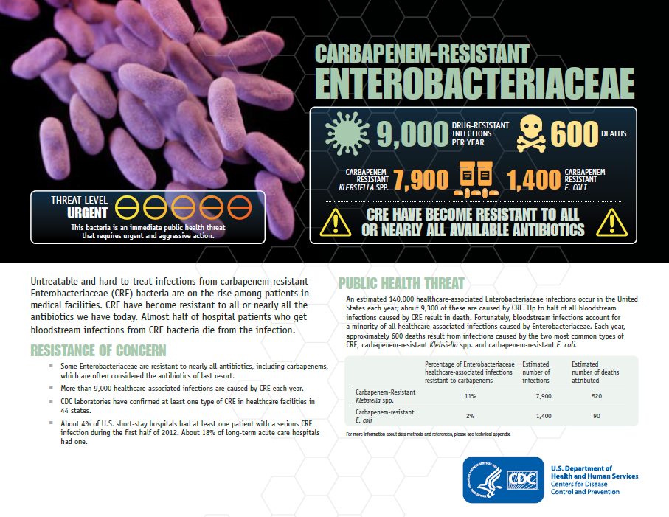

Slide 58
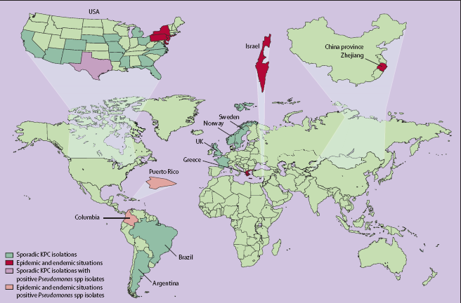
Multiple states, multiple nations
Nordmann et al. “The real threat of Klebsiella pneumoniae carbapenemase producing
Bacteria” Lancet Infect Dis 2009;9: 228–36

Slide 59
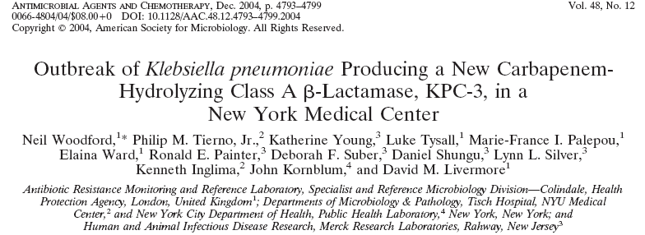
 | 2002 | 2004 | 2005 | 2008
PercentageResistant | 9% | 18% | 36% | 38%
Total # of isolates | 1435 | 1967 | 2229 | 1301
# Resistant isolates | 129 | 345 | 795 | 488

Slide 60
Control measures, and a
Decrease in resistance rates
Improved hand hygiene
Improved environmental cleaning
Antimicrobial stewardship program

Slide 61
Rate of carbapenem non-susceptible K. pneumoniae per 100 admissions, 2009-2012

Slide 62
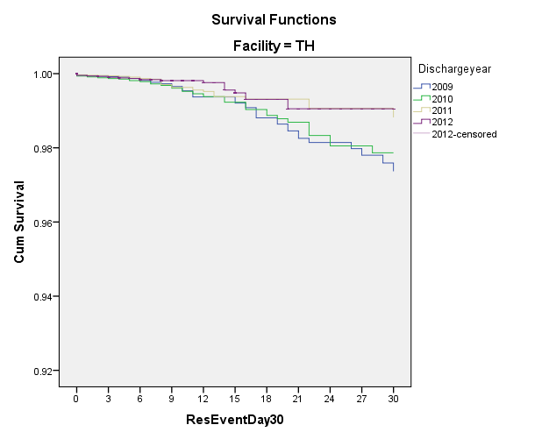
Cumulative risk of carbapenem-resistant K. pneumoniae, by hospital day
Decrease in length of stay alone does not account for lower rates of CR-Kp
Hospital Day

Slide 63
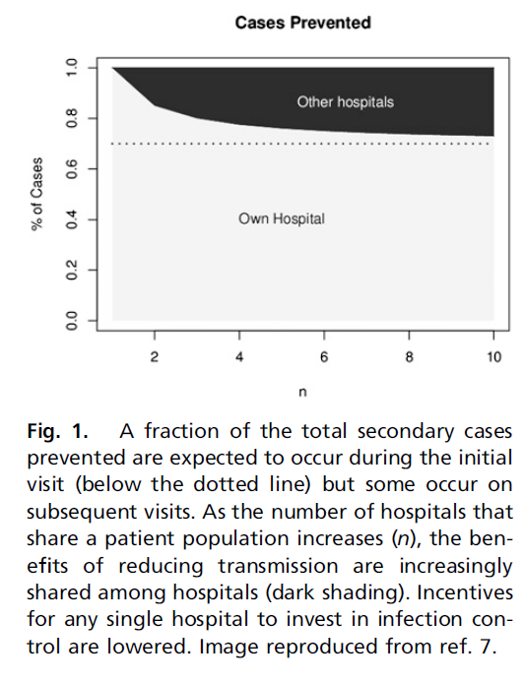
The need for a system-wide approach
MRSA strains are carried between hospitals by shared patients.
Infection Control measures are more likely to succeed when hospitals sharing patients coordinate their efforts.
‘The appropriate scale to address infection control is at the level of the system, not at the individual hospital.’
Number of hospitals that share a patient population
Laxminarayan, R. (2012). "Crafting a system-wide response to healthcare-associated infections." Proceedings of the National Academy of Sciences 109(17): 6364-6365.

Slide 64
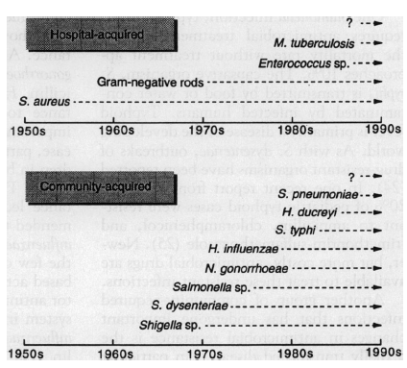
Emergence of antimicrobial resistance, 1950-1990
Hospital-acquired
‘The hospital and the community as separate ecosystems’
‘Different populations, selective pressures, reservoirs and other factors.’
‘These ecosystems are not isolated from each other, and there are ample opportunities for the exchange of drug-resistant genes and organisms.’
Community-acquired
Cohen, M. L. (1992). Science 257(5073): 1050-1055.

Slide 65
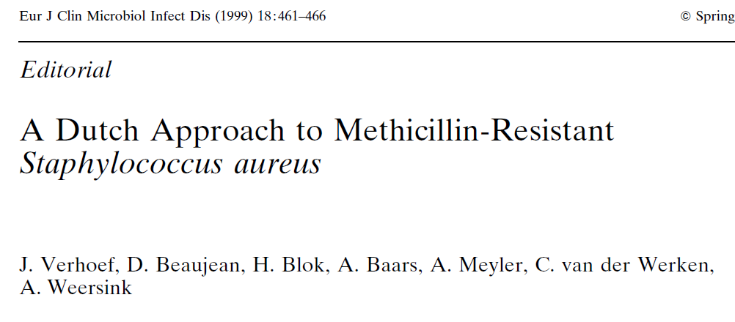
MRSA rates, i.e. proportion of S. aureus isolates that are resistant to methicillin
  Netherlands: <5%
  Some U.S. and S. European hospitals: >50%
  Some hospitals in the Far East: up to 80%
The Dutch approach:
  Stringent antibiotic policy
  Infection control measures:
    Screening and isolation/cohorting MRSA patients
    Screening and treating MRSA carriage in health care workers
    Molecular surveillance for MRSA outbreaks in the hospital -> Search and Destroy
  Costs
Verhoef, J., D. Beaujean, et al. (1999). "A Dutch Approach to Methicillin-Resistant Staphylococcus aureus." European Journal of Clinical Microbiology and Infectious Diseases 18(7): 461-466.

Slide 66
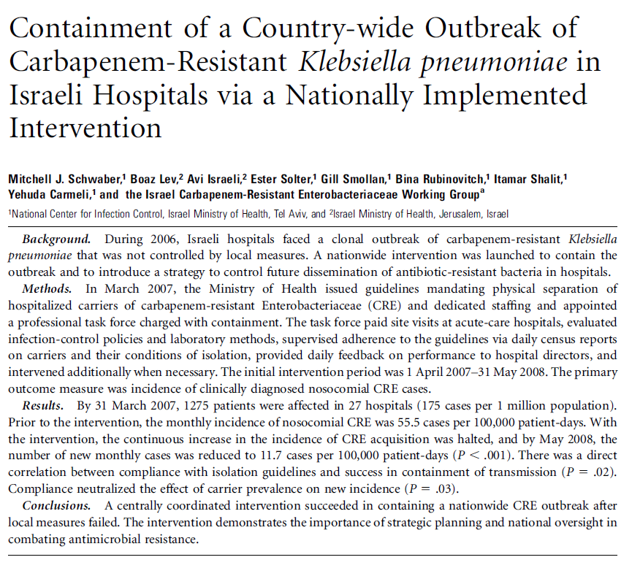
Schwaber, M. J., B. Lev, et al. (2011). "Containment of a country-wide outbreak of carbapenem-resistant Klebsiella pneumoniae in Israeli hospitals via a nationally implemented intervention." Clin Infect Dis 52(7): 848-855.

Slide 67
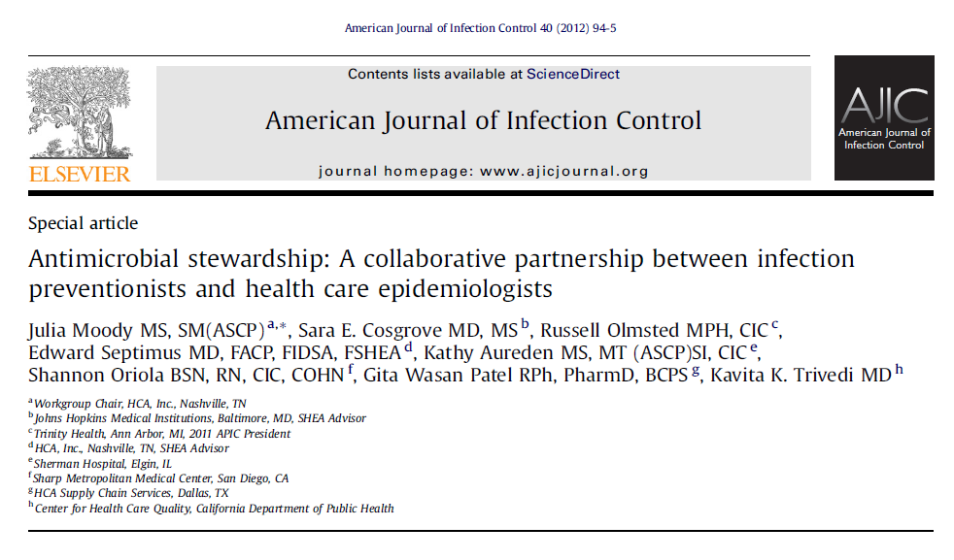
AJIC 40 (2012) 94-5

Slide 68
Resources
CDC Get Smart for Healthcare:
  http://www.cdc.gov/getsmart/healthcare/
IDSA/SHEA Guidelines for Antimicrobial Stewardship Programs
  http://www.journals.uchicago.edu/doi/pdf/10.1086/510393
APIC stewardship:
  http://www.apic.org/Professional-Practice/Practice-Resources/Antimicrobial-Stewardship
SHEA stewardship:
  http://www.shea-online.org/PriorityTopics/AntimicrobialStewardship.aspx
IDSA stewardship:
  http://www.idsociety.org/Stewardship_Policy/

Slide 69

http://www.cdc.gov/getsmart/healthcare/

Slide 70
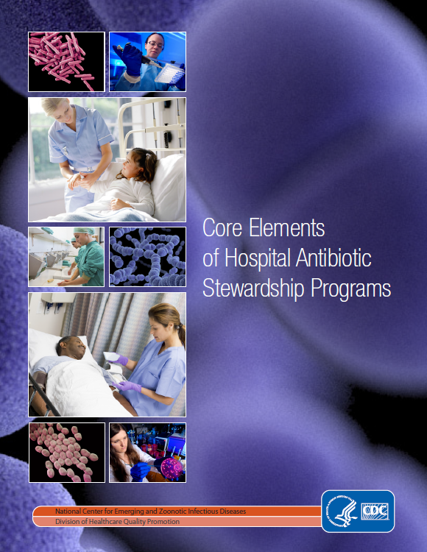
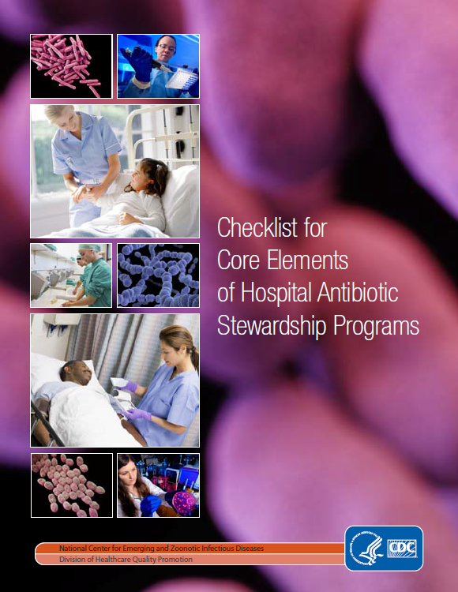

Slide 71
END

