Slide 1
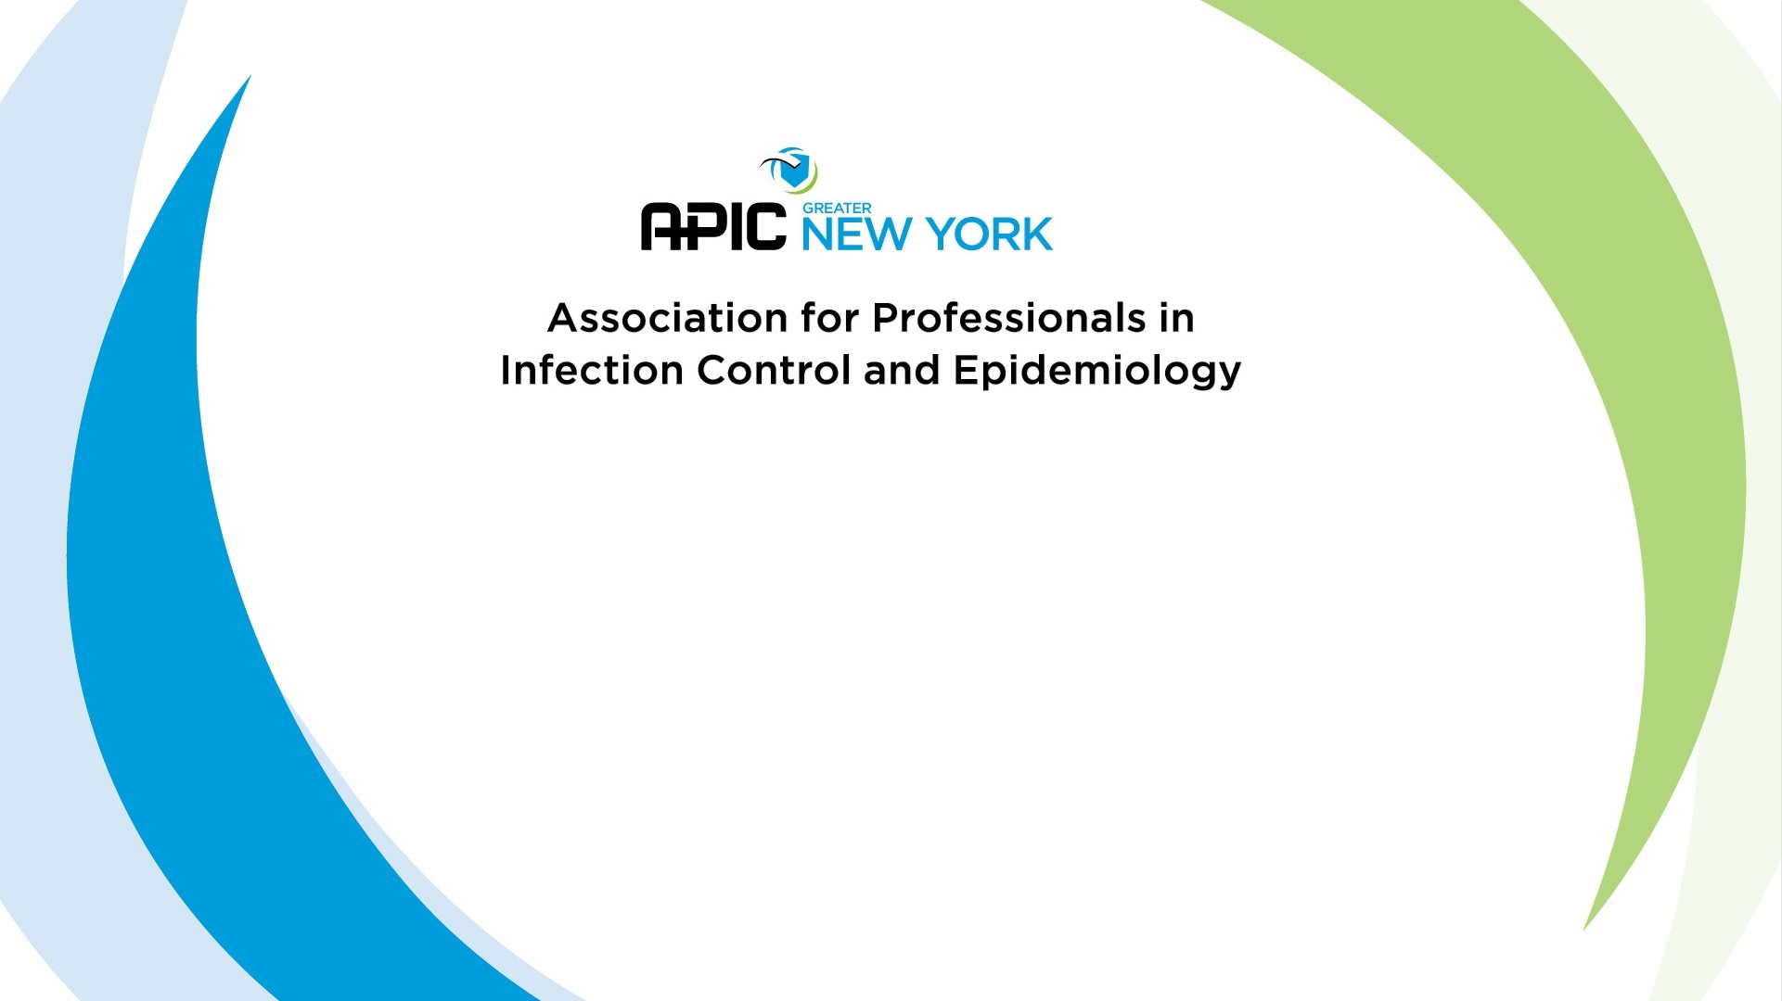
Preparing for Certification
D. Kyle Willey, BS CIC

Slide 2
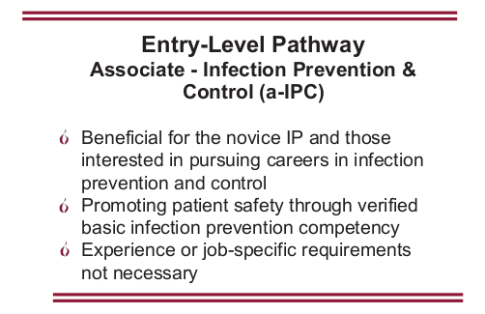
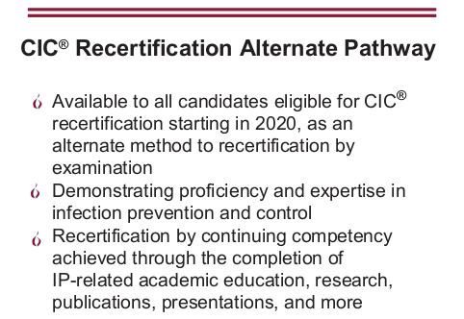
News! – New Certification Initiatives

Slide 3
What is on the Exam?
Identification of Infectious Disease Processes (22 items)
  Interpret diagnostic and laboratory reports
  Practices for specimen collection, handling, and storage
  Correlate clinical s/s with infectious disease processes
  Differentiate colonization, infection, and contamination
  Differentiate prophylactic, empiric, and therapeutic uses of antimicrobials

Slide 4
What is on the Exam?
Surveillance and Epidemiologic Investigation (24 items)
  Design of Surveillance Systems
  Collection and Compilation of Surveillance Data
  Interpretation of Surveillance Data
  Outbreak Investigation

Slide 5
What is on the Exam?
Preventing/Controlling the Transmission of Infectious Agents (25 items)
  Develop evidence-based/informed infection prevention and control policies and procedures
  Collaborate with relevant groups and agencies in planning community/facility responses to biologic threats and disasters
  Identify and implement infection prevention and control strategies

Slide 6
What is on the Exam?
Employee/Occupational Health (11 items)
  Develop screening and immunization programs
  Evaluate data and develop work restriction recommendations related to communicable diseases and/or exposures
  Recognize healthcare personnel who may represent a transmission risk to patients, coworkers, and communities
  Assess risk of occupational exposure to infectious diseases (e.g., Mycobacterium tuberculosis, bloodborne pathogens)

Slide 7
What is on the Exam?
Management and Communication (13 items)
  Infection Prevention program planning
  Communication and Feedback
  Evaluate and facilitate compliance with accreditation standards/regulatory requirements
  Quality Performance Improvement and Patient Safety

Slide 8
What is on the Exam?
Education and Research (11 items)
  Education
    Assess needs, develop goals and measurable objectives
    Prepare, present, or coordinate educational content that is appropriate for the audience
  Research
    Conduct a literature review
    Critically appraise the literature
    Facilitate incorporation of applicable research findings into practice

Slide 9
What is on the Exam?
Environment of Care (14 items)
  Elements important for a safe care environment
  Assess infection risks of design, construction, and renovation
  Evaluation and monitoring of environmental cleaning and disinfection
  Selection and evaluation of environmental disinfectant products

Slide 10
What is on the Exam?
Cleaning, Sterilization, Disinfection, Asepsis (15 items)
  Identify and evaluate appropriate cleaning, sterilization and disinfection practices
  Collaborate with others to assess products under evaluation for their ability to be reprocessed
  Identify and evaluate critical steps of cleaning, high level disinfection, and sterilization

Slide 11
1. A facility is establishing a new Infection Control program. Which of the following should be recommended?
Sample Test Questions
One Infection Preventionist for every 250 patients
Purchase of data management software for surveillance
An Infection Prevention and Control Committee that holds monthly meetings
An Infectious Disease physician as an program director
Discussion:
A couple good choices. Any bad/wrong ones?
What will give us the most for time/money/effort?

Slide 12
2. A form of interactive training is often preferred among adult learners. However, in some situations a lecture may represent the best approach. In which of the following situations should the IP consider using a lecture?
Sample Test Questions
When reviewing accreditation survey results for the infection prevention program with managers
When addressing inaccurate data entry of reportable infections by a health data analyst
After observing unsafe disposal of contaminated syringes in the Emergency Department
When discovering employees with influenza-like symptoms providing patient care
Discussion:
What are the pros/cons of a lecture from an Adult Learner standpoint?
Notes:
Must determine main problem prior to education/performance improvement

Slide 13
3. Adult learners are often motivated to learn by:
1. The need for new skills
2. Professional standard mandates
3. Desire for promotion and increased salary
4. Changing cultural expectations
2, 4
1, 3
3, 4
1, 4
Discussion:
What are the best/worst motivators for Adult Learners?

Slide 14
4. Which of the following viruses has been associated with the HIGHEST rate of transmission among infants in neonatal nursery settings?
Sample Test Questions
Discussion:
How are each transmitted?
What risk factors are involved?
herpes simplex virus
cytomegalovirus (CMV)
Coxsackievirus
respiratory syncytial virus
Notes:
Blood/Body Fluid exposures on A, C, D

Slide 15
5. A case of which of the following situations warrants immediate investigation by the infection preventionist (IP)?
Sample Test Questions
H. influenza pneumonia in a patient in the Medical Unit
conjunctivitis in a patient following eye surgery
Legionella pneumonia in a patient in the Oncology Unit
norovirus in a patient in the Emergency Department
Discussion:
All require attention, what is MOST IMMEDIATE?
Can we rule out any?

Slide 16
6. An infection preventionist (IP) is developing a post-discharge surveillance program for surgical site infections. A review of the literature on the subject should indicate which of the following?
Sample Test Questions
There are published standard methods for conducting post-discharge surveillance.
More than 50% of surgical site infections may be missed without a formal post-discharge surveillance system in place.
Post-discharge surveillance that solicits direct feedback from patients yields data with the best specificity and sensitivity to identify true infection.
The trend of shorter length of stay has not significantly impacted the rate of surgical site infections identified through inpatient surveillance programs.
Discussion:
What risk factors are involved?

Slide 17
7. An infection preventionist (IP) noted an increase in sternal surgical site infections (SSIs) following CABG procedures performed in the IP's facility during the past four quarters. Which of the following should be reviewed by the IP in conjunction with the interdisciplinary team?
Sample Test Questions
infusion of vancomycin mean duration = 90 minutes
discontinuation of antibiotics 24 hours after surgery
mean glucose readings 6 AM day 2 postoperative = 120 mg/dL (6.7 mmol/L)
shaving the site 1 hour before surgery
Discussion:
Are there any we can exclude?
What is correct for these?
These all used to be the SCIP measures – we stopped measuring in 2014 or so.

Slide 18
8. An agency employing 230 homecare nurses reported eight needlestick injuries resulting from the use of lancets in spring-loaded devices. The FIRST intervention should be to
Sample Test Questions
design a poster on lancet use for each work site
meet with the nurses individually to determine circumstances contributing to the injuries
distribute the nurses' injury reports describing the circumstances of their injuries to the rest of the nursing staff
call the manufacturer to report a product defect
Discussion:
Are there any we know that we can exclude?

Slide 19
8 (Follow-up). Which foodborne illness outbreaks of the following are most attributed to?
Sample Test Questions
Using non-pasteurized eggs in salad dressing
Rinsing raw chicken prior to preparation
Not rinsing raw vegetables
Can openers
Deli slicers
Salmonella
Salmonella, Campylobacter, C. perfringens, E.coli
Hepatitis A, E.coli, Listeria
Mold, yeast, E.coli
Listeria – 3rd highest deaths

Slide 20

Notes:
References
1. Association for Professionals in Infection Control and Epidemiology. (2015). Certification Study Guide, 6th edition. Arlington: Association for Professionals in Infection Control and Epidemiology.
2. Association for Professionals in Infection Control and Epidemiology, Inc. (2015). APIC Text of Infection Control and Epidemiology. Arlington, VA.
3. Certification Board of Infection Control and Epidemiology, Inc. (2016, June). Certification in Infection Prevention and Control (CIC). Milwaukee, Wisconsin. Retrieved from https://view.officeapps.live.com/op/view.aspx?src=https://www.cbic.org/UserFiles/file/UnderstandingCBICandtheCICCredential-2018-longversion.ppt
4. Certification Board of Infection Control and Epidemiology, Inc. (2018). CBIC Certification Website. Retrieved 10 1, 2018, from CBIC Website: https://www.cbic.org/certification
5. Krein, S. L., Hofer, T. P., Kowalski, C. P., Olmsted, R. N., Kauffman, C. A., Forman, J. H., et al. (2007). Use of Central Venous Catheter-Related Bloodstream Infection Prevention Practices by US Hospitals. Mayo Clinic Proceedings, 82(6), 672-678.
6. Murphy, D. M., Hanchett, M., Olmsted, R. N., Farber, M. R., Lee, T. B., Haas, J. P., et al. (2012). Competency in infection prevention: A conceptual approach to guide current and future practice. American Journal of Infection Control, 40(4), 269-303.
7. Pogorzelska, M., Stone, P. W., & Larson, E. L. (2012). Certification in infection control matters: Impact of infection control department characteristics and policies on rates of multidrug-resistant infections. American Journal of Infection Control, 40(2), 96-101.
8. Pogorzelska-Maziarz, M., & Kalp, E. L. (2017). Infection prevention outside of the acute care setting: Results from the MegaSurvey of infection preventionists. American Journal of Infection Control, 45(6), 597-602.
9. Saint, S., Greene, M. T., Olmsted, R. N., Chopra, V., Meddings, J., Safdar, N., et al. (2013). Perceived strength of evidence supporting practices to prevent health care-associated infection: Results from a national survey of infection prevention personnel. American Journal of Infection Control, 41, 100-106.
10. Smith, P. W., Bennett, G., Bradley, S., Drinka, P., Lautenbach, E., Marx, J., et al. (2008). SHEA/APIC Guideline: Infection Prevention and Control in the Long-Term Care Facility. Infection Control and Hospital Epidemiology, 29(9), 785-814.
11. The National Association of Directors of Nursing Administration in Long Term Care. (2016). Summary of the New CMS Requirements for Infection Prevention and Control in Long Term Care Settings. The Director, 24(3), 17-23.

