Slide 1
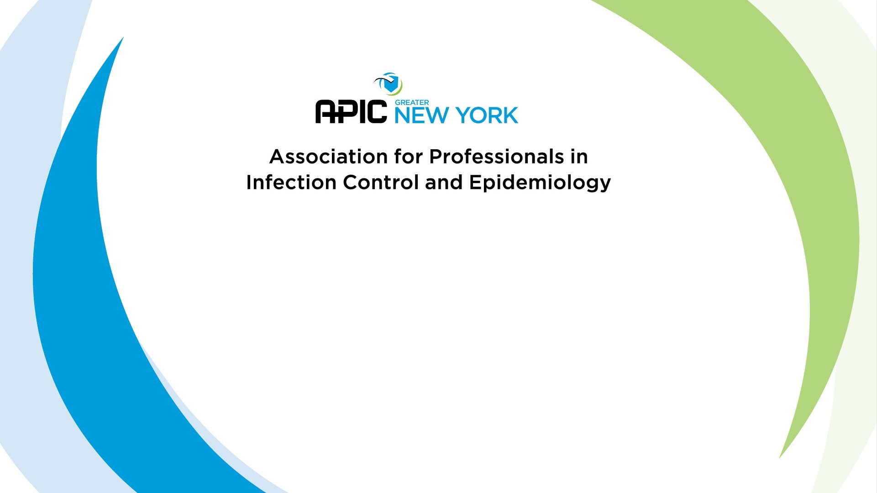
Preparing for Certification
D. Kyle Willey, BS CIC

Slide 2
1. A 55-year-old male who is admitted to an emergency department with a high fever and myalgias rapidly develops respiratory distress that requires ventilation. When questioning the family, the Infection Preventionist (IP) learns that the only change in his routine activities was cleaning out an abandoned storage shed near the family home approximately 2 weeks previously. Which of the following infectious diseases MOST likely results in these symptoms?
Sample Test Questions
Hantavirus
Plague
Lyme disease
Q Fever
Discussion:
What are the important clues in the question?
How are each transmitted?
What are the symptoms?

Slide 3
2. Which of the following specimens must be protected from exposure to air?
Sample Test Questions
nasal washings
needle aspirate from lung abscess
cerebrospinal fluid
conjunctival scrapings
Discussion:
Why do we need to protect from exposure?
Are any already exposed?
Notes:
Must determine main problem prior to education/performance improvement

Slide 4
3. A patient is admitted for aggressive chemotherapy and on hospital day 13, the patient develops high fevers and consolidation on chest x-ray. A chest CT shows left lower lobe patchy infiltrate with dense central consolidation. Which of the following is the most likely cause?
Aspergillus
Legionella
Candida tropicalis
Nocardia asteroids
Discussion:
What factors go into the response?
What are the s/s?
What is the BEST match for unilateral infiltrate?

Slide 5
4. Over a 3 month period, eight patients were diagnosed with Legionella pneumonia. The location of the patients were: 4 in the liver transplant unit, 2 in the trauma unit, and 1 each in the pediatric and psychiatric unit. To control Legionella in this facility, the ICP should:
Sample Test Questions
Discussion:
What is the problem?
Do the different types of units matter?
What risk factors are involved?
Review engineering department’s schedule for changing the HEPA filters
Discontinue the use of the air conditioners on the affected units
Focus surveillance on pediatric and psychiatric units
Culture water supplies from the affected units
Notes:
Blood/Body Fluid exposures on A, C, D

Slide 6
5. A pediatric patient has had erythema of the cheeks for 2 weeks, particularly when in sunlight. A PCR test for B19 DNA is found positive by laboratory study. This child MOST likely has
Sample Test Questions
Lyme disease
Fifth disease
Leprosy
Streptobacillosis
Discussion:
What is the best clue?
What s/s are present?
How do each disease typically present?

Slide 7
6. A patient who has undergone cardiopulmonary resuscitation is subsequently diagnosed as having meningococcal meningitis. Which of the following employees should receive prophylaxis?
Sample Test Questions
anesthetist who performed endotracheal intubation
physician who administered intravenous medications
technician who performed the EKG
nurse who performed chest compressions
Discussion:
Focus on the actions. What risk factors are involved?
Rank the risk from highest to lowest.

Slide 8
7. Which of the following organisms is a spiral-shaped rod associated with gastroenteritis?
Sample Test Questions
Shigella sonnei
Campylobacter jejuni
Escherichia coli
Salmonella enteritidis
Discussion:
Are there any we can exclude?
  One of these things is not like the other. One of these things does not belong…

Slide 9
Follow-up. Which of the following diseases is caused by a spiral-shaped bacterium?
1. Leptospirosis
2. Lyme Disease
3. Relapsing Fever
4. Syphilis
Sample Test Questions
2 and 3
1 and 4
All of the above
None of the above
Discussion:
Are there any we know that we can exclude?
Are there any we know that we can include?

Slide 10

Notes:
References
1. Association for Professionals in Infection Control and Epidemiology. (2015). Certification Study Guide, 6th edition. Arlington: Association for Professionals in Infection Control and Epidemiology.
2. Association for Professionals in Infection Control and Epidemiology, Inc. (2015). APIC Text of Infection Control and Epidemiology. Arlington, VA.
3. Certification Board of Infection Control and Epidemiology, Inc. (2016, June). Certification in Infection Prevention and Control (CIC). Milwaukee, Wisconsin. Retrieved from https://view.officeapps.live.com/op/view.aspx?src=https://www.cbic.org/UserFiles/file/UnderstandingCBICandtheCICCredential-2018-longversion.ppt
4. Certification Board of Infection Control and Epidemiology, Inc. (2018). CBIC Certification Website. Retrieved 10 1, 2018, from CBIC Website: https://www.cbic.org/certification
5. Krein, S. L., Hofer, T. P., Kowalski, C. P., Olmsted, R. N., Kauffman, C. A., Forman, J. H., et al. (2007). Use of Central Venous Catheter-Related Bloodstream Infection Prevention Practices by US Hospitals. Mayo Clinic Proceedings, 82(6), 672-678.
6. Murphy, D. M., Hanchett, M., Olmsted, R. N., Farber, M. R., Lee, T. B., Haas, J. P., et al. (2012). Competency in infection prevention: A conceptual approach to guide current and future practice. American Journal of Infection Control, 40(4), 269-303.
7. Pogorzelska, M., Stone, P. W., & Larson, E. L. (2012). Certification in infection control matters: Impact of infection control department characteristics and policies on rates of multidrug-resistant infections. American Journal of Infection Control, 40(2), 96-101.
8. Pogorzelska-Maziarz, M., & Kalp, E. L. (2017). Infection prevention outside of the acute care setting: Results from the MegaSurvey of infection preventionists. American Journal of Infection Control, 45(6), 597-602.
9. Saint, S., Greene, M. T., Olmsted, R. N., Chopra, V., Meddings, J., Safdar, N., et al. (2013). Perceived strength of evidence supporting practices to prevent health care-associated infection: Results from a national survey of infection prevention personnel. American Journal of Infection Control, 41, 100-106.
10. Smith, P. W., Bennett, G., Bradley, S., Drinka, P., Lautenbach, E., Marx, J., et al. (2008). SHEA/APIC Guideline: Infection Prevention and Control in the Long-Term Care Facility. Infection Control and Hospital Epidemiology, 29(9), 785-814.
11. The National Association of Directors of Nursing Administration in Long Term Care. (2016). Summary of the New CMS Requirements for Infection Prevention and Control in Long Term Care Settings. The Director, 24(3), 17-23.

