Slide 1
Items that interested me at
APIC 2015
Barbara A. Smith
Thank you for the support to attend APIC 2015

Slide 2
Evidence behind the new guidelines for reprocessing flexible endoscopes and
Reprocessing endoscopes in ambulatory care settings
Ofstead, Wetzler, Eiland, Rocco

Slide 3
Risk of transmission
Oft quoted statistics of 1 infection in 1.8 million by endoscope
Extrapolated from review articles and estimated # of procedures in US
Yet…
2010- Hennepin MC: incorrect info from manufacturer led to notification of 2600 pts
2009 FDA – 9 cases C. diff
2013- est. 6- 42 % attack rates for ERCP scopes (different locations)
LA: 2 deaths – 2015
Seattle – 11 deaths – 2014
Chicago – 2 deaths- 2014

Slide 4
Results of inspections
Date | State | Reason for visit | Findings
2010 | CA | routine | Lack of tracking Expired HLD
2010 | MN | complaint | Blood on scope Incorrect connector
2011 | NJ | routine | Lack of competency demonstration Incorrectly performed leak test
2011 | NV | complaint | Dripping scopes
2011 | NJ | routine | Lack of PPE and hand washing

Slide 5
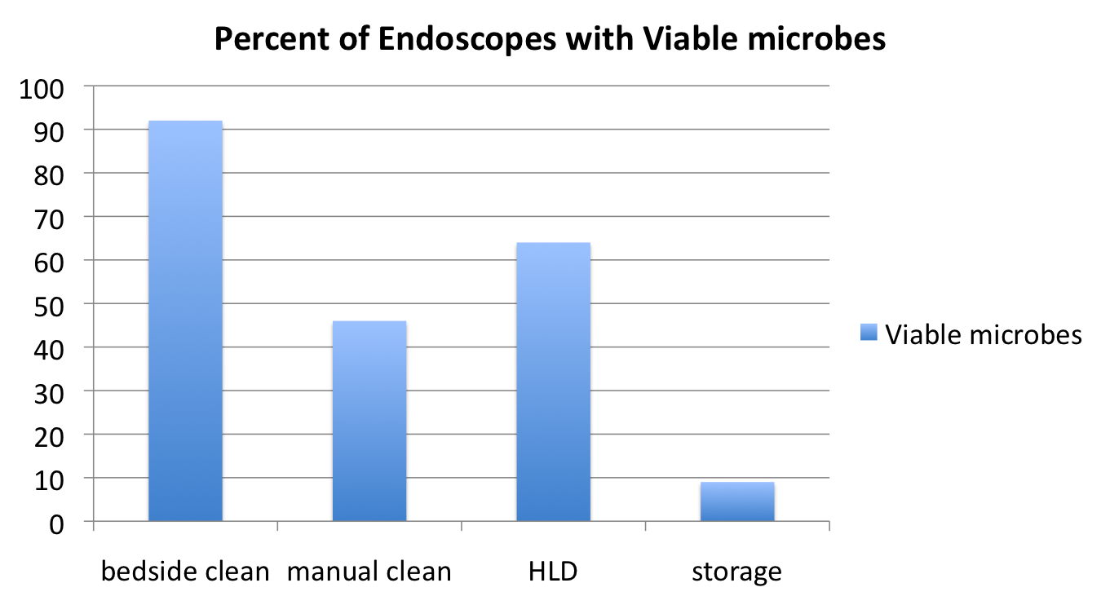
2 phase study of HLD

Slide 6
Factors impacting risk
Procedural | Patient | Community | Facility
Entry point | Age | Prevalence of BBP | Outpatient vs. inpatient
Organ of interest | Comorbidities | Antimicrobial usage | Age of scopes
Reprocessing delays | Severity of illness |  | Quality of reprocessing
Mucus membranes disrupted | Immune compromised |  | Monitoring of reprocessing
 | Hx of antimicrobials |  | Response to breaches
 | Interventions during case |  | Use of electronic data

Slide 7
Assessing your practice
DO the scopes or cabinets smell bad
Can you smell chemicals
How are the scopes stored
Are there stains in the cabinet
Does # of MEC strips coincide with # of cases
Are logs UTD:
  Cycle complete, Leak test, HLD temp and mec, filter changes, maintenance

Slide 8
Improving practice
Perform audits
Cleanliness effectiveness checks
Inspect channels with bore scope
Periodic microbial cultures
Engage manufacturers

Slide 9
More strategies
Read all instructions for use
  Which may differ from published guidelines
  Example of maximal storage time
Automate whenever possible
Make sure adequate room for reprocessing

Slide 10
Using data for prevention: what’s on TAP in your hospital
Target – Assess - Prevent
Gould/ Dudeck/ Soe

Slide 11
TAP strategy
Target
TAP report in NHSN
Identify units with > HAIs
Assess
Assess for gaps
Prevent
Feedback to units
Links to implementation guides
Engage group
Measure practices
Assessment tools
Evaluate interventions

Slide 12
How derived in NHSN
Annual survey
Rate tables
SIRS
Event level info (CLABS and Cauti)
www.cdc.gov/hai/prevention/tap.html
Designed to compare to HHS SIR targets
  CLABS - 0.5
  CAUTI – 0.75
  CDI- 0.7

Slide 13
What do IPs want to know? A review of queries from IP talk and APIC.org
Landers/Gase

Slide 14
Methods
Classified IP talk content
Classified apic.org searches
Compared the two results
Prioritize research topics

Slide 15
What’s there- IP talk
IP talk | Material
15,556 members 34,000 discussions 1,300 library items | Presentations- one EVS example 1652 downloads Video- 428 downloads Document - 1727 downloads

Slide 16
What’s there – APIC.org
37,728 visitors per month
404,407 page views
Page Rank of 6 – which is good

Slide 17
Compared the topics on each
APIC competency mode:
  IP & C domain
  Technical
  Leadership /program management
  PI and implementation science
Infection – organism
Infection – type
Practice – hand hygiene
Practice - isolation

Slide 18
What they found
APIC.org | IP talk
CAUTI Hand hygiene Construction MRSA Ebola ESBL CCLABSI Risk assessment C. Difficile Epi 101 Library APIC text ICRA Bioterrorism Emerging infections Certification Antibiotic stewardship Ebola patient care protocol | Risk assessment Bed bugs MRSA Ebola Library Construction CAUTI Hand hygiene Rounds IC plan Ultrasound gel Stethoscopes IP week SSI Steriples Fans Nails

Slide 19
Top downloads
Novice Roadmap Infection preventionist
New member brochure
IP competency model
CAUTI implementation guide
Duodenoscopes and other endoscope FDA letter

Slide 20
Findings
Congruence between both searches
Limitations
  What IPs want to know; Not need to know
  May not be representative of all IPs
  Seasonal variations not accounted for
  Identified future research possibilities
  Hand hygiene and CAUTI

Slide 21
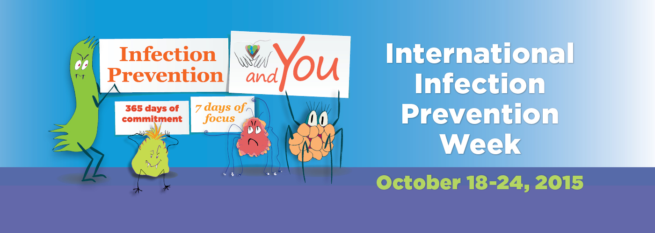

Slide 22
Infection Prevention and You materials
ABC's of Antibiotics Flyer for patient
What are healthcare-associated infections?
Who are infection preventionists
Infection Prevention and You Infographic Flyer for patients
Infection Prevention and You - Isolation Precautions

Slide 23
Volunteer
Conference Committee
Communications Committee
Education Committee
Emergency Preparedness
Member Services
Nominating and Awards.
Practice Guidance
Professional Development e.
Public Policy
Research Committee
CBIC- Board members, test writers, reviewers

