Slide 1

APIC Conference Experience
By Karina Albuquerque MSN, RN, CIC
Facility: Elmhurst Hospital Center
Date: 9/21/2022

Slide 2

Virtual APIC Conference Attendee
First time attending APIC conference
There were a variety of presentations to watch (either live sessions or on demand)
Attendees also had access to posters brought by professionals from all over the country
Platform was easy to navigate
Aside from presentations on Infection Prevention practices, there were presentations on leadership styles, Rejection (Surprising Lessons from 100 Days of Rejection) etc…
Although attending the conference remotely is convenient, I will try to attend it in person for a full experience

Slide 3
Some interesting presentations:
  Water Systems Management and Regulatory Compliance Updates
  Endoscope Processing: What the Revised AAMI Standard Means for IPC
  Critical Updates: AAMI ST 91 for Flexible Endoscope Processing
  SMART Compliance in the Ambulatory Setting

Slide 4
Water Systems Management and Regulatory Compliance Updates
The presenters:
Tamika J. Brown, LTC Enforcement
Branch Manager, Survey &
Operations Group (SOG), Centers for Medicare & Medicaid Services (CMS)
CAPT Hyosim Seon-Spada, DNP, RN, June 15, 2022
FNP, CIC, USPHS, Survey and LTC
Enforcement Branch Manager, SOG,
CMS

Slide 5
Water Systems Management and Regulatory Compliance Updates
CDC: Investigations show almost all outbreaks were caused by problems preventable
with more effective water management and 9 in 10 are preventable outbreaks.
Approx. 7.2 million Americans get sick every year (from waterborne pathogens).
The rate of reported cases of legionellosis has increased 286% in the US during
2000–2014.
Approximately 9% of reported legionellosis cases are fatal.
Approx. 19% of outbreaks were associated with long-term care facilities and 15%
with hospitals (the rest was not related to healthcare facilities).

Slide 6
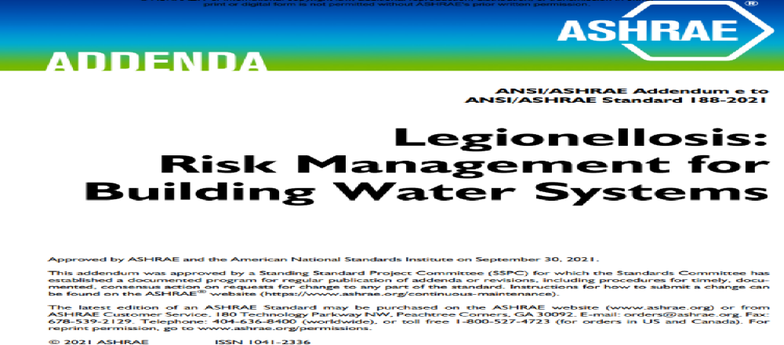
Water Systems Management and Regulatory Compliance Updates cont.
ASHRAE industry standard and the CDC toolkit: Water Management Plan.
ANSI/ASHRAE Addendum e to ANSI/ASHRAE Standard 188-2021

Slide 7
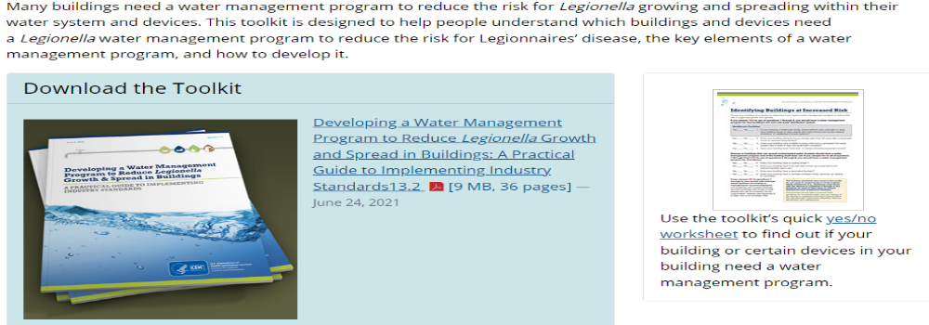
Water Systems Management and Regulatory Compliance Updates cont.
CDC Toolkit: Developing a Water Management Program to Reduce Legionella Growth and Spread in Buildings: A Practical Guide to Implementing Industry Standards (June 24, 2021)
Legionella: Developing a Water Management Program | CDC

Slide 8
Water Systems Management and Regulatory Compliance Updates cont.
Report from the Health Department
State Public Health Laboratory report
Facility Reported Incidents (FRI)
Hospital report on patients from the nursing homes with Legionnaires'
disease or pneumonia associated with the waterborne diseases
Life safety survey report during recertification survey
Complaints from family members or employees
EPA
Contaminant results

Slide 9
Water Systems Management and Regulatory Compliance Updates cont.
IP Role to Improve or Prevent Deficiencies (Tips/Suggestions)
Waterborne Healthcare –Associated Infections (HAIs) & Prevention Strategies
Water Management Team, Water management plan/ program
Assist in conducting the facility-specific risk assessment for hazard analyses, environmental and infection control
Ongoing audit to ensure the water management team is adhering to the policies and procedures
and recommended testing protocols
Know local, regional, state, and national contact and resources (CDC)
Be familiar with updated CMS and CDC water management program essentials
Be familiar with CDC education, tools, and additional resources (i.e., Water Management Consultants)
Immediate corrective actions when the water test shows positive with pathogenic organisms, perform
Root Cause Analysis, facilitate last systemic changes within the facilities to drive sustained compliance
Record keeping and routinely follow up, report surveillance data to the team, and discussion with the
Water management team or committee
Evaluate water management plan and policies and procedures annually
Maintain effective communication channels, including key personnel

Slide 10
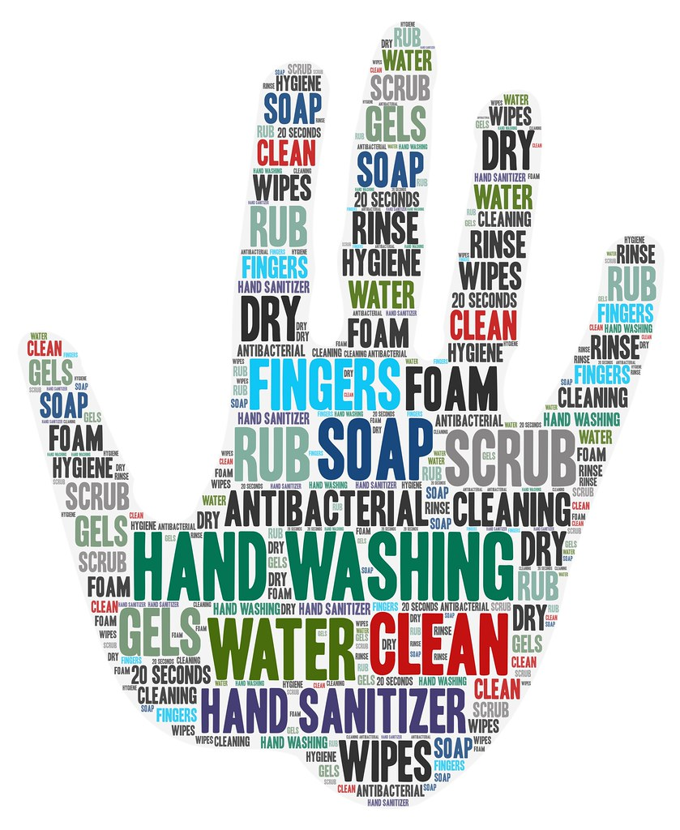

Thank you

