Slide 1
Heighten Your DVT Awareness
Reaching New Heights in Understanding CVC Complications
Michael Brazunas, RN, BSN, VA-BC

Slide 2
Disclosures
AngioDynamics, Inc.
Association for Vascular Access – Director-at-Large

Slide 3
Objective
Identify 3 central venous catheter (CVC) complications
Recognize the prevalence and clinical relevance of 3 CVC complications
Examine in-depth details of CVC-related thrombosis
Distinguish varying methods of managing catheter-related thrombosis

Slide 4
Complications of Central Venous Catheters (CVCs)

Slide 5
Catheter-Related Infections
There are three types of catheter-related infections¹:
Blood stream infections
Catheter colonization
Exit-site infection

Slide 6
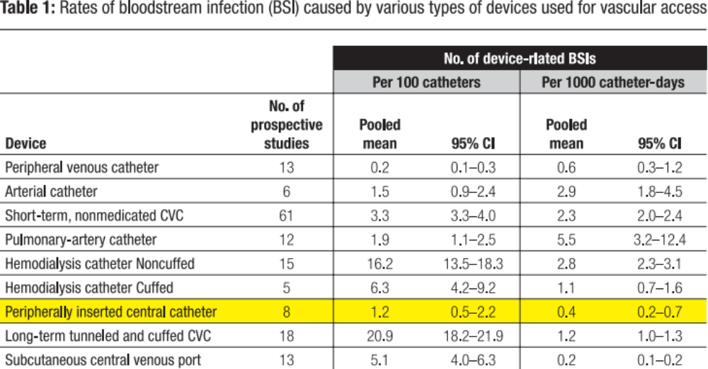
How Often Do PICCs Cause CLA-BSI^{6,31}
Prevalence and Relevance
Approximately .5 – 2.2% of PICCs have CR-BSIs
(per 100 catheters)

Slide 7
CR-BSI – Stacking the ODDs in YOUR Patients’ Favor
According to the APIC “Guide to the Elimination of Catheter-Related Bloodstream Infections” 2009, evidence-based recommendations are categorized as follows:
• Healthcare worker and patient education
• Asepsis
• Catheter selection
• Catheter site selection
• Maximum sterile barrier precautions
• Cutaneous antisepsis
• Catheter and catheter site care
• Catheter replacement strategies
• General catheter management strategies

Slide 8
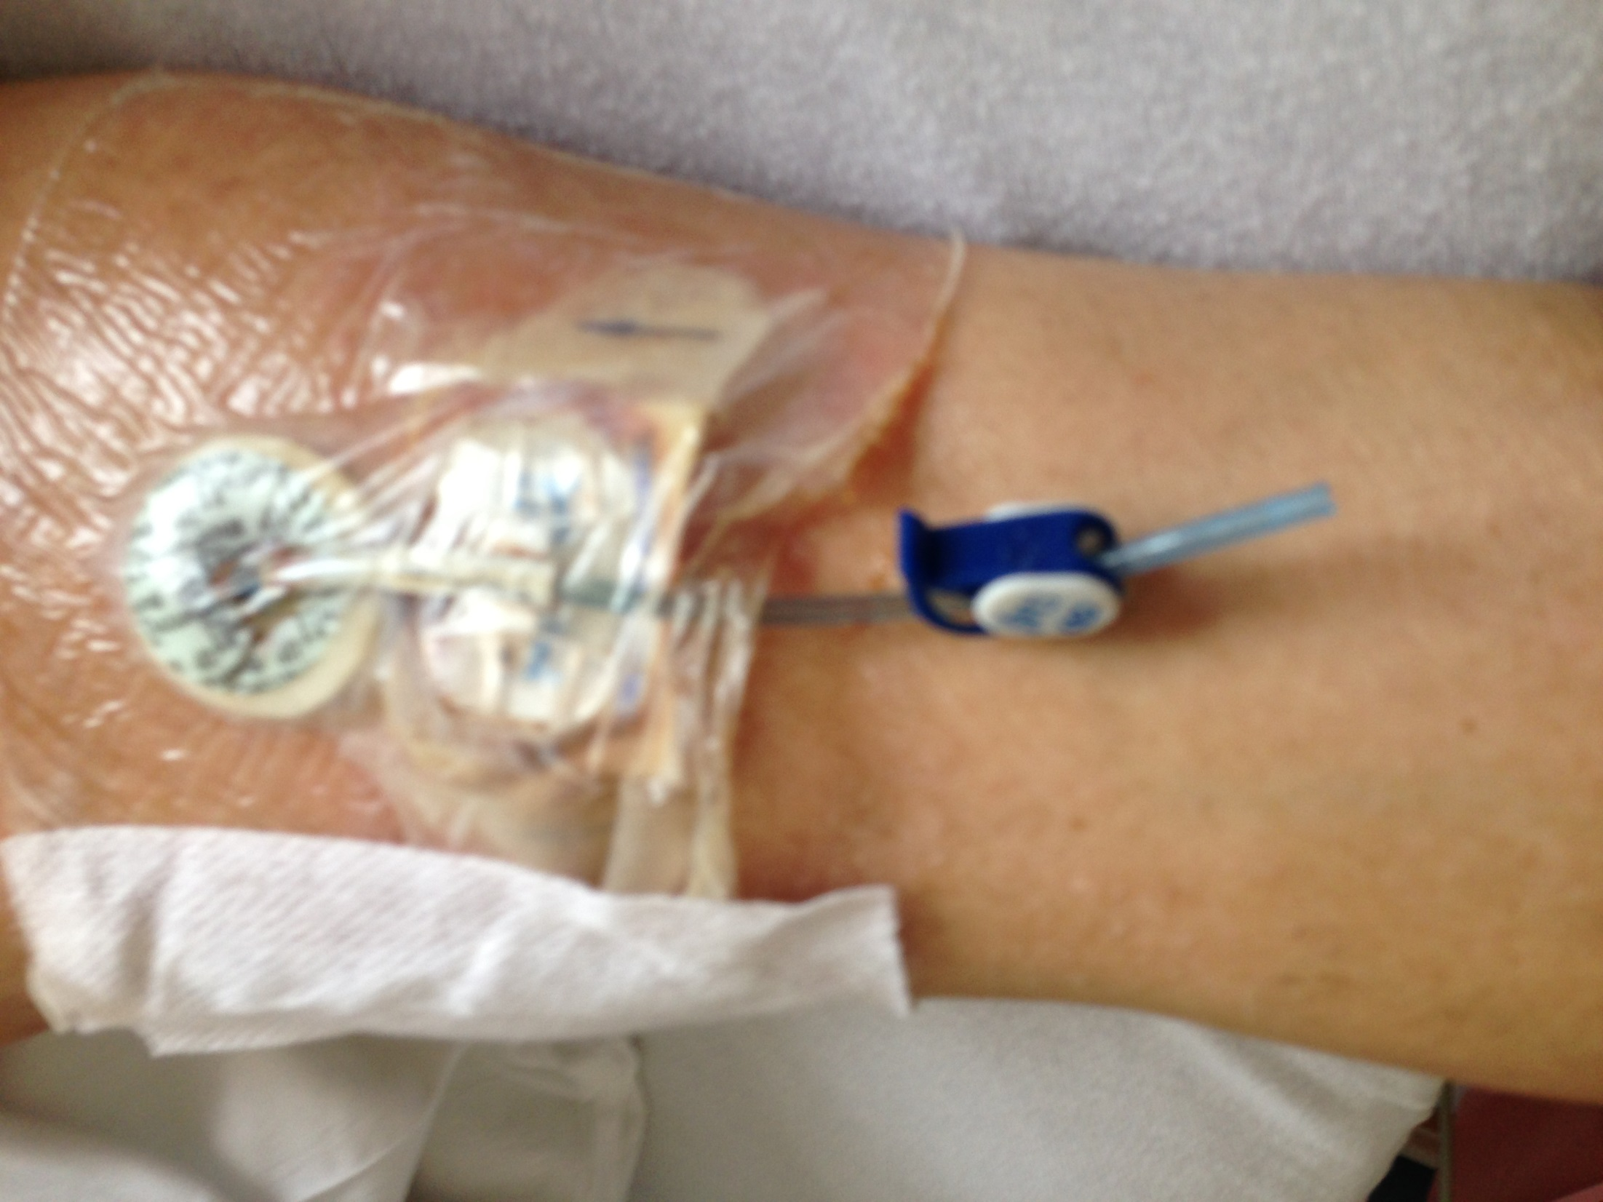

Slide 9
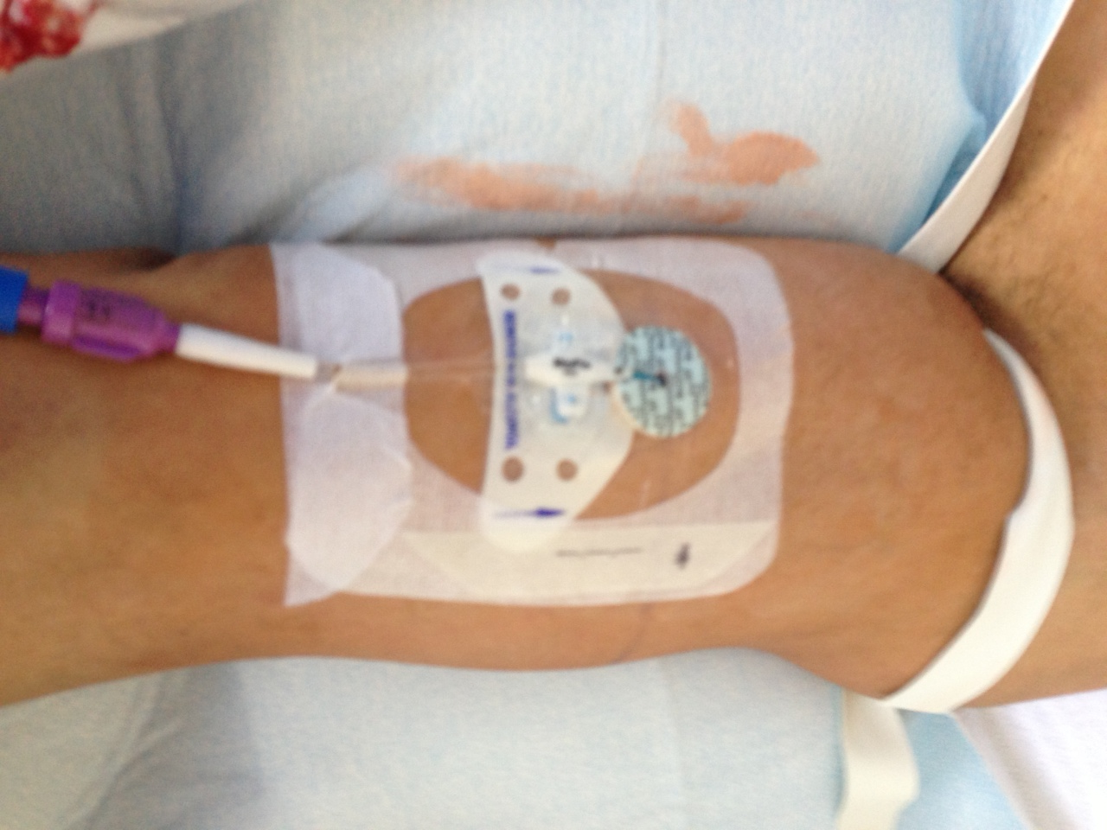

Slide 10
CR-BSI – Stacking the ODDs in YOUR Patients’ Favor
From APIC “Guide to the Elimination of Catheter-Related Bloodstream Infections” 2009:
“Raad and colleagues caution that a multi-pronged approach to CRBSI prevention is still required and should include a combination of novel preventative measures such as:
• Antiseptic techniques
• Novel technologies
• Prudent catheter insertion and timely removal”

Slide 11
THE LINK BETWEEN THROMBUS & INFECTION
  What comes first; the thrombus or the infection?
  Thrombus and fibrin sheaths are the food that bacteria live and thrive on
  The correlation between the two is widely accepted
  Preventing thrombus reduces infection

Slide 12
THE LINK BETWEEN THROMBUS & INFECTION
Show me the data
Raad, The Relationship Between the Thrombotic and Infectious Complications of Central Venous Catheters, JAMA 1194
  Post-mortem evaluation of 72 cancer patients with CVCs showed a strong correlation between CR-sepsis and CVC thrombosis
    Fibrin layer present on ALL catheters
    CR-Thrombosis present in 38% of cases
    23% of these had sepsis
  All patients with sepsis had thrombosis--

Slide 13
THE LINK BETWEEN THROMBUS & INFECTION
Show me the data
The role of tissue plasminogen activator use and systemic hypercoagulability in central line-associated bloodstream infections. (American Journal of Infection Control 42 (2014) 417-20)
The use of TPA was associated with a higher risk of developing CLABSI.
  3901 patients with PICCs, 178 excluded….left a total of 3723 pts.
  1463 received TPA
    32 developed a CLABSI = 2.2%
  2260 did not receive TPA WHAT CAN WE INFER ?
    14 developed a CLABSI = 0.62%

Slide 14
THE LINK BETWEEN THROMBUS & INFECTION
Show me more data:
Management of occlusion and thrombosis associated with long-term indwelling central venous catheters Lancet 2009
  “Catheter Related Thrombosis can lead to further complications such as increased risk of subsequent catheter infections…”
  “Microbiological studies have shown that proteins within a clot, such as fibrinogen and fibronectin, attract staphylococcal species… thereby increasing the risk of catheter infection”
Infections increase the risk of central venous catheter-related thrombosis in adult acute myeloid leukemia. Thrombosis Research 2013
  “…both CVC-exit site infections and sepsis were confirmed to be independent risk factors for CRT development.”

Slide 15
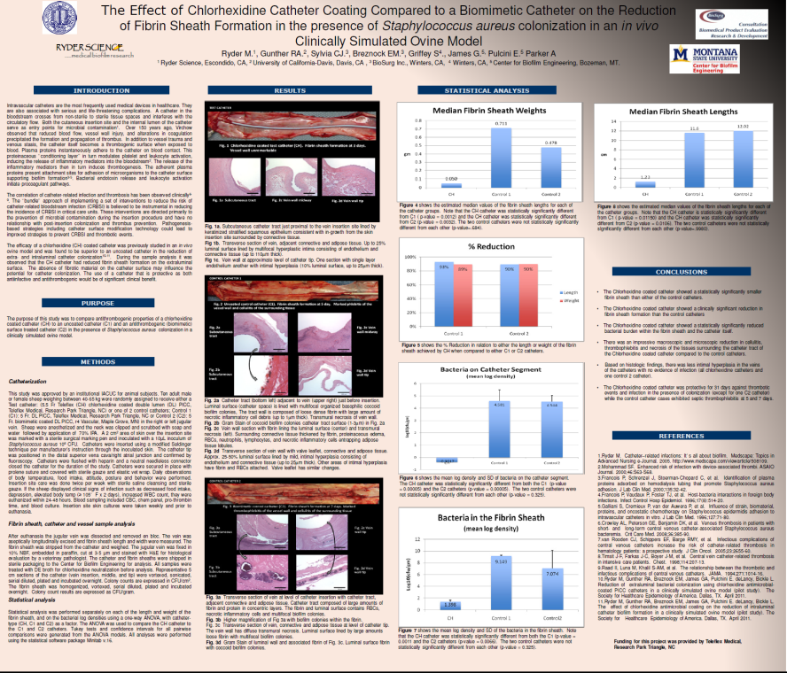
THE LINK BETWEEN THROMBUS & INFECTION
Show me more data:
From APIC “Guide to the Elimination of Catheter-Related Bloodstream Infections” 2009:
  “…infected thrombus of the great vessels secondary to vascular catheter use, continues to pose a risk to patients.”
  “Future technologies may also include agents or materials that prevent thrombus formation.”

Slide 16
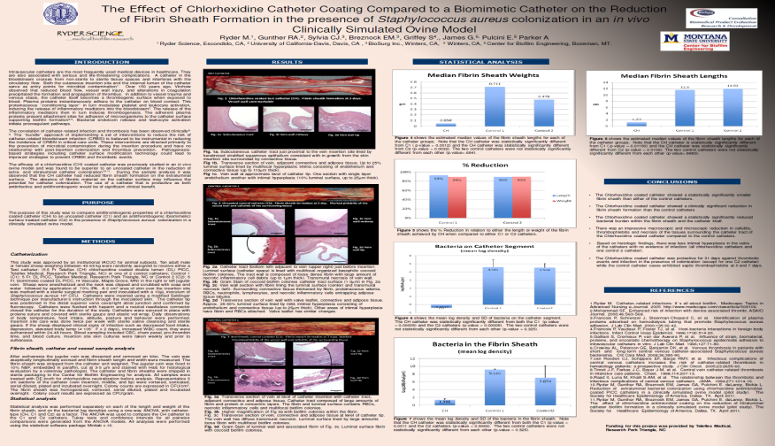
THE LINK BETWEEN THROMBUS & INFECTION
Show me more data:
Ryder et. al. The Effect of Chlorhexidine Catheter Coating Compared to Biomimetic Catheter on the reduction of Fibrin Sheath Formation in the of Staphylococcus aureus colonization in an in vivo Clinically Simulated Ovine Model
  “The correlation of catheter-related infection and thrombosis has been observed Clinically”

Slide 17
THE LINK BETWEEN THROMBUS & INFECTION
Show me more data:
Catheter-Related Infection and Thrombosis: A Proven Relationship. A Review of Innovative PICC Technology to Reduce Catheter-Related Infection and Thrombosis – Nancy Mareau
“The relationship between thrombosis and infection has been established with significant colonization in areas of clot, and higher rates of catheter-related sepsis and catheter-related septicemia when thrombosis is present.”
“ In animal studies, fibrin sheath formation around central venous catheters significantly promoted colonization, catheter-related infection and persistent bacteremia.”

Slide 18
Catheter-Related Thrombotic Occlusions

Slide 19
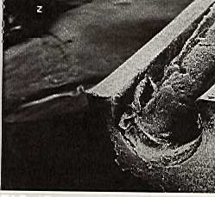
Catheter-Related Occlusions^{5,7,8}
Prevalence and Relevance
Most common non-infectious complication in the long-term use of CVCs, and in particular PICCs^{5,7}
Approximately 1 in 4 CVCs may become occluded⁸
Occlusions may present as
  Partial or complete
  Thrombotic or non-thrombotic
  Intraluminal or extraluminal

Slide 20
How do YOU Determine Occlusions?
Prevalence and Relevance
Potential indicators of catheter occlusion⁷
  Inability to infuse fluids
  Lack of free-flowing blood return
  Increased resistance when flushing
  Sluggish flow
  Frequent infusion pump alarms
Learn what YOUR prevalence and relevance are!

Slide 21
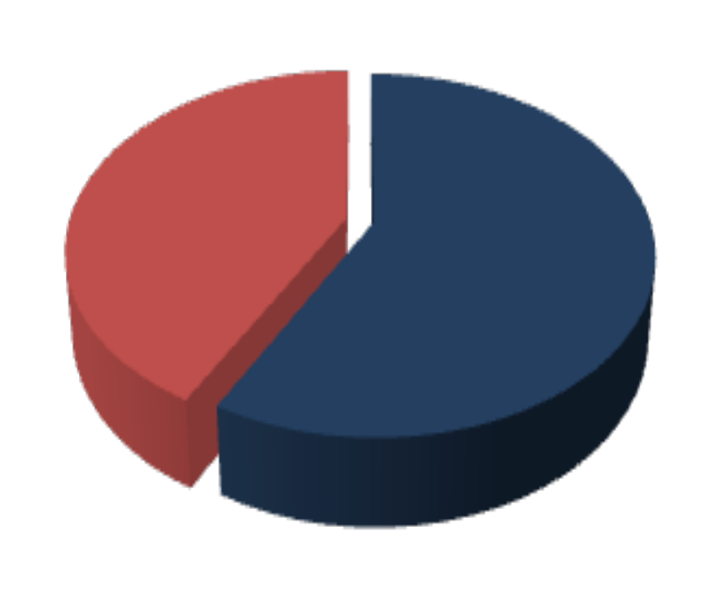
CVC-Related Occlusion^{7,8}
Prevalence and Relevance
Non-thrombotic occlusions
  Mechanical
  Lipid or chemical aggregation
  Precipitate
Thrombotic occlusions
  Intraluminal
    Thrombus
  Extraluminal
    Fibrin Sheath
    Mural thrombosis
Non-Thrombotic
42%
Thrombotic
58%
Haire & Herbst, 2000; Herbst & McKinnon, 2001.

Slide 22


Fibrin Formation
Proteins bind to surface
Platelets and white cells adhere to proteins
Fibrinous sheath forms, 1 mm thickness within 24 hrs¹²

Slide 23
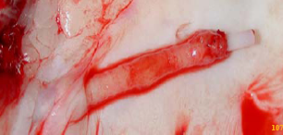
Fibrin Sheath

Slide 24
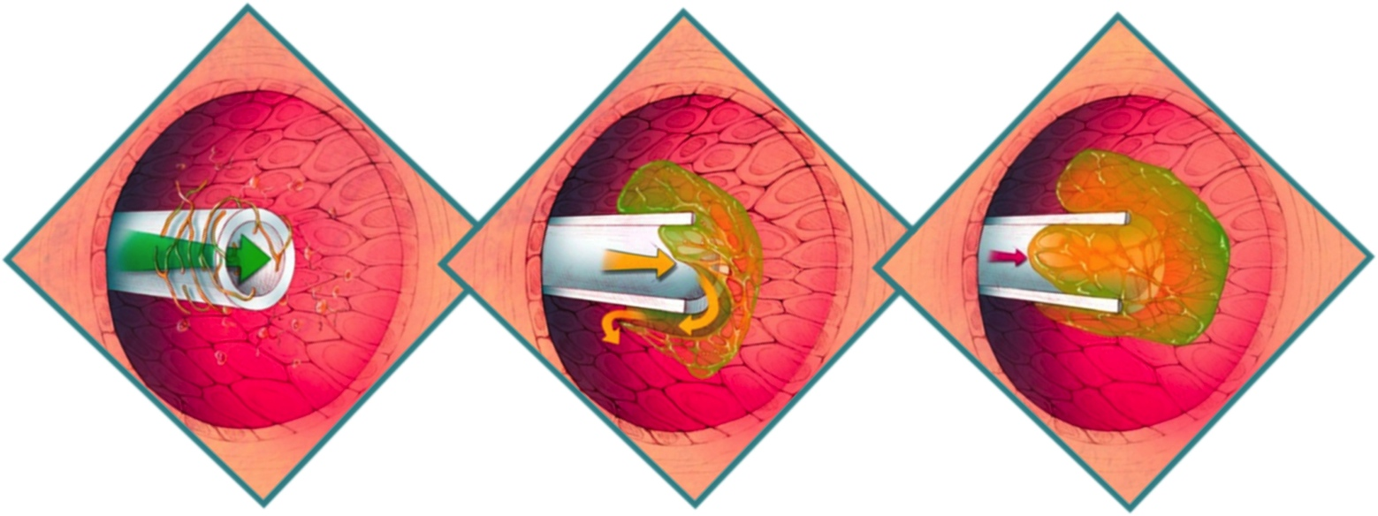
Intraluminal Thrombotic Occlusions ^{4,7,13}
Fibrin accumulation can initiate inside the catheter tip and is often the result of blood reflux into the catheter

Slide 25
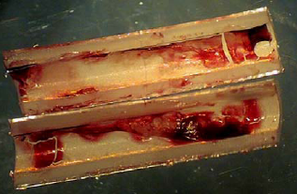
Intraluminal Thrombus

Slide 26
Catheter-Related
Deep Vein Thrombosis

Slide 27
Deep Vein Thrombosis Awareness ^{10,}11
Prevalence and Relevance
Each year 200,000-600,000 Americans suffer from Venous Thromboembolism (VTE) which includes Deep Vein Thrombosis (DVT) and Pulmonary Embolism (PE) ¹¹
At least 100,000 deaths per year are directly related to VTE¹⁰
VTE is the leading cause of preventable, in-hospital deaths affecting more people annually than highway fatalities and breast cancer combined¹⁰
74% of people surveyed have little or not awareness of DVT symptoms¹¹

Slide 28
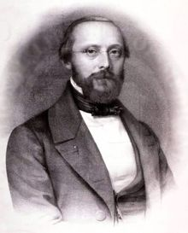
Inherent CVC-Related Risk Factors for DVT^{14,16}
Virchow’s Triad illustrates the inherent risk factors that present with CVC placement, predisposing a patient to DVT^{14,16}
  Vessel wall injury
  Stasis
  Hypercoagulable state
Virchow’s Triad
Stasis
THROMBOSIS
Vessel Wall Injury
Hyper
coagulability
Notes:
Let’s discuss the causes and risks of Deep Vein Thrombosis.
There are many pre-disposing risk factors to venous thrombosis.
In the early 1800s, a German pathologist, Rudolf Virchow, described three key elements of clot formation, that we now refer to as Virchow’s triad.
We will briefly review the criteria on this slide, but will dive in deeper in the next several slides. The three key criteria are:
Alterations in normal blood flow, or stasis;
Injuries to the vascular endothelium or inner lining of the vessel;
Alterations in the constitution of blood known as hypercoagulability.
Many patients in acute care settings satisfy two or three of these criteria, making them at even further risk of developing a clot.

Slide 29
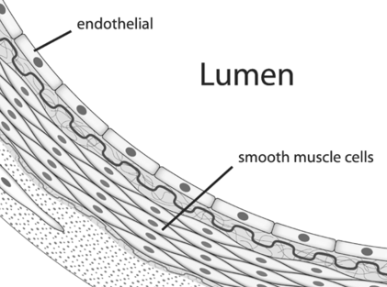
Why is Vessel Wall Injury a Risk for VT?
The endothelium is the thin layer
of cells forming an interface between circulating blood in the lumen and the rest of the vessel wall. The endothelium provides a non-thrombogenic surface.
Disruptions in the endothelium may cause the thrombin cascade to become activated.
PICC placement causes a disruption to the endothelium.
  21 G needle puncture (sometimes double wall)
  Wire and sheath/ dilator trauma
  Irritation caused by indwelling PICC
Notes:
Let’s talk for a moment about vessel wall injury because it is critical when discussing thombosis.
The endothelium in general provides a non-thrombogenic surface through which the blood circulates.
When the vessel walls are disrupted however, such as due to injury or the placement of a PICC, it can cause the thrombin cascade to activate.

Slide 30
Venous Thrombosis Risks¹⁵
Patient and Vascular
Catheter-associated infection
Fibrinous catheter lumen occlusion
Extrinsic vascular compression
Age extreme (old/young)
Technical
Larger catheter diameter
Multi-lumen catheters
Catheter tip malposition
Two or more
insertion attempts
Left-sided placement
Subclavian vein insertion
Treatment-Related
L-asparaginase
Estrogen or progesterone agents
Recombinant human Interleukin-2
Granulocyte-macrophage CSF
Thalidomide
Notes:
Potential risks of venous thrombosis fall into three main categories:
The first category has to do with the patient and how their body responds to the catheter. Does an infection or occlusion form? Is the patient very old or young? Etc.
The second category are risks caused by technical aspects of the catheters and their placement / insertion. How large is the catheter diameters? How many lumens does it have? Where was it placed? Etc.
The third and last category of risks relates to how the patient is treated. What therapies and treatments were prescribed or used in conjunction with the catheter placement?
Each time a CVC is placed it is important to consider all of these factors to help determine the risk for the patient.

Slide 31
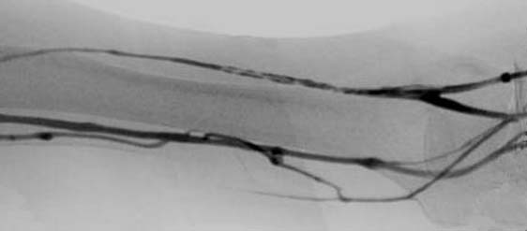
Cather-Related Venous Thrombosis^{33,34}
If a CR-venous thrombus develops, between the catheter and the vessel wall it may:
Lead to blockage of the vein
Be a life-threatening condition
Have potential complications including, but not limited to, pulmonary embolism

Slide 32
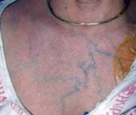
Venous Thrombosis

Slide 33
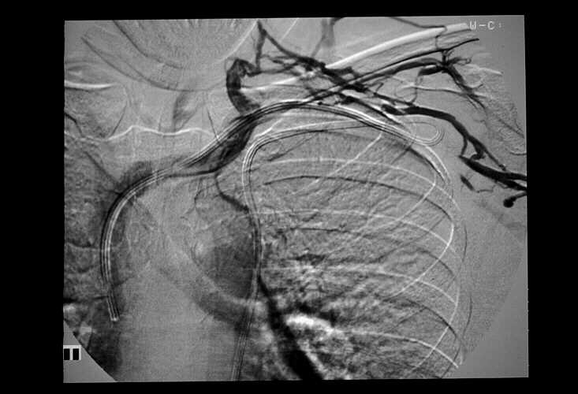
Venogram – Subclavian Venous Thrombosis
Collaterals
Thrombosis
Catheter
Tip
Slide-courtesy of NIH, D.J. Mayo, RN
Notes:
This venogram shows the position of a catheter-related thrombus as well as the blockage of flow in the collateral vessels.

Slide 34
PICC-Related DVT Incidence Rates
64% Asymptomatic & symptomatic
Prevalence and Relevance
Symptomatic PICC related DVTs
  3-7.8% incidence
Asymptomatic + symptomatic PICC related DVTs
  Up to 64% incidence
Median time to thrombus: 8 to 12 days
3-7.8% Rate of Symptomatic PICC Related DVTs²²
Notes:
There is a significant difference in symptomatic DVTs vs. asymptomatic DVTs rates.
In most cases, PICC-related DVT is asymptomatic, which is critical to know because the typical signs of DVT are not present.
Studies have shown that symptomatic PICC-related DVTs are as low as 1-4%, but combined with asymptomatic DVTs, the rate reaches approximately 38%.

Slide 35
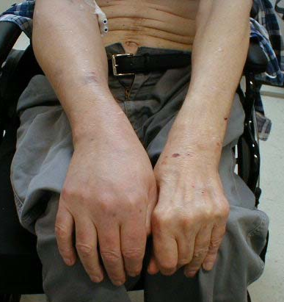
Known Sequelae of UEDVT^{23,28}
Pulmonary Embolism
  Occurs in approximately 6% of patients
Post-thrombotic syndrome
  Pain
  Limb edema
  Lipodermatosclerosis
  Skin changes
  Secondary varicose veins
SVC syndrome

Slide 36
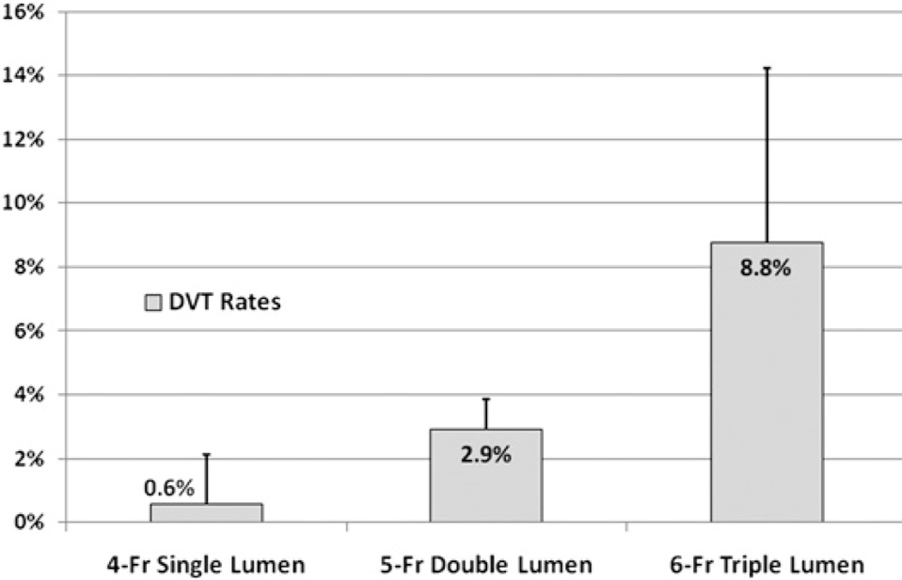
Risk Factors for CR-UEDVT^{17,19,25,26,27}
Catheter Diameter^{25,26}
  Increased incidence of thrombosis with larger diameter catheters & smaller vessels
Prior DVT²⁵
Hypercoagulability^{17,27}
Anticoagulant use^{17,27}
Surgery Duration²⁵
PICC Duration²⁵
Length of Stay²⁵
Males¹⁹
Symptomatic DVT Rates
Evans et. al CHEST 2010

Slide 37
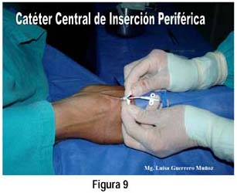
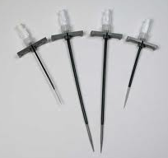
Tools for PICC Insertion &
Vessel Wall Injury^{18,19}
The “tools” for PICC insertion can be a part of the ‘issue’

Slide 38
Stenosis in Vessel
Stenosis and thrombosis of cephalic vein due to PICC
Slide-courtesy of Tom Vesely, MD
Notes:
Stenosis can also occur when the vessel wall has been traumatized, as this image demonstrates.

Slide 39
Why is Stasis a Risk for VT?
Understanding Stasis and Poiseuille’s Law – Mathematical equation related to fluid flow and hemodynamics (blood flow)
  Fluid movement within a tube – movement near the edge moves slowly due to friction
  Fluid movement near center of the tube (vessel) moves more quickly
  A CVC displaces some of the faster-moving blood AND creates turbulence
  A CVC also provides additional friction due to its own surface
  Overall flow is reduced and a level of stasis results

Slide 40

Similar to how a river flows

Slide 41
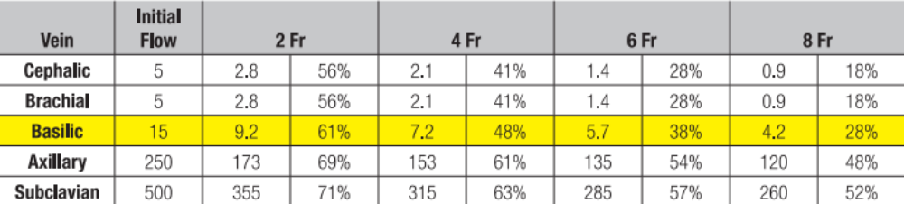
How are Devices Related to Venous Stasis? ²⁰
PICC French size may contribute to venous stasis
Smaller devices in larger vessels are less likely to cause venous stasis

Slide 42
PICC Related Thrombosis ²⁰
Study | Type |  | Detection | Thrombosis
Ng | Prospective | Symptomatic | Clinical with US Confirmation | 1.6%
Grove | Retrospective | Presumed Symptomatic | Ultrasound | 3.9%
Chemaly | Retrospective | Presumed Symptomatic | US or Venogram | 2.5%
King | Retrospective | Symptomatic | Clinical with US Confirmation | 2.0%
Cowl | Prospective (PICC vs. SC) | Symptomatic | Clinical with US Confirmation | 7.8%
Gonsalves | Retrospective | Asymptomatic | US Central Veins Only | 7.0%
Abdullah | Prospective | Asymptomatic | Venogram | 38.5%
Allen | Retrospective | Asymptomatic | Venogram | 23.3%

Slide 43
Clinical Significance of
PICC-Related DVT ¹⁹
Fletcher, J., et al., Neurocritical Care, 2011
Study aims to determine the clinical significance of PICC-Related DVT in critically ill patients
Retrospective study
  479 had PICCs placed over course of 2-year review
  39 patients developed symptomatic PICC-related DVT (8.1%)
  Size and location of device was not associated with thrombosis development
Pulmonary embolus attributed to PICC-related DVT (1.3%)
Authors recommend prospective studies comparing PICCs and CVCs in critically ill patients

Slide 44


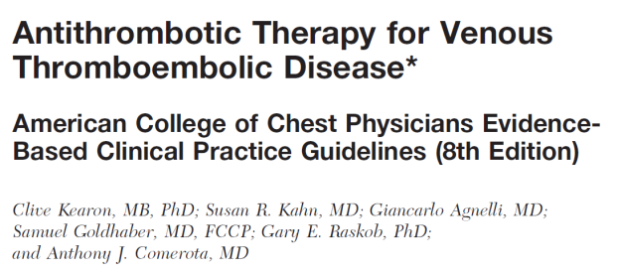
Managing Catheter-Related Thrombosis – Clinical Review³⁰
1.1.3. For patients with acute DVT, we recommend initial treatment with low molecular weight heparin, unfractionated heparin, or fondaparinux for at least 5 days and until the INR is > 2.0 for 24 h.
1.1.4. In patients with acute DVT, we recommend initiation of Coumadin together with LMWH, UFH, or fondaparinux on the first treatment day.
Notes:
For patients presenting with acute DVT, initial treatment with low molecular weight heparin, unfractionated heparin, or fondaparinux for at least 5 days is recommended.
In addition, Coumadin should be combined with the selected treatment on the first day of treatment.

Slide 45
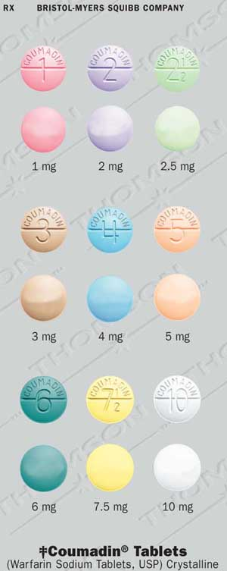
Managing Catheter-Related Thrombosis – Clinical Review³⁰
8.4.1. For patients with acute UEDVT,
we recommend treatment with Coumadin for > 3 months.
8.4.3. For patients who have UEDVT in association with a
central venous catheter that is removed, we do not recommend
that the duration of long-term anticoagulant treatment be
shortened to < 3 months.
Notes:
Treatment with Coumadin is recommended to continue for a minimum of 3 months.
In patients with catheter-related UEDVT, anticoagulant treatment should continue for no less than 3 months post removal.

Slide 46
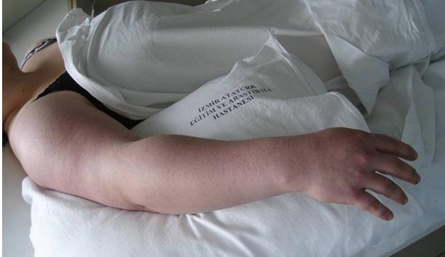
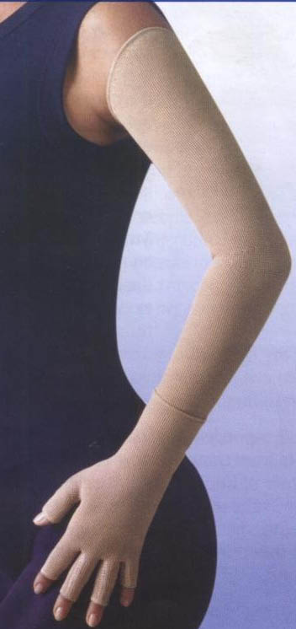
Managing Catheter-Related Thrombosis – Clinical Review³⁰
8.6.1. In patients with UEDVT who
have persistent edema and pain,
we suggest elastic bandages or elastic compression sleeves to reduce symptoms
of post-thrombotic syndrome of the
upper extremity.
Notes:
If a patient complains of persistent pain and of has persistent swelling in the arm, compression sleeves or elastic bandages are should be used to reduce post-thrombotic symptoms.

Slide 47
Managing Catheter-Related Thrombosis – Clinical Review³⁰
8.4.2. For most patients with UEDVT in association with a central venous catheter we suggest that the catheter not be removed if it is functional and there is an ongoing need for the catheter.
Notes:
In general, if the catheter is still functional and necessary, it is recommended the catheter not be removed despite the UEDVT complication.

Slide 48
You Can Make A Difference!
Use evidenced-based practice to make the best decisions for your PATIENTS

Slide 49
Citations
McGee, D.C., Gould, M.K., “Preventing Complications of Central Venous Catheterization”, The New England Journal of Medicine, 2003, 348(12):1123-1133.
O'Grady, N.P., et al., “Guidelines for the Prevention of Intravascular Catheter-related Infections”, MMWR, 2002; 51:1-26.
Miller, D., O’Grady, N.P., “Guidelines for the Prevention of Intravascular Catheter-related Infections: Recommendations Relevant to Interventional Radiology”, Journal of Vascular and Interventional Radiology, 2003, 14:355-358.
Cathflo® Brochure.
Bartock, Linda, “Evidence-based Systematic Review of Literature for the Reduction of PICC Line Occlusions”, Journal of the Association for Vascular Access, July 2010, accessed 5/12/11. http://www.faqs.org/periodicals/201007/2095040541.html
Crnich, C.J., Maki, D.J., “The Promise of Novel Technology for the Prevention of Intravascular Device-related Bloodstream Infection. II-Long-term devices”, Clinical Infectious Diseases, Vol 34, No. 10, May 15, 2002, pp. 1362-1368.
Andris, D., “Central Venous Catheter Occlusion: Successful Management Strategies”, MedSurg Nursing, August 1999, Vol. 8/No. 4, pp. 229-238.
Stephens, L.C., et al., “Are clinical signs accurate indicators of the cause of central catheter occlusion?”, Journal of Parenteral Nutrition,1995, 9:75-79.
Hadaway, L., R.N., “Reopen the Pipeline”, Nursing, August 2005, pp. 54-61.
Thrombosis Adviser, http://www.thrombosisadviser.com/en/resources/thrombosis-facts.php (Accessed 10/10/11).
11. Goldhaber, S.Z., “Deep-Vein Thrombosis: Advancing Awareness to Protect Patient Lives”, American Public Health Association, Public Health Leadership Conference on Deep-Vein Thrombosis, Washington, D.C., February 26, 2003.
Ryder, M., “The Role of Biofilm in Vascular Catheter-related Infections”, Topics in Advanced Practice Nursing Journal,” Medscape, 2005, 5(3), accessed 5/12/10. http://www.medscape.com/viewarticle/508109
Schilling, S., et al., “The Impact of Needleless Connector Device Design on Central Venous Catheter Occlusion in Children: A Prospective, Controlled Trial”, Journal of Parenteral Nutrition, 2006, 30(2):85-90.
Yacopetti, N., “Central Venous Catheter-Related Thrombosis, A Systematic Review”, The Art and Science of Infusion Nursing, July/August 2008, 31:4:241-248.
JNCCN 2006; 4:889-901.
Seeley, M., et al., “Prediction Tool for Thrombi Associated with Peripherally Inserted Central Catheters”, Journal of Infusion Nursing, 2007, 30(5):280-286.
17. King, M. et al., “Peripherally Inserted Central Venous Catheter Associated Thrombosis: Retrospective Analysis of Clinical Risk Factors in Adult Patients”, Southern Medical Journal, 2006, 99(10):1073-1077.

Slide 50
Citations
18. Bonizzoli, M., et al., “Peripherally Inserted Central Venous Catheters and Central Venous Catheter Related Thrombosis in Post-Critical Patients”, Intensive Care Medicine, 2011, 37:284-289.
19. Fletcher, Jeffrey J., et al., “The Clinical Significance of Peripherally Inserted Central Venous Catheter-related Deep Vein Thrombosis”, Neurocrit Care, 2011, DOI 10.1007/s12028-011-9554-3.
20. Nifong, T., “Infection or clot – which comes first?”, 22nd Annual Scientific Meeting of the Association for Vascular Access, Point/Counter Point Presentation, 9/11/08.
21. Abramson, N., Abramson S., “Hypercoagulability: Clinical Assessment and Treatment: Causes of Hypercoagulability”, Southern Medical Journal, 94:10.
22. Allen, A., “Venous Thrombosis Associated with the Placement of Peripherally Inserted Central Catheters”, Journal of Vascular and Interventional Radiology, 2000,11:1309–1314.
23. Kutcher, N., “Deep Vein Thrombosis of the Upper Extremities”, The New England Journal of Medicine, 2011, 364(9):861-869.
24. Nifong,T., McDevitt, T., “The Effect of Catheter to Vein Ratio on Blood Flow Rates in a Simulated Model of Peripherally Inserted Central Venous Catheters”, CHEST, 140; 48-53 pre-published 2/24/11, DOI 10.1378/10.chest.10-2637.
25. Evans, R., et al., “Risk of Symptomatic DVT Associated with Peripherally Inserted Central Catheters”, CHEST, 2010:138:4:803-810.
26. Grove, J., Pevec, W, “Venous Thrombosis Related to Peripherally Inserted Central Catheters”, Journal of Vascular and Interventional Radiology, July 2000, 11(7): 837-840.
27. Dubois, J., et al., “Incidence of Deep Vein Thrombosis Related to Peripherally Inserted Central Catheters in Children and Adolescents”, Canadian Medical Association Journal, November 6, 2007, 177(10):1185-1190.
28. Prandoni, P., Kahn, R.S., “Post-thrombotic Syndrome: Prevalence, Prognostication and Need for Progress”, British Journal of Haematology, 2009, 145:286-295.
29. Debourdeau, P., et al., 2008 SOR Guidelines for the Prevention and Treatment of Thrombosis Associated with Central Venous Catheters in Patients with Cancer: Report from the Working Group,” Annals of Oncology, 2009, 20:1459–1471.
30. Kearon, C., et al., “Antithrombotic Therapy for Venous Thromboembolic Disease”, CHEST, 2008, 133:454–545.
31. Cummings-Winfield, Cynthia, “Restoring Patency to Central Venous Access Devices”, Clinical Journal of Oncology Nursing, 2008, 12 (6): 925-934.
32. Raad, I., “The Relationship Between the Thrombotic and Infectious Complications of Central Venous Catheters”, JAMA, 1994.
33. The Oley Foundation, http://www.oley.org/lifeline/95-065.html, Accessed 6/25/11.
Wingerfer, L., “Vascular Access Device Thrombosis”, Clinical Journal of Oncology Nursing, 2003;7:345-348.
© 2012 AngioDynamics, affiliates or a subsidiary. All rights reserved. NAVED110 / 01/12

