Slide 1
My “Infamous” Career
AKA
How Did I End Up Here?
Robin Haag, RN, BC, MA
Chief Executive Officer
At Finally Retired

Slide 2
IC Champion 2015
It is an honor to be recognized by your peers
Still not sure why I was selected
I'm told I am not easy to work with
I'm sarcastic
I'm opinionated

Slide 3
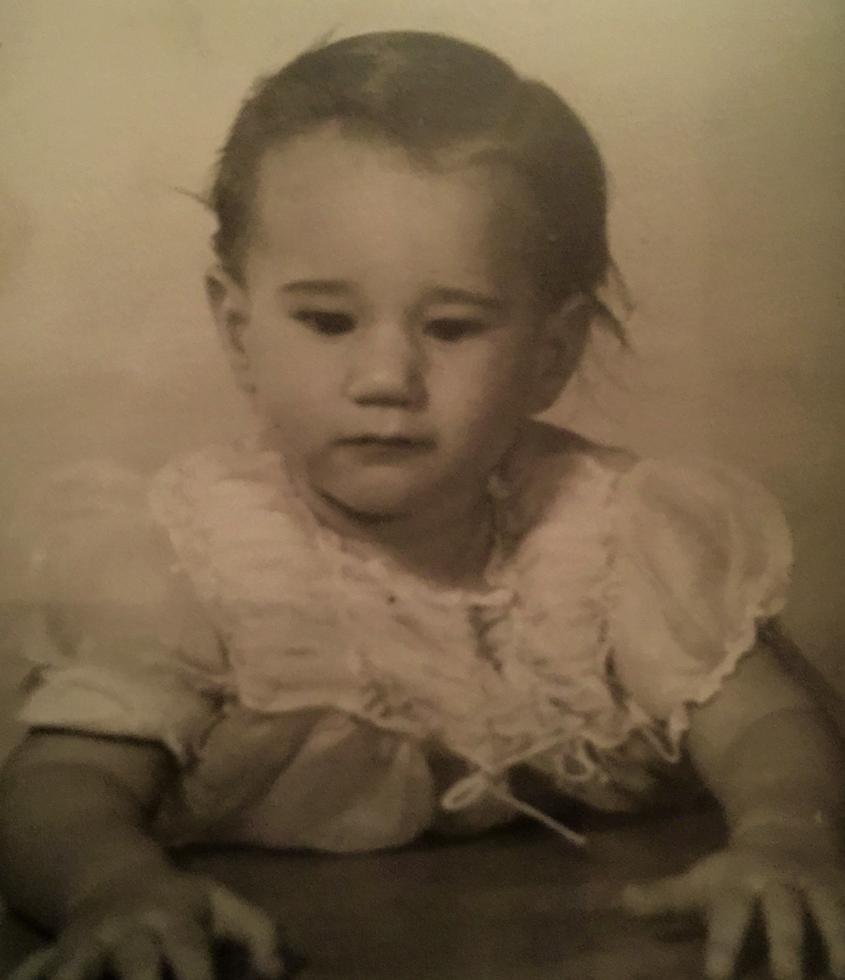
Who Am I?
Born and bred in Brooklyn
  Crown Heights
  Sheepshead Bay
Parents
  Millie and Artie Pepper
Sister
  Marcia
Blonde until I was 5
Brown Eyes

Slide 4

Career Path
Why Nursing?
  Graphic design was a hard way to make a living
  “Jewish girls become teachers, not nurses”
Education
  SBHS
    Guidance Counselor: “Not College Material”
  SCCC
    Drank my way through
  Downstate
    “I’ll flunk out all the P’s to get you”

Slide 5
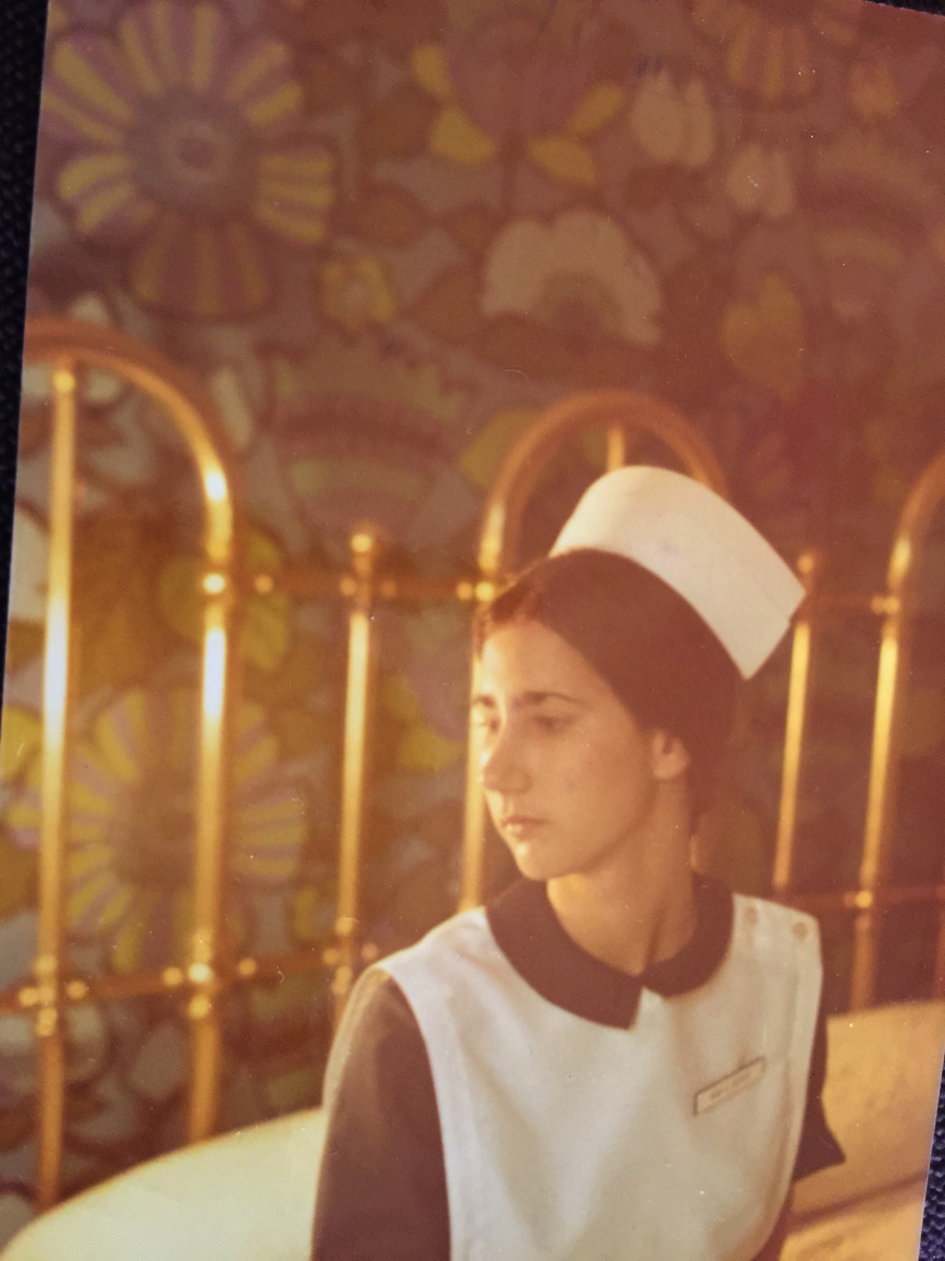
Work History
Wanted to be a Midwife
  One year Med Surg first
7/73 MSKCC: Chemo unit
  1st Baccalaureate graduate hired
  Taught me how to be a nurse
    Went home crying 1st few months
    Persistence
    Compassion
    Death with dignity
Needed a paradigm shift
  NYU MA Nursing Education
  Critical Care

Slide 6
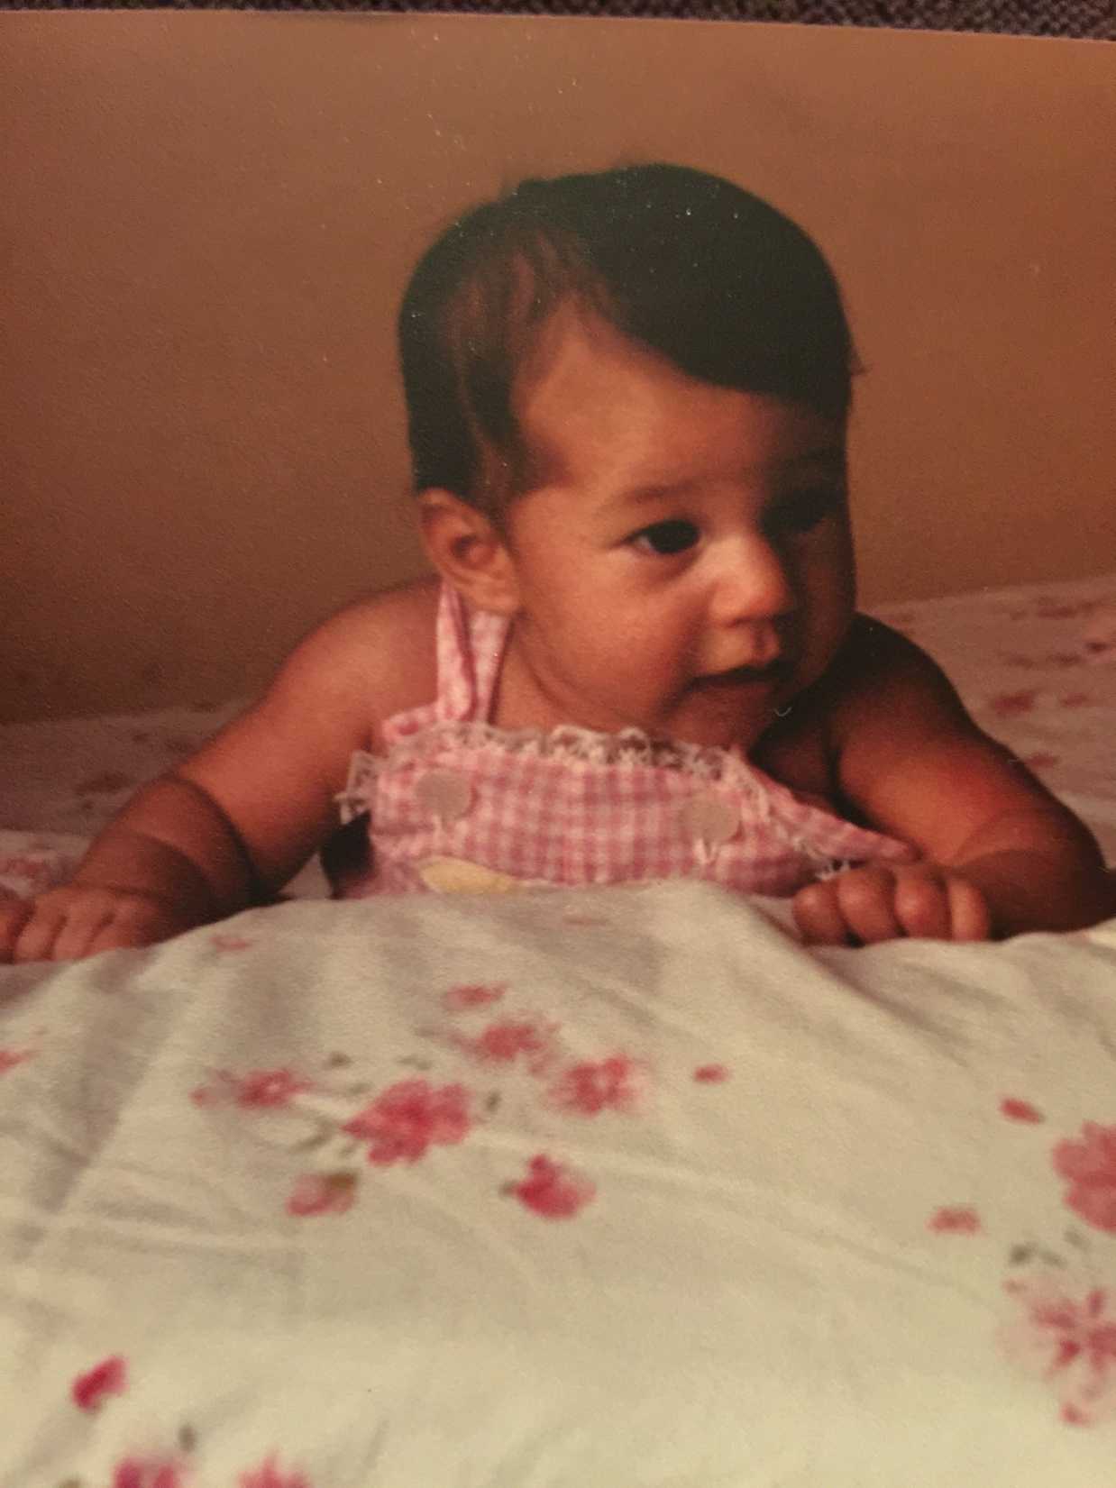
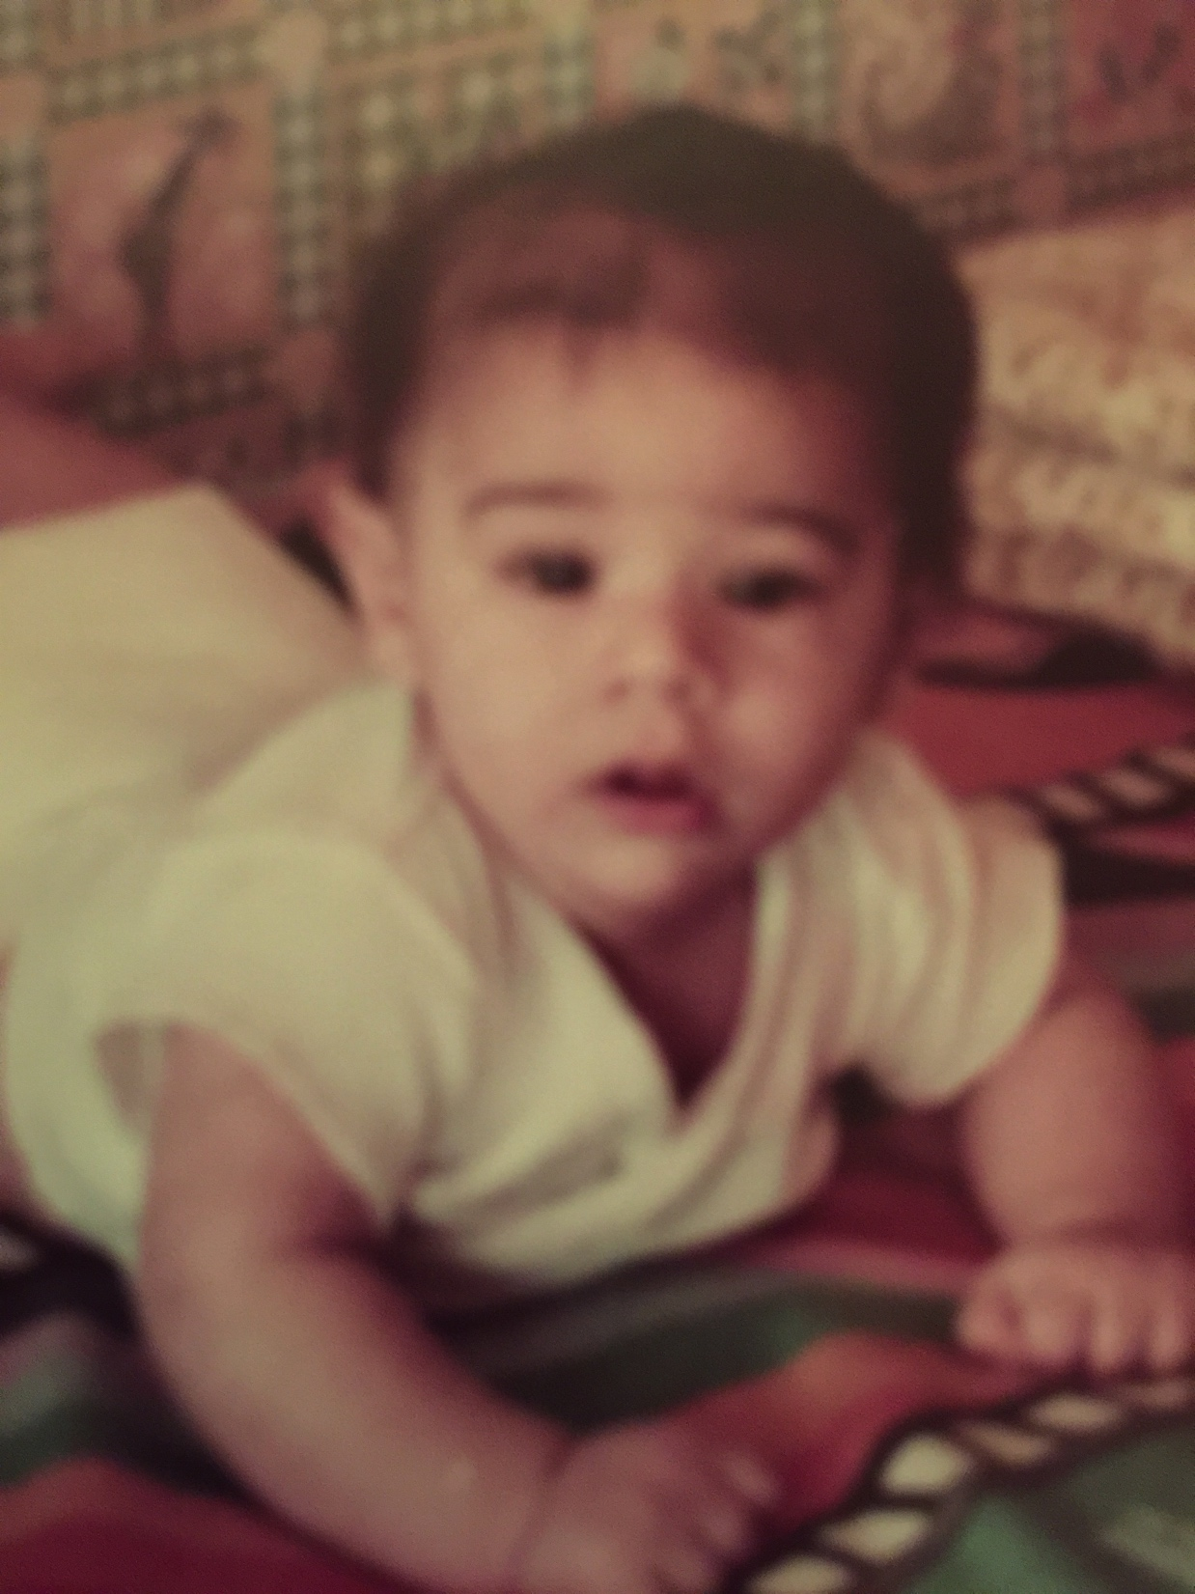
Coney: 41 Year Synopsis
Positions
  11/74: Staff Nurse CCU
  7/78: Clinical Supervisor Med-Surg (age 26)
  5/80 Elizabeth
  9/80 MMC Critical Care
  6/83 Joshua
  9/83 CIH Critical Care Float
  5/86 Nursing Education Instructor
  10/90 Director Nursing Education
    Making Coney better than its reputation
  7/98 Director Infection Control and HIV Services
    Providing safe patient care
  4/15 Retired

Slide 7

Stepping Back to July 1998
IC Director with No IC Experience
Enter APIC Chapter 13
Support and Mentorship
  Audrey Adams
  George Allen
  Providence Budet
  Jean Goias
  Pat Hinds
  Ike Luten
  MaryAnn Magurl
  Sarah Petrello

Slide 8
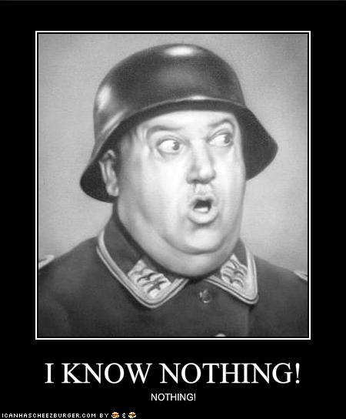
My 1st Week as an IC Director
Friday Afternoon 3 PM
  Call from ER
  Patient died
    Suspected Meningococcal Meningitis
      I think I've heard of that
  Oh BTW
    Brought directly by taxi from JFK airport
  ME Case
  Enter Marcy Layton in my life

Slide 9

The Mentored Become Mentors
Everyone starts at the beginning
Make a conscious decision
  Eat our young
  Take the high road
  How do you want to be treated?
  Share your policies and best practices
Remember where you came from
  No matter your title or position
  It strengthens you as a person
  It strengthens our profession
Pay it forward

Slide 10
Retirement Schedule
Wake up at 8 AM
Morning news 8 - 9 AM
Maury Show 9 – 11 AM
Family Feud 11 – 12 PM
Judge Faith 12 –1PM
The People’s Court 1-2 PM
Divorce Court 2 – 3 PM
Dr. Phil 3 – 4 PM
Judge Judy 4 – 5 PM
News 5 – 7 PM
Jeopardy 7 PM
Wheel of Fortune 7:30 PM
Reality TV 8PM
Hallmark Movie 9 PM
Bedtime 11 PM

Slide 11
Future Plans
Spend time with my family
  I am no longer married to my job
Nurture my hobbies
  Genealogy
  Photography
Travel
Consult
  TJC perhaps?
Snowbird
  Never want to shovel snow again!
Play golf
Remain an active APIC member

Slide 12
Life After Retirement
Words of Wisdom
  There is life after retirement
  It is stress free!
  I can sleep through the night
  They will survive without you
  You will thrive without them
  Don’t be afraid of change
  When you reach that fork in the road, take it

Slide 13

I have a lifetime of cherished personal and professional memories
I thank you all for being part of them

Slide 14
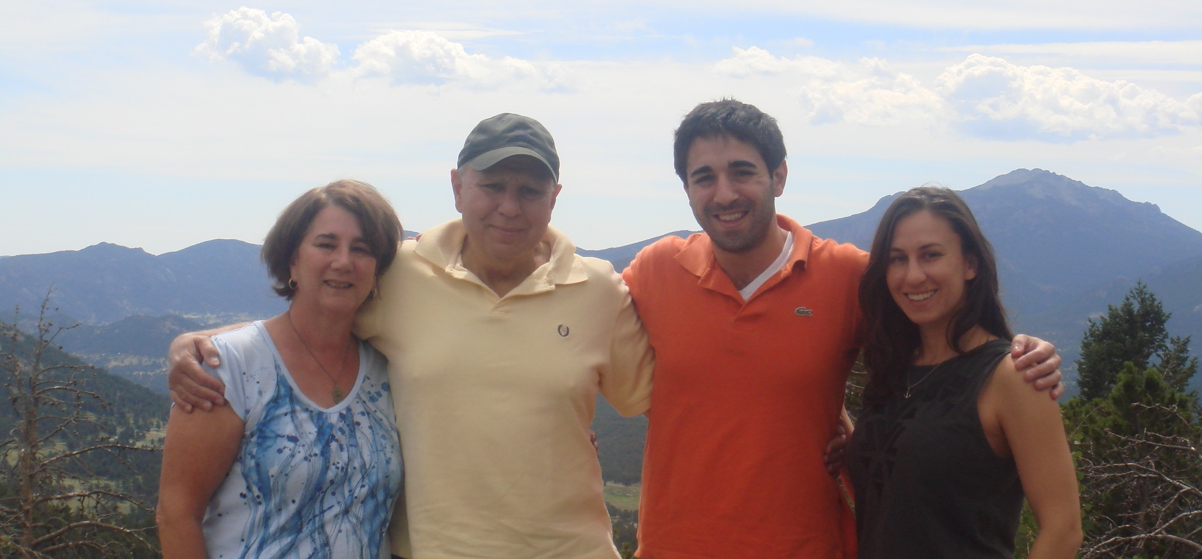
My New Focus

