Slide 1
APIC Chapter 13
Journal Club
January 16, 2019
Presented by: Talia Lefkowitz, RN, BSN, CIC
Mount Sinai Hospital

Slide 2
How Clean is the Linen at My Hospital?
The Mucorales on Unclean Linen Discovery Study of Large United States Transplant and Cancer Centers
Clinical Infectious Diseases, 2018; XX(XX):1-4
Brief report, published online October 9, 2018
Alexander J. Sundermann, Cornelius J. Clancy, A. William Pasculle, Guojun Liu, Richard B. Cumbie, Eileen Driscoll, Ashley Ayres, Lisa Donahue, Steven A. Pergam, Lilian Abbo, David R. Andes, Prantharthi Chandrasekar, Alison L. Galdys, Kimberly E. Hanson, Kieren A. Marr, Jeanmarie Mayer, Seema Mehta, Michele I. Morris, John Perfect, Sanjay G. Revankar, Becky Smith, Sankar Swaminathan, George R. Thompson III, Merin Varghese, Jose Vazquez, Estella Whimbey, John R. Wingard, and M. Hong Nguyen

Slide 3
Background
What is Mucorales?
Largest and most studied order of the zygomycete fungi
Can cause a life-threatening infection called mucormycosis
  Mortality rates exceed 50%
  Risk factors include solid organ or stem cell transplantation, neutropenia, diabetic ketoacidosis, iron overload, burns, and trauma (immunosuppressed population)
  Costly
    Almost double the cost of aspergillosis!

Slide 4
Background
Mucormycosis and the healthcare setting
Outbreaks of healthcare-associated mucormycosis can be difficult to recognize
Three outbreaks recently linked to contaminated healthcare linens (HCLs) or laundry carts

Slide 5
Background
Regulation of healthcare linens
No government regulations regarding microbiologic testing of HCLs
Required by certain third-party certification programs for healthcare laundries
  Example: Textile Rental Services Association (TRSA)
    Voluntary program that certifies US laundry
    “Hygienically clean” = “free of pathogens in sufficient numbers to cause human illness”
      No validated definition for “sufficient numbers” ( <=50 cfu per square decimeter)
      No agreement on which pathogens pose the greatest risk

Slide 6
Background
Study objective
To determine the extent to which freshly-laundered HCLs delivered to US transplant and cancer centers are contaminated with Mucorales

Slide 7
Methods
Dedicated team met the HCL delivery trucks on arrival and immediately performed cultures
  RODAC agar plates
Linens were considered “hygienically clean” = no growth of Mucorales on >90% of items tested from the laundry

Slide 8
Results
Microbiologic surveillance study
May 25 2017- December 29, 2017
15 transplant and cancer hospitals
Visual inspection
Microbiologic testing results

Slide 9
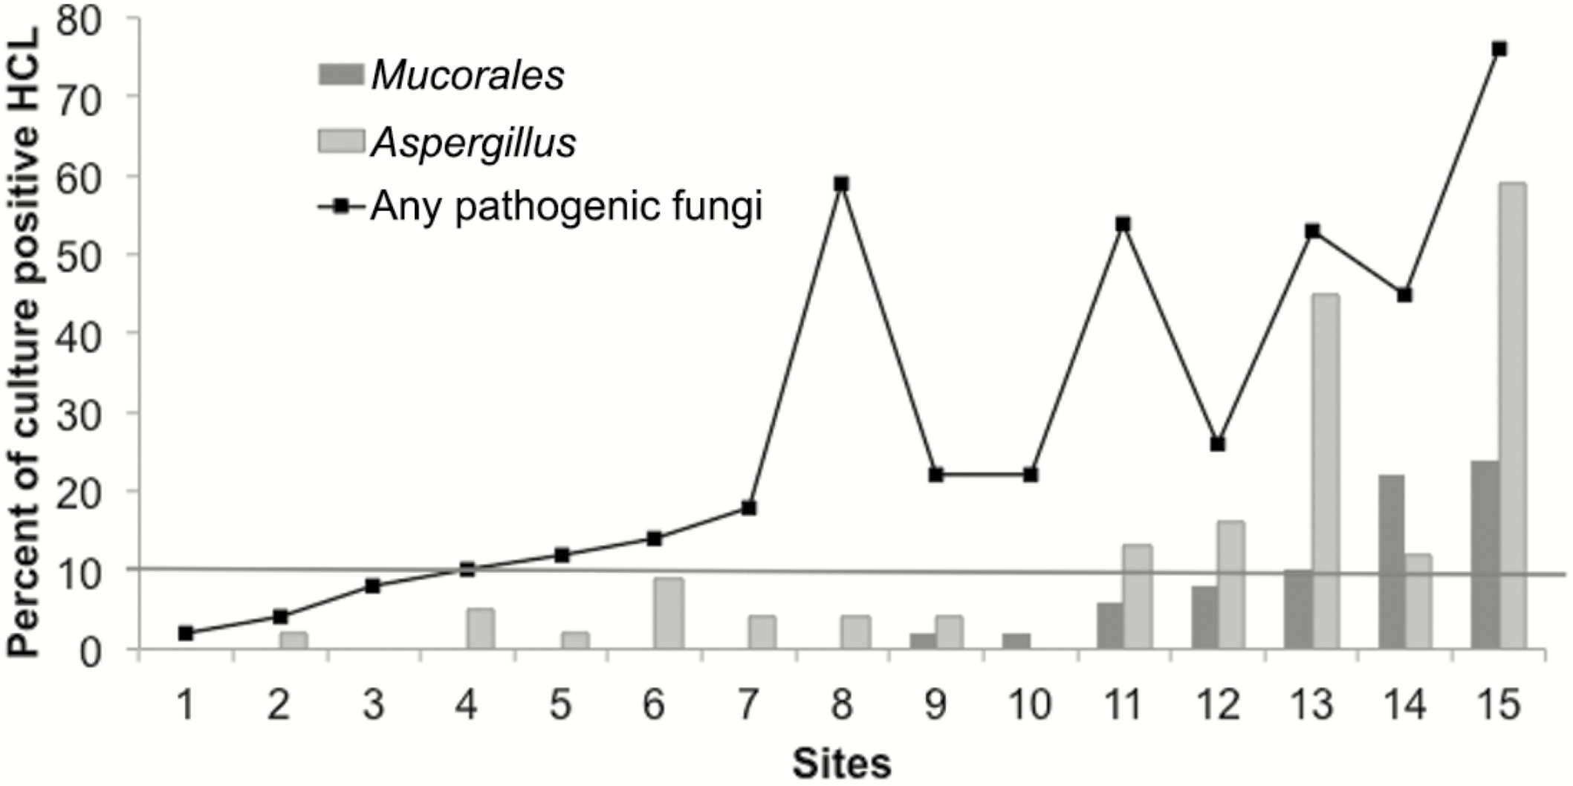
From: How Clean Is the Linen at My Hospital? The Mucorales on Unclean Linen Discovery Study of Large United States Transplant and Cancer Centers
Clin Infect Dis. Published online October 09, 2018. doi:10.1093/cid/ciy669
Clin Infect Dis | Published by Oxford University Press for the Infectious Diseases Society of America 2018.This work is written by (a) US Government employee(s) and is in the public domain in the US.
Notes:
Figure 1. Percentages of healthcare linens (HCLs) that were culture positive for Mucorales, Aspergillus, and other pathogenic molds. Culture results by hospital. Percentages of HCLs that were culture positive for Mucorales, Aspergillus, and any pathogenic mold (defined as Mucorales, Aspergillus spp., Fusarium, and dematiaceous molds) are shown (y-axis). Centers are ordered on the x-axis by the ascending percentage of HCL contaminated with Mucorales. The threshold for defining hygienically-clean HCL was 10%, which was exceeded for Mucorales at 15% (3/20) of hospitals (indicated by the horizontal line). Mucorales were recovered from HCL at 47% (7/15) of hospitals and from 5% (37/745) of all HCLs. Mucorales included Rhizopus spp. (R. stolonifer, R. oryzae, and R. microsporus) and Syncephalastrum. In addition to Mucorales, pathogenic molds included Aspergillus (12%, 87/745), dematiaceous molds (11%, 82/745), and Fusarium (3%, 22/745). There were 26% (192/745) of HCLs that grew other molds of low pathogenic potential, including sterile mycelium (7%, 55/745) and Penicillium (3%, 23/745). Abbreviation: HCL, healthcare linen.
9

Slide 10
Results
Microbiologic testing results
  HCLs were contaminated with Mucorales upon arrival at 47% of hospitals (7/15)
  HCLs were not hygienically clean for Mucorales at 20% of hospitals (3/15)
  At each hospital center, 0-24% of HCLs were culture-positive for Mucorales

Slide 11
Results
Significant association
Visibly-soiled HCLs or carts and higher maximum temperature and relative humidity in the vicinity → HCLs contaminated with Mucorales

Slide 12
Results
Longitudinal microbiologic testing
  To evaluate the variability of Mucorales contamination of HCLs at 1 hospital
    June 2016 through January 2017
    HCLs did not meet the hygienically-clean standard on 75% of the sampling dates
  Data was shared with the laundry facility

Slide 13
Results
Longitudinal microbiologic testing (continued)
  Laundry facility → remediation
    February through May 2017
    Implemented:
      Cleaning of HCL carts
      Lint control measures
  Post-remediation
    June 2017 – January 2017
    On 83% of sampling dates, no Mucorales was detected
    On 15% of sampling dates, only 2% of samples tested positive for Mucorales

Slide 14
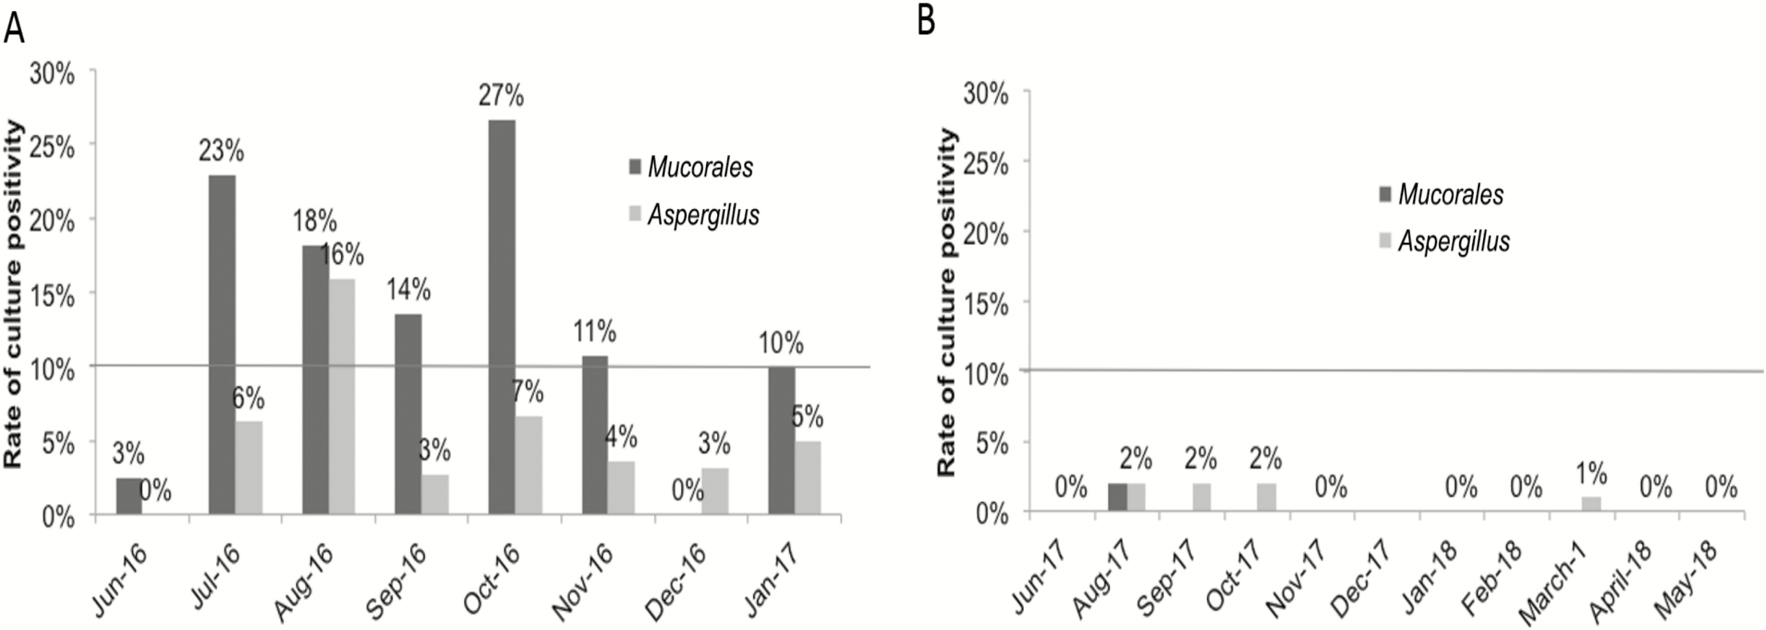
From: How Clean Is the Linen at My Hospital? The Mucorales on Unclean Linen Discovery Study of Large United States Transplant and Cancer Centers
Clin Infect Dis. Published online October 09, 2018. doi:10.1093/cid/ciy669
Clin Infect Dis | Published by Oxford University Press for the Infectious Diseases Society of America 2018.This work is written by (a) US Government employee(s) and is in the public domain in the US.
Notes:
Figure 2. Percentages of healthcare linens (HCLs) that were culture positive for Mucorales, Aspergillus, and other pathogenic molds during a longitudinal study at 1 hospital. Monthly testing was performed over 2 time periods: A, June 2016–January 2017 and B, June 2017–January 2018. No sampling was performed in July or December 2017. Culture data from the first time period were shared with the off-site laundry, which performed environmental remediation between February and May 2017. The hospital was also included in the multicenter study (represented as Center 3 in Figure 1), using data from June 2017. The horizontal line represents the 10% culture positivity cut-off to define HCL as hygienically clean.
14

Slide 15
Discussion
First study to measure Mucorales contamination in freshly-laundered HCLs
Be aware that HCLs can be contaminated
Findings are concerning given that healthcare-associated mucormycosis outbreaks have been linked to HCLs

Slide 16
Discussion
Recommendations
  Periodic visual inspection (linens and carts)
  Consider microbiologic surveillance and remediation
  Collaborate to develop reasonable standards
  Consider protocols to limit exposure

Slide 17
Discussion
Rationale to support microbiologic surveillance culturing:
  Direct inoculation or aerosolization of Mucorales spores from contaminated linens can result in mucormycosis
  Trend towards third-party certification of healthcare laundries requiring microibiologic testing of linens by independent lab
  Longitudinal study suggests that microbiologic surveillance and environmental remediation may diminish Mucorales contamination

Slide 18
Discussion
Limitations
  Does not assess linen contamination within the hospital
  Descriptive study; no epidemiological or clinical data
  Did not culture for bacteria
  The significance of the linens contaminated with Aspergillus or “not hygienically clean for Aspergillus” is unclear
    Transmission of Aspergillus or other molds from HCLs is not documented

Slide 19
Discussion
Conclusion
Freshly-laundered HCLs delivered to US transplant and cancer centers were contaminated with Mucorales and other pathogenic molds
Follow-up studies are needed to understand significance of findings and determine whether surveillance and remediation are needed
Priorities include developing:
  Practical and efficient testing methods
  Criteria for interpreting culture results
  Reasonable performance standards at laundries and in hospitals
We can’t eliminate the risk of infection due to opportunistic environmental pathogens in our highly-immunosuppressed populations, but we can work collaboratively to establish rational approaches to mitigate risk and optimize patient safety

Slide 20
