Slide 1
APIC GNY Journal Club
April 19, 2017

Slide 2
Duodenoscope hang time does not correlate with risk of bacterial contamination
AJIC , April 1, 2017, Vol 45, Issue 4, pages 360-364
http://www.ajicjournal.org/article/S0196-6553(16)31084-7/fulltext

Slide 3
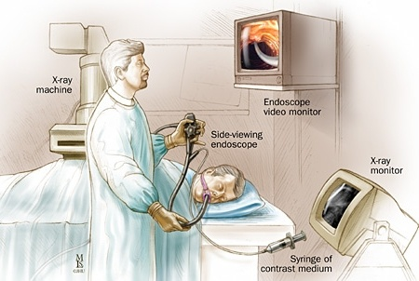
Endoscopic Retrograde Cholangiopancreatography
ERCP
Duodenoscope

Slide 4
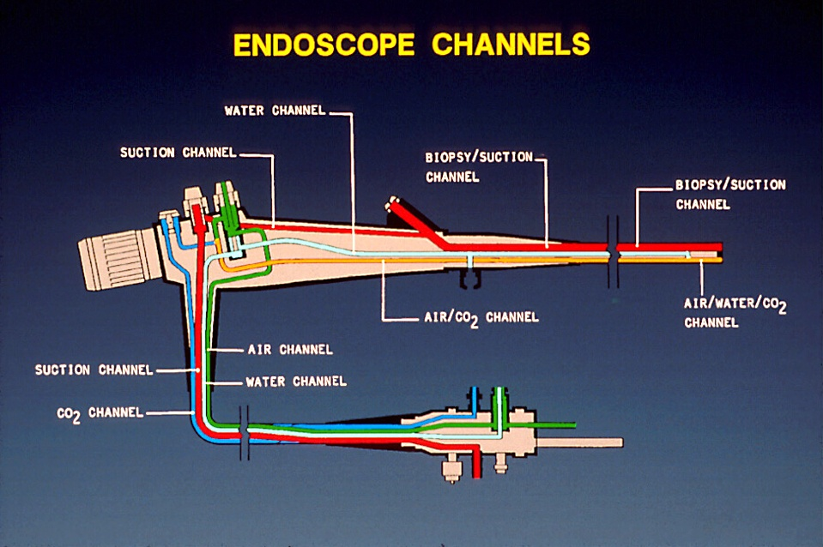
BACKGROUND
FEATURES OF ENDOSCOPES THAT PREDISPOSE TO DISINFECTION FAILURES
Require low temperature disinfection
Long narrow lumens
Right angle turns
Blind lumens
May be heavily contaminated with pathogens, 10⁹
Cleaning (4-6 log₁₀ reduction) and HLD (4-6 log₁₀ reduction) essential for patient safe instrument

Slide 5
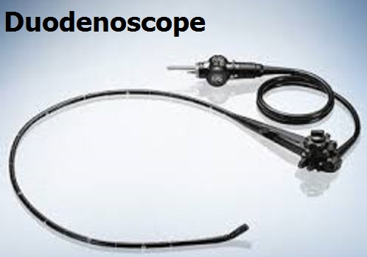
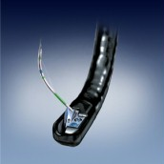
Working Length 4 feet
Diameter .5 inch
Channel .16 inch
Angulation Left to Right
Right to Left

Slide 6
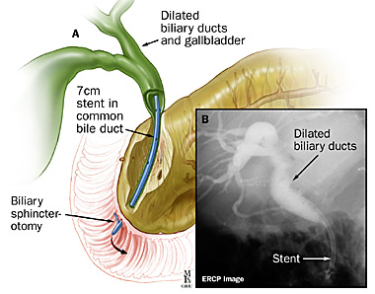
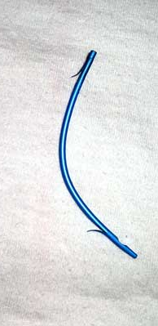
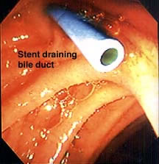
Duodenoscopes and Instruments Access Difficult Anatomic Areas Often at a 90º Angle

Slide 7
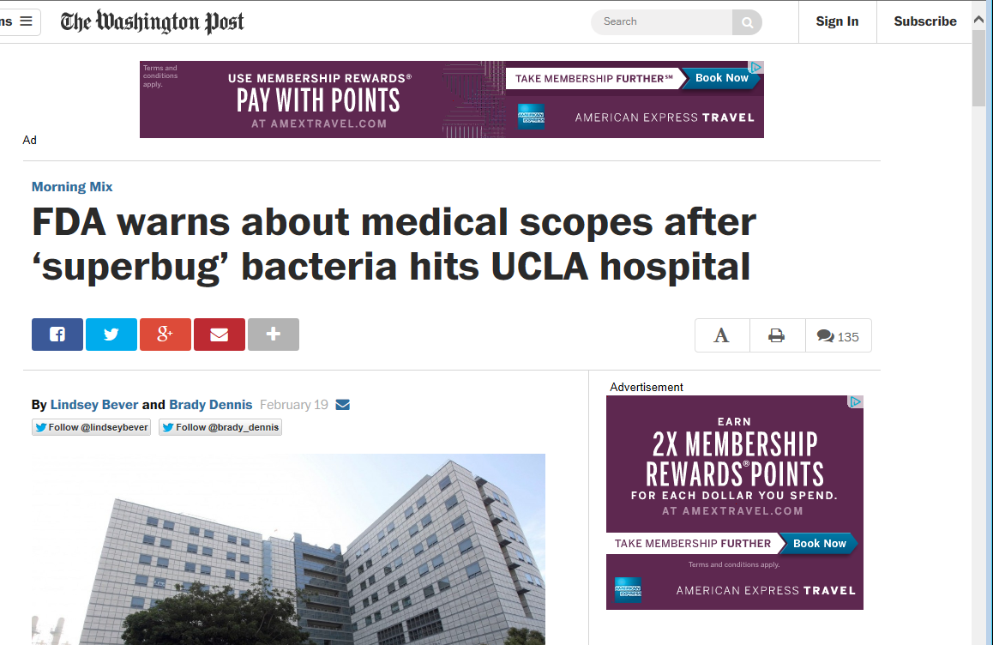
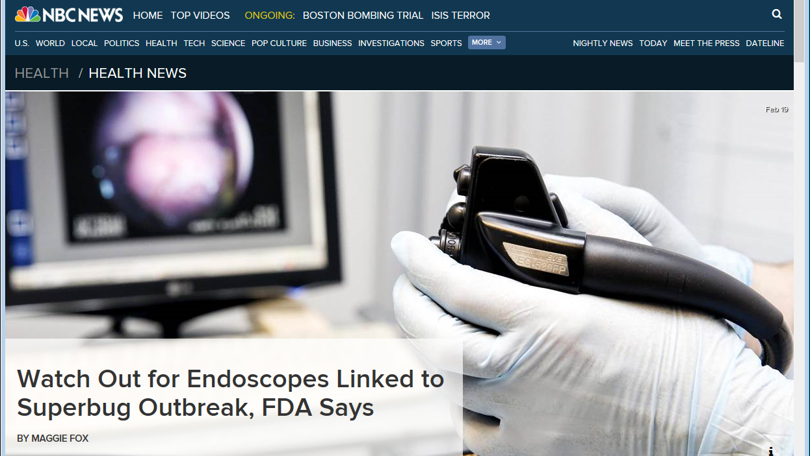

Slide 8
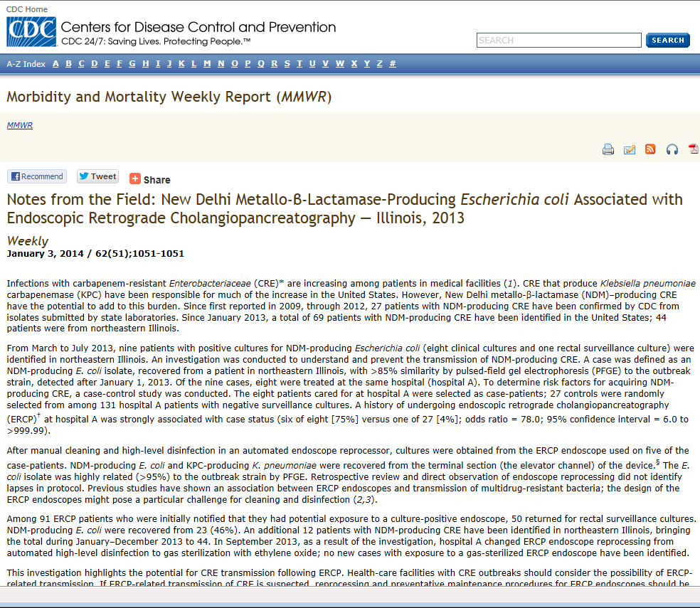
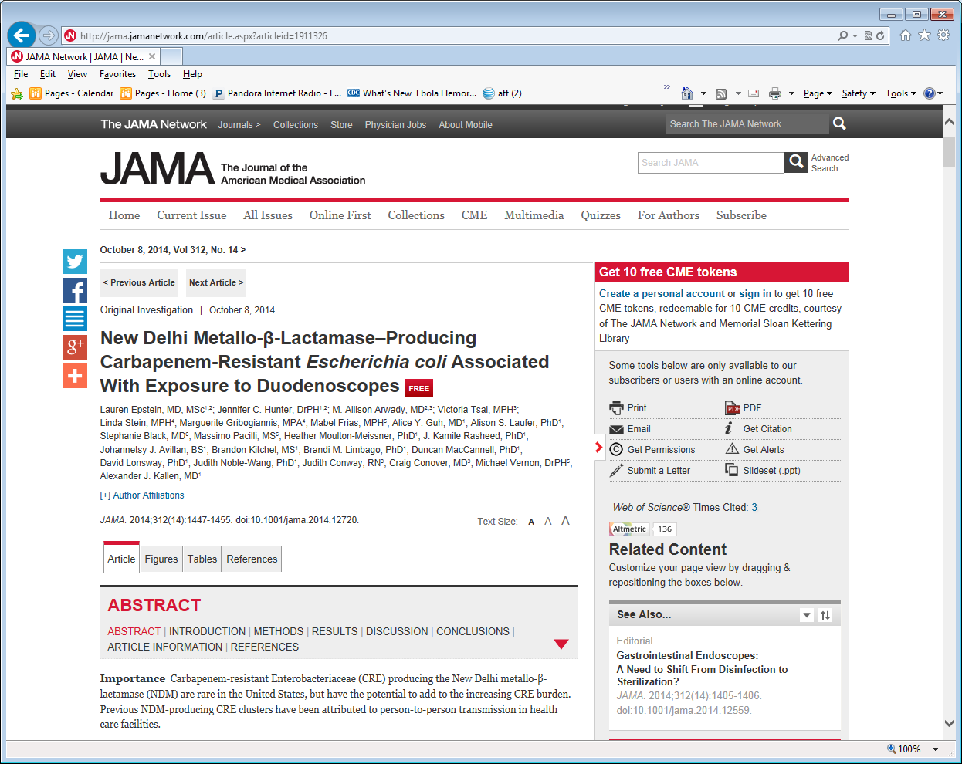

Slide 9
Recommendations
CDC, FDA, NYS DOH, Professional Organizations, Vendors
Strictly adhere to all of manufacturer’s guidelines.
Evaluate current processes:
  Cleaning
  Drying
  Disinfection
Ensure staff are aware of patient risks posed by
inadequately processed scopes.
Ensure optimal training of staff.
Assess staff competencies periodically.
Assess feasibility of testing adequacy of cleaning.

Slide 10
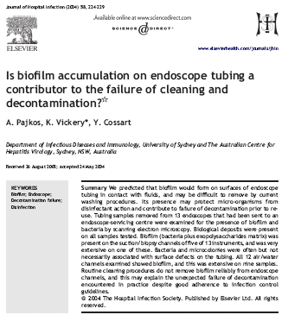
BIOFILMS
Pajkos, Vickery, Cossart. J Hosp Infect 2004;58:224

Slide 11
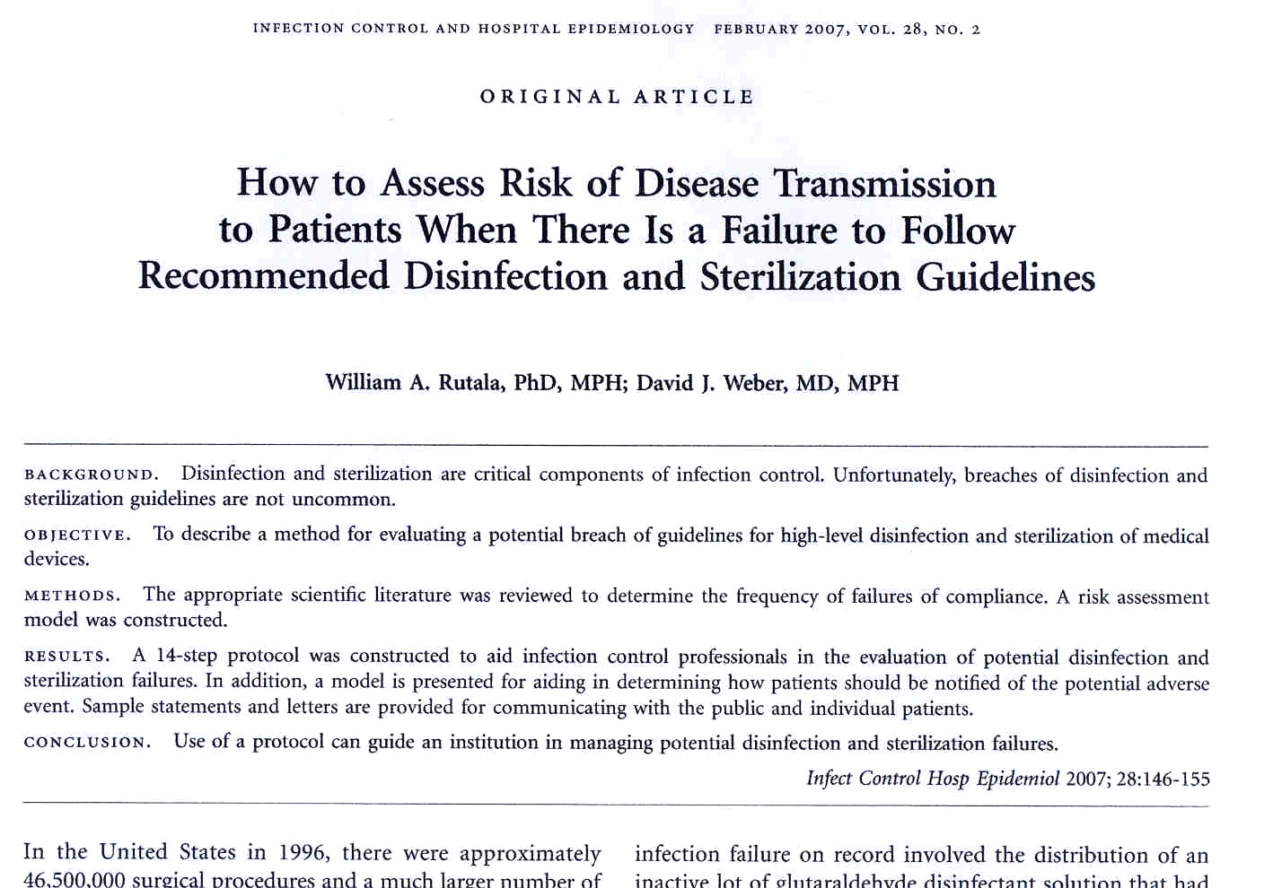

Slide 12
Endoscope Reprocessing:
Current Status of Cleaning and Disinfection
Guidelines
  Multi-Society Guideline, 12 professional organizations, 2011
  Centers for Disease Control and Prevention, 2008
  Society of Gastroenterology Nurses and Associates, 2010
  AAMI Technical Information Report, Endoscope Reprocessing, In preparation
  Food and Drug Administration, 2009
  Endoscope Reprocessing, Health Canada, 2010
  Association for Professional in Infection Control and Epidemiology, 2000

Slide 13
ENDOSCOPE REPROCESSING
Multi-Society Guideline on Endoscope Reprocessing, 2011
PRECLEAN-point-of-use (bedside) remove debris by wiping exterior and aspiration of detergent through air/water and biopsy channels; leak test
CLEAN-mechanically cleaned with water and enzymatic cleaner
HLD/STERILIZE-immerse scope and perfuse HLD/sterilant through all channels for exposure time (>2% glut at 20m at 20ºC). If AER used, review model-specific reprocessing protocols from both the endoscope and AER manufacturer
RINSE-scope and channels rinsed with sterile water, filtered water, or tap water. Flush channels with alcohol and dry
DRY-use forced air to dry insertion tube and channels
STORE-hang in vertical position to facilitate drying; stored in a manner to protect from contamination

Slide 14
AJIC
Duodenoscope hang time does not correlate with risk of bacterial contamination

Slide 15
Highlights
Current guidelines recommend a maximum hang time for duodenoscopes of 5-14 days.
•Among 465 cultures, 34 followed a hang time ≥7 days; 431 occurred within 7 days.
•The maximum hang time was 40 days; 12 cultures revealed significant contamination.
•Prolonged hang time was not associated with a higher likelihood of contamination

Slide 16
Background
The group sought to study the association between hang time and risk of duodenoscope contamination.

Slide 17
Methods
We analyzed cultures of the elevator mechanism and working channel collected in a highly standardized fashion just before duodenoscope use.
Hang time was calculated as the time from reprocessing to duodenoscope sampling.
The relationship between hang time and duodenoscope contamination was estimated using a calculated correlation coefficient between hang time in days and degree of contamination on the elevator mechanism and working channel.

Slide 18
Results
The 18 study duodenoscopes were cultured 531 times, including 465 (87.6%) in the analysis dataset.
Hang time ranged from 0.07-39.93 days, including 34 (7.3%) with hang time ≥7.00 days.
Twelve cultures (2.6%) demonstrated elevator mechanism and/or working channel contamination.
The correlation coefficients for hang time and degree of duodenoscope contamination were very small and not statistically significant (−0.0090 [P = .85] for elevator mechanism and −0.0002 [P = 1.00] for working channel).
Odds ratios for hang time (dichotomized at ≥7.00 days) and elevator mechanism and/or working channel contamination were not significant.

Slide 19
Reviewer's Thoughts/Comments
Were there any consistent trends on the scopes that were contaminated?
Same technician that cleaned scope
Same individual that sampled scope
Could contaminated results be a result of needing re-education of individual?
Should they have cultured the scope channels after reprocessing?

Slide 20
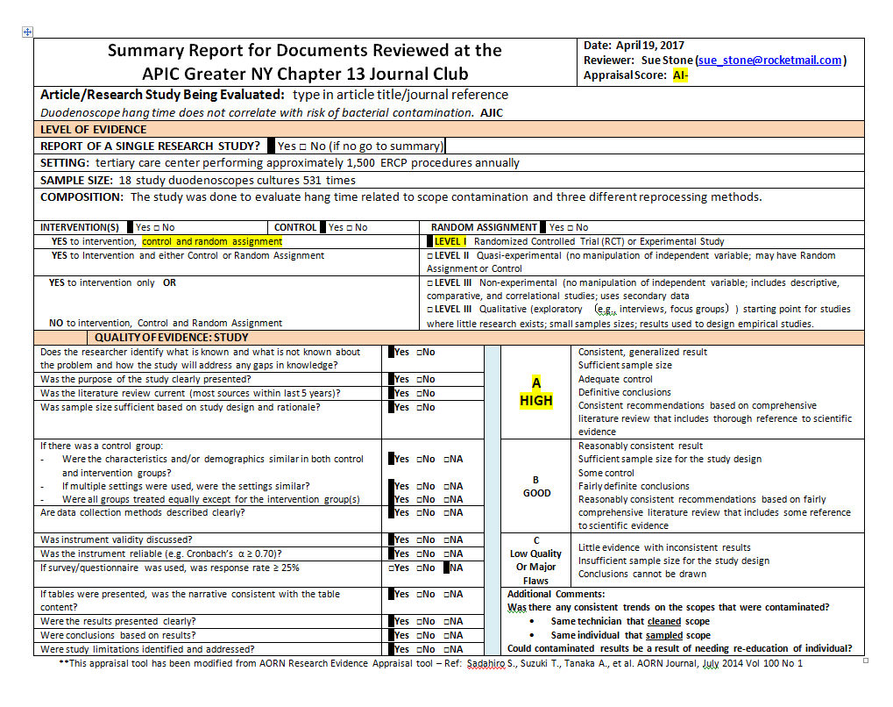

Slide 21
Hidden slides

Slide 22
IS THERE A STANDARD TO DEFINE WHEN A DEVICE IS CLEAN?
There is currently no standard to define when a device is “clean”, cleanliness controlled by visual
Potential methods: level of detectable bacteria; protein (6µg/cm²); endotoxin; ATP; lipid
This is due in part to the fact that no universally accepted test soils to evaluate cleaning efficiency and no standard procedure for measuring cleaning efficiency

Slide 23
Reprocessing Flexible Endoscopes
Objectives
Risks associated with reprocessing flexible endoscopes
Causes of contamination and infection
  Complex device/complex reprocessing
Gaps in current reprocessing standards
Establish scientific rationale and evidence requirements for enhancing safe practices

Slide 24
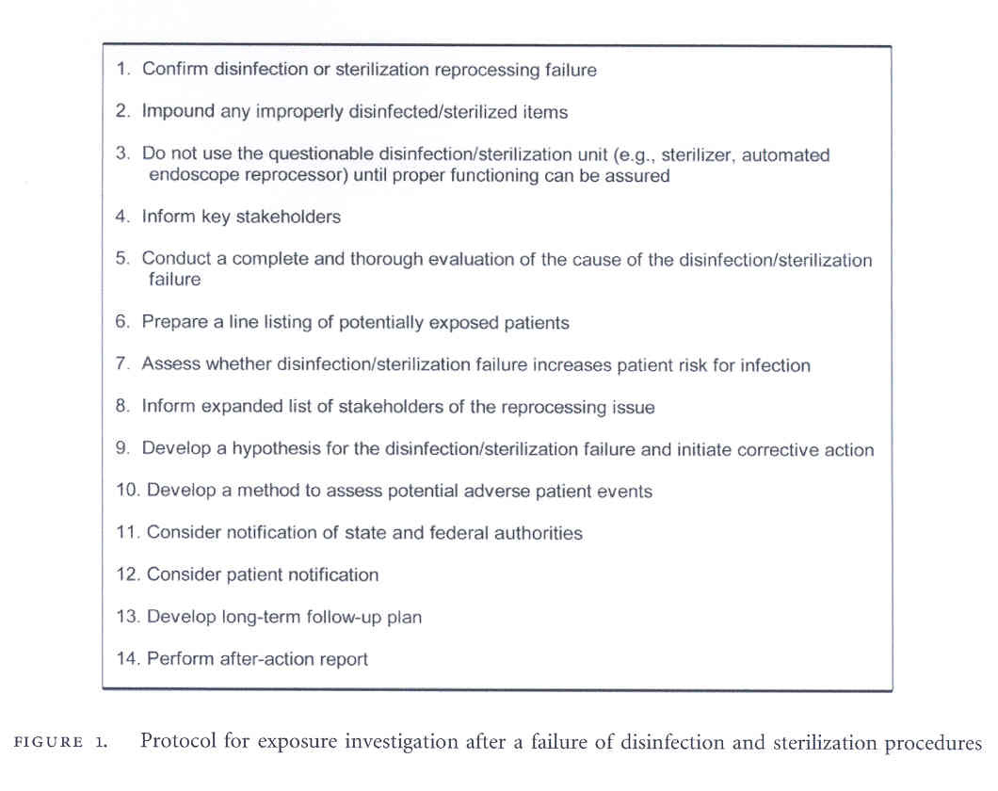

Slide 25
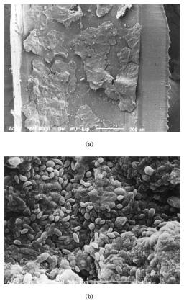
BIOFILMS
(Multi-Layered Bacteria Plus Exopolysaccharides That Cement Cell to Surface;
Develop in Wet Environments)
Notes:
Bacteria residing within biofilms are many times more resistant to chemical inactivation than bacteria is suspension
Does formation of biofilms within endoscopic channels contribute to failure of decontamination process? Not known
Could be a reason for failure of adequate HLD processes but if reprocessing performed promptly after use and endoscope dry the opportunity for biofilm formation is minimal

Slide 26
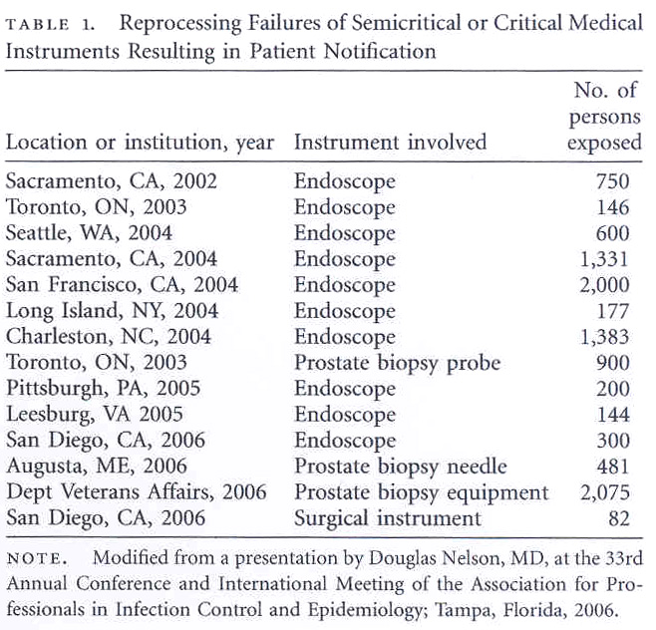

Slide 27
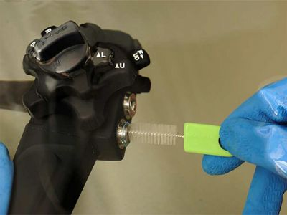
Monitoring Endoscope Cleaning

Slide 28
ENDOSCOPES
Widely used diagnostic and therapeutic procedure (11-22 million GI procedures annually in the US)
GI endoscope contamination during use (10⁹ in/10⁵ out)
Semicritical items require high-level disinfection minimally
Inappropriate cleaning and disinfection has lead to cross-transmission
In the inanimate environment, although the incidence remains very low, endoscopes represent a significant risk of disease transmission

