Slide 1
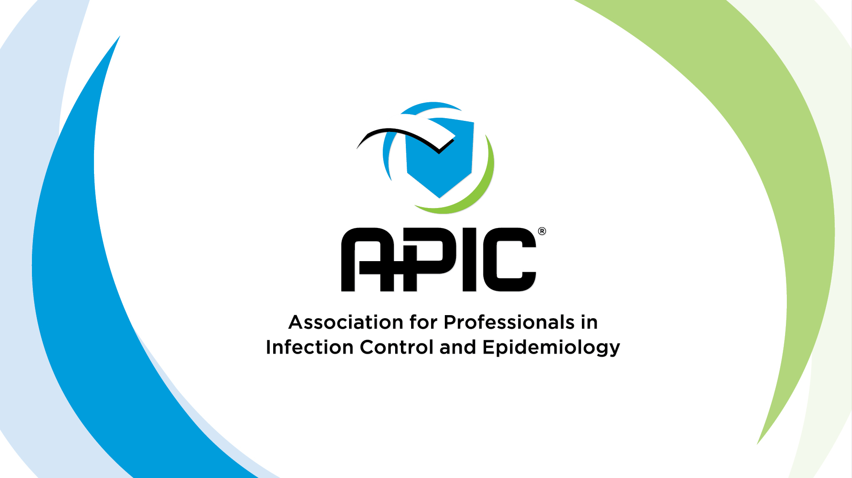
Journal Club Presentation
Kyle Willey

Slide 2
Perceived Impact of State-Mandated Reporting on Infection Prevention and Control Departments
Monika Pogorzelska-Maziarz, PhD, MPH; Pamela B. de Cordova, PhD, RN-BC; Carolyn T.A. Herzig, PhD, MS; Andrew Dick, PhD; Julie Reagan, JD, PhD, MPH; Patricia W. Stone, PhD, RN
American Journal of Infection Control, February 2019
  Volume 47, Issue 2, Pages 118–122

Slide 3
Background
Currently, most US states have adopted legislation requiring hospitals to submit health care–associated infection (HAI) data.
This study evaluated the perceived impact of state HAI laws on infection prevention and control (IPC) departments.

Slide 4
Methods
Secondary use of P-NICER Study data
  Fall 2011
Variations in resources and characteristics in states with and without laws were compared by use of χ², Mann-Whitney (Wilcoxon), and Student t tests.

Slide 5
Methods
Multinomial logistic regression was used to identify increases or decreases, versus no change, in perceived resources, time, influence, and visibility of the IPC department in states with and without HAI laws.

Slide 6
Results
1,036 IPC departments provided complete data (30% response rate)
755 (73%) were located in states with mandated reporting laws

Slide 7
Results
Hospitals in states with laws were more likely to be:
  located in the Northeast (in either urban or suburban settings)
  to employ a full- or part-time physician hospital epidemiologist
  to have a greater number of admissions and patient-days in 2011

Slide 8
Results
Not associated with being in a state with laws:
  Bed size
  IP certification
  participation in HAI reduction initiatives
  being part of a larger system that shares infection prevention resources
  hospital type, ownership status, and medical school affiliation

Slide 9
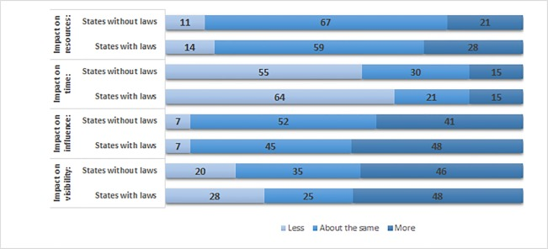
Results (Perception)

Slide 10
Results (Perception)
IP’s in states with reporting laws were:
  More likely to report having more resources for the IP department
  Less time for routine IP activities
  Less visibility of the department within the hospital

Slide 11
Results (Perception)
IP’s in states with reporting laws were:
  More likely to report spending more time on reporting requirements
    Adjusted results were not significantly significant

Slide 12
Discussion
IP roles changing due to demand for quality care and transparency of outcomes
IPs spend half of their time in their offices and on surveillance activities
Reporting mandates and surveillance activities impacts the traditional role of the IP

Slide 13
Discussion
Mandated reporting has:
  Positive impact on IP outcomes (CAUTI, CLABSI, SSI, etc.), IP resources, IP influence
  Negative impact on visibility of IP, time off floors
Overall: Shift in IP role from watchdog to Performance Improvement consultant

Slide 14


