Slide 1
The Role of the Antimicrobial Stewardship In the Acute Care Inpatient Setting
Kimberly Sarosky, MS, PharmD, BCPS
Clinical Pharmacy Specialist
Infectious Diseases & Critical Care
Mount Sinai St. Luke’s

Slide 2

Disclosures
Nothing to Disclose

Slide 3
Objectives
Introduce the Future of Antibiotics in an Era of Resistance
Discuss the goals & purposes of hospital antimicrobial stewardship program (ASP)
[Maximize clinical outcomes, Minimize toxicity & adverse events, Reduce occurrence of Multidrug Resistant Organisms (MDROs), Control cost]
Review the Center for Disease Control and Prevention 7 Core Elements of Hospital ASP
  [Leadership Commitment, Accountability, Drug Expertise, Action, Tracking, Reporting, Education]

Slide 4
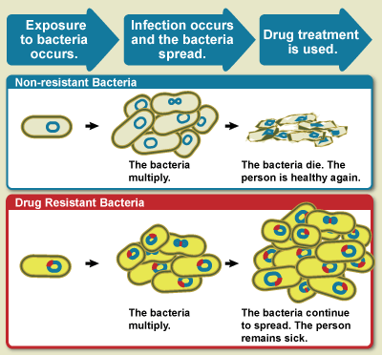
Antibiotic Resistance: An Unintended Consequence
Uncontrollable Factors
Bacterial mutations
Antibiotic use in food production
  Livestock feed more stringent regulations effective January 2017
  Results hopefully lessen produce contamination of soil & water
Controllable Factors
Antibiotic Overuse
  Overprescribing in outpatient & inpatient
  Resistance development
  Increased Antibiotic Associated Adverse Events
Poor Infection Control & Prevention Practices in Healthcare Organizations
  Minimize the spread of multidrug resistant organisms (MDROs)
U.S. National Institutes of Health, “Search for Studies,” http://www.clinicaltrials.gov.

Slide 5
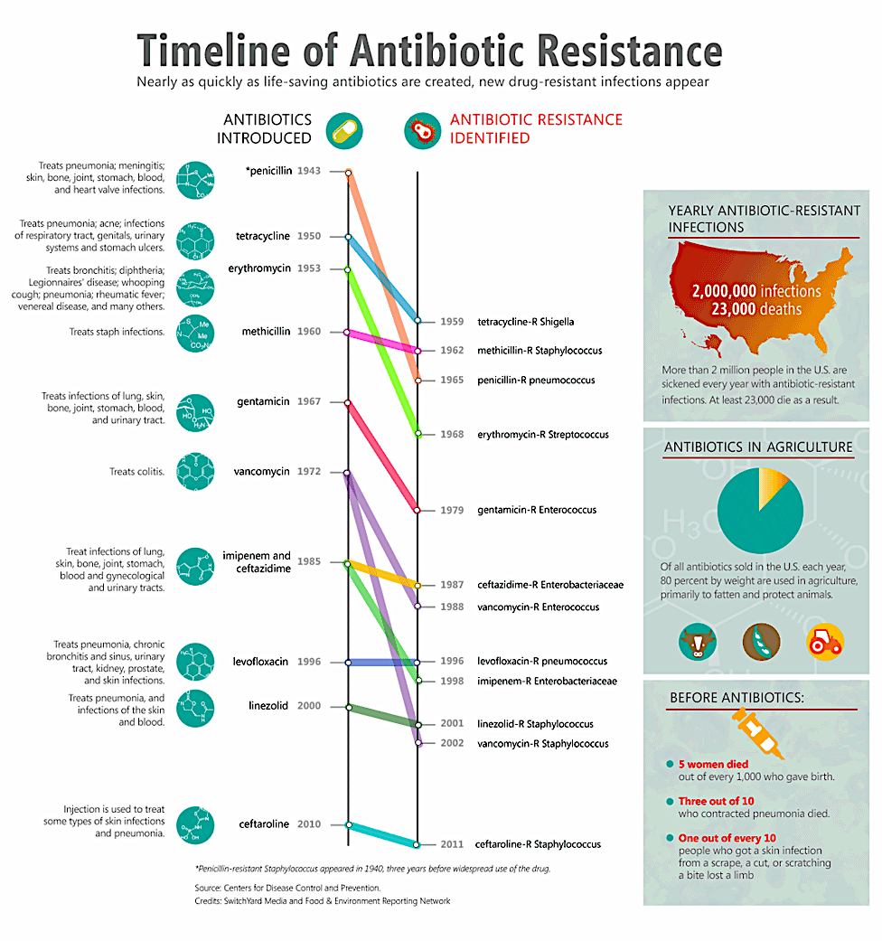
Timeline of Antibiotic Resistance

Slide 6
Current State: Nothing New in Antibiotic Classes
No new antibiotic classes developed in past 10⁺ years
New medications derived from existing classes
  Ceftolozane-tazobactam (Zerbaxa®), Ceftazidime-avibactam (Avycaz®)
  Telavancin (Vibativ®), Dalbavancin (Dalvance®), Oritavancin (Orbactiv®)
  Tedizolid (Sivextro®)
  Isavuconazonium sulfate (Cresemba®)
In the Pipeline (Phase 3) derived from existing classes
  Imipenem cilastatin-relebactam, Meropenem-vaborbactam (Carbavance®)
  Eravacycline
  Plazomicin
U.S. National Institutes of Health, “Search for Studies,” http://www.clinicaltrials.gov.

Slide 7
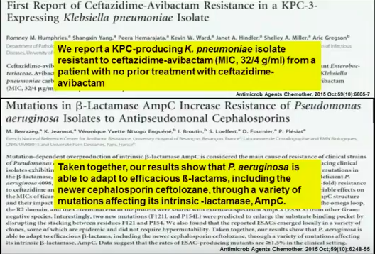
Documented Resistance to Newly Marketed Agents

Slide 8
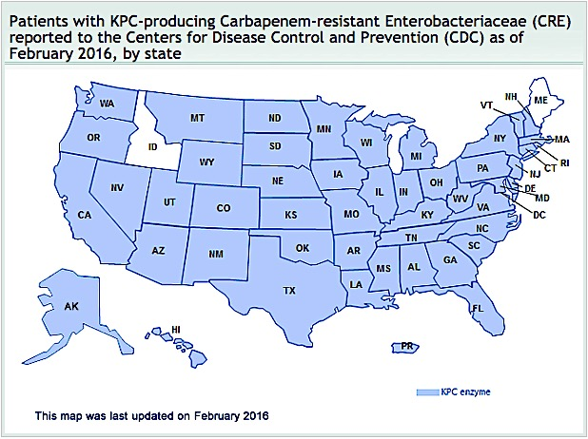
Carbapenem-Resistant Enterobacteriaceae (CRE)
https://www.cdc.gov/hai/organisms/cre/TrackingCRE.html#

Slide 9
Toxic Antibiotics for Treating Common Infections
Colistin & Polymyxin
Activity: Gram Negative Organisms only
  Multidrug resistant strains
  Carbapenem Resistant Enterobacteriaceae (E. coli, Klebsiella, Acinetobacter, Pseudomonas)
Toxicity
  Nephrotoxicity – similar to aminoglycosides
  Neurotoxicity – dizziness, weakness, paresthesias, vertigo, confusion
  Bronchospasm – inhalational delivery
Susceptibility testing
  Poorly standardized
Li et al. Lancet Infect Dis. 2006; 6:589

Slide 10
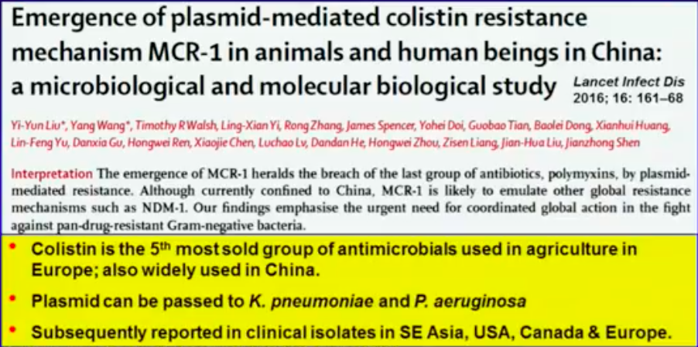
Resistance to Last Resort Agents: A Real Concern

Slide 11
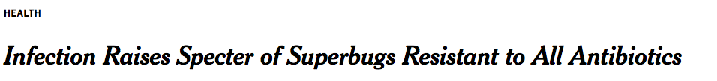

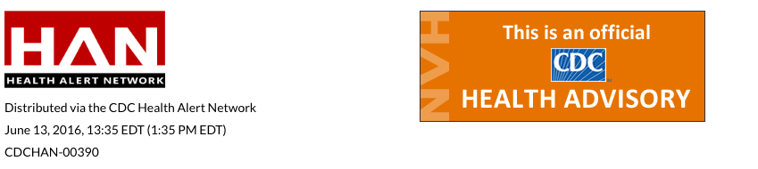
PAN-Resistant Bacteria
Have Arrived!

Slide 12
National Statistics on a Growing Crisis
2 million people infected with antibiotic resistant bacteria
  23,000 deaths annually as a direct result of these infections
Organism | Total Annual Cases | Annual MDR Cases | Annual Deaths
Methicillin-Resistant Staphylococcus aureus (MRSA) | 80,461 | -- | 11,285
Streptococcus pneumoniae | -- | 1,200,000 | 7,000
Extended-Spectrum β-Lactamase (ESBL) + Enterobacteriaceae | 140,000 | 26,000 | 1,700
VRE | 66,000 | 20,000 | 1,300
CRE Enterobacteriaceae | -- | 7,900 Klebsiella spp. 1,400 E. coli | 600
Pseudomonas | 51,000 | 6,700 | 440
Neisseria gonorrhoeae | 820,000 | 246,000 | --
Candida | 46,000 | 3,400 (fluconazole resistant) | 220

Slide 13
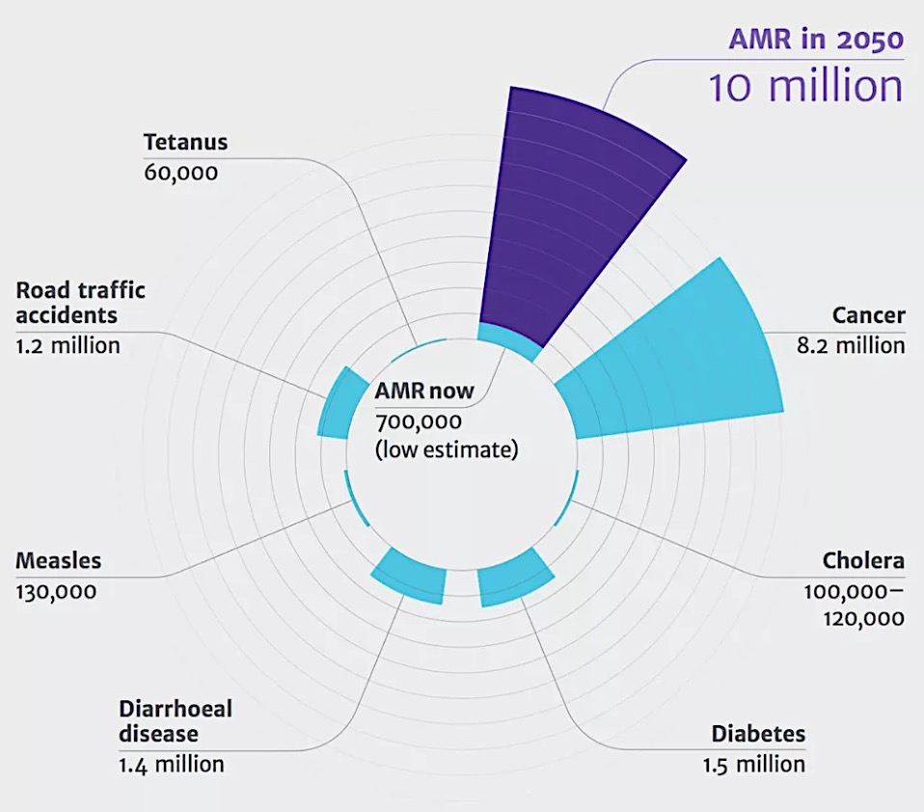
Predictions for the Future by 2050
AMR = Antimicrobial Resistance
http://www.vox.com/2016/9/20/12979968/antibiotic-resistance-superbugs-un.

Slide 14
Unintended Consequences of Antibiotic Use
(In)Appropriate Use
Antibiotics are the 2nd most prescribed medication class
200–300 million prescriptions per year (~80% population)
55% within inpatient setting
30 – 50% of Antibiotic use is inappropriate
Both Inpatient & Outpatient in United States
25 – 40% of Hospitalized Patients Receive Antibiotics
Fridkin S, et a. MMWR. 2014; 63(9):194-200.

Slide 15

Unintended Consequences of Antibiotic Use
Antibiotic-Associated Adverse Events
Most Common Adverse Events
Allergic Reactions (80%)
Adverse effects (18%)
Diarrhea, headache, dizziness
Serious Adverse Events
  Macrolides, Fluoroquinolones
  Cardiac Arrhythmias
  Drug-drug interactions
    [Fluoroquinolone FDA Drug Safety Communication
    May 2016, Update July 2016]
Antibiotics account for 1 in 5 Adverse Drug Events
140,000⁺ ER visits annually
6.1% of these require admission
http://www.cdc.gov/drugresistance/threat-report-2013/
http://www.fda.gov/Drugs/DrugSafety/ucm500143.htm

Slide 16
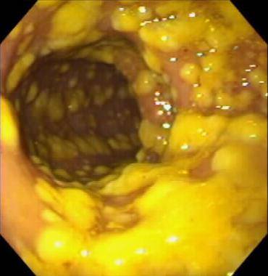
Unintended Consequences of Antibiotic Use
Clostridium difficile Infections (CDIs)
250,000 infections annually
  14,000 Deaths
  1 Billion Dollars in Excess Medical Costs
Antibiotic Exposure is the single most important risk
Exposure to antibiotics increases the risk of CDI by at least 3 fold for at least one month
Up to 85% of patients with CDI have antibiotic exposure 28 days
CDC and Prevention Antibiotic/Antimicrobial Resistance – Biggest Threats. http://www.cdc.gov/drugresistance/biggest_threats.html Accessed 09/30/16

Slide 17

Purpose & Goals of Antimicrobial Stewardship Programs
Why is it Necessary?

Slide 18
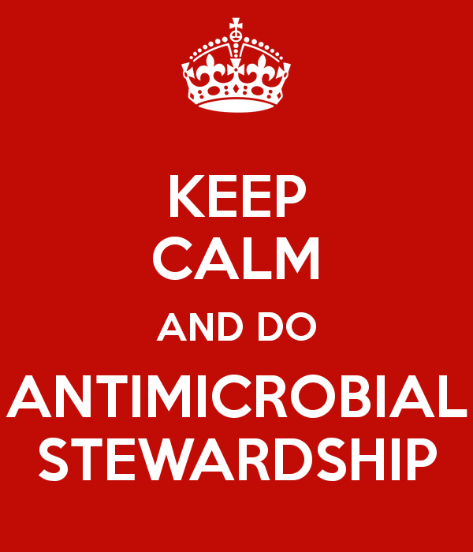
Definition: Antimicrobial Stewardship Program (ASP)
“Systematic and multidisciplinary approach to the appropriate use of antimicrobial agents to achieve optimal patient outcomes”
Not just about reducing antibiotic use, but a focus upon quality care for the patient
Assures the patient:
Receives antibiotics when appropriately indicated
Correct medication, dose, route and duration
Fridkin SK, Srinivasan A. Clin Infect Dis. 2013 Oct 25
Dellit TH, et al. Clin Infect Dis. 2007; 44: 159-177.

Slide 19
Goals of ASP
Maximize clinical outcomes
  Increased infection cure rates
  Reduced treatment failures
  Increased frequency of correct prescribing for therapy & prophylaxis
Minimize unintended consequences
  Adverse events & toxicities
  Unintended consequences such as CDI
  Emergence & Spread of MDROs
Improve cost-effectiveness
  Duration of therapy
  Length of stay
Fridkin SK, Srinivasan A. Clin Infect Dis. 2013 Oct 25
Dellit TH, et al. Clin Infect Dis. 2007; 44: 159-177.

Slide 20


Regulatory Agencies on Board
Policy Implementation Effective January 2017
Centers for Medicare & Medicaid Services §482.42
Hospitals required to have ”policies and procedures for, and to demonstrate evidence of, an active and hospital-wide ASP” as a Condition of Participation
Contains prescriptive FTE attributes
The Joint Commission
Standard MM.09.01.01
Eight elements on performance
Hospital ASP required to educate, monitor, track and measure antibiotic use
Includes CDC’s 7 Core Elements for Hospital ASPs

Slide 21
Centers for Medicare & Medicaid Services §482.42
ASP Leader Responsible for:
Development & Implementation of the hospital-wide ASP based upon nationally recognized guidelines
Communication & collaboration on antimicrobial use issues
Competency-based training & education on ASP guidelines, policies and procedures
ASP Must Demonstrate:
Coordination among all hospital staff, services & programs responsible for antimicrobial use and resistance
Document evidence-based use of antimicrobials
Improvements in proper antimicrobial use by all hospital departments & services
“Average-size” Hospital (124 beds):
0.25 pharmacist full-time equivalent (FTE)
0.1 physician FTE
0.05 network data analyst FTE
American Society of Health-system Pharmacists. Antimicrobial Stewardship in Hospitals to Become National Requirement. http://www.ashp.org/menu/News/PharmacyNews/NewsArticle.aspx?id=4352 Accessed 9/30/2016.

Slide 22
The Joint Commission Standard MM.09.01.01
One appointed Leader responsible for:
ASP as an organization priority
ASP Must Educate:
All hospital staff involved with antimicrobial ordering, dispensing, administration & monitoring on resistance and ASP policies
Patients & families as needed on appropriate use of antimicrobials
Multidisciplinary Team (part-time or consultant staff acceptable):
Infectious disease physician
Infection preventionist(s)
Pharmacist(s) – at least one
Practitioner
Includes Centers for Disease Control and Prevention’s 7 Core Elements of Hospital ASP
Utilizes Organization-approved multidisciplinary protocols
Collects, Analyzes & Reports ASP Data for improvement opportunities
American Society of Health-system Pharmacists. Antimicrobial Stewardship in Hospitals to Become National Requirement. http://www.ashp.org/menu/News/PharmacyNews/NewsArticle.aspx?id=4352 Accessed 9/30/2016.

Slide 23
Seven Key Elements for an Effective ASP in the Inpatient Setting
Disclaimer: Elements are NOT overly prescriptive & should be tailored to an institution’s individual needs
Notes:
According to the New York State Department of Health (DOH) Hospital-Acquired Infection (HAI) 2013 Report, only 53% of New York hospitals report having an existing antibiotic stewardship program and many have identified shortcomings in current approaches

Slide 24
Seven Hospital ASP Core Elements
Leadership Commitment
Accountability
Drug Expertise
Action
Tracking
Reporting
Education
Centers for Disease Control and Prevention. Core Elements of Hospital Antimicrobial Stewardship Programs. http://www.cdc.gov/getsmart/healthcare/. Accessed 9/30/2016.

Slide 25
Leadership Commitment
Role of Physician Leaders
Critical Players for ASP Success
Determining Program Goals
  Support facility efforts to improve & monitor antimicrobial use
  Job descriptions & annual appraisals denote ASP involvement
  Ensure participation from all healthcare members for ASP activities
  Adequate resources (human, financial & IT) for key players
Communicates expectations, monitor & enforce ASP policies
Qualifications
Interest in antibiotic use & patient safety
Diplomatic & collegial
Ideally Infectious Diseases Trained
Centers for Disease Control and Prevention. Core Elements of Hospital Antimicrobial Stewardship Programs. http://www.cdc.gov/getsmart/healthcare/. Accessed 9/30/2016.

Slide 26
Accountability & Drug Expertise
Stewardship Program Leader
Ultimately responsible for program outcomes
Physicians with formal training in Infectious Diseases is most ideal (Preferably full-time staff member)
Hospitalists w/o ID training with commitment to quality improvement with antibiotic use
Pharmacy Leader
Co-leader of ASP
Bridge to pharmacy staff & pharmacy specialists
Comfortable advising physicians & other healthcare providers
Pharmacy & Therapeutics Committee alone should not take on the sole responsibility of ASP
Centers for Disease Control and Prevention. Core Elements of Hospital Antimicrobial Stewardship Programs. http://www.cdc.gov/getsmart/healthcare/. Accessed 9/30/2016.

Slide 27
Key Support of Other Healthcare Providers
Clinicians & Department Heads
Should be fully aware of, engaged & supportive of ASP efforts
Infection Preventionists & Hospital Epidemiologists
Assist with monitoring and reporting resistance & HAI trends
Quality Improvement Staff
Antibiotic optimization is a quality & patient safety issue
Laboratory Staff
Ensure lab results presented in a manner that optimizes appropriate antibiotic use
Information Technology Staff
Integration of new ASP protocols, clinical decision support & action prompts within hospital computerized provider order entry (CPOE) system
Nursing
Assure cultures obtained prior to antibiotics; prompt discussion regarding antibiotic duration
Centers for Disease Control and Prevention. Core Elements of Hospital Antimicrobial Stewardship Programs. http://www.cdc.gov/getsmart/healthcare/. Accessed 9/30/2016.

Slide 28
Action
ASP Interventions – should be specific to hospital needs, resource availability & content expertise
Three Intervention Categories:
  Broad
    Antibiotic “Time Outs”
    Prior Authorization (Requires Full-Time Coverage)
    Prospective Audit and Feedback (More Flexible Coverage)
  Pharmacy Driven
    Automatic IV to PO interchange
    Dose adjustment & optimization
    Time-sensitive automatic stop orders
    Automated alerts for therapy duplication & drug interactions
  Infection & Syndrome Specific
    Community-acquired Pneumonia (CAP)
    Urinary tract infections (UTIs)
    Skin and soft tissue infections
    CDI
Centers for Disease Control and Prevention. Core Elements of Hospital Antimicrobial Stewardship Programs. http://www.cdc.gov/getsmart/healthcare/. Accessed 9/30/2016.

Slide 29
Tracking
Monitoring antibiotic prescribing
Identifies improvement opportunities & assess impact of outcomes
Prospective Process or Retrospective Outcome reviews
Documentation of efforts & feedback on acceptance is critical
Examples:
Accurate application of diagnostic criteria for infection
Cultures & relevant tests obtained prior to therapy initiation
Recommended antimicrobial prescribed for indication
Indication & duration of therapy documented
Appropriate modification of therapy based on microbiological cultures
Timely administration of antibiotics
Centers for Disease Control and Prevention. Core Elements of Hospital Antimicrobial Stewardship Programs. http://www.cdc.gov/getsmart/healthcare/. Accessed 9/30/2016.

Slide 30
Reporting: Common Terms
Days of therapy (DOT)
Total # of
antibiotics
administered
Assumes antibiotic dosing is appropriate at all times
Takes into account acute changes in organ impairment
Usually requires EHR with eMAR to extract data
Defined Daily Dose (DDD)
Average daily dose of antibiotic in a standard patient established
Focuses on population-based parameters
Does not account for organ impairment
Common Denominator
Patient Days – daily count of number of patients in a specific ward location during a time period
1,000 Patient Days
Duration
Of Therapy
X
Centers for Disease Control and Prevention. Core Elements of Hospital Antimicrobial Stewardship Programs. http://www.cdc.gov/getsmart/healthcare/. Accessed 9/30/2016.

Slide 31
Reporting
Outcomes
Clinical
Process
Humanistic
Economic
Clinical cure/failure rates
Readmission rates (30 days)
Resistance rates
Infection-related mortality
Length of stay
Dose optimization
Adherence to hospital specific guidelines
Appropriate de-escalation/streamlining
Appropriateness of therapy
Adverse drug events avoided
Time to receipt of appropriate antimicrobials
IV/PO conversion rates
Outpatient intravenous therapy rates
Antimicrobial utilization (DDD or DOT)
Hospital wide antimicrobial expenditures
Relative consumption
Rate of intravenous antimicrobial use
Nonformulary agents avoided
Duration of antimicrobial therapy
C. Difficile infections
Cultures before antibiotics
Moehring RW et al. Curr Infect Dis Rep. 2012; 14(6): 592 – 600.

Slide 32

Education
Engage ALL stakeholders across continuum of care
Didactic Education
General principles of antimicrobial therapy
Interpretation of antibiogram & culture susceptibilites
Diagnostic & treatment guidelines or pathways
Most effective with combined with active intervention
Useful Resources:
National Foundation for Infectious Diseases
  http://www.nfid.org/links/antimicrobial-resistance
American Hospital Association’s physician leadership forum
  http://www.ahaphysicianforum.org/resources/appropriate-use/antimicrobial/index.shtml

Slide 33
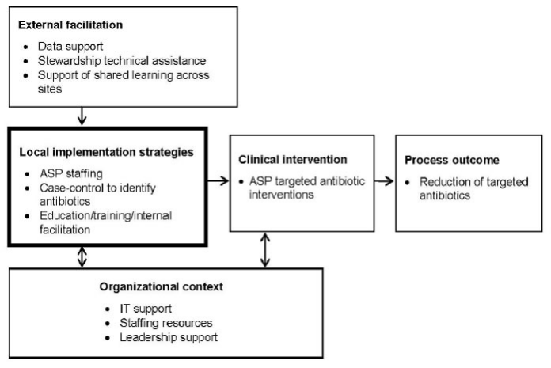
Considerations for ASP Implementation

Slide 34
Implementing an Antimicrobial Stewardship Program at Mt. Sinai St. Luke’s

Slide 35

Background: Mt. Sinai St. Luke’s (MSSL)
523 Licensed Beds
Morningside Heights & West Harlem
Teaching Hospital (438 FTEs Interns & Residents)
Level I Trauma & Stroke Center
Medical, Surgical, Cardiac & Cardiothoracic Surgical Intensive Care Units
September 2013
Merger of Continuum Health Partners (St. Luke’s – Roosevelt Hospitals, Beth Israel Petrie & King’s Highway Brooklyn Divisions, and NY Eye & Ear Infirmary) with Mt. Sinai Health System

Slide 36
MSSL Structure & Resources:
Infectious Diseases and Pharmacy Services
Two Inpatient ID Services (HIV Inpatient & General ID Consult; 7 days per week)
10 ID Physicians rotate coverage for Consult Service
Infectious Diseases Fellowship (2 years – 2 Fellows per year)
24-hour Inpatient Pharmacy Services
1 Director of Pharmacy, 1 Assistant Director of Clinical Services, 1 Pharmacy Operations Manager
1 Clinical Pharmacy Specialist, 1 Clinical Pharmacy Manager
18 Staff Pharmacists (14 Full-Time, 1 Part-Time, 3 Per Diem)
PGY-1 Pharmacy Residency (1 year – 4 Residents per year)
Laboratory
On-site facility, performs services & reports results in Electronic Health Record (EHR)
Rapid diagnostic testing using polymerase chain reaction (PCR) for MRSA, C. difficile & other organisms
Information Technology
Bar Coding Medication Administration (BCMA) System (Oral dosage forms only)
GE Centricity PRISM (Inpatient EHR, CPOE, eMAR)
EmStat – Emergency Department EHR & CPOE
Pharmacy OneSource Quantifi

Slide 37
Development of ASP at MSSL:
Sept 2007 to Dec 2015
Clinical Pharmacy Manager – collaborates with Department of Infectious Diseases (ID) and Infection Prevention & Control to develop ASP initiatives
ASP data compilation & presentation to Antimicrobial Stewardship Group
Review of Antimicrobial & Antiviral Formulary Restriction Processes
  Approval provided by ID Fellows & ID Attendings
Education to hospital staff for new ASP policies
Primary preceptor for PGY-1 pharmacy residents on Infectious Disease Clinical Rotation (4 weeks)
Pharmacy Residents – trained by clinical pharmacy manager to perform ASP interventions:
IV to po, dose adjustment, therapeutic monitoring, restriction approval requests, C. difficle report
Data entry of own ASP interventions & those done by staff pharmacists

Slide 38
Broadening ASP at MSSL:
July 2016 to Present
Clinical Pharmacy Specialist – hired as part of CMS & Joint Commission January 2017 Mandate
Performs all duties as noted by prior Clinical Pharmacy Manager
NEW Responsibilities
Approval of Restricted Antimicrobials
  Weekdays 8:00AM to 4:00PM (Weekends, after hours & holidays by ID Fellows)
Attends daily rounds with Inpatient ID Consult Service
Pharmacy Residents – Perform all ASP duties as previously described
NEW Responsibilities
Trained by Clinical Pharmacy Specialist to approve restricted antimicrobials & antivirals during ID Clinical Rotation (upon licensure)
Pharmacy ASP liaison to interdisciplinary teams while on other clinical rotations

Slide 39
Leadership Commitment
Chief Medical Officer
Joined MSSL August 2014
Pulmonary – Critical Care Medicine
30⁺ years experience
Leads & Implements clinical direction of ASP & Infection Prevention & Control Program at MSSL
Chief of Division of Infectious Diseases
Joined MSSL July 2016
Infectious Diseases Medicine
20⁺ years experience
Defines the mission & oversees operation ID section of medicine at MSSL & Mt. Sinai West (MSW)
ASP Program Director
Joined MSSL July 1988
Infectious Disease Medicine
20⁺ years experience
Coordinates efforts between ASP clinical pharmacy specialists & responsible for ASP outcomes at MSSL & MSW

Slide 40
Drug Expertise
Clinical Pharmacy Specialist
Two years post-graduate residency training at hospitals with well-established ASP
  The Brooklyn Hospital Center (Established 2006)
  University of Massachusetts Memorial Medical Center (Established 1996)
Joined MSSL August 2010
  Faculty at Long Island University School of Pharmacy
  Preceptor of pharmacy students for Internal Medicine & Critical Care and PGY-1 pharmacy residents for Medical Intensive Care Unit (MICU)
Critical Care Pharmacotherapy Focus
  Daily interdisciplinary rounds at MSSL MICU
Development of Hospital Policies & Protocols
Sepsis Code Policy
Vancomycin Dosing Protocol & Automatic Stop Orders
Revisions to perioperative antimicrobial prophylaxis (SCIP)
Responsible for reporting antibiotic use data & collaborating with other ASP leads

Slide 41
Action: Restrictions & Prospective Review
Prospective Review of Antimicrobials
Daily Automated list of patients on Antibiotics (Restricted & Non-restricted)
  Average census 50 to 60 patients (~20 on HIV Inpatient Service or ID Consult Services)
Approval of Restricted Antimicrobials
8:00AM to 4:00PM – Alpha-numeric Text Paged or Direct Phone Call by:
Hospital Staff Members
  Internal Medicine Residents
  Midlevel Providers - Nurse Practitioners & Physician Assistants
  Surgical Residents
  Attending Physicians – Internal Medicine Non-teaching Service
Staff Pharmacists
  Notification of new orders written by Hospital Provider requiring ASP approval

Slide 42
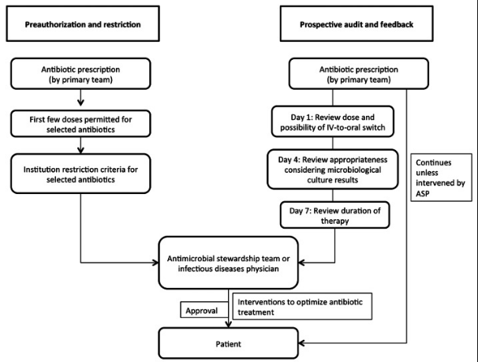
Action: Restrictions & Prospective Review
Overnight:
Supply Doses until 10AM

Slide 43
Action: MSSL Restricted Antimicrobials
Unrestricted Antibiotics | First Dose Dispensed w/o ID Approval | Approval by ID Required for First Dose | Approval by ASP Program Director
Acyclovir Oral Valacyclovir Amoxicillin-Clavulanate Ampicillin Ampicillin-sulbactam 1.5g Azithromycin Oral Cefazolin Ceftriaxone (CAP only) Ciprofloxacin Oral Doxycycline Fluconazole Metronidazole Nafcillin Nitrofurantoin All Oral Cephalosporins All Forms of Penicillin Sulfamethoxazole-Trimethoprim Oral Vancomycin IV | Acyclovir IV Amioglycosides Azithromycin IV Aztreonam Ampicillin-sulbactam 3g Piperacillin-tazobactam Cefepime Cefotaxime Cefoxitin Ceftazidime Ceftriaxone (non-CAP) Clindamycin Ciprofloxacin IV Levofloxacin Oral & IV Imipenem Oseltamivir Sulfamethoxazole-Trimethoprim IV Vancomycin oral | Amphotericin B Atovaquone Caspofungin Colistin Ganciclovir Polymyxin Ertapenem Meropenem Foscarnet Tigecycline Linezolid Itraconazole Posaconazole Voriconazole Rifabutin Rifampin | Ceftaroline Daptomycin Fosfomycin

Slide 44
Action: Automated Pharmacy IV to PO
Daily Automated Reports Emailed to Pharmacy Residents
  Following 48 hours of IV therapy with documented clinical improvement & tolerate po
  Ampicillin-sulbactam → Amoxicillin-clavulanate
  Azithromycin*
  Cefazolin → Cephalexin*
  Ceftriaxone → Cefpodoxime*
  Ciprofloxacin*
  Clindamycin*
  Doxycycline
  Fluconazole
  Linezolid*
  Metronidazole*
Ordersets built in CPOE system for common medications

Slide 45
Action: Vancomycin Utilization
Review in Medical Intensive Care Units at MSSL & MSW
Demographics | MSSL (n = 47) | MSW (n = 15) | Total (n = 62)
Sex, Age
Male Female | 28 19 | 7 8 | 35 27
Mean Age (years) | 66 | 63 | 65
Indications
Empiric, n (%) | 43 (91.5) | 15 (100) | 58 (93.5)
Treatment, n (%) | 4 (8.5)* | 0 (0) | 4 (6.5)
Risk Factors for MRSA
Colonization, n (%) | 7 (14.9) | 0 (0) | 7 (11.3)
Recent antibiotic use, n (%) | 18 (38.3) | 7 (46.7) | 25 (40)
ESRD on HD, n (%) | 2 (4.2) | 0 (0) | 2 (3.2)
SNF/NH, n (%) | 6 (12.8) | 0 (0) | 6 (9.7)
Recent Hospitalization, n (%) | 22 (46.8) | 6 (40) | 28 (45.2)
Immunocompromised, n (%) | 7 (14.9) | 4 (26.7) | 11 (17.7)
> 2 RF’s, n (%) | 20 (42.6) | 3 (20) | 23 (37)
0 RF’s, n (%)** | 14 (29.8) | 4 (26.7) | 18 (29)
MRSA Surveillance
Positive | 5 (10.6) | 0 (0) | 5 (8)
Negative | 37 (78.7) | 15 (100) | 52 (83.9)
Ordered | 2 (4.2) | 0 | 2 (3.2)
Pending | 3 (6.4) | 0 | 3 (4.8)

Slide 46
Action: Vancomycin Utilization
Results
Composites | MSSL (n = 47) | MSW (n = 15) | Total (n = 62)
Total Vancomycin Use
Days | 210 | 117 | 327
Mean Days/Patient | 4.5 | 7.8 | 5.2
Excess Days | 69 | 45 | 109
Excess Doses | 110 | 60 | 170
Excess Cost | $1,104.00 | $602.18 | $1,706.18
Total Vancomycin Levels
Number | 59 | 37 | 96
Levels/Patient | 1.3 | 2.4 | 1.5
Excess Levels | 18 | 18 | 39
Excess Levels/Patient | 0.6 | 1.2 | 0.63
Excess Cost | $129.78 | $129.78 | $259.56
Total Excess Cost | $1,233.78 | $731.96 | $1,965.74
Estimated Annual Excess Cost | $10,692.76 | $12,687.31 | $23,380.07

Slide 47

Action – Future Initiatives
72 Hour Automatic Stop Orders Vancomycin
  Continuation Requires ID Approval
  Implementation Hospital Wide
Pathways for Management of Common Infections
  Appropriate Diagnosis, Treatment, Duration
  Minimize Utilization of Fluoroquinolones

Slide 48
Tracking & Reporting
Healthcare Association of New York State (HANYS) Antibiotic Stewardship Collaborative
Antimicrobial Monitoring Group (MSSL & MSW)
Hospital Acquired Infections (HAIs)
  CLABSI
  CAUTI
  VAP
  C. Difficile
Antimicrobial Subcommittee Pharmacy & Therapeutics Committee
Notes:
HANYS statewide hospital and continuing care association in New York. We are located near Albany and represent 500 not-for-profit and public hospitals, nursing homes, home care agencies, and other healthcare organizations. HANYS is committed to supporting members as they accelerate their focus on antibiotic stewardship, providing tools and resources to reduce drug-resistant organisms, prevent Clostridium difficile infections, and prepare for future mandates.
(IPRO)

Slide 49
Education
Antibiogram on Intranet
Annual Housestaff Presentation on ASP
Online Annual Competencies through Portal for Education & Advancement of Knowledge (PEAK)
  Infection Prevention and Control & Hand Hygiene (All Staff)
  IV to PO Conversion of Antimicrobial Agents (Specific to Pharmacy)
  Sepsis Education (All Staff)
Debriefing for all Hospital Acquired Infections (HAIs)
  Catheter-Associated Urinary Tract Infection (CAUTI)
  Central Line-Associated Blood Stream Infecdtion (CLABSI)
  C. Difficile
  Ventilator-Associated Pneumonia (VAP)
Patient Education on Therapy Initiation & Discharge
Notes:
IC&P CLABSI-Biopatch for nursing

Slide 50
Summary
Antimicrobial Resistance
Global Concern with minimal options for future antimicrobial therapy
Results from inappropriate use of antibiotics (i.e. over-prescribing)
Utilization of last line options increasing adverse consequences
(i.e. nephrotoxicity, hospital-acquired infections)
Antimicrobial Stewardship Programs
Systematic and multidisciplinary approach
Appropriate use of antimicrobial agents to achieve optimal patient outcomes
Effective January 1, 2017 required implementation for all hospitals by TJC & CMS
ASP Should Incorporate
Goals appropriate for needs & resources available
Coordination among staff, services & programs responsible for antimicrobial use and resistance
Documentation of antimicrobial utilization, evidence based policies & protocols,
Education to all hospital staff involved and patients
Strategies for implementing improvement processes for ASP

Slide 51
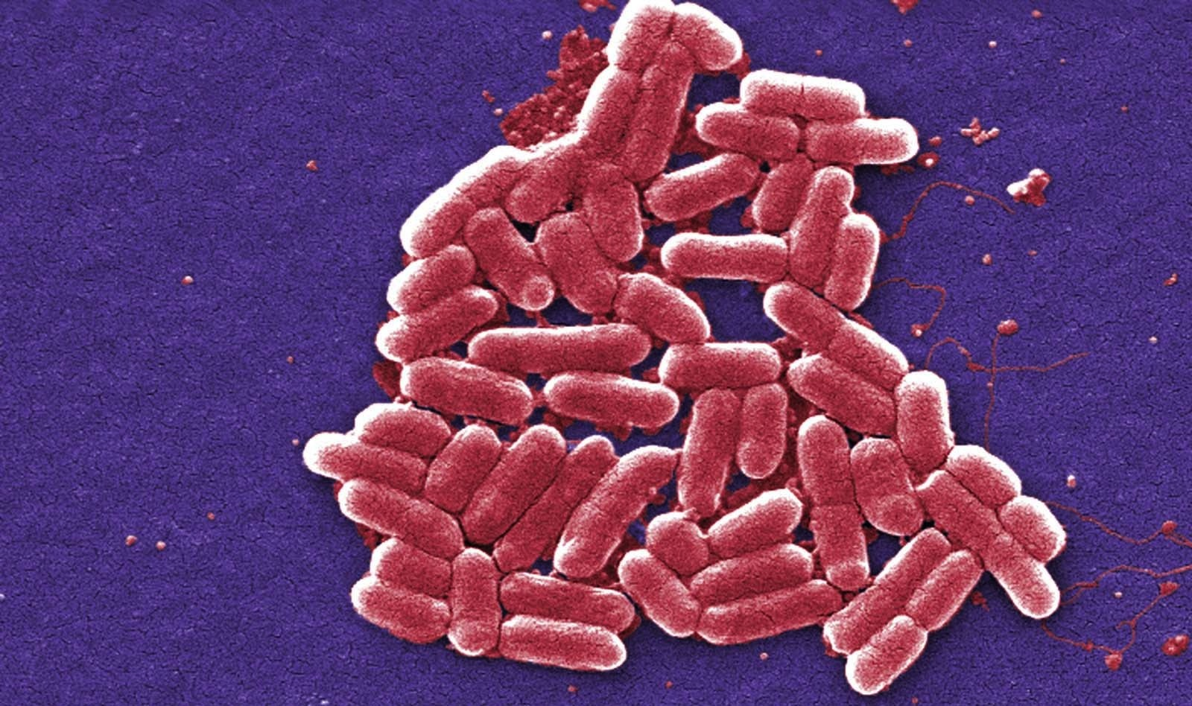
QUESTIONS?

Slide 52
The Role of the Antimicrobial Stewardship In the Acute Care Inpatient Setting
Kimberly Sarosky, MS, PharmD, BCPS
Clinical Pharmacy Specialist
Infectious Diseases & Critical Care
Mount Sinai St. Luke’s
Email: ksarosky@chpnet.org

