Slide 1

Overview of Disease Reporting
New York City Health Department
Division of Disease Control
David Lee, MPH, MBA
Muriel Silin, MPH
Lixuan Wang, MPH

Slide 2
Agenda
Reportable Disease Surveillance
Tuberculosis B (TB) Reporting
Improving Provider Reporting
Electronic Case Reporting
Questions and Feedback

Slide 3
Reportable Disease Surveillance
Disease surveillance is the cornerstone of public health
  Provider reports
  Electronic laboratory reports (ELR)
Data are used to inform case management activities and public health interventions
In addition, reporting is reinforced by:
  State mandates (NYS Sanitary Code)
  City mandates (NYC Health Code)
    Requires reporting of some diseases addition to NYS Sanitary Code
Notes:
You’ll often hear that surveillance is the cornerstone of public health. Modern health departments receive data on reportable diseases through 2 main streams:
Provider case reports – well, hopefully you’re all familiar with that already ☺ These are reports sent in by hospitals and providers.
ELR is the automated transmission of reportable laboratory findings from commercial, public health, hospital, and other labs to state and local public health departments from a laboratory information management system or an electronic health records system.
These surveillance data inform case management and other interventions– we’ll describe these in a bit more detail later on
And lastly, this reporting is legally mandated, both by State and City laws. I also added some additional slides with more details about these laws in the appendix for your information.

Slide 4
NYC Health Code
Provider reporting requirements in Health Code Article 11 and lab reporting requirements in Article 13
Routinely reviewed and amended to accommodate:
  Evolving diseases and conditions of interest
  Advances in reporting and surveillance capabilities
Proposed amendments to the Health Code must be approved by the 11-member Board of Health
Data collected for public health purposed is not subject to HIPAA
Notes:
I’ll give you a quick run-through of how the NYC Health Code works.
These laws are routinely reviewed and amended to include new diseases or conditions. Sometimes, there have already been public health interest, but now other factors like improvements in technology allow us to make use of the newly reportable data.
Board of Health
Includes Commissioner of Health, Dr. Mary T. Bassett
Most members are appointed by the Mayor and with the consent of City Council and serve 6-year terms
Each member is a recognized expert, and the group represents a range of health and medical disciplines
And lastly but very importantly, surveillance reports are exempted from HIPAA

Slide 5
Case reporting: Who? What?
Who needs to report?
  Providers
  Hospitals
What diseases are reportable?
  Specific diseases and conditions (~90)
  Outbreaks (in 3 or more persons) of any disease
  Unusual manifestations of a disease/condition
  Any newly apparent or emerging disease/syndrome

Slide 6
Case reporting: Why?
Data are used for surveillance.
Follow disease trends over time
Conduct contact and contact investigations
  Case isolation; e.g. TB, SARS
  Prophylaxis; e.g. Hep A, meningitis
  Contact tracing; e.g. TB, STIs including HIV
Identify and investigate outbreaks
Evaluate prevention and control measures
Notes:
Stole this slide from Dr. Marci Layton and Dr. Don Weiss.

Slide 7
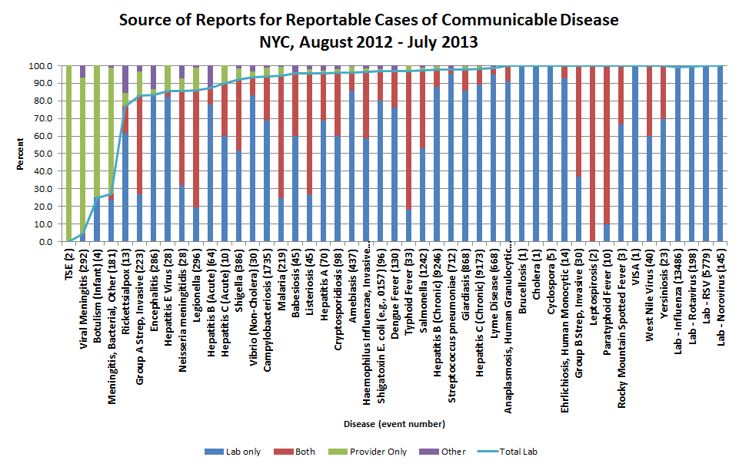
Case reporting: Why?
Can’t we just rely on ELR?
Notes:
Graphic from the Bureau of Communicable Disease’s epidemiologist and research scientist, Jennifer Baumgartner.
Slide is included so that you can review at your own leisure. What I want to bring your attention to, is the fact that for many diseases, most data come from ELR. So why can’t we just rely on ELR?

Slide 8
Case reporting: Why?
Case reports vs ELR
ELR provide vast majority of reportable disease data in NYC
ELR may be necessary for a definitive diagnosis, but are not always sufficient
Providers often have access to information that labs do not and can provide useful context to the lab reports
  More complete demographic and personal information, including behavioral and occupational risk factors
  Clinical presentation
  Treatment information
  Pregnancy status
Notes:
Not all diseases have rapid laboratory diagnostics.
And not all diseases have a positive lab result eg. clinical (culture-negative)cases of TB

Slide 9
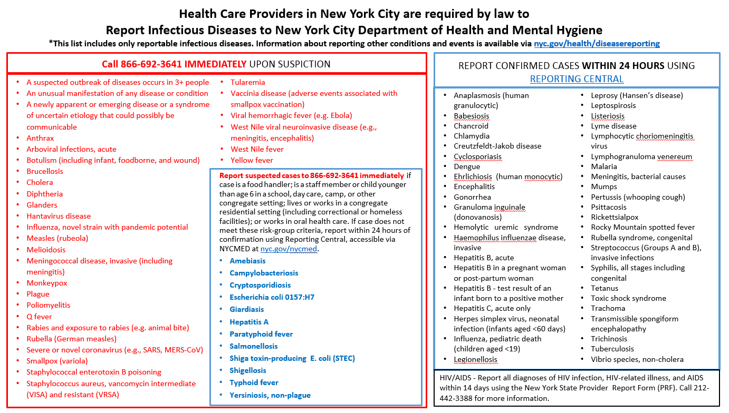
Case Reporting: When?

Slide 10
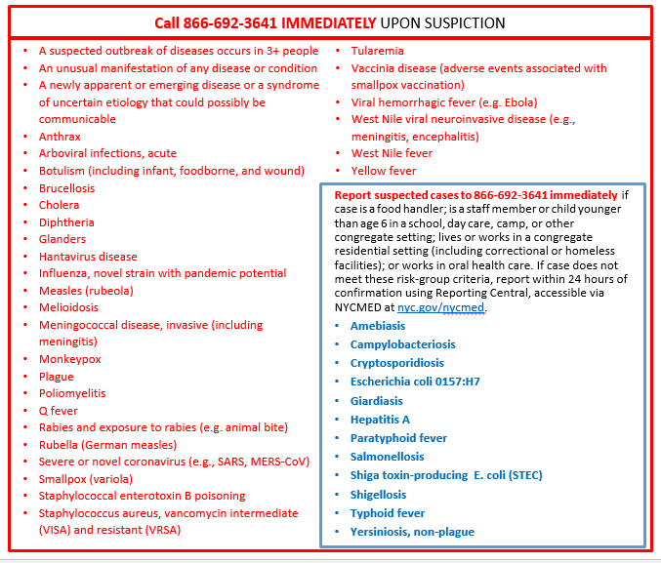
Immediately Reportable

Slide 11
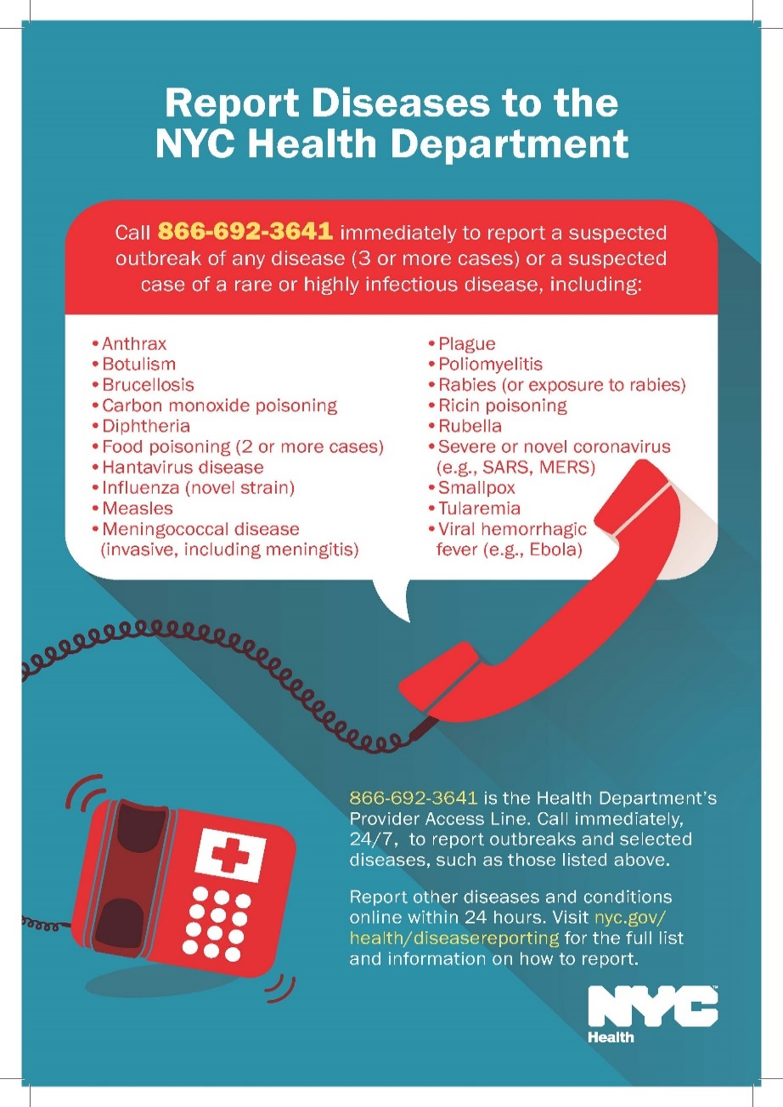
Immediately Reportable
Provider Access Line (PAL): 866-692-3641
A 24/7 resource for reporting and medical information
When you call to report, an agent will connect you to the appropriate surveillance number or, in non-urgent situations, give you reporting instructions
When you call for information, we will answer your questions about diagnosis, testing, or other public health issues

Slide 12
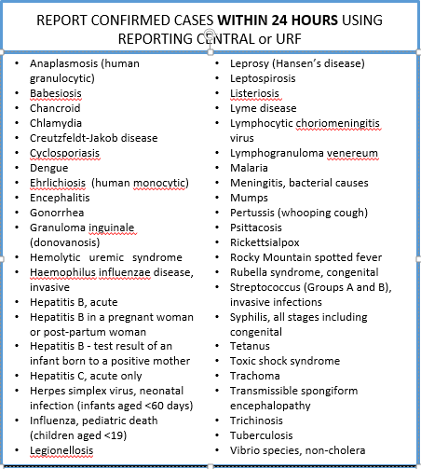
Reportable within 24 hours

Slide 13
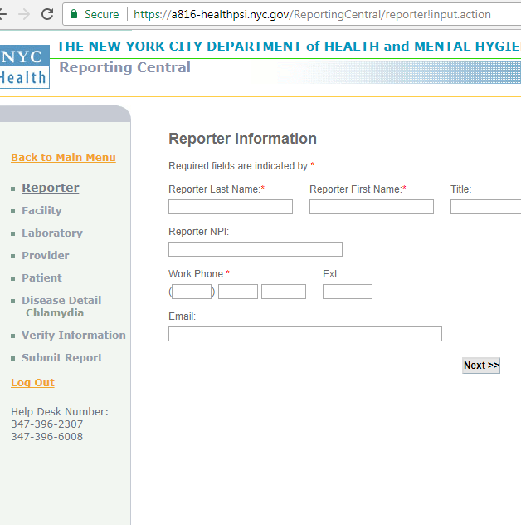
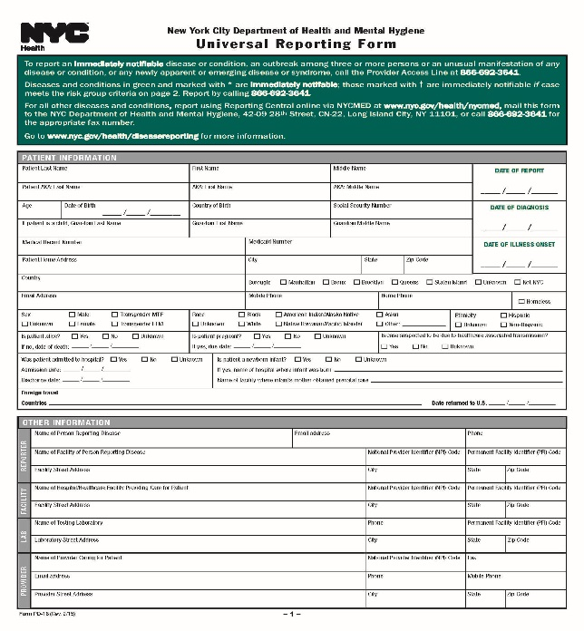
Reportable within 24 hours
Reporting Central & URF
  Reporting Central: (preferred method) register and log in to NYCMED at nyc.gov/nycmed to access
  Universal Reporting Form (URF): fax or mail form to Health Department

Slide 14
Special Reporting Requirements
HIV/AIDS
Other Conditions & Events
  Poisonings (carbon monoxide, lead, other)
  Lead poisoning
  Window falls
  Drowning
  Deaths, births, terminations of pregnancy
  Immunizations administered & related adverse events
  Blood lead levels
  Sterilizations

Slide 15
Resources
Refer to details on NYCDOHMH Reportable Diseases website
Download How to Report Diseases, Events, and Conditions to the New York City Health Department (PDF)
Sign up for the Health Alert Network (HAN)

Slide 16
TB Reporting

Slide 17
Mission and Goals of NYC BTBC
Mission
Prevent the spread of tuberculosis (TB) and eliminate it as a public health problem in New York City
Goal
Identify individuals with suspected or confirmed TB and ensure appropriate treatment
Ensure individuals at high risk for progression from latent infection to active disease receive treatment for latent TB infection
Notes:
Our mission is to identify individuals with suspected or confirmed TB disease and ensure their appropriate treatment, ideally on a regimen of directly observed therapy.
To ensure that individuals who are at high risk for progression from latent infection to active disease (e.g., contacts of active cases, immunocompromised individuals, recent immigrants from areas where TB is widespread) receive treatment for latent TB infection and do not develop disease.
Ensure individuals at high risk for progression from latent infection to active disease (e.g., contacts of active cases, immunocompromised individuals, recent immigrants from areas where TB is widespread) receive treatment for latent TB infection and do not develop disease.

Slide 18
BTBC Key Activities and Services
Direct patient care
  Provides free diagnostic and treatment services, and offer clinic-based directly observed therapy (DOT) in four TB clinics throughout the city
Surveillance and reporting
  Maintain surveillance and case management system, and monitor trends
Case management and contact investigation
  Conduct intensive case management to ensure TB patients complete treatment, ideally on DOT
  Evaluate household contacts for TB infection and disease
Outbreak detection and control
  Investigate genotyped clusters and coordinate public health interventions to prevent the spread of TB
Medical consultation and outreach
  Set standards and guidelines, and provide consultation for health care providers on all aspects of TB control
Research and evaluation
  Conduct ongoing analysis and evaluation of policies and practices, and monitor performance indicators
Notes:
Direct patient care
Provides free diagnostic and treatment services, and offer clinic-based directly observed therapy (DOT)
Provides social services, referrals and HIV counseling and testing at chest centers
Surveillance and reporting
Review reports submitted by providers and laboratories for timeliness and accuracy
Maintain surveillance and case management system, and monitor trends
Manage interstate referrals of TB cases and contacts who move in and out of NYC
Case management and contact investigation
Conduct intensive case management to ensure TB patients complete treatment, ideally on DOT
Provide treatment recommendations to non-BTBC providers and monitor treatment progress
Evaluate household contacts for TB infection and disease
Outbreak detection and control
Coordinate genotyping of culture-positive TB isolates for all TB cases
Investigate genotyped clusters and coordinate public health interventions to prevent the spread of TB
Medical consultation and outreach
Set standards and guidelines, and provide consultation for health care providers on all aspects of TB control
Collaborate with providers, community-based organizations and other agencies
Research and evaluation
Conduct ongoing evaluation of policies and practices, and monitor performance indicators
Conduct data analysis and research on all aspects of TB control

Slide 19
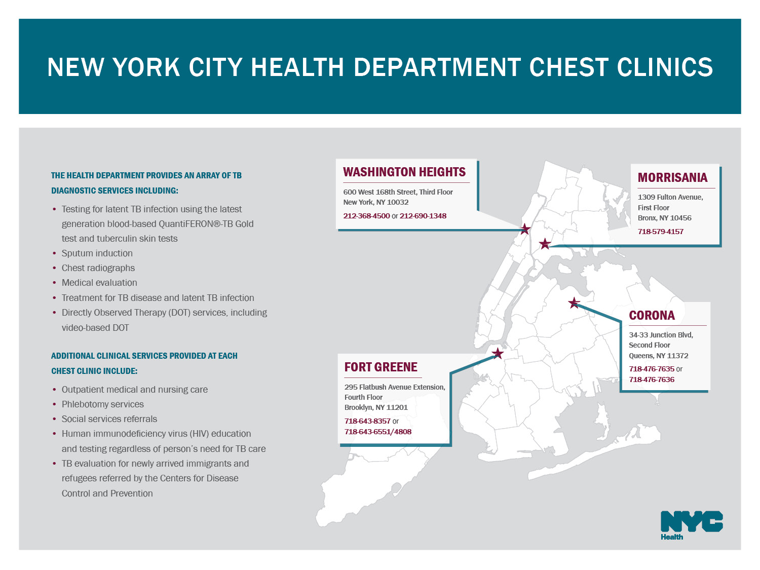

Slide 20
Every TB patient is assigned a DOHMH case manager
Patient reported to health department
Assigned a BTBC case manager
Chart review
Interview patient
Identify contacts
Interview and test contacts
Follow-up for cases and contacts through treatment completion
Notes:
Data is reported to us
Each case, suspect and contact is assigned to a TB case manager. We use a team-based approach to case management. The case manager is the heart of this team and they work with staff in a all offices of the Bureau to ensure that patients and their contacts are effectively evaluated and treated.
Conduct intensive case management to ensure TB patients complete treatment
Offer directly observed therapy (DOT) at places convenient to the patient
Educate patients on TB pathogenesis and transmission
Conduct comprehensive patient interview and extensive chart reviews
BTBC medical consultants provide treatment recommendations to non-BTBC providers and monitor progress of treatment

Slide 21
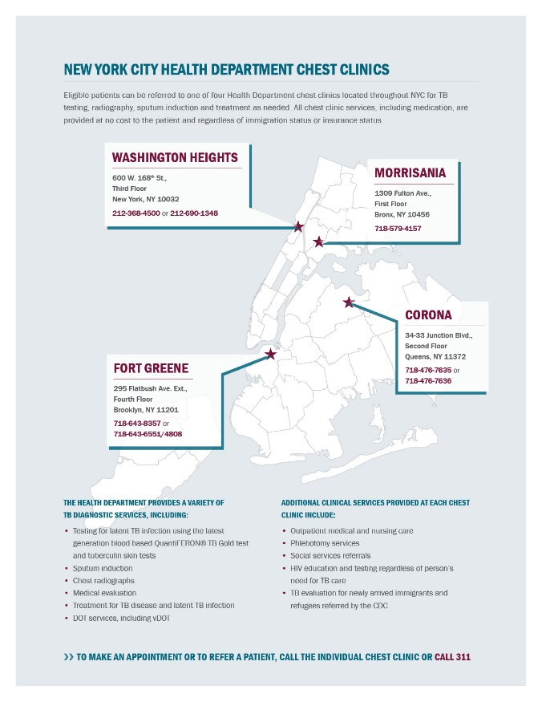
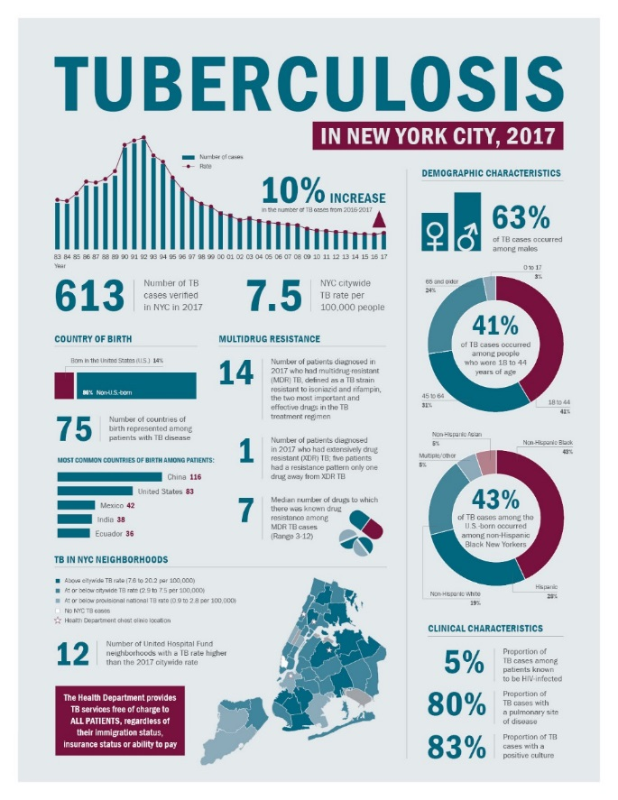
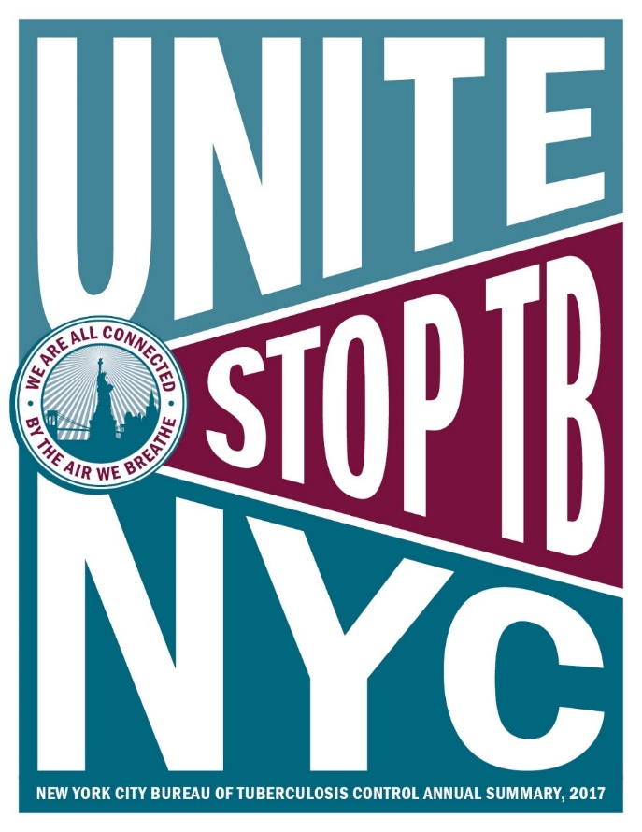
Use data strategically
Routine data analysis
  Surveillance data
  Sentinel populations
  Ad hoc analyses
Research and program
evaluations
Inform investigations
  Contact investigations
  Expanded contact investigations
  Cluster investigations
  Outbreak investigations

Slide 22
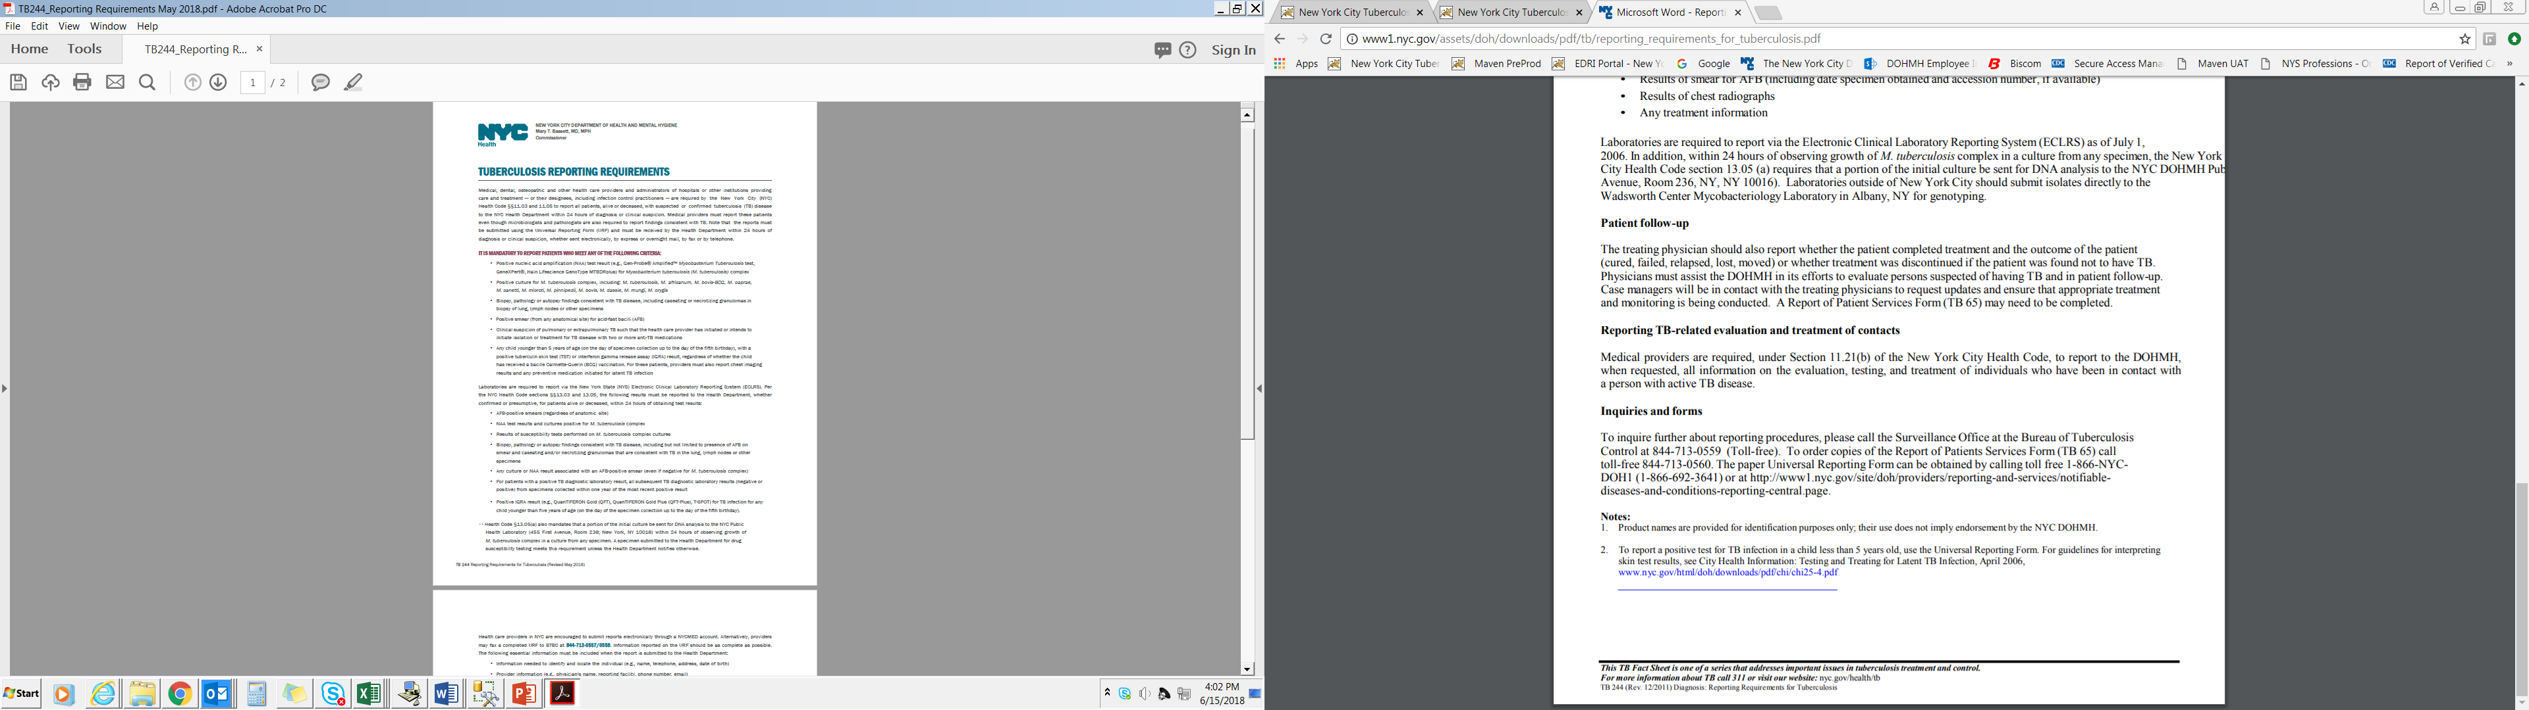
NYC TB reporting requirements
TB 244

Slide 23
Persons Required to
Report TB
Physicians treating TB patients
Infection control staff or designated personnel
Laboratory personnel
Medical examiners
Out-of-NYC health departments

Slide 24
Criteria for TB Reporting
Positive TB results are reportable within 24 hours:
  Positive AFB smears (from the result date)
  Patients started on > 2 anti-TB medications (from the date therapy was started)
  Positive NAA results (any specimen, from the result date)
  Positive culture for M. tb complex (from the date identified as positive)
  Positive TB infection test (TST or QFTG) for a child < 5 years old (up to 5)
  Pathology findings consistent with TB (from the date preliminary findings are available)

Slide 25
Timing of Reporting
TB reports must be received within 24 hours of the time the diagnosis is made or suspected for providers and hospitals, and for positive results from laboratories

Slide 26
How to Report
TB patients may be reported via:
The Universal Reporting Form online (Reporting Central)
  Electronic reporting via the NYCMED portal is preferred
  Reports are sent directly to the TB Registry
Paper URFs can be faxed (844) 713-0557, 0558
Telephone to the TB Hotline (844) 713-0559
  An online or paper URF should follow within 48 hours
Laboratories are mandated to report via NYS DOH’s Electronic Clinical Laboratory Reporting System (ECLRS)
  Results are automatically sent to NYS DOH
  Filtered to the appropriate health department based on patient address
  All laboratories testing for TB are certified for ECLRS reporting

Slide 27
Reporting by
Healthcare Providers
Providers are required by law to report within 24 hours any patient with:
    Patients with criteria for reporting (positive laboratory results or on anti-TB meds)
    Clinically suspected TB, with no positive laboratory results
Notes:
The Health Code requires physicians and hospitals to report TB patients to the DOHMH within 24 hours of detection. This includes patients with the reportable criteria I mentioned earlier.
If no positive results are available, and a patient has signs/symptoms of TB then the person should be reported within 24 hours of clinical suspicion, even if culture results are still pending.
The reporting form currently used, the URF, should be as complete as possible, no area should be left blank; if the information is unknown or some laboratory test results are not back yet, then mark “pending”.
We are getting reporting forms from hospitals financial departments for reimbursement purpose. Sometimes, the only reporting form we receive is from the finance staff and only the demographic and hospital information is completed. Many of these patients never turn out to have TB and some do not even have smear and culture sent; in some cases we have investigated, the ICP does not know about the patients. It seems then that TB is brought up for some of these patients solely for reimbursement purposes: this is quite an unacceptable practice. I am urging you to educate and work with your hospital finance department to ensure that they report through you or the patient’s provider and that the required information is complete and the reporting is justified.

Slide 28
Healthcare Provider Reporting
In hospitals, some providers are not familiar with public health reporting
  Infection control staff usually report for medical staff
  Treating physicians are still legally responsible to ensure NYC DOHMH is notified about TB patients
Private providers report themselves
  Often not familiar with TB specific reporting requirements
  Require education about TB reporting
  Need for ongoing follow-up communication as part of BTBC patient case management

Slide 29
Physician Role in Disease Reporting
Think about and recognize TB!
Diagnose and report in a timely manner
  Alerting infection control staff in hospitals
  Reporting and diagnostic delays -> delayed public health action
Provide follow-up treatment information
Cooperate with public health officials
Notes:
What can providers do to control TB? Think about and recognize TB and promptly report to the health department when TB is suspected.
If the clinician thinks that the patient COULD have TB, then he/she should immediately report.
Delayed reporting is a problem that may result in delayed treatment and contact investigation and in patients lost to follow-up. It is an issue that we try to address through provider education at every opportunity
We need full cooperation of ICP and providers for case management of TB patients and to resolve issues quickly.

Slide 30
HIPAA
Protects the privacy of identifiable health information
Does not limit public health and disease control activities
Public health agencies are exempt
Providers and laboratories are both required to report
NYC DOHMH employees are legally allowed to access patients records and laboratory results for reportable conditions

Slide 31
DOHMH Role in Surveillance with Providers and Laboratories
Educate providers and infection control
Have a productive relationship with those who have to report
Communicate with laboratories about their electronic reporting to ensure reports come in mostly standardized
  Correct codes (LOINC for test types and SNOMEDS for results)
  Complete descriptions
  Correct and complete patient and provider demographics
Timely receipt of reports from ECLRS and Reporting Central to the TB registry for case assignment

Slide 32
Key Surveillance activities
Review and enter data in TB Registry from hospitals, physicians, laboratories, other jurisdictions
Monitor TB registry workflows
Receive and submit hospital discharge approvals for respiratory smear (+) patients
Answer TB Hotline calls from providers and the public
Review and clean non-standardized electronic laboratory results
Follow up on missing data (Micro & pathology reports, URFs, kids < 5 years old, interstate referrals)

Slide 33
Key Surveillance activities -2
Receive and send interjurisdictional and international notifications
  Cases
  Suspects
  Contacts
  Worksite and other congregate setting investigations
  Airline notification letters
Reporting delay follow up
Data QA
Reporting to CDC and NY state

Slide 34
TB Surveillance Process
  Receive reports from different sources (Reporting Central, ECLRS, paper URFs, hotline calls, laboratories, interjurisdictional notifications)
  Monitor workflows to set case status for automatic assignment
  Conduct data checks, follow-up for completeness and verification
  Perform data cleaning and analysis
  Communicate with Bureau of TB Control staff and providers about issues with patient reports (incomplete, errors, invalid)
Note: There is no LTBI surveillance at this time as LTBI is not reportable, except for contacts & children < 5 years of age

Slide 35
Reporting Central
Accessed via the NYCMED portal
Providers can complete the URF online
Allows hospital staff and other providers to report patients with any reportable disease or condition online
Decreases reporting time and improves data completion
Reports are sent directly to different registries/systems

Slide 36
Reporting by
Laboratories - 1
Labs are required by law to report these positive results:
  AFB smears
  Cultures + for M. tb complex, including:
  M. tuberculosis, M. africanum, M. bovis-BCG, M. caprae, M. canettii, M. microti, M. pinnipedii, M. bovis, M. bovis-BCG, M. africanum, M. tuberculosis hominis, M. pinnipedii, M. canettii, M. caprae, M. microti, M. orygis, M. mungi, M. dassie
  Rapid diagnostic tests identifying M. tb complex
    Nucleic acid amplification (NAA) tests: MTD, PCR
  Susceptibility results for M. tb complex cultures
    Including mutation analysis: Gene Xpert, Hain, Whole genome sequencing
  Pathology findings consistent with TB
  Blood assays positive for TB infection for children age 0-5 years old
Notes:
Laboratories are required to report by law AFB+ smears, Cultures + for M tuberculosis, rapid diagnostic (NAA) tests identifying M tb, results of susceptibility tests on M tb cultures, pathology findings consistent w/ TB. They should report each and every result that meets these criteria, even if the patient has previously been reported.
This does not preclude providers from reporting: both laboratory and provider must report.
If a patient has an AFB+ smear, laboratories are required to report the related culture, even if it is negative. All tests associated with a positive smear should be reported.

Slide 37
Reporting by
Laboratories - 2
Must report ALL positive results
Must also report negative findings associated with a positive result, such as a negative culture following a + AFB smear
All negative results within one year following a positive result for M. tb complex is reportable (NAA, culture)
The processing laboratory is required to report

Slide 38
Pathology Findings
Suggestive of TB
Presence of acid-fast bacilli (AFB)
Caseating/non-caseating granuloma
Necrotizing/non-necrotizing granuloma
Chronic granulomatous lesions/chronic inflammation with granuloma formation
Necrotizing inflammation
Tubercles
Fibro-caseous lesions
Langhans giant cells/multinucleated Langhans cells
Epithelioid cells/Epithelioid granuloma
Giant cells
Notes:
TB can also be suspected or diagnosed based on findings on a biopsy or surgical specimens. Findings c/w M tb disease include: of course, presence of acid-fast bacilli (AFB), but also, caseating/non-caseating granuloma, tubercles, fibro-caseous lesions, necrotizing/non-necrotizing granulomas, Langhans giant cells/multinucleated Langhans cells, epithelioid cells/pithelioid granuloma, necrotizing inflammation, chronic granulomatous lesions/chronic inflammation with granuloma formation, and giant cells
The presence of these findings is reportable w/in 24 hours also.

Slide 39
Patient Assignment
Patients are assigned based by hospital/clinic address or patient’s address
Automatic assignment done in registry based on patient information
If a patient has no assignment criteria, no case management will be done
Assignments go to case management workflows to the field staff to assign to case managers
Notes:
Every confirmed case is assigned a health department case manager, regardless of where they get TB care.

Slide 40
Criteria and Assignment Levels
Priority level 1 = smear positive sputum, culture positive, or NAA (nucleic acid amplification) positive
= other indication for immediate case management actions
= left hospital AMA w/ no AFB specimen or with unknown AFB smears
= contacts reported as TB suspects
Priority level 2 = cavitary CXR or CT scan
= patients < 18 years old
= HIV-positive and homeless at the time of report, have a history of prior TB,
have a positive TST result, have ever been in a correctional facility, and/or have
pathology findings consistent with TB
= smear-negative/culture-negative patients confirmed with TB
= smear-positive pathology results
Priority level 3 = Patient on 2 or more anti-TB medications (currently or recently)
but does not meet criteria for priority levels 1 and 2
= Case previously closed, which did not meet priority levels 1 and 2
= Smear-positive and NAA-negative
= Pathology finding of caseating granulomas, or caseating necrosis from any site.
= Culture positive for M. bovis-BCG

Slide 41
Incomplete Patient Data
To allow timely assignment and follow-up, patient data must include:
  Demographics
  Clinical information needed for patient assignment
  Date of specimen collection, disease site, specimen source, accession number and smear result must be entered
  For pulmonary disease, AFB smear results should be included; these results are usually known within 24 hours
  Medications
  If information is unknown, enter unknown, do not leave blank

Slide 42
Challenges for provider reporting
Most experienced providers understand importance of public health reporting
A few providers may not perceive it as high priority
Some physicians may even consider reporting a burden or too time consuming
Physicians do not always notify the ICN/P of the patients they are investigating for TB
Patients in outpatient care may not be known to ICPs for DOHMH reporting

Slide 43
Pharmacy Reporting
Infection Control Dept. should work with the hospital pharmacy to learn about patients started on anti-TB medications
Many NYC hospitals already have this system in place
The pharmacy should report to infection control any patient started on 2 or more first-line anti-TB drugs
Field staff conduct checks at hospital and commercial pharmacies to ensure patients pick up their TB meds

Slide 44
Reporting by Infection Control Practitioners
Most know the requirements but not always accurately
  Usually when new to public health reporting
They have competing priorities and often report multiple diseases or conditions
Often not enough staff and are pressed for time
ICN/P may not know of patients clinically diagnosed with TB unless in isolation or notified by the treating MD
May submit initial reports to DOHMH with errors which lead to inappropriate patient assignment for case management

Slide 45
TB Control
Contact information
TB Hotline
(844) 713-0559
Secure fax
(844) 713-0557 or 0558

Slide 46
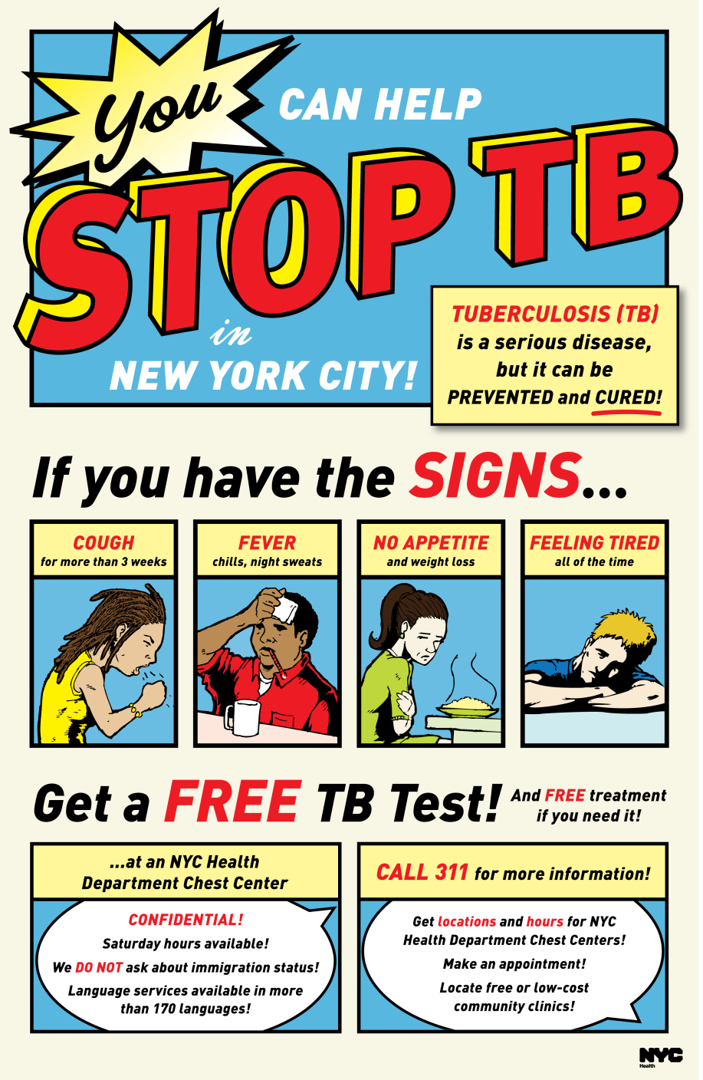
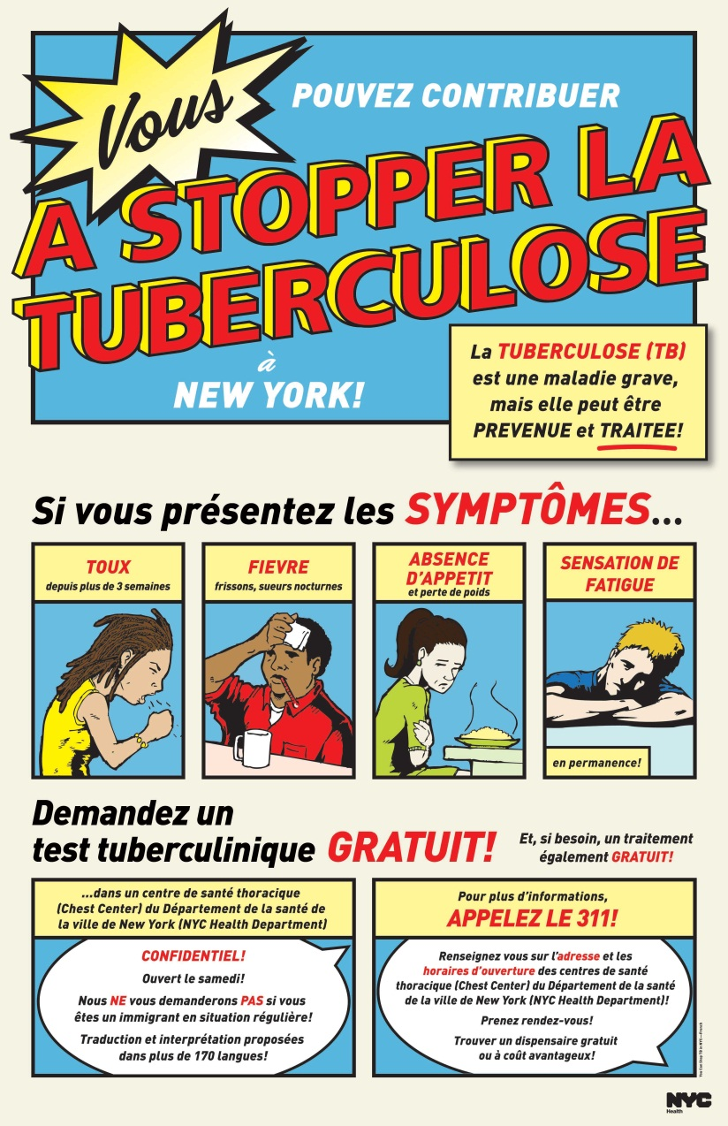


Notes:
46

Slide 47
Improving Provider Reporting

Slide 48
Diseases Reported through Reporting Central
2016 & 2017 (preliminary)
Notes:
n2016= 47,727
We’re looking through our data to explore what is reported by Reporting Central and by whom. As you can see, Reporting Central receives a high volume– particularly for STIs and TB.

Slide 49
Improving Provider Reporting
Learning from Reporting Central (RC) Users
What functionalities do you want to see in RC?
How do we get paper reporters to use RC instead?
What kind of information and guidance do reporters need?
How else can we improve the reporting experience?
Notes:
We need your feedback!

Slide 50
Electronic Case Reporting (ECR)
Automated case reporting from electronic health records
“The future of surveillance”
  Better data for public health
  Less manual work for you!
Pilot activities with health departments around the country
  Including NYC DOHMH!
Tell your IT/Informatics staff if you are interested
  Email rcorrado@health.nyc.gov
  Refer to NYCDOHMH ECR Website

Slide 51
Questions? Feedback?
General questions:
  Licia Wang (lwang4@health.nyc.gov)
TB reporting:
  Muriel Silin (msilin@health.nyc.gov)
Electronic case reporting:
  Rachel Corrado (rcorrado@health.nyc.gov)
  David Lee (dlee8@health.nyc.gov)

Slide 53
Appendix slides

Slide 54

Legal Authority
10th Amendment- powers not specifically delegated to the federal government by the constitution are reserved to the States.
State laws
“Home Rule”
Police powers
Privacy issues
Notes:
Points:
Tenth Amendment-- The powers not delegated to the United States by the Constitution, nor prohibited by it to the States, are reserved to the States respectively, or to the people
Home rule authority. To avoid the need for specific authorization each time a new need arises, most states—either through legislation or by constitutional amendment—have given local governmental units the right of local self-governance, to make decisions concerning their own welfare. Home rule allows local government to carry out public health and other functions without having to seek legislative authority anew for each specific activity. Without constitutional or statutory home rule authority, cities and town governments would not be empowered with their own rule-making functions.
Examples
1905 Jacobsen vs. Massachusetts: Mass statute granted city boards of health authority to mandate smallpox vaccination when necessary for public health and safety. In 1902 an epidemic in Cambridge was occurring, all adults were required to get vaccinated or pay a fine of $5. No provision to force a vaccination. Henning Jacobsen refused on grounds he had a bad reaction to a previous vaccination. He was fined $5. He appealed all the way to the Supreme Court and they upheld State’s decision.
The case of Mary Mallon (1907-1938): George Soper tracks several outbreaks to her and she is taken into custody and tested. First healthy carrier ever found in N America. Offered choice- stop working as a cook or have gall bladder removed, she refused both. Was placed in isolation. After 3 years on North Brother Island bungalow she acquiesced and promised not to cook any longer. In 1915 there were 25 cases of typhoid at Sloan Maternity Hospital, Mary was again taken into custody and sent to N. Brother island.
Courts upheld the New York City health department's authority to require window guards in high-rise residences (home rule).
Courts upheld the authority of the Mayor of San Francisco to declare a “public health emergency” and authorize needle-exchange programs that were otherwise illegal under state law (home rule).
Background
State health agencies: All fifty states, the District of Columbia, and the territories of Guam, Puerto Rico, American Samoa, and the U.S. Virgin Islands have a state or territorial health agency (which we will call a state agency for brevity). Each state health agency is directed by a health commissioner or a secretary of health. Each state also has a chief state health officer, who is the top public sector medical authority in the state. (The same person may fill both positions, or the chief state health officer may answer to the director of the state agency.)
State boards of health: As of 1982, twenty-four states had boards of health. In most of these states, the chief health officer reports to the board. In some states, the chief health officer is a member of the board. More than 90 percent of the state boards are appointed by the governor. The remainder are appointed by professional associations or by the state health agency director. The general responsibilities of state boards of health are policy and budget related.
State and Local Government on the Net
http://www.statelocalgov.net/index.cfm
It is common for city councils to develop their own local public health ordinances or health codes. This autonomous exercise of power is limited by the rule that localities may not assign responsibilities to local health departments that are in conflict with state laws and regulations. Thus public health law is even more of a patchwork at the local level, where health departments are not only responsible for local public health ordinances but must also deal with enforcement authority, responsibility, and limitations established by state law.
Courts have upheld government’s right to protect the greater population, Famous case in Massachussets:

Slide 55
New York City Health Code
Title II,
Article 11
Reportable diseases and conditions
§11.03 Diseases and conditions reportable
… the Department may conduct such surveillance, epidemiologic and laboratory investigation activities as it shall deem necessary … and implement public health measures to control the disease or condition and prevent additional morbidity or mortality
§11.11-49 Exclusion & isolation powers
… A case or carrier of the diseases… shall be excluded until two negative stool samples, taken not less than 24 hours apart …
§11.23 & 11.55 Quarantine & detention
… the health of others … endangered by a case, contact or carrier, or suspected case, contact or carrier of a contagious disease that … may pose an imminent and significant threat … the Commissioner may order the removal and/or detention of such a person …
Notes:
The State Sanitary code and the City Health Code set forth the diseases reportable by law. The health code also sets forth the “police powers” of the health department to prevent the transmission of disease. For example, we have the power to exclude a food handler form work if they are ill with Salmonella. We also have the power to restrain uncooperative individuals though this is seldom used and when it is mostly by the Bureau of TB Control.
Upon receipt of a report submitted pursuant to this section or any other provision of this article or other applicable law, the Department may conduct such surveillance, epidemiologic and laboratory investigation activities as it shall deem necessary to verify the diagnosis, ascertain the source or cause of infection, injury or illness, identify additional cases, contacts, carriers or others at risk, and implement public health measures to control the disease or condition and prevent additional morbidity or mortality.
11.15
(1) A case or carrier of the diseases listed in this paragraph who is a food handler; an enrollee or attendee under the age of six or staff member who has contact with children under the age of six in a school, day care facility, camp or other congregate care setting with children under the age of six; or a health care practitioner in a hospital or medical facility who provides oral care, shall be excluded until two negative stool samples, taken not less than 24 hours apart and no less than 48 hours after resolution of symptoms, are submitted to the Department and until determined by the Department to no longer be a risk to others; provided that, if the patient has received antimicrobial therapy, the first stool sample shall be taken no less than 48 hours after the last dose:
11.23
Upon determining by clear and convincing evidence that the health of others is or may be endangered by a case, contact or carrier, or suspected case, contact or carrier of a contagious disease that, in the opinion of the Commissioner, may pose an imminent and significant threat to the public health resulting in severe morbidity or high mortality, the Commissioner may order the removal and/or detention of such a person or of a group of such persons by issuing a single order, identifying such persons either by name or by a reasonably specific description of the individuals or group being detained. Such person or group of persons shall be detained in a medical facility or other appropriate facility or premises designated by the Commissioner and complying with subdivision (d) of this section.

