Slide 1
Eradication of a Burkholderia cepacia Outbreak in an Intensive Care Unit by a Bundled Environmental
Hygiene Approach
Elsa Santos-Cruz BSc, CIC
September 16, 2015

Slide 2
Disclosures
None

Slide 3
The Mount Sinai Hospital
1,171 bed Academic Tertiary Care Center on Upper East Side of New York City
  Heart, Abdominal Organ, and Bone Marrow Transplantation
Includes 6 Adult Intensive Care Units
6.5 number of ICPs

Slide 4
Background
5 patients identified as colonized and/or infected with B. cepacia complex over a months
Increased prevalence prompts and outbreak investigation
  Retrospective chart review
  Observation of Environmental Hygiene
  Observation of Clinical Practices

Slide 5
Burkholderia cepacia complex
Multidrug-resistant Gram-negative bacilli
  9 genomovars
  Found in soil, water, fruit, and vegetables
Most commonly seen as a pathogen in cystic fibrosis patients
Rarely identified at MSH

Slide 6
Terminal Clean
Environmental cultures obtained from high-touch surfaces
Respiratory surveillance samples obtained on admission to unit and weekly
Patients relocated and ICU closed for terminal cleaning
  Unused medications and supplies were discarded
  Bedside storage cabinet was discarded
  Detail cleaning of all areas in the room using approved hospital disinfectant- Quaternary ammonia, and Bleach wipes, and the use of Ultraviolet germicidal irradiation

Slide 7
Repopulating the Unit
Ventilators Replaced
Patients and staff cohorted based on B. cepacia status
Adenosine triphosphate (ATP) testing and post cleaning environmental sampling

Slide 8
Results
Pre-cleaning environmental cultures revealed B. cepacia complex from multiple high touch surfaces

Slide 9

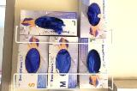
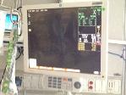
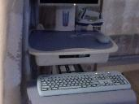
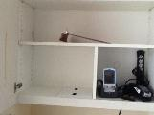
Room A: Respiratory Carrier
Sink Surface |  | Burkholderia cepacia group and other Gram-negative organisms
Outside of Glove Box in Room |  | Burkholderia cepacia group and other Gram-negative organisms
Bedside Monitor |  | Streptococcus spp.
WOW Keyboard |  | Coagulase-negative Staphyloccus
Top Shelf in Room |  | Coagulase-negative Staphyloccus

Slide 10
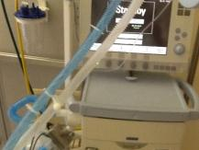
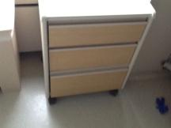
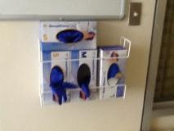
Room B: “Clean” Room
Flat surface of ventilator
Patient bed side storage cabinet inside of the top draw
Gloves box outer surface, inside the patient’s room.
Burkholderia cepacia group and other Gram-negative organisms

Slide 12
Results
Two months after terminal cleaning, cohorting, & enhanced daily cleaning with ATP audit, no further cases of B. cepacia
Audit and respiratory surveillance discontinued
Continuation of enhanced daily cleaning and terminal cleaning at discharge with no further cases for 5 months

Slide 13
Conclusions
Implementation of a daily and terminal cleaning bundle eliminated horizontal spread by eradicating the organism from the patient environment
HAI MDRO incidence in the ICU decreased by 63%
compared to the pre-cleaning period.

Slide 14
Future Directions
Rolling out a similar bundled approach to tackle other MDROs

Slide 15
Thank You
Gopi Patel,MD
Nathaniel Bravo, RN, MA,CIC
Michell Reyes, MT, CIC
Roopa Kohli-Seth, MD
Fran Wallach, MD

