Slide 1

Celebrating APIC’s 50th anniversary

Slide 2
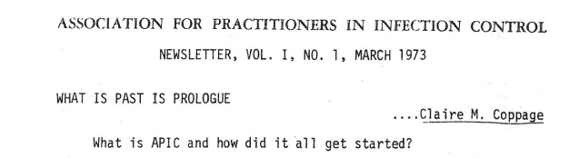
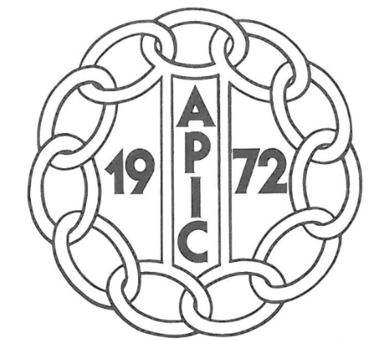
Beginnings
1969: Claire Coppage, organizer of a CDC training program for nurse epidemiologists,
recruits class members to serve on a national steering committee.
1972: APIC is established. Patricia Lynch is elected as the first APIC president.
APIC-New England, founded by Carole DeMille and other ICPs, becomes APIC’s first chapter.
1973: APIC’s first national conference is held in Toronto.
https://apic.org/50th-anniversary-timeline/
https://apic.org/Resource_/TinyMceFileManager/History/PS1204_HIST_REVISED_NO_ADS.pdf

Slide 3
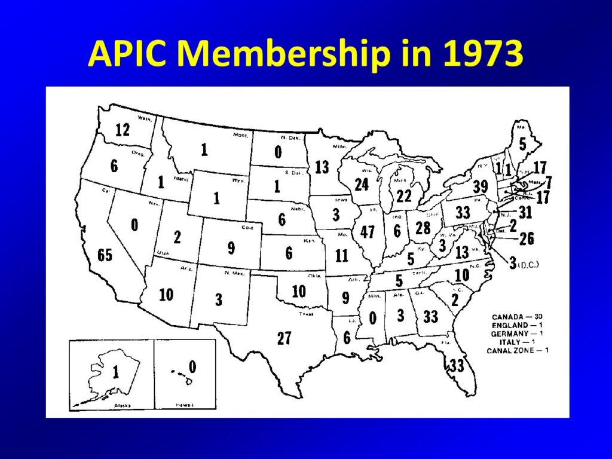
https://apic.org/50th-anniversary-timeline/

Slide 4
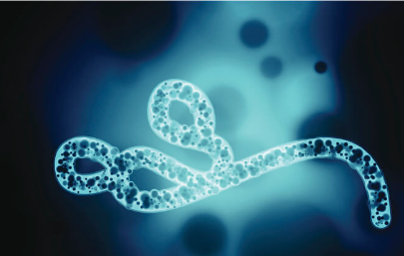
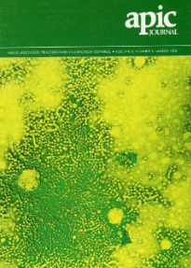
breakthroughs
1974: The CDC released a nationwide study, the Study on the Efficacy of Nosocomial Infection
Control, also known as the SENIC Project. Results determined that hospitals with IP
programs experienced significantly lower rates of HAIs than hospitals without IPs.
1976: Ebola outbreak in Zaire; Legionella is discovered after an outbreak at an American
Legion convention in Philadelphia.
1978: APIC participates in the first “Infection Control Nurse” international conference,
sponsored by the World Health Organization in Denmark and releases first position
statement entitled, “Statement on Infection Control Programs”.
https://apic.org/50th-anniversary-timeline/ https://apic.org/Resource_/TinyMceFileManager/History/PS1204_HIST_REVISED_NO_ADS.pdf

Slide 5
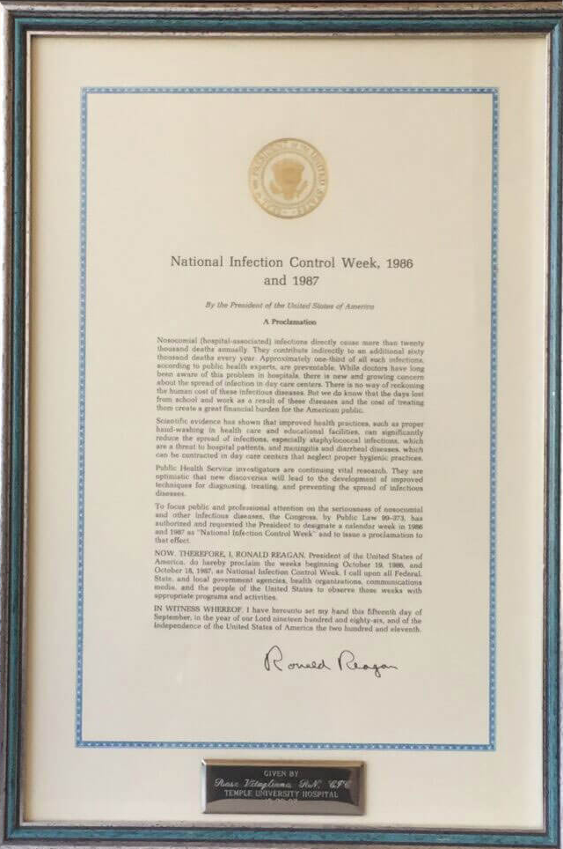
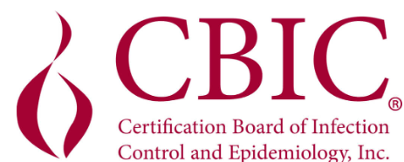
APIC’s Impact Grows
1980: The first issue of the American Journal of Infection Control (AJIC) is published.
1981: The APIC Certification Association (later known as CBIC) is established;
first AIDS cases are identified in California.
1983: First CBIC certification exam is administered.
1985: U.S. faces TB resurgence due to HIV.
1986: International Infection Prevention Week is established be President Reagan;
Infection control becomes a Condition of Participation by CMS (then known as the
Health Care Financing Administration; APIC membership reaches 7,000+ members.

Slide 6
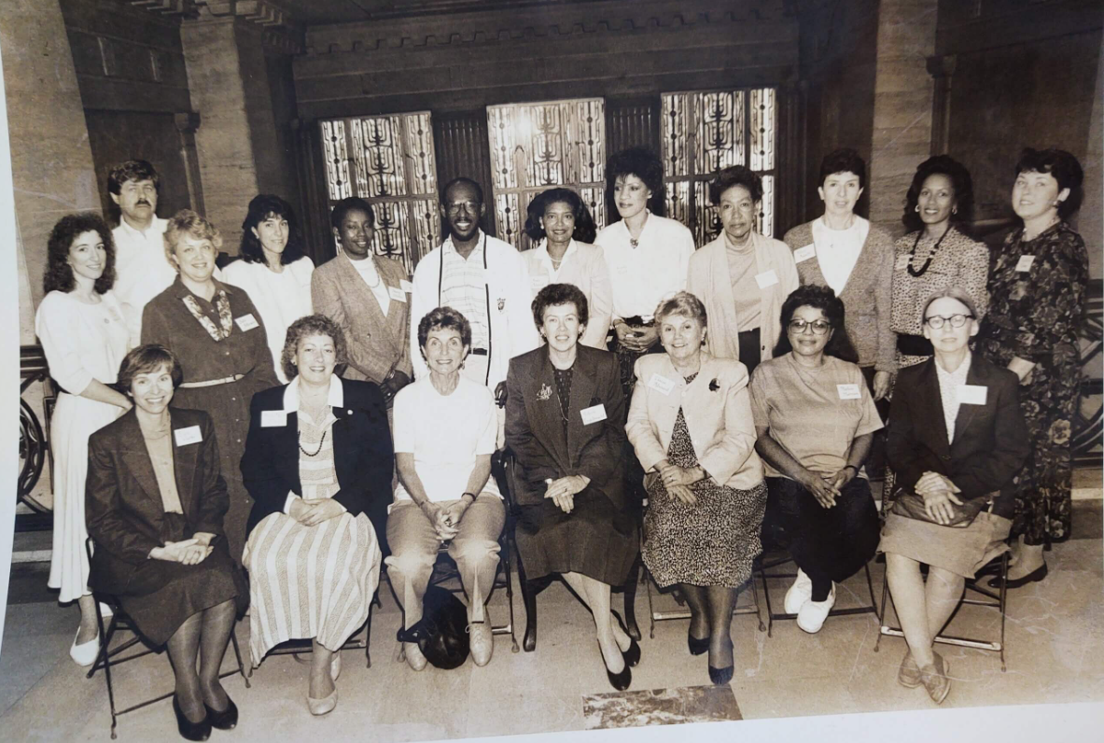
Organizational Changes
1989: CDC holds field courses, “Management Skills for ICNs”.
This NYC class includes professionals who are now well-known NYS leads!
1993–1994: APIC changes its name to Association for Professionals in Infection Control
and Epidemiology, establishes its office in Washington D.C., hires its first
CEO and starts its Research Foundation.
1995: APIC publishes its first hand hygiene guideline, authored by Dr. Elaine Larson. Dr.
Larson becomes Editor of AJIC, a position she holds for 25 years, until her
retirement in 2019.

Slide 7

APIC Expands
1996: APIC Infection Control and Applied Epidemiology: Principles and Practice is published (Currently known as
APIC Text). The APIC.org website is launched!
2000: The APIC Guideline for Endoscopy is published. Endemic measles eliminated in the U.S.
2002: APIC/CBIC is represented on TJC Infection Control Advisory Panel.
2003: The SARS-CoV (Severe Acute Respiratory Syndrome) pandemic begins. Canada requests US IPs to
assist. Ann Marie Pettis and Linda Greene, future APIC presidents, respond to the call.

Slide 8

APIC on the move
2005: APIC releases position paper on mandatory public reporting of HAIs, published in AJIC. Paves the way for state, then federal HAI reporting to CDC’s NNIS, which later became NHSN. APIC publishes a State of the Science Report entitled, The Economic Impact of Infection Control”.
2006: Membership tops 10,000!
2007: APIC’s first major research study about MRSA prevalence is published.
2008: The term, “Infection Preventionist” is coined by APIC.

Slide 9
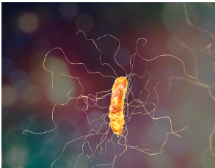
Emerging Threats
2008: APIC holds first national conference on C. difficile. The APIC/SHEA Guideline, Infection
Prevention and Control in the Long-Term Care Facility, is published.
2012: APIC develops the first competency model for an Infection Preventionist.
2014: Ebola outbreak in West Africa begins; APIC members provide on the ground
training and assist in response; APIC testifies before congress that only 6% of IPs
feel well-prepared to receive an Ebola patient
2019: The arrival of SARS-CoV-2.
2020: WHO declares COVID-19 a global pandemic. In December 2020, the First COVID-19 vaccine,
developed by Pfizer-BioNTech, is released under EUA for U.S. public aged 16 years and older.

Slide 10


APIC and Infection Prevention:
Looking Back, Moving Forward
2021: APIC creates the IP Academic Pathway to accelerate careers of new IPs.
The first virtual APIC conference is held.
2022: APIC celebrates its 50th anniversary!

