Slide 1
Infection Control Training in
Dental Health Care
Elsa Santos – Cruz,BSc.,CIC
Infection Preventionist
Notes:
07/16/96
##
*
*

Slide 2


The great aim of education is not knowledge but action
By
Herbert Spencer

Slide 3
Objectives
Define healthcare-associated disease transmission, engineering controls, safe injection practices and work practice control;
 Describe specific high-risk procedure and practices that increase dental health-care personnel (DHCP) and patient exposure to other potentially infectious material (OPIM);
 Describe specific measures to prevent transmission of bloodborne pathogens from patient to patient, DHCP to patient and patient to DHCP via contaminated equipment;
Notes:
07/16/96
##
*
*

Slide 4

Objectives cont.
 Identify work practice controls designed to eliminate the transmission of bloodborne pathogens during the use of sharp instrument and
 Identify where engineering or work practice controls can be utilized to prevent exposure to bloodborne pathogens

Slide 5
Definition:
Infection - a condition in which the body is invaded by micro-organisms which may cause damage to the body system
Control – to regulate or maintain
Healthcare-associated infections (HAIs) – infections associated with healthcare delivery in any setting (e.g., hospital, home care).
Engineering Controls – (e.g., sharp disposal containers, safer medical devices) that isolate or remove the bloodborne pathogens hazard from the workplace.
Injection safety (or safe injection practices) – a set of measures taken to perform injections in an optimally safe manner for clients, HCWs, and others.
Work Practice Controls –that reduce the like hood of exposure to bloodborne pathogens by altering the manner in which a task is performed (e.g., prohibiting recapping of needles by two hand-handed technique).

Slide 6
Pathogen
disease –causing bacteria
Source
reservoir that allows pathogens to survive
Mode
transmission from source to host
Entry
pathogen may enter the host
Susceptible
Host
one who is not immune

Slide 7
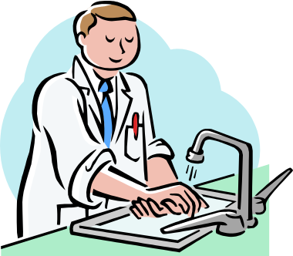
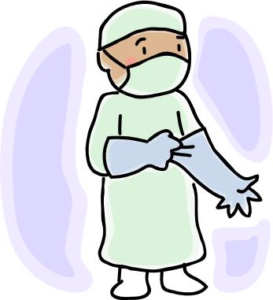
Breaking the chain of infection-
Applied to all health care workers
A licensed health care provider can lose their license if they do not practice proper infection control protocols.
Opportunistic micro-organisms live
in warm and most environments.

Slide 8

Standard Precautions
DHCP shall assume that all blood or other potentially infectious material from any patient is contaminated with a pathogen such as HIV or HBV.
This policy is regardless of the patients location, age, diagnosis, or the quantity of blood or body fluid generated.

Slide 9
Personnel Health Element
1. Education and training
2. Immunizations
3. Exposure prevention and post -exposure management
4. Medical condition management and of work related illness and restriction
5. Health record maintenance

Slide 10
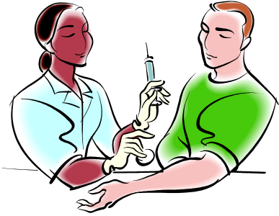
Occupational exposure
Occupational exposures should be considered urgent medical concerns to ensure timely post exposure management and administration of HBIG, hepatitis B vaccine, and/or HIV PEP.

Slide 11

Occupational Exposures
Occupational Exposure
means reasonably anticipated skin, eye, mucous membrane, or parenteral contact with blood or other potentially infectious materials that results from the performance of a DHCP’s duties.

Slide 12

Other Potentially infectious material (OPIM)
  Blood
  Cerebrospinal fluid
  Pleural fluid
  Pericardial fluid
  Peritoneal fluid
  Amniotic fluid
  Synovial fluid
  Semen
  Vaginal secretions
  Any visibly bloody fluid
  Unfixed tissue
Vomit, Saliva, Tears, Sweat, Urine and Feces are not considered infectious unless visibly contaminated with blood

Slide 13

Exposure Procedure
1.Wash the area with soap and water. If mucous membrane (mouth) is exposed, flush with water only.
2.Report immediately to the administrative personnel in charge of OPIM exposure.
3.Complete an incident report form
4. Evaluate the source status in reference to
Bloodborne pathogens.
5. Plan for appropriate follow-up.
Notes:
07/16/96
##
*
*

Slide 14

Assessment of Exposure
All blood and other potentially
infectious exposures to employees are assessed for their risk
The nature of the exposure, infectiousness of the source, patient and other risk factors are evaluated
Notes:
07/16/96
##
*
*

Slide 15
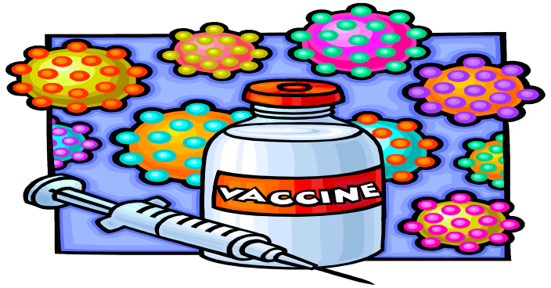
Bloodborne Pathogens
Hepatitis B – Vaccination is an effective means of preventing Hepatitis B infection.
More infectious than HIV virus.
Hepatitis C – can be transmitted through unsafe injection practices and procedures.
HIV – confidential tests require your name and other personal information. Your family physician can get the results
Notes:
07/16/96
##
*
*

Slide 16

Personal Protective Attire
Personal Protective Equipment (P P E) is specialized clothing or equipment worn by an employee for protection against a hazard. General work clothes (e.g., uniforms, pants, shirts or blouses) not intended to function as protection against a hazard are not considered to be personal protective equipment.

Slide 17
Components of Standard Precautions:
Work Practices which prevent DHCP exposure with potentially infectious body fluids.- PPE
Gloves:
  Used when you expect your hands to have contact with any body fluid or non-intact skin or mucous membrane
Gowns:
  Used when you could expect to have any body fluid, non-intact skin, or mucous membrane make contact with your body/clothing
Mask, eye protection, face shield:
  Used when you could expect to have any body fluid spray or splash toward your eyes, nose, and/or mouth

Slide 18



Slide 19
Masks, Protective eyewear, Face shields
Wear a surgical mask and either eye protection
with solid side shields or face shield to protect mucous membrane of the eys, nose and mouth
Change masks between patients
Clean reusable face protection between patients; if visible soiled, clean and disinfect.

Slide 20
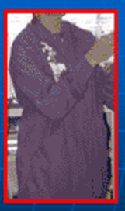
Protective Clothing
Wear gowns, lab coat, or
uniform that covers skin and clothing likely to be soiled with infectious material
Change if visibly soiled
Remove all barriers before leaving the work area

Slide 21
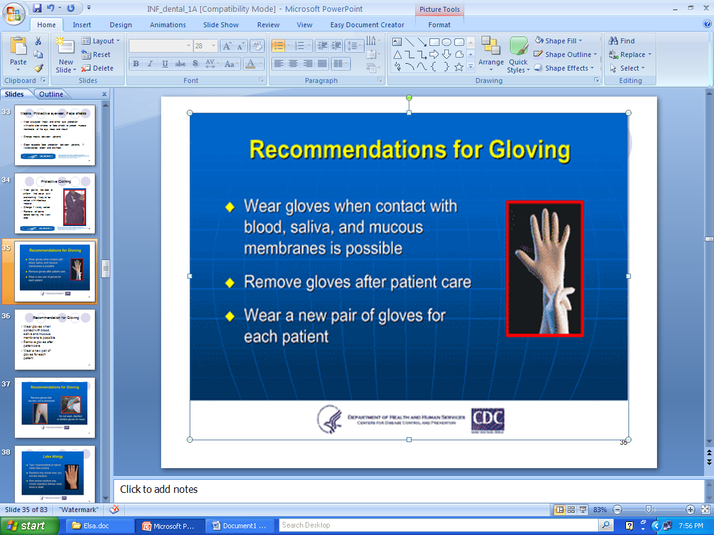
Recommendation for Gloving
Wear gloves when contact with blood, saliva and mucous membrane is possible
Remove gloves after patient care
Wear a new pair of gloves for each patient

Slide 22
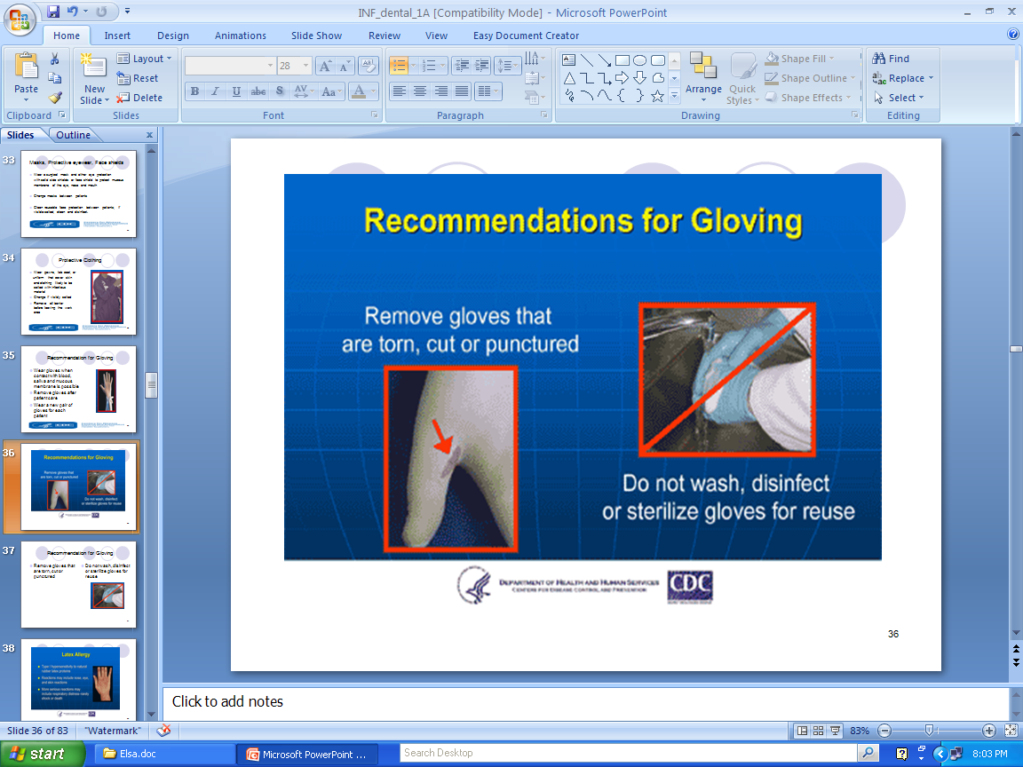
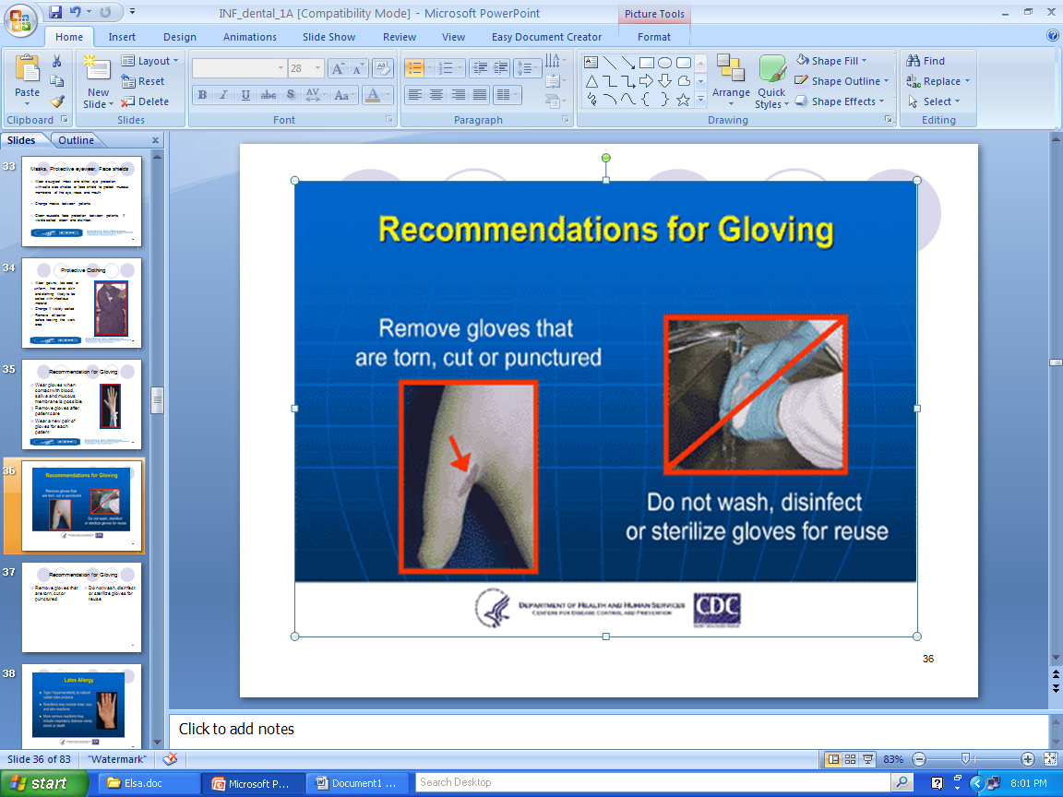
Recommendation for Gloving
Remove gloves that are torn, cut or punctured
Do not wash, disinfect or sterilize gloves for reuse

Slide 23
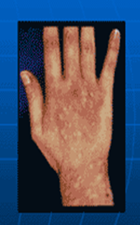
Latex Allergy
Type 1 hypersensitivity to natural rubber latex protein
Reactions may include nose, eye and skin reaction
More seroius reaction may include respiratory distress – rarely shock or death

Slide 24
General Recommendations
Contact Dermatitis and Latex Allergy
Educare DHCP about reaction associated with frequent hand hygiene and glove use
Get medical diagnosis
Screen patients for latex allergy
Ensure a latex safe environment
Have latex-free kits available

Slide 25
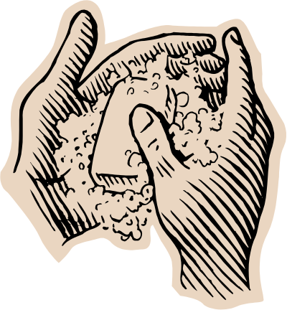
Work Practices
Methods of reducing transmission
of communicable diseases
  Handwashing-the single most effective way to prevent infection
    When hands are obviously soiled
    After each handling of individual patients
    Before putting on gloves
    After removing disposable gloves
    Beginning and end of shift
Notes:
07/16/96
##
*
*

Slide 26

Handwashing
Hands and other skin surfaces must be washed as soon as possible after contact with blood or body fluids
The use of gloves does not eliminate the need for handwashing
Notes:
26

Slide 27
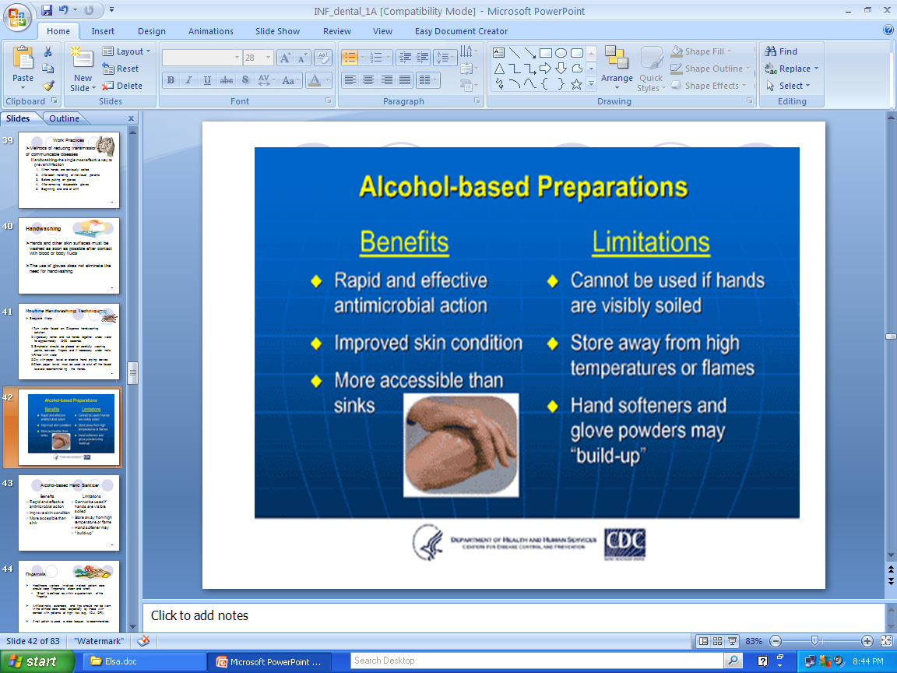
Alcohol-based Hand Sanitizer
Benefits
Rapid and effective antimicrobial action
Improve skin condition
More accesible than sink
Limitations
Cannot be used if hands are visible soiled
Store away from high temperature or flame
Hand softener may
“ build-up”

Slide 28
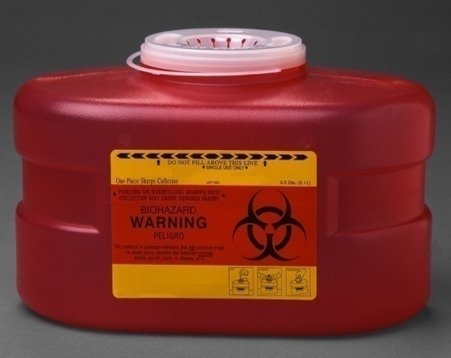
Proper disposal of waste
Sharp container – the receptacle must be puncture-resistant
Needles, sharps, and syringes
Contaminated materials – items soaked with blood and other infectious body fluids and blood filled IV bags and tubings
Red Bag –with Biohazard sign

Slide 29
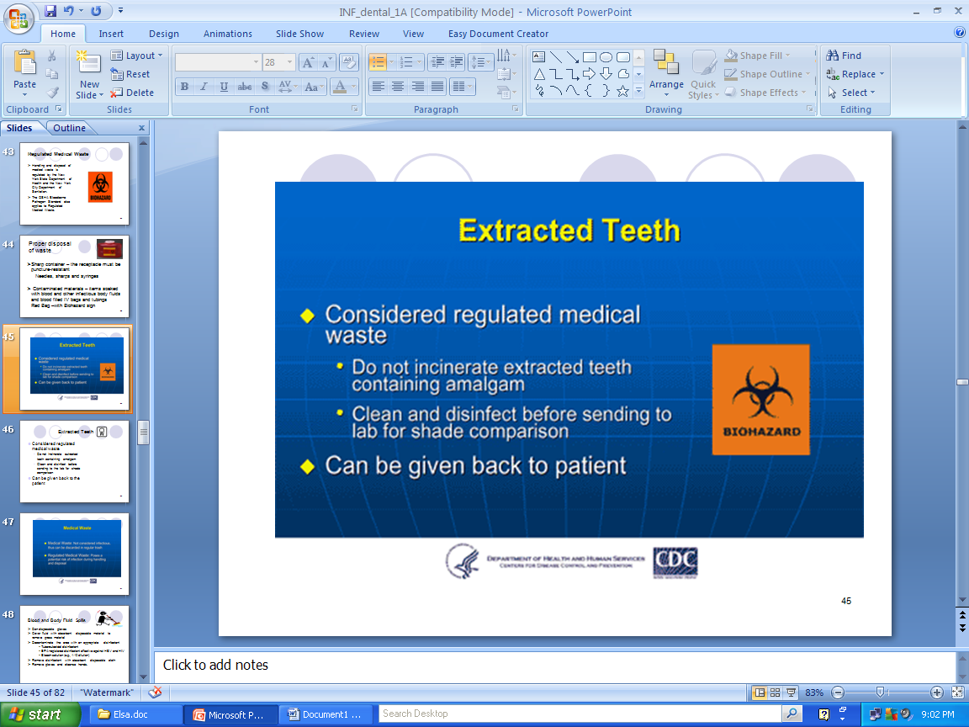
Regulated Medical Waste
Handling and disposal of medical waste is regulated by the New York State Department of Health and the New York City Department of Sanitation.
The OSHA Bloodborne Pathogen Standard also applies to Regulated Medical Waste
Regulated Medical Waste: poses a potential risk of infection during handling and disposal

Slide 30

Extracted Teeth
Considered regulated medical waste
  Do not incinerate extracted teeth containing amalgam
  Clean and disinfect before sending to the lab for shade comparison
Can be given back to the patient

Slide 31

Blood and Body Fluid Spills
Don disposable gloves
Cover fluid with absorbent disposable material to remove gross material
Decontaminate the area with an appropriate disinfectant
    Tuberculocidal disinfectant
    EPA-registered disinfectant effective against HBV and HIV
    Bleach solution (e.g., 1:10 dilution)
Remove disinfectant with absorbent disposable cloth
Remove gloves and cleanse hands.

Slide 32
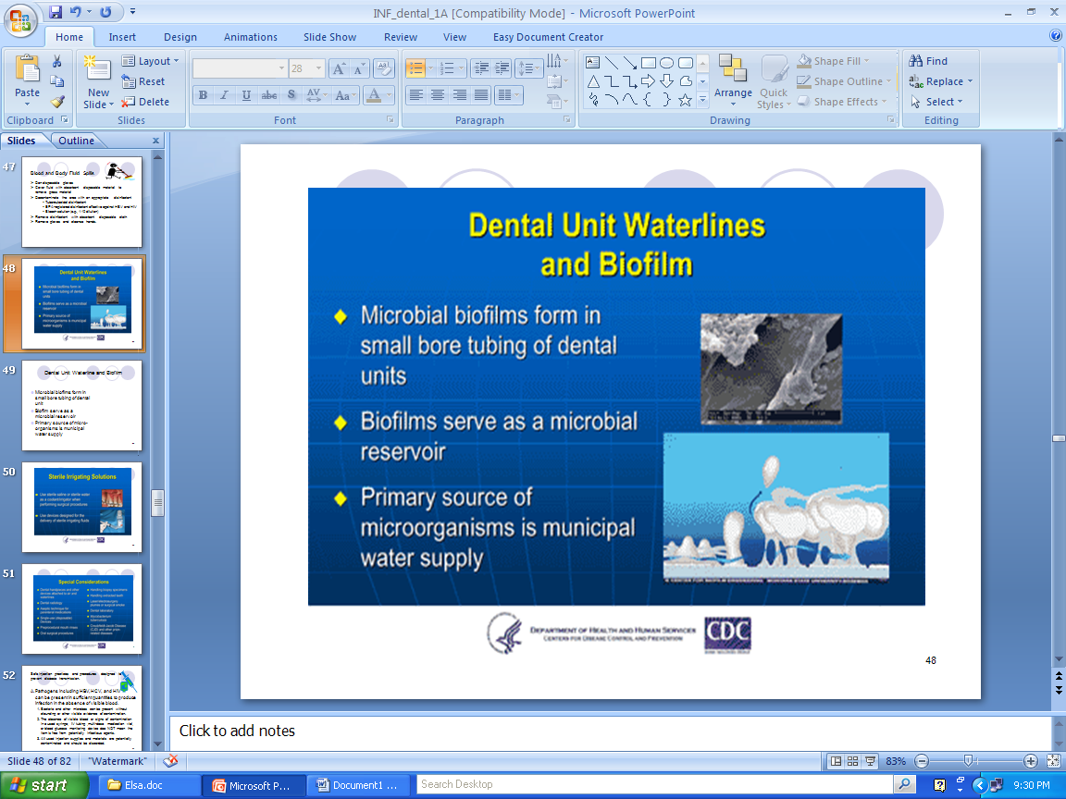
Dental Unit Waterline and Biofilm
Microbial biofilms form in small bore tubing of dental unit
Biofilm serve as a microbial reservoir
Primary source of micro-organisms is municipal water supply

Slide 33
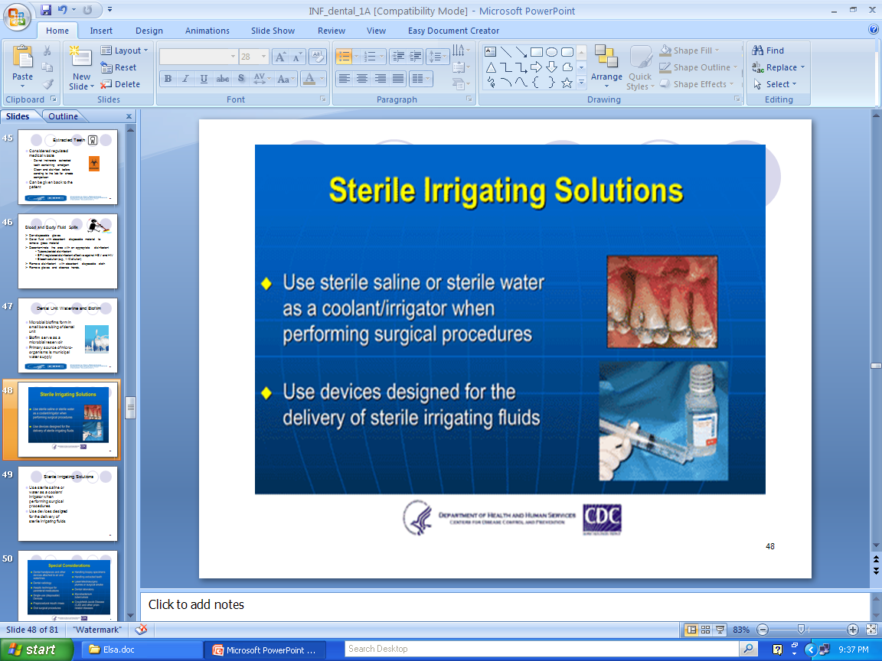
Sterile Irrigating Solutions
Use sterile saline or water as a coolant/ irrigator when performing surgical procedures
Use devices designed for the delivery of sterile irrigating fluids

Slide 34

Safe injection practices and procedures designed to prevent disease transmission.
Parenteral Medications
IV tubings, bags connections, needles and syringes are single-use disposable
Single dose vials
  Do not administer to multiple patients even if the needle on the syringe is changed
  Do not combine leftover content for later use

Slide 35
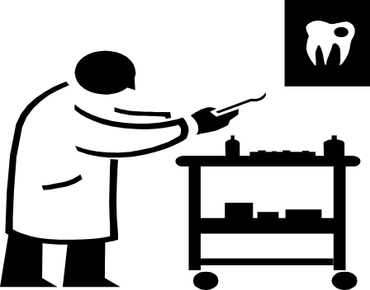
Maintenance of safe environment:
Definition
  1. Contamination - the presence of
  microorganisms on an item or surface
  2. Cleaning - the process of removing all foreign material from object using water and detergents.
  3. Decontamination - the use of physical or chemical means to remove microorganism where they are no longer capable of transmitting infectious particles.
  4. Disinfection - the use of chemical to eliminate microorganisms but not necessarily all microbial form.
  5. Sterilization - the use of chemical and physical procedure to destroy all microbial life.
Notes:
07/16/96
##
*
*

Slide 36

Cleaning, Disinfection, and Sterilization of Equipment
Expectations of DHCP who are not directly
responsible for cleaning and reprocessing
  Knowledge of basic concepts of cleaning, disinfection, and sterilization.
  Appropriate application of safe practices for handling devices and equipment.
  Identify professional responsibility for maintaining a safe patient care environment.

Slide 37
Single-Use (Disposable) Devices
Intended for use on one patient during a single procedure
Usually not heat tolerant
Can not be reliably cleaned
Example: Syringe needle, prophylaxis cups, and plastic orthodontic brackets

Slide 38
Critical Instruments
Penetrate mucous membrane or contact bone, bloodstream or other sterile tissue (of the mouth)
Heat sterilize between uses or use single use, disposble devices
Example includes surgical instruments, scaple blades, peridontal scalers, and surgical dental burs

Slide 39
Semi-critical Instruments
Contact mucous membrane but do not penertate soft tissue
Heat sterilize or high level disinfect
Example: dental mouth mirrors, amalgam condensers, and dental handpieces

Slide 40
Non-critical Instruments
Contact intact skin
Clean and disinfect using low to intermediate level disinfectant
Examples: X-ray heads, facebow, pulse oximeter, blood pressure cuff

Slide 41
Instrument Processing Area
Use a designated processing area to control quality and safety
Divide processing area
  Receiving, cleaning, and decontamination
  Preparation and packaging
  Sterilization
  Storage

Slide 42
Non-critical Instruments
Contact intact skin
Clean and disinfect using low to intermediate level disinfectant
Examples: X-ray heads, facebow, pulse oximeter, blood pressure cuff

Slide 43
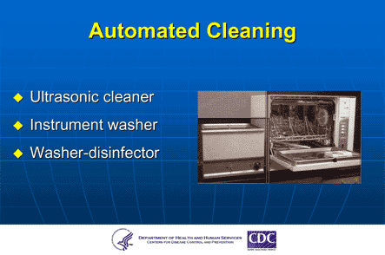
Automated Cleaning
Ultrasonic cleaner
Instrument washer
Washer-disinfector

Slide 44
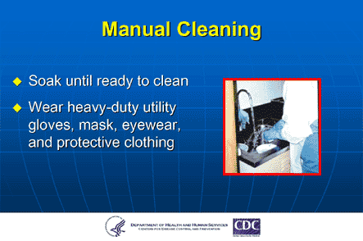
Manual Cleaning
Soak until ready to clean
Wear heavy utility gloves, mask, eyeware and protective clothing

Slide 45
Preparation and Packaging
Critical and semi-critical items that will be stored should be wrapped or placed in containers before heat sterilization
Hinged instrument opened and unlocked
Place a chemical indicator inside the pack
Wear heavy-duty puncture-resistant utility gloves

Slide 46
Heat-Based Sterilization
Steam sterilization
  Gravity displacement
  Pre-vacuum
Dry heat
Unsaturated chemical vapor

Slide 47
Sterilization Monitoring-
Types of Indicators
Mechanical
  Measure time, temperature, pressure
Chemical
  Change in color when physical parameter is reached
Biological (spores test)
  Use biological spores to assess the sterilization process directly

Slide 48
Storage of Sterile and Clean Items and Supplies
Use date- or event-related shelf life practices
Examine wrapped items carefully prior to use
When packaging of sterile items is damaged, re-clean, re-wrap, and re-sterilize
Store clean items in dry, closed or covered containment

Slide 49
Categories of Environmental Surfaces
Clinical contact surfaces
  High potential for direct contamination from spray or splatter or by contact with DHCP’s gloved hand
Housekeeping surfaces
  Do not come in contact with patients or devices
  Limited risk of disease transmission

Slide 50
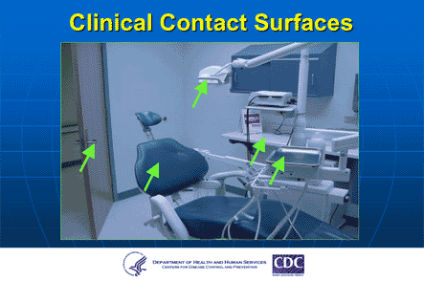
Clinical Contact Surfaces

Slide 51
General Cleaning Recommendations
Use barrier precautions (e.g., heavy duty utility gloves, mask, protective eyewear) when cleaning and disinfecting environmental surfaces
Physical removal of microorganisms by cleaning is as important as disinfection process
Follow manufacturer’s instruction for proper use of EPA-registered hospital disinfectant
Do not use high-level disinfectants on environmental surfaces

Slide 52
Dental hand pieces and Other devices attached to Air and Waterline
Clean and sterilize intraoral devices that can be removed from air and waterlines
Follow manufacturer’s instructions for cleaning, lubrication, and sterilization
Do not use liquid germicide or ethylene oxide

Slide 53
Components of Devices Permanently Attached to Air and Waterlines
Do not enter patient’s mouth but may become contaminated
Use barriers and change between uses
Clean and intermediate – level disinfect the surface of devices if visibly contaminated

Slide 54
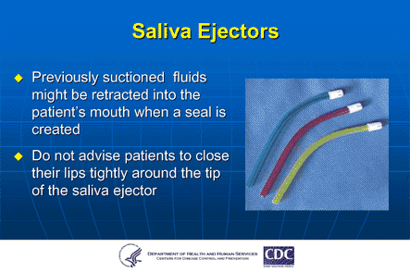
Saliva Ejectors
Previously suctioned fluids might be retracted into the patient’s mouth when a seal is created
Do not advise patients to close their lips tightly around the tip of saliva ejectors

Slide 55
Dental Radiology
Wear gloves and other appropriate personal protective equipment as necessary
Heat sterilize heat tolerant radiographic accessories
Transport and handle exposed radiographs so that they will not become contaminated
Avoid contamination of developing equipment

Slide 56
Dental Laboratory
Clean and disinfect prosthesis and impressions
Wear appropriate PPE until disinfection has been completed
Clean and heat sterilize heat-tolerant items used in the mouth

Slide 57
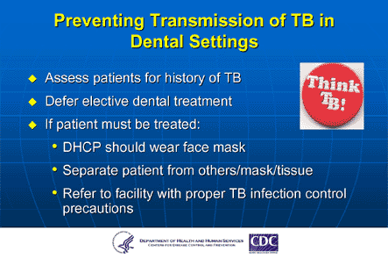
Preventing transmission of TB in Dental Setting
Assess patients for history of TB
Defer elective dental treatment
If patient must be treated:
DHCW should wear face mask
Separate patient from others
Refer to facility with proper TB infection control precautions

Slide 58

Annual Physical Examination
Yearly check of Tuberculin Skin Test–TST (PPD) for all Health Care Workers.
If positive, annual assessment
of Tuberculosis symptoms.
Yearly Flu vaccination –start on October.

Slide 59

Be Safe – Protect Yourself
Do the right thing
Be smart

