Slide 1
Are hospital floors an underappreciated reservoir for transmission of health care-associated pathogens?
AUTHORS: Abhishek Deshpande MD, PhD et al.
AJIC 45 (2017) 336-8
BeverlyAnn Collins RN MS CIC
Kings County Hospital Center
APIC Greater NY Chapter 13 – Journal Club – 3/15/17

Slide 2
Objectives of Study
Authors endeavored to validate recent reports which documented
contamination of hands of health care workers (HCWs) by objects/items contaminated with bacteria from hospital floors
Background
Efforts to improve disinfection usually focus on surfaces that are frequently
touched by the hands of patients and HCWs (e.g., bed rails and call buttons)
Health care facility floors are often heavily contaminated; limited attention has
been paid to disinfection of floors because they are not frequently touched
Floors are a potential source of transmission because they are often contacted
by objects that are subsequently touched by hands (e.g., shoes and socks)

Slide 3
Cleaning in each hospital entailed high-touch surfaces in C difficile
(CDI) isolation rooms daily with bleach wipes
Floors were cleaned during admission only if visibly soiled and were mopped
with a quaternary ammonium-based disinfectant after patient discharge
One of the 5 hospitals used ultraviolet room disinfection to supplement
cleaning after discharge of a C. diff patient

Slide 4
Study Methods
5 participating Cleveland-area hospitals participated in study
BBL CultureSwabs (Becton Dickinson, Cockeysville, MD) were used to sample 1-sq ft areas of the floor in the bathroom and areas adjacent to the bed in C. diff isolation rooms as well as in 2 or 3 randomly selected non-CDI rooms on the same patient care unit
Rooms were cultured either during the patient stay or after completion of cleaning after patient discharge
After swab collection, a 2 × 2 cm pre-moistened gauze pad was used to sample an adjacent 1-sq ft area for C difficile broth enrichment cultures
Cultures were processed for MRSA, VRE, and C difficile
At least 30 rooms were cultured in each hospital.

Slide 5
In addition to surface cultures,
A point prevalence survey was done to assess the frequency with which high-touch objects were present on floors in randomly selected patient rooms in each facility
Information was collected on the number and types of high-touch objects on floors
To assess potential for transfer of pathogens from the floor to hands
via fomites, research personnel picked up items in direct contact
with the floor using either their bare hands (nonisolation rooms)
or sterile gloves (CDI or other isolation rooms)
Bare hands were cultured before and after contact with the objects, whereas gloved hands were cultured only after contact.

Slide 6
RESULTS FOR ROOM CONTAMINATION
A total of 318 floor sites were sampled in 159 patient rooms (2 sites per room).
Floor contamination was common in CDI and non-CDI rooms, and C diff was the most frequently recovered pathogen
MRSA and VRE were recovered significantly more often from floors in CDI versus non-CDI rooms (P < .05), whereas recovery of C diff was similar in CDI
and non-CDI rooms (P = 0.6)
The frequency of contamination was similar for each of the 5 hospitals and from room and bathroom floor sites
In comparison to rooms cultured during the patient stay (n = 109), rooms cultured after post-discharge cleaning (n = 50) had less contamination with MRSA (13%) and VRE (35%);

Slide 7
C difficile contamination was higher after post-discharge cleaning (53%) as compared to during hospital stay (44%)

Slide 8
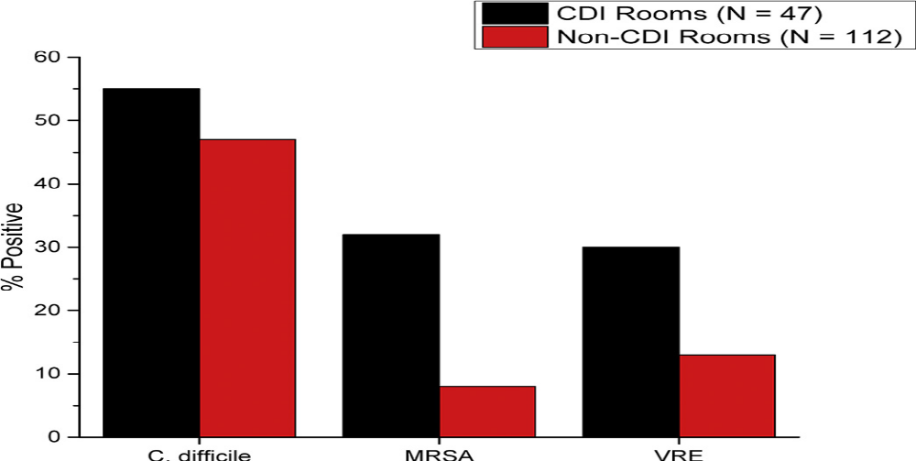
Recovery of Clostridium difficile, methicillin-resistant Staphylococcus aureus, and vancomycin-resistant enterococci from floors in patient rooms from 5 hospitals in northeast Ohio.

Slide 9
RESULTS FOR HIGH TOUCH OBJECTS ON FLOOR
100 occupied rooms surveyed (n = 10-25 per hospital)
41 (41%) had 1 or more high-touch objects in contact with the floor (range,
1-4 objects per room). High-touch objects included:
Personal items (e.g. clothing, canes, and cell phone chargers)
Medical devices or supplies (e.g. pulse oximeter, call button, heating pad,
urinal, blood pressure cuff, wash basin, and heel protector)
Linen such as bed sheets, pillow, and towels
Bare or gloved hand cultures were collected for 31 of the high-touch objects
MRSA, VRE, and C difficile were recovered from 6 (18%), 2 (6%), and 1 (3%),
respectively from these cultures

Slide 10
SUMMARY
Floors in patient rooms were frequently contaminated with health care-associated pathogens
It was not uncommon for high-touch objects to be in direct contact
with the floor
Touching these objects resulted in transfer of pathogens to hands
These results suggest that floors in hospital rooms could be an underappreciated source for dissemination of pathogens

Slide 11
STUDY implications
Because floors are frequently contaminated, it would be reasonable to educate health care personnel and patients that they should avoid placing high-touch objects on the floor
Studies are needed to examine the efficacy of current floor cleaning and disinfecting strategies in removing potential pathogens from floors (esp. C diff) since spores were frequently recovered from floors in both CDI and non-CDI rooms
Authors also suggested that studies are needed to assess the potential for other modes of dissemination from floors (e.g. shoes, wheelchairs, and other wheeled equipment) since a recent study suggested that wheelchairs could be a source of pathogen dissemination in health care facilities

Slide 12
STUDY LIMITATIONS
The study only studied C difficile spores and 2 gram-positive vegetative pathogens
Additional studies are needed to investigate contamination of floors with gram-negative pathogens and viruses
None of the hospitals used sporicidal agents on floors and therefore the frequency of C difficile spore contamination is likely to be higher than in facilities that use sporicidal agents
Researchers did not determine whether non-CDI rooms with positive floor cultures for C difficile had recently housed CDI patients
Results may underestimate the frequency of MRSA and VRE contamination on floors because the culture swab method is less sensitive than the gauze pad with broth enrichment method that was used for C difficile cultures
Sporicidal disinfectants are not typically used on floors

Slide 13
References
1. Donskey CJ. Does improving surface cleaning and disinfection reduce health
care-associated infections? Am J Infect Control 2013;41:S12-9.
2. Weber DJ, Rutala WA, Miller MB, Huslage K, Sickbert-Bennett E. Role of hospital surfaces in the transmission of emerging health care-associated pathogens: norovirus, Clostridium difficile, and Acinetobacter species. Am J Infect Control 2010;38:S25-33.
3. Fekety R, Kim KH, Brown D, Batts DH, Cudmore M, Silva J Jr. Epidemiology of antibiotic-associated colitis; isolation of Clostridium difficile from the hospital environment. Am J Med 1981;70:906-8.
4. Shanom A, Muzslay M, Wilson P. A novel quantitative sampling technique for detection and monitoring of Clostridium difficile contamination in the clinical environment. J Clin Microbiol 2015;53:2570-4.
5. Wong T,Woznow T, Petrie M, Murzello E, Muniak A, Kadora A, et al. Postdischarge decontamination of MRSA, VRE, and Clostridium difficile isolation rooms using 2 commercially available automated ultraviolet-C emitting devices. Am J Infect Control 2016;44:416-20. Epub ahead of print.
6. Mahida N, Boswell T. Non-slip socks: a potential reservoir for transmitting multidrug-resistant organisms in hospitals? J Hosp Infect 2016;94:273-5.
7. Koganti S, Alhmidi H, Tomas M, Cadnum JL, Jencson A, Donskey CJ. Evaluation of hospital floors as a potential source of pathogen dissemination using a nonpathogenic virus as a surrogate marker. Infect Control Hosp Epidemiol 2016;37:1374-7.
8. Sitzlar B, Deshpande A, Fertelli D, Kundrapu S, Sethi AK, Donskey CJ. An environmental disinfection odyssey: evaluation of sequential interventions to improve disinfection of Clostridium difficile isolation rooms. Infect Control Hosp Epidemiol 2013;34:459-65.
9. Peretz A, Koiefman A, Dinisman E, Brodsky D, Labay K. Do wheelchairs spread pathogenic bacteria within hospital walls? World J Microbiol Biotechnol 2014;30:385-7.

Slide 14
