Slide 1
Professional Development Education AWARD
Nancy J. Hogle, MPH, MS, BSN, RN, CIC
Department of Infection Prevention and Control
New York Presbyterian Hospital
September 19, 2018

Slide 2
Methods Used to Study for CIC exam
3-5 month time frame
APIC Infection Prevention Certification Review Course 3.0 ($350)
  APIC On-Line Education module
  Final assessment
APIC text On-line ($169)
APIC chapter 13 Certification study Group (FREE)
APIC Certification Study Guide, 6th edition ($99)

Slide 3
APIC Infection Prevention Certification Review Course 3.0
Identification of Infectious Processes
Surveillance and Epidemiological Investigation
Preventing/Controlling the Transmission of Infections Agents
Employee/Occupational health
Management and communication
Education and research
Environment of care
Cleaning, disinfection, sterilization, asepsis
Certification review-practice exam

Slide 4
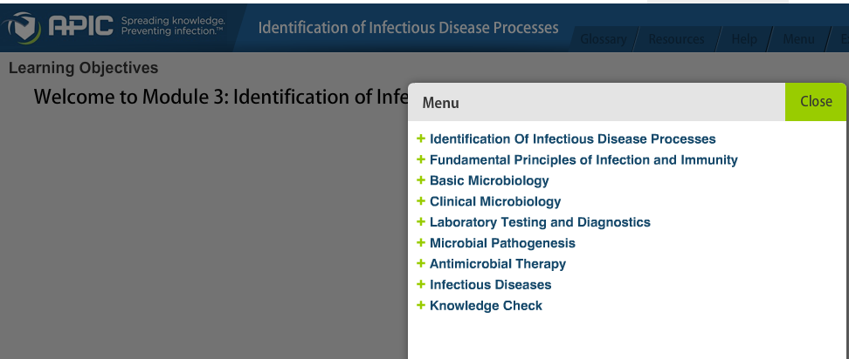
APIC Infection Prevention Certification Review Course 3.0
Each section has a menu

Slide 5
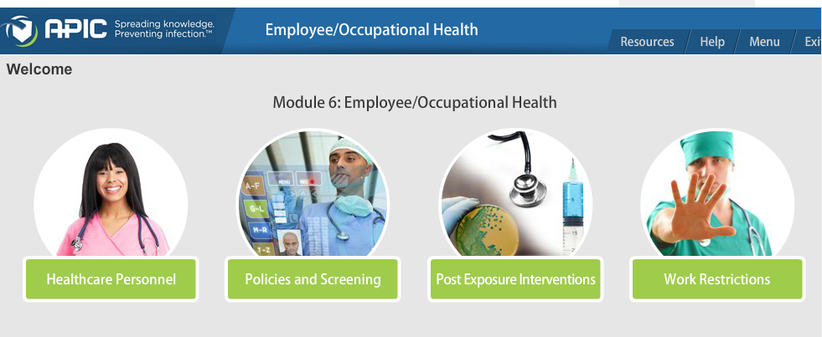
APIC Infection Prevention Certification Review Course 3.0
Each section has multiple sub-sections

Slide 6
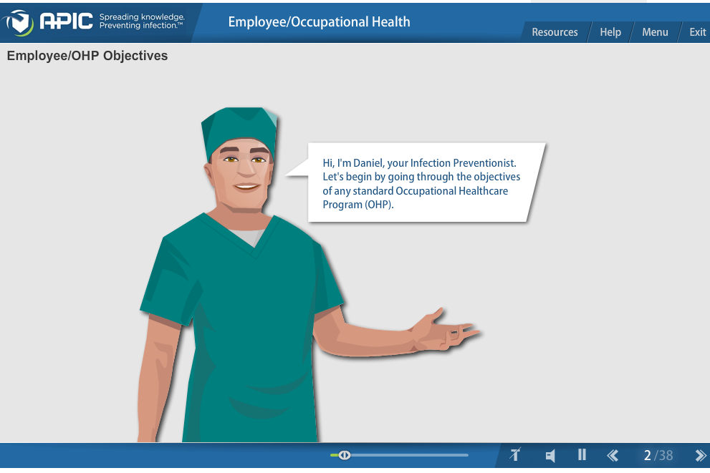
Infection Prevention Certification Review Course 3.0

Slide 7
APIC Infection Prevention Certification Review Course 3.0
Exam questions at the end of each section
Certification Review - Final Assessment
  134 questions
  Gives answers and rationale for all questions
  Can only take it once
Take course evaluation for CEUs

Slide 8
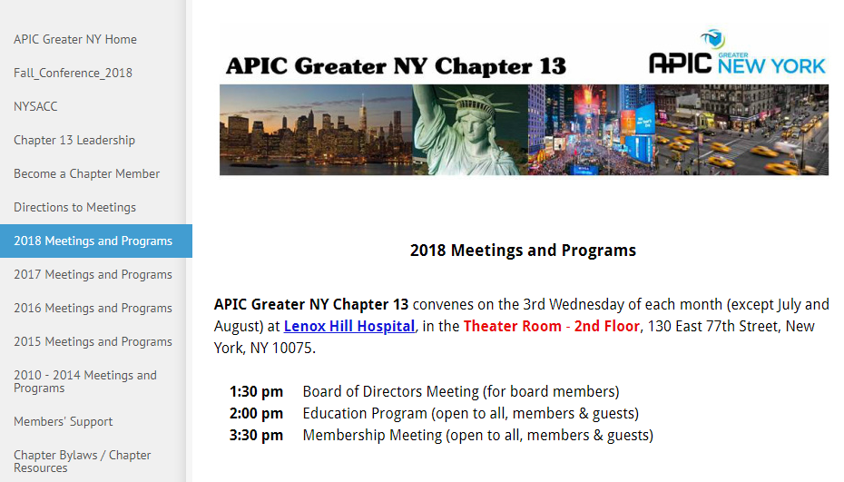
APIC chapter 13 Certification study Group

Slide 9
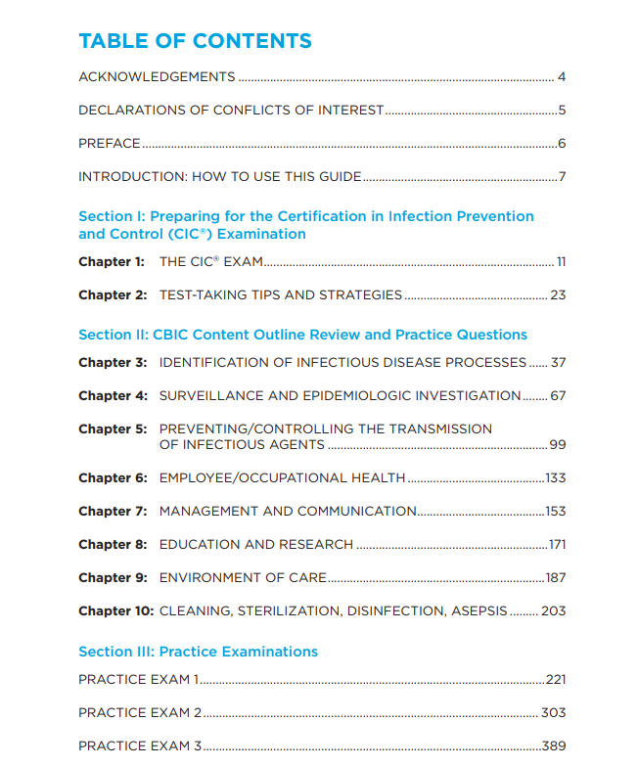
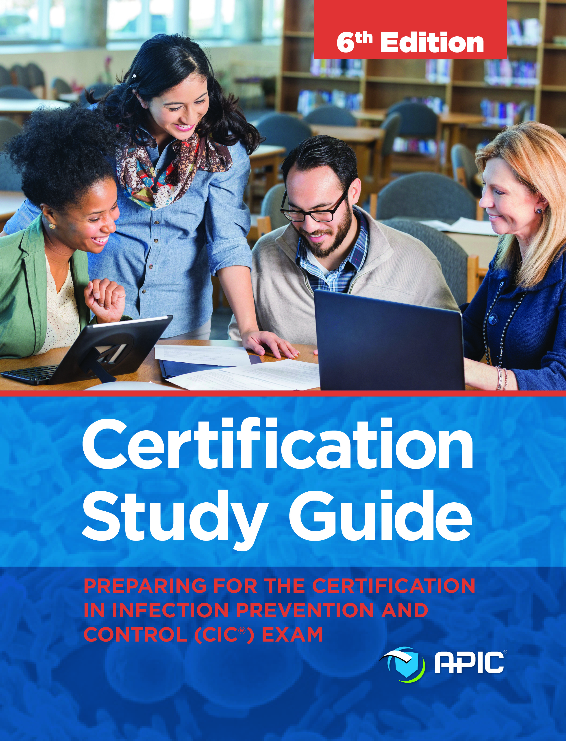
APIC Certification Study Guide, 6th edition

Slide 10
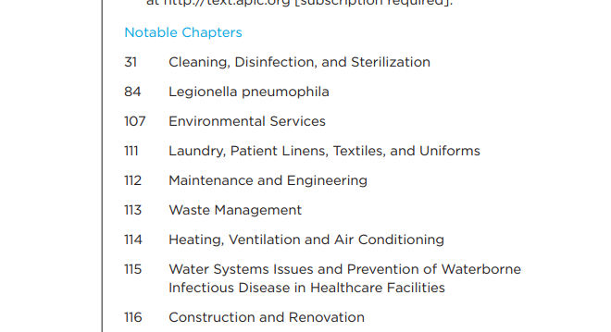
APIC Certification Study Guide, 6th edition

Slide 11
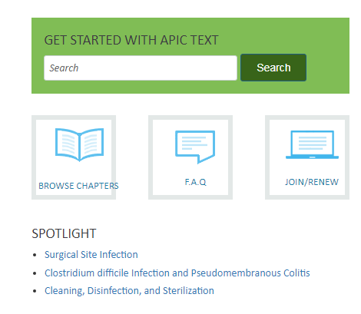
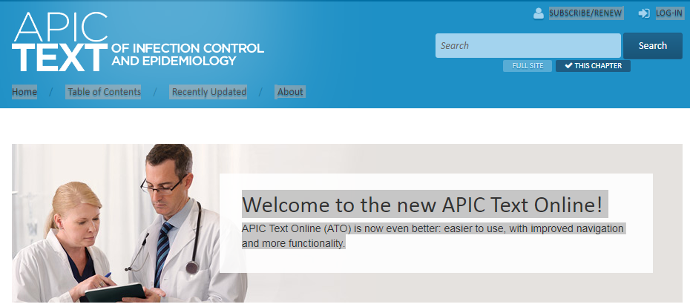
APIC text On-line

