Slide 1
Infection ControL Champion 2017
Presentation
Steve Bock BSN RN CIC FAPIC
NYU Langone Health
January 17, 2018

Slide 2
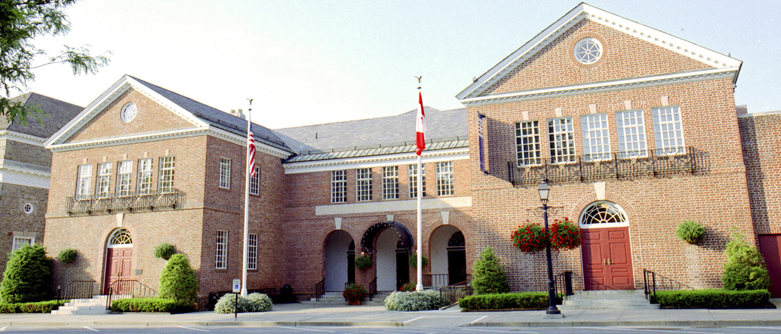
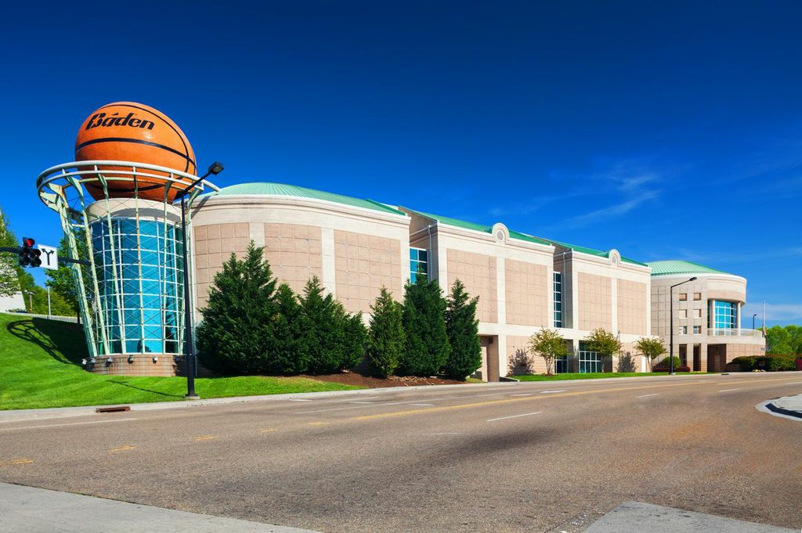
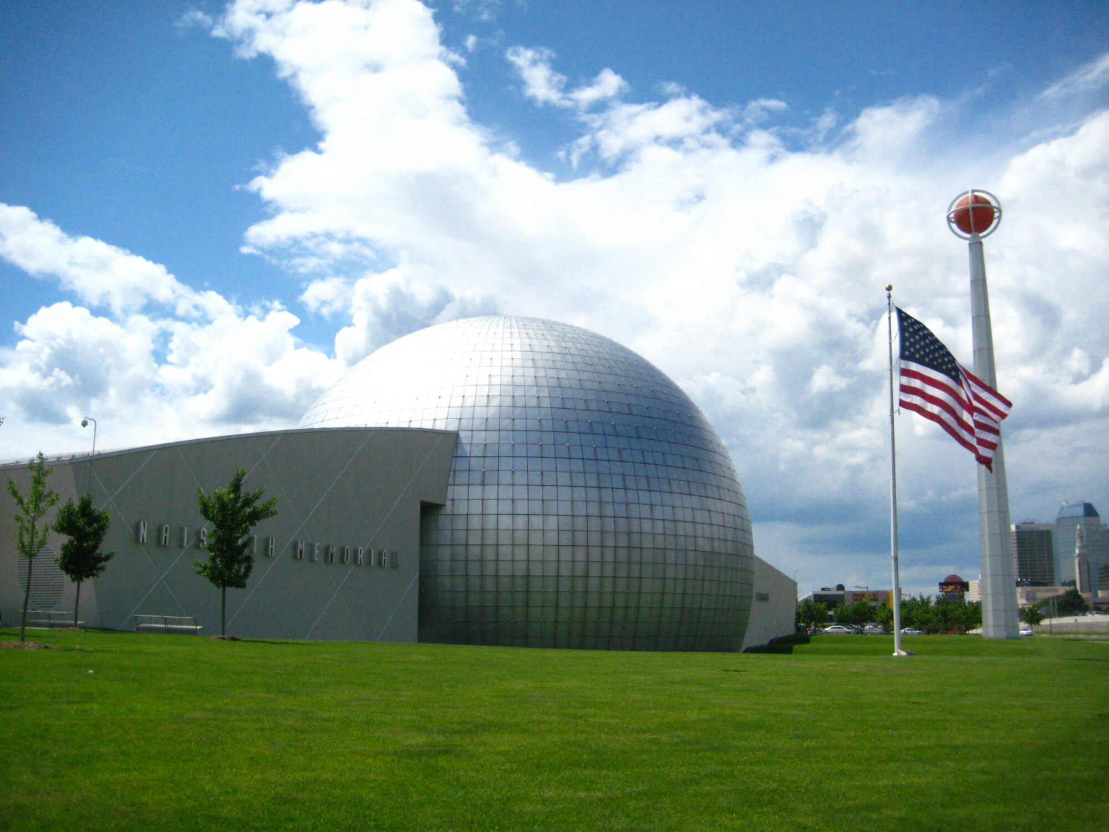
Hall of Fame!

Slide 3
Thank You APIC Greater NY Chapter 13!
APIC Greater NY Chapter 13 – Past Infection Control Champions =
our Hall of Fame!
2016 - Sarah Petrello RN CIC
2015 - Robin Haag RNC MA
2014 - Beth Nivin MPH
2013 - Sandra Hardy RN MA
2012 - David Calfee MD
2011 - Cynthia Spry MA MSN
2010 - George Allen PhD CIC
2009 - Kate Gase MPH CIC
2008 - Brian Koll MD
2007 -
2006 - Rachel Stricof MPH
2005 - Robert Holtzman MD

Slide 4
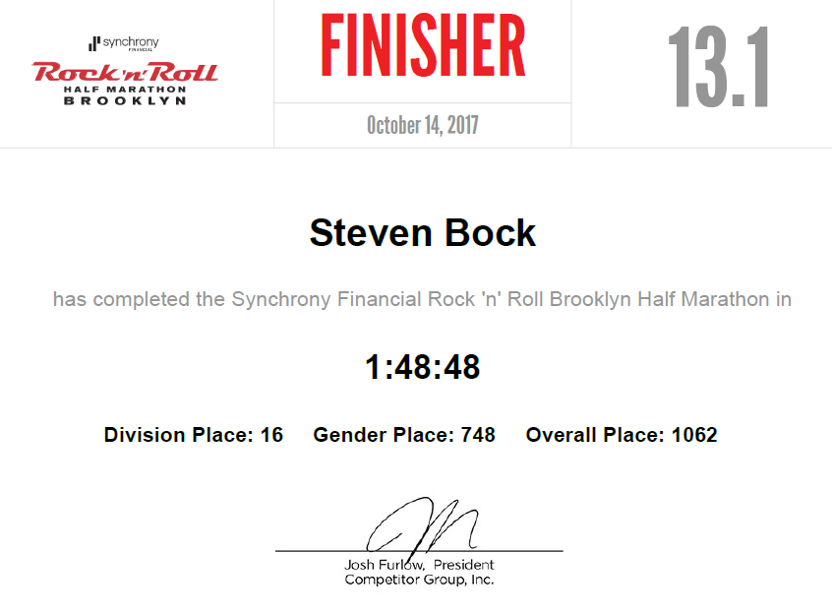
Me, a champion?
Google – “define Champion”
1: warrior, fighter a champion of his king
2: a militant advocate or defender a champion of civil rights
3: one that does battle for another's rights or
honor
4: a winner of first prize or first place in
competition
5: a person who enthusiastically supports,
defends, or fights for a belief or principle.

Slide 5
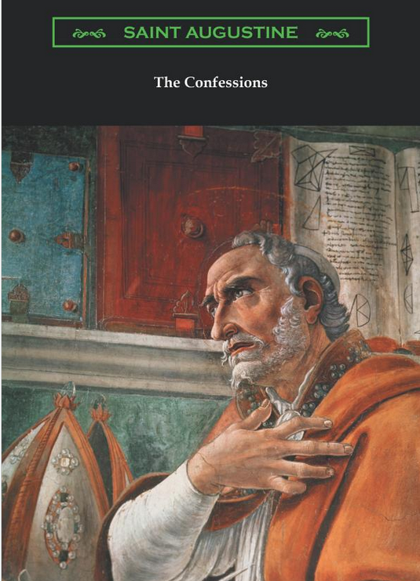
Who, me?
“Quaecumque Sunt Vera” …translated is "Whatsoever things are true“
Northwestern University, Evanston, IL
✰ WCAS ‘83 – BA Biochemistry
✰ NURS ‘86 – BSN Nursing
Finally, brothers and sisters, whatever is true, whatever is noble, whatever is right, whatever is pure, whatever is lovely, whatever is admirable—
If anything is excellent or praiseworthy—think about such things.
Whatever you have learned or received or heard from me, or seen
in me—put it into practice.

Slide 6
Champion Recipe
Google: “how do you become a champion?”
Become a student of the game....
Find great teachers and learn as much as you can from them....
Develop a strict training routine....
Train your body and your mind....
Find ways to motivate yourself....
Discipline yourself and reward yourself.

Slide 7
Champion Recipe
How to Think Like a Champion: Three Tips to Winning Ways*
Jonathan Fader Ph.D. (Psychology Today 5/19/14)
“Nobody has a “champion’s mind” gene. You are not born a champion, you become one—and the empowering truth is that almost anybody can become a champion.”
Champions think gold. They never aim for silver, nor do they settle for it. They are always on a personal mission to perform at their best.
Technical: Your mechanics, your coordination.
Tactical: The strategies you use to outmaneuver your opponent on the court, field, etc.
Physical: Strength, stamina, and conditioning.
Mental: Your thoughts, your feelings, your emotions. Note that this is different from Tactics—it doesn’t relate to the mental techniques you use on your opponents, but upon yourself. It’s more about psyching yourself up than psyching someone else out.

Slide 8

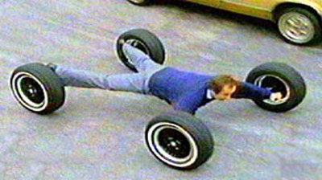
Champion Recipe
APIC Greater NY – how you, too, can be a champion!
Technical: Your “mechanics / coordination”
means we need to know some basic IPC
stuff…to recognize HAIs, and recommend how
to stop them from happening.
Become Certified! How long are you going to
wait? Then, pursue FAPIC!
Remember St. Paul’s admonition to a church
in the ancient Roman Empire – “put it into
practice.”
Be present at work, at chapter meetings,
even the conferences we hold…participate, but go beyond just showing up.
Pay attention to opportunity (be ready to help…you don’t have to run a marathon)

Slide 9
Champion Recipe
APIC Greater NY – how you, too, can be a champion!
Tactical: The strategies you use to outmaneuver
your opponent on the court, field, etc.
Physical: Strength, stamina, and conditioning.
Who is our opponent? Sometimes it is us…What
is our problem? Not doing something…
So, do something!
Volunteer. There are many ways to help!
Some ways you can help involve small amounts of time and effort. You just have to be able to lift small weights!
Some ways you can help involve more than just a few minutes of effort. OK, so you have to lift heavy weights!

Slide 10

Champion Recipe
APIC Greater NY – how you, too, can be a champion!
Mental: Your thoughts, your feelings, your emotions…
You have to decide to help, just like you have to
decide to keep running even when your legs are tired.
Running a half marathon is 50% physical and
50% mental!
You can share the work – no one needs to do
all the work solo. No one here does, not even the
famous folks on our chapter’s hall of fame.
Are you ready to become an APIC champion?
I hope so!

Slide 11

APIC Greater NY Chapter 13 – I say

Slide 12


NYU Langone Health
NYU Langone Brooklyn
NYU Langone Orthopedic Hospital

