Slide 1
Journal Club
APIC Greater NY Chapter 13
Abegail Pangan, RN, BSN, CIC

Slide 2
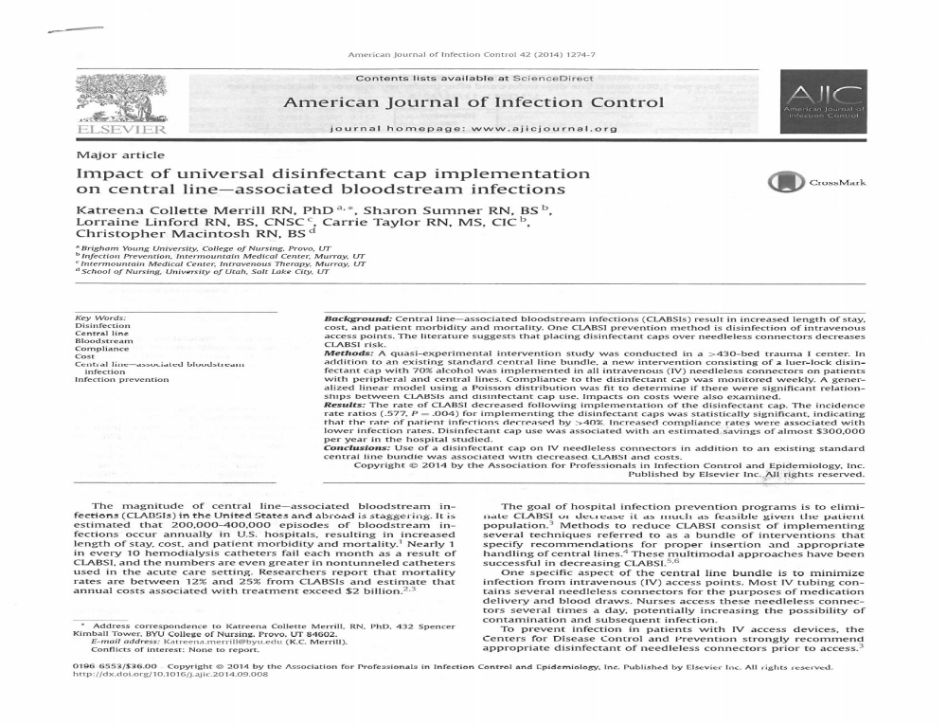

Slide 3
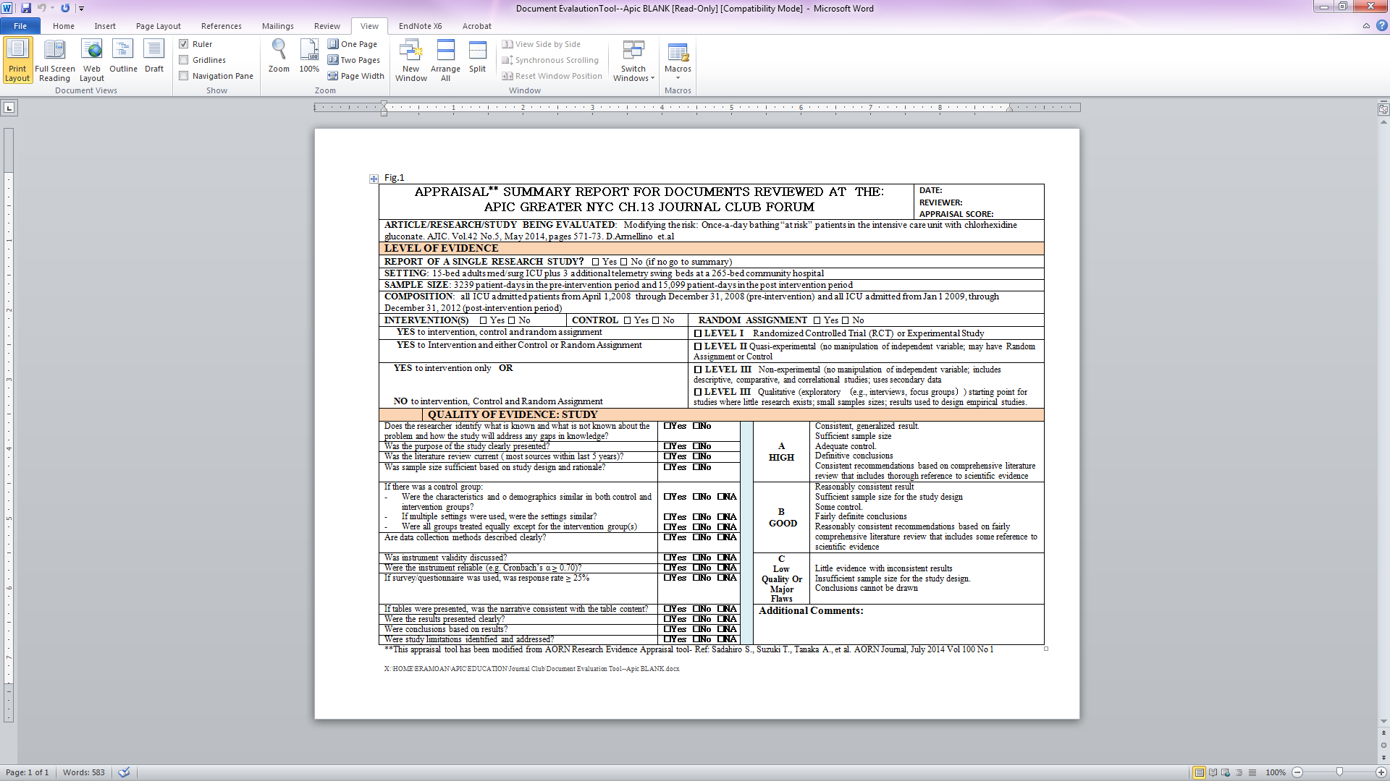

Slide 4
Summary
This study investigated the impact of universal cap implementation on Central Line Associated Bloodstream Infections (CLABSI)
Association of decreased CLABSI and costs with the use of disinfectant cap on IV needleless connectors in addition to an existing standard central line bundle

Slide 5
Relevance
It is estimated that 200,000 to 400,000 episodes of bloodstream infections occur annually in US hospitals
Mortality rates are between 12% to 25% from CLABSIs with an estimated annual costs associated with treatment exceed $2 billion
CDC strongly recommends appropriate disinfectant of needleless connectors prior to access.

Slide 6
Setting and design
Quasi experimental short interrupted series intervention study
430-bed tertiary care trauma I center in the US Mountain West
A luer lock disinfectant cap with 70% alcohol was implemented in all patients (newborn & adults) with peripheral and central lines
Patients residing on 13 inpatient units beginning January 2012
Excluded in this study- ED, ambulatory care, surgical services, L &D, postpartum and well baby nursery

Slide 7
Objective
To analyze the effect of universal IV needleless connector disinfectant cap implementation on the rate and type of CLABSI and estimated costs in a large tertiary care center
The relationship between disinfectant cap compliance and CLABSI rates is explored.

Slide 8
Intervention
The disinfectant cap (Curos Disinfecting Port Protector) is a plastic threaded device that contains 70% isopropyl alcohol.
Effective within 3 mins of application and may be used up to 7 days
The disinfectant cap was placed universally on all needleless IV connectors
Compliance is monitored weekly and reported to each unit to encourage use

Slide 9
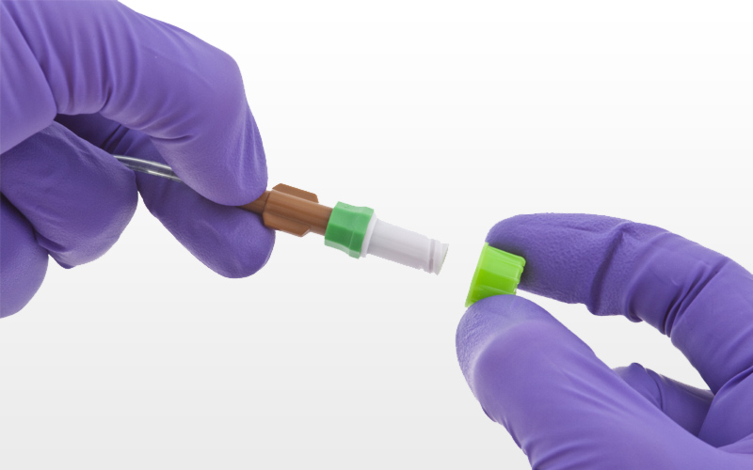
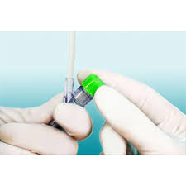

Slide 10
Data collection
Compliance was determined by audits conducted 1-2 times per week beginning Feb 2012 and lasting throughout the study period
Compliance rate per central line patient = number of disinfectant caps present divided by the number of total available needleless connectors
Data aggregated was reported to the nursing department and reported to each manager

Slide 11
Analysis
The rate of CLABSI and costs were compared for 12 months before (2011) and after (2012).
Data was analyzed using IBM SPSS version 22.0
A generalized linear model using a Poisson distribution
Model was adjusted for the number of line days per patient

Slide 12
Results
Rate of CLABSI per 1,000 line days decreased following implementation of disinfectant cap
The rate of patient infections decreased by >40% with the use of disinfectant cap
After implementation- estimated annual savings of $282,840
Decrease of 68 patient hospital days and prevented one death

Slide 13
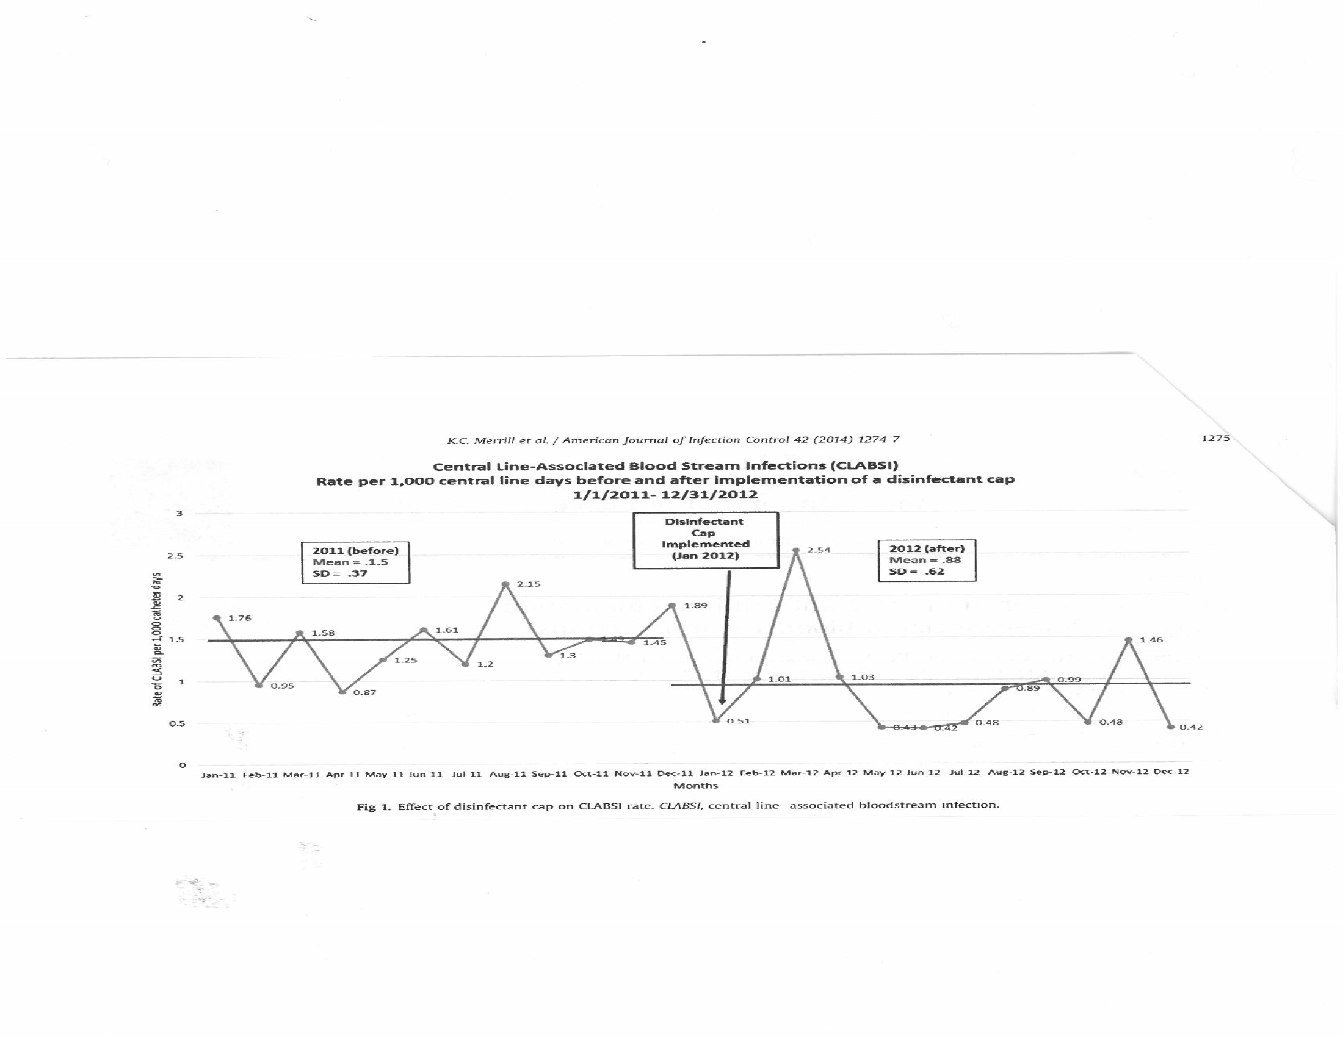

Slide 14
Limitations
Ongoing education was implemented simultaneously which might have affected the CLABSI rates
Use of disinfectant cap may have resulted in increased vigilance to compliance which was not measured in the study
Costs estimates were based on projections in literature- they might not reflect true costs

Slide 15
Conclusion
Relationship between implementation of disinfectant cap and reduced rates of CLABSI, cost, length of stay and mortality
Consider to implement new product technology
Success in implementation of quality improvement and compliance rates in CLABSI prevention
This improvement model might prove successful in other infection prevention campaigns.

Slide 16
Implications
Level II random assignment- Quasi experimental
Grade B- Reasonably consistent result
- Reasonable sample size
- Fairly definite conclusion with consistent
recommendations based on fairly
comprehensive literature review
- No control group
Other suggestions or comments?

