Slide 1

APIC Chapter 13:
Journal Club Presentation
Ranekka Dean, PhD RN CIC FAPIC
President-Elect

Slide 2
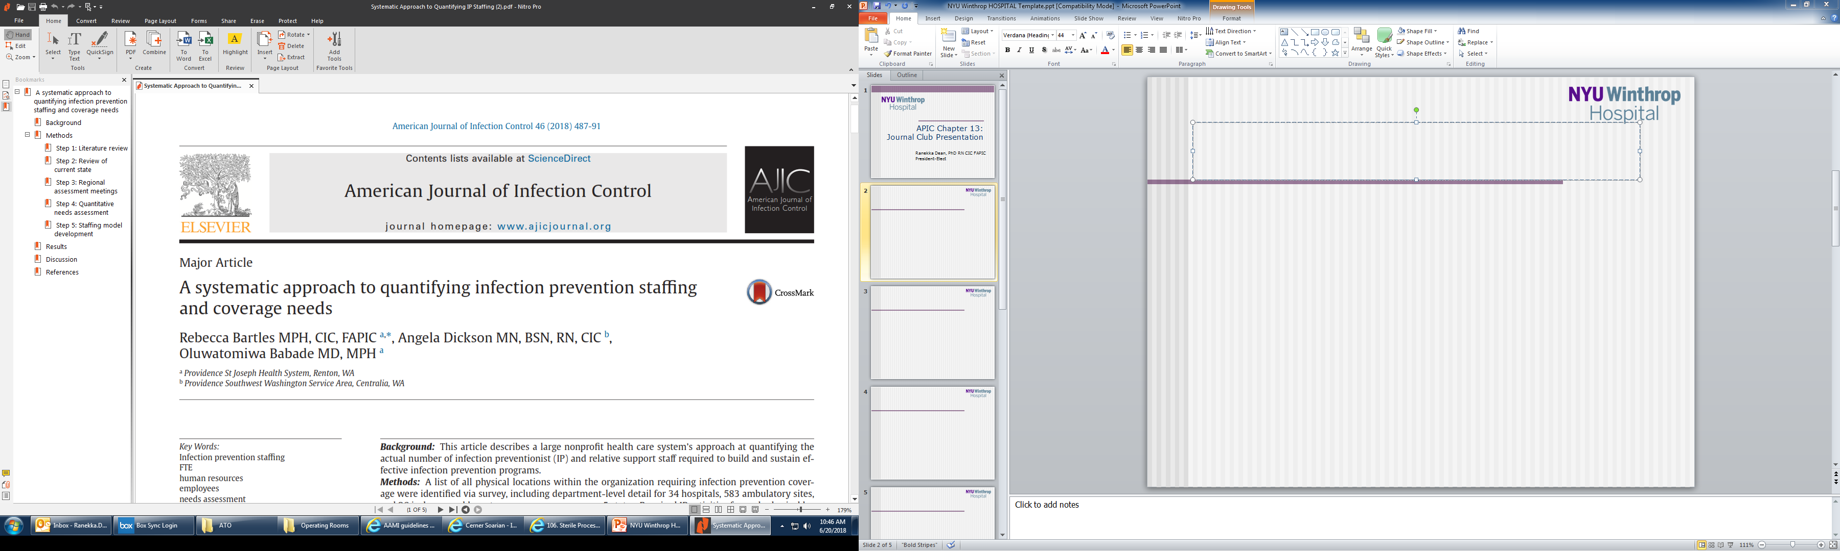

Slide 3
Abstract
Background: This article describes a large nonproﬁt health care system’s approach at quantifying the actual number of infection preventionists (IP) and relative support staff required to build and sustain effective infection prevention programs.
Methods: A list of all physical locations within the organization requiring infection prevention cover- age were identiﬁed via survey, including department-level detail for 34 hospitals, 583 ambulatory sites, and 26 in-home and long-term care programs across 5 states. Required IP activities for each physical lo- cation were also tallied by task. Type of activity, frequency (times per year), hours per activity, and total number of locations in which each activity should occur were determined. From this, the number of hours per week of infection prevention labor resources needed was calculated.
Results: Quantitative needs assessment revealed actual labor need to be 31%-66% above current bench- marks of 0.5-1.0 IP per 100 occupied beds. When aggregated across the organization, the comprehensive review results yielded a new benchmark of 1.0 infection prevention full-time equivalent per 69 beds if ambulatory, long-term care, or home care are included.
Conclusions: Size, scope, services offered, populations cared for, and type of care settings all impact the actual need for IP coverage, making the survey benchmarks available in the literature invalid. A comprehensive assessment of health care organization composition and structure is necessary prior to determining the IP staﬃng needs for that organization.

Slide 4
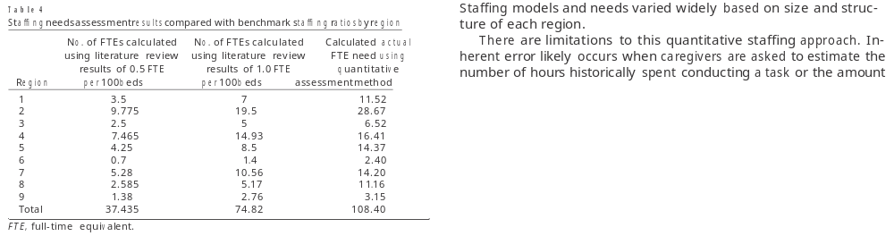
Results

Slide 5
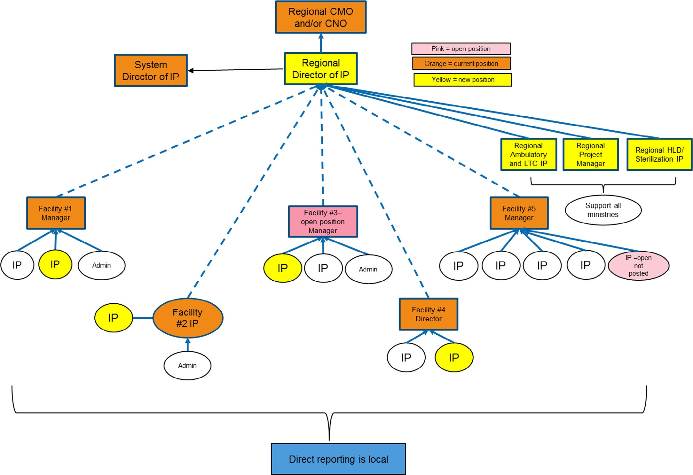
Sample Staffing Model

Slide 6
Discussion
Current resources are antiquated
Demand is high
Varying degree of acuity and risk
Bulk of time spent on surveillance & reporting
More time needed for environmental rounding, education
Addition of support positions
Need comprehensive assessment to determine adequate staffing

Slide 7
Limitations
Estimation errors
No studies correlating increase staffing & lower HAIs
IPC priorities varies per location
Doesn’t account for changes to IPC programs

Slide 8
