Slide 1
Impact of State Reporting Laws on Central Line–Associated Bloodstream Infection Rates in U.S. Adult Intensive Care Units
Hangsheng Liu, Carolyn T. A. Herzig, Andrew W. Dick,
E. Yoko Furuya, Elaine Larson, Julie Reagan,
Monika Pogorzelska-Maziarz, and Patricia W. Stone
Health Services Research 2016 Jul 24. doi: 10.1111/1475-6773.12530.

Slide 2
Objective
To examine the effect of mandated state health care–associated infection (HAI) reporting laws on central line–associated bloodstream infection (CLABSI) rates in adult intensive care units (ICUs).

Slide 3
Background
HAIs continue to represent common adverse events for hospitalized patients; at any given time, an estimated 1 in 20 hospitalized patients has an HAI
Recently, many states have enacted HAI reporting laws to improve safety and quality of care.
Key reporting requirements in the HAI laws vary across states, including (1) mandatory data submission either to a state agency or NHSN, (2) public reporting, and (3) public disclosure of facility identifiers
Federal regulations have ensued, including nonpayment by the Centers for Medicare and Medicaid Services (CMS) for certain HAIs (CMS 2015a), and the inclusion of HAI rates in the Value Based Purchasing program of the Affordable Care Act in 2010 (CMS 2014)

Slide 4
Conceptual Framework
To examine the relationship between state HAI reporting laws and CLABSI rates over a 6 1/2-year time period using a large, national sample of hospitals and ICUs reporting infection data to the NHSN between 2006 and 2012*
To assess the incremental effect of state mandatory reporting laws above and beyond the impact of federally mandated laws by utilizing longitudinal data for states that passed state-specific HAI reporting laws and those that did not.
*The researchers chose the NHSN CLABSI definition (as opposed to other metrics, such as administrative coding) because of the long-established application and acceptance among infection prevention and
health care epidemiology experts

Slide 5
Method
A quasi-experimental* study design to identify the effect of state mandatory reporting laws. (Several secondary models were conducted to explore potential explanations for the plausible effects of HAI laws).
Data reported before and after by states that implemented a reporting law prior to the end of the study period were used to:
    measure changes in CLABSI rates within the same ICUs and
    to compare such changes in ICUs in reporting states to changes in ICUs in non-reporting states
*A quasi-experiment is an empirical study used to estimate the causal impact of an intervention on its target population. Quasi-experimental research shares similarities with the traditional experimental design or randomized controlled trial, but they specifically lack the element of random assignment to treatment or control. In some cases, the researcher may have control over assignment to treatment. Quasi-experiments are subject to concerns regarding internal validity, because the treatment and control groups may not be comparable at baseline. Statistical tools are used that allow for statistical control

Slide 6
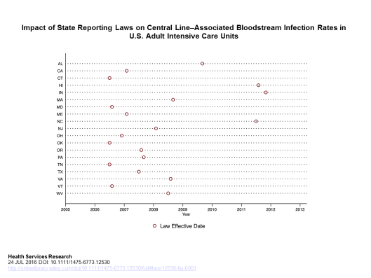
Timing of the law effective dates across states
The large variation in the timing of the law effective dates across states (Figure 1) substantially strengthens the identification of the laws’ effects separately from calendar time effects.

Slide 7
Outcomes
Primary:
Monthly CLABSI events weighted by patient days was the main outcome so that the potential effect of reducing central line usage could be captured;
CLABSI rates were measured as the number of events per 1,000 patient days.
Secondary:
CLABSI rates weighted by central line days and time spent by infection preventionists on infection surveillance and control activities were secondary outcomes.
Infection preventionist time was measured as the reported number of hours per 100 hospital beds per week. All measures came from the NHSN hospital annual survey, including the characteristics of the hospitals

Slide 8
Statistical Analysis
A variant of a typical difference-in-differences model that allowed to identify secular trends and time profiles of the mandate effects more robustly due to the variation in the timing of the law effective dates.
Statistical analysis for the CLABSI event counts at the ICUs level to control for the time of state law implemented and for the months data were contributed.
The infection control practices were not included in the main model because they are likely on the casual pathway between the laws and the CLABSI rates and including them would have led to an underestimation of the law’s effect.
Descriptive statistics comparing the average CLABSI rates, ICU, and hospital characteristics by category using t-tests and v2 tests of ICUs in states with and without reporting
Several additional analyses were conducted to check the robustness of the results and explore potential explanations for the plausible effects of HAI laws

Slide 9
Sample Description
As of December 2012, 32 states had mandatory HAI reporting laws (law effective dates ranging from January 2004 to October 2011) and 16 states did not have reporting laws;
of those states with laws, CLABSI data were available before and after the law in 19 reporting state
26 reporting states (18 in the analysis) had validation processes for verifying the completeness, accuracy, and/or quality of reported CLABSI data; 12 reporting states (8 in the analysis) had a validation process for auditing medical record
Of the 750 hospitals that enrolled and provided access to their NHSN data, 718 (1,464 ICUs) reported CLABSI data during 2006–2012 and provided NHSN annual survey data.
There were no significant differences in average CLABSI rates between the study hospitals and other NHSN hospitals, although they differed by hospital size, geographic location, number of
admissions, and number of ICU beds
After excluding ICUs in the reporting states that did not voluntarily report data prior to the law, the main analytic sample included 244 hospitals, 947 hospital years, 475 ICUs, 1,902 ICU years, and 16,996 ICU months

Slide 10
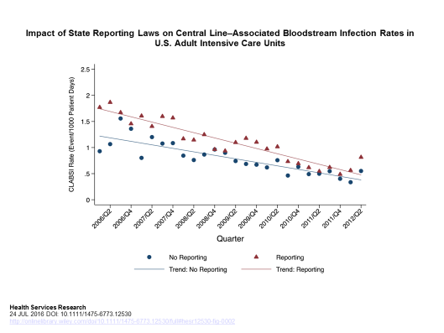
Trends in CLABSI Rates

Slide 11
Effect of HAI Laws on CLABSI Rates
Table 3: Effect of HAI Reporting on CLABSI Rates: Poisson Regression Results
Variables Incidence Rate Ratio Coefficient Standard Error p Value
Month 25 to month 65 prior to the law effective date (reference)
Month 19 to month 24 0.915 0.089 0.123 .472
Month 13 to month 18 0.825 0.192 0.117 .099
Month 7 to month 12 0.833 0.182 0.108 .093
Month 1 to month 6 0.655 0.422 0.117 .000
Month 0 to month 5 0.693 0.366 0.127 .004
Month 6 to month 11 0.763 0.270 0.130 .037
Month 12 to month 17 0.753 0.283 0.144 .050
Month 18 to month 23 0.572 0.558 0.163 .001
Month 24 to month 29 0.618 0.482 0.165 .003
Month 30 to month 35 0.636 0.453 0.184 .014
Month 36 to month 41 0.854 0.158 0.207 .445
Month 42 to month 47 0.702 0.354 0.234 .130
Month 48 to month 53 0.696 0.363 0.256 .156
Month 54 to month 59 0.583 0.540 0.300 .072
Month 60 to month 65 0.402 0.912 0.350 .009
Month 66 to month 77 0.343 1.071 0.410 .009

Slide 12
Conclusions
This is the first study to use longitudinal national data to evaluate the impact of state mandated HAI reporting laws on CLABSI rates in adult ICUs
ICUs in states with laws experienced larger declines in CLABSI rates, even after controlling for the overall decreasing trend during the study period.
“Gearing up” for mandatory reporting, the declining effect appeared 6 months prior to the effective date of the law, and effects were persistent and increased for more than 6 years after the law’s effective date:
  ↓ 34 percent by the time the law was implemented;
  reduction increased to 43 percent 2 years after implementation
  reduction increased to 66 percent 6 1/2 years after implementation. That is, by 2 years after implementation, over 80 percent of the reduction occurred before the law became effective; by 6 1/2 years after implementation, about 50 percent of the reduction could be attributed to the pre-law period

Slide 13
