Slide 1
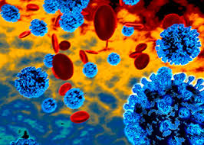
Microbiology for the
Infection Preventionist
Marianne Pavia MS, MT(ASCP), CLS, CIC, FAPIC

Slide 2
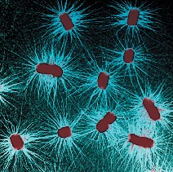
The Scope of Microbiology
Microbiology: The study of living things too small to be seen without magnification
Microbes interact with humans
Many are useful or essential for human life
At times, microbes cause disease

Slide 3
Classification
Bacteria – survive on appropriate media, stain gram-positive or -negative
Viruses – obbligate intracellular parasites which only replicate intracellularly (DNA, RNA)
Fungi – non-motile filamentous, branching strands of connected cells
Metazoa – multicellular animals (e.g.parasites) with complicated life cycles often involving several hosts
Protozoa – single cell organisms with a well-defined nucleus
Rickettsia – very small bacteria spread by ticks
Prions – unique proteins lacking genetic molecules
Chlamydia – bacteria lacking cell walls

Slide 4
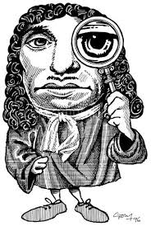
The Father of Microbiology
Discovery of microorganisms 1700
Before seen, disease was thought to be caused by” spirits”
Anthony van Leeuwenhoek invented the first microscope

Slide 5
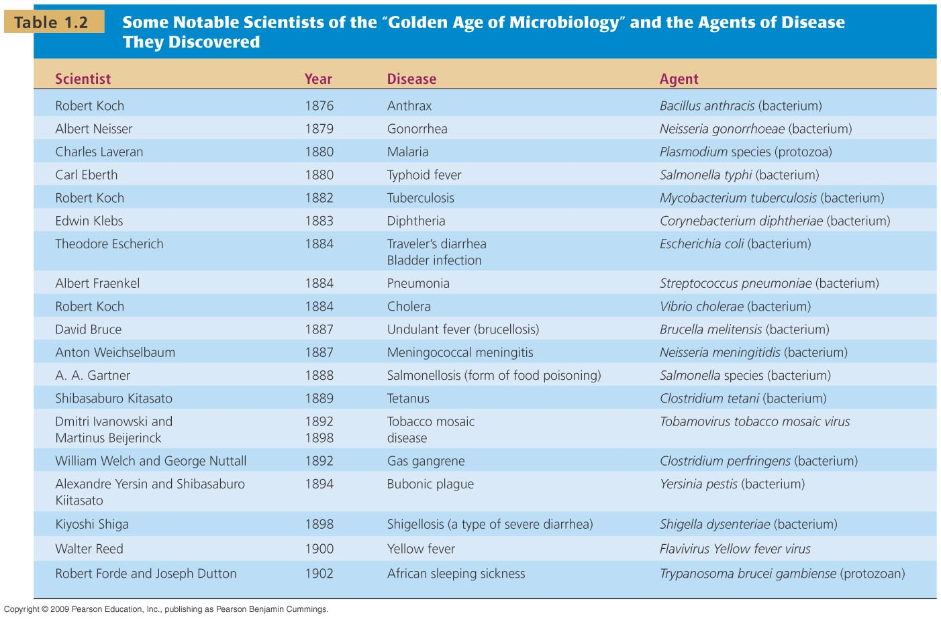

Slide 6
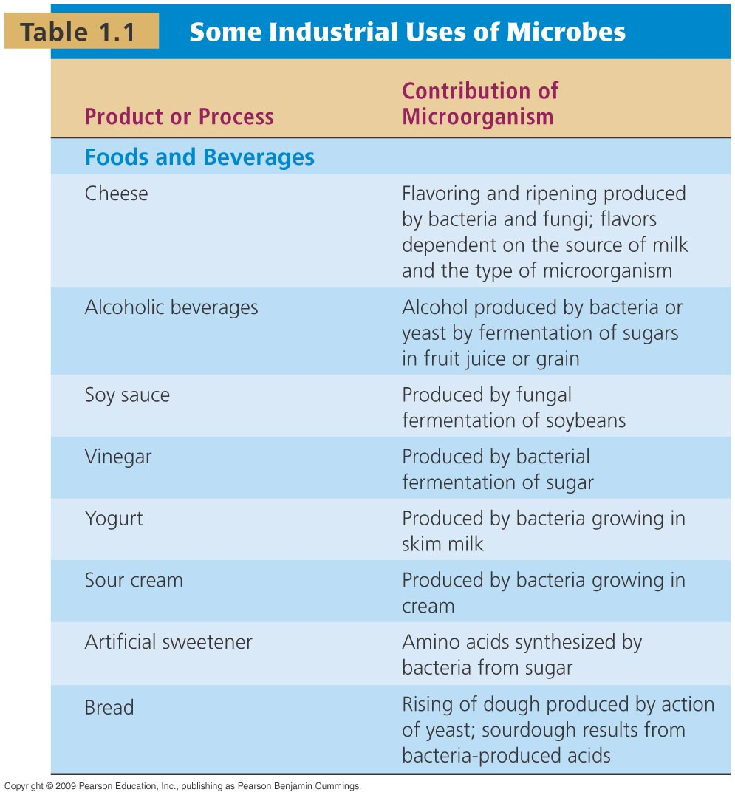

Uses of Microbes

Slide 7
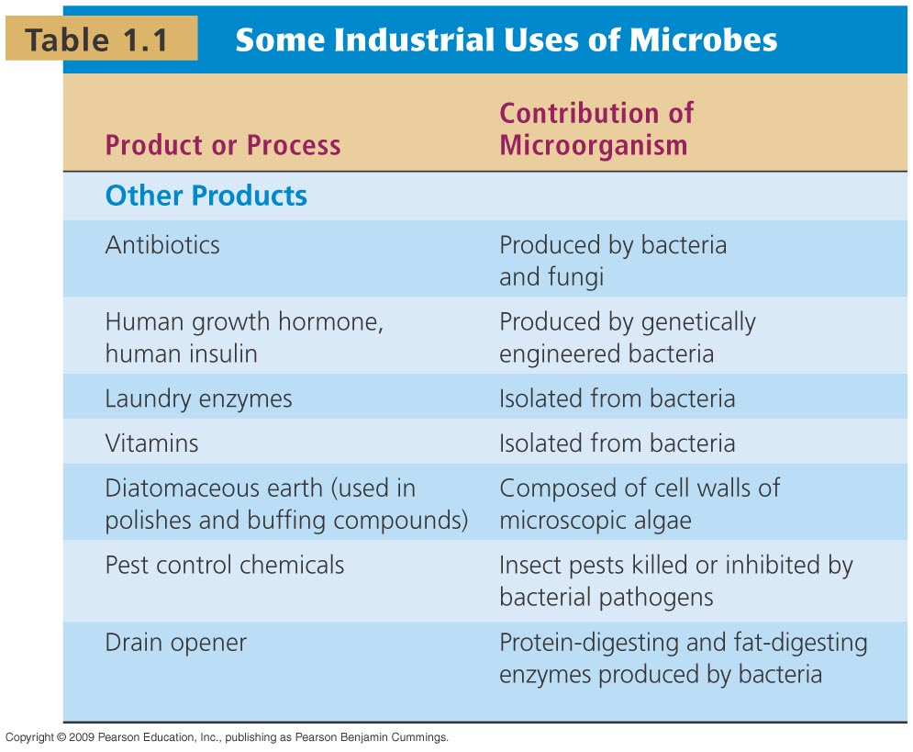
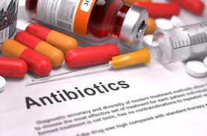
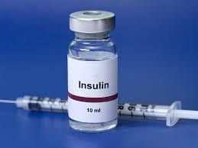
Uses of Microbes

Slide 8
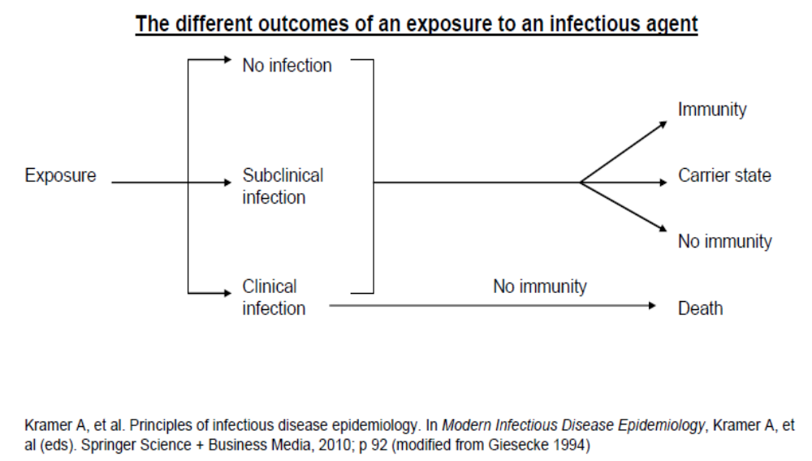
Exposure

Slide 9
Germ Theory
Microorganisms that cause disease are called pathogens.
The diseases they cause are called infectious diseases.
The interval from exposure to clinical symptoms is call the incubation period.
The interval during which the host can transmit infection is the infectious period.
Environmental and hereditary factors often influence the severity of the disease, and whether a particular host individual becomes infected when exposed to the pathogen.

Slide 10
Flora
Normal flora are microbes regularly found at particular regions of the body.
Resident flora are life-long microorganisms present at certain anatomical sites.
Transient flora are unable to colonize the body for long periods.
The composition of flora changes with age, sex, diet, development and environment.

Slide 11
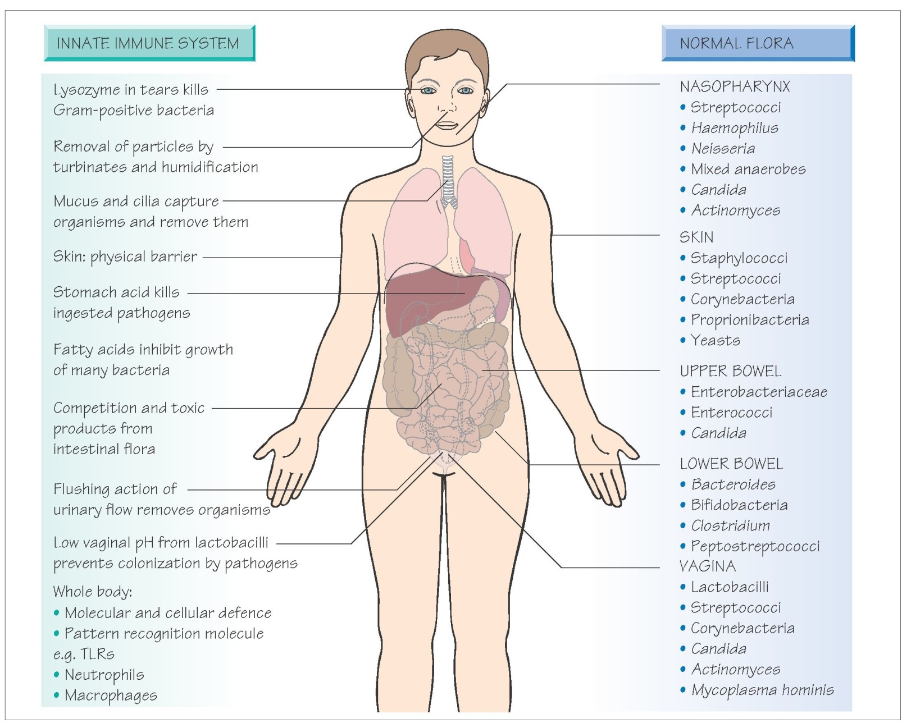

Slide 12
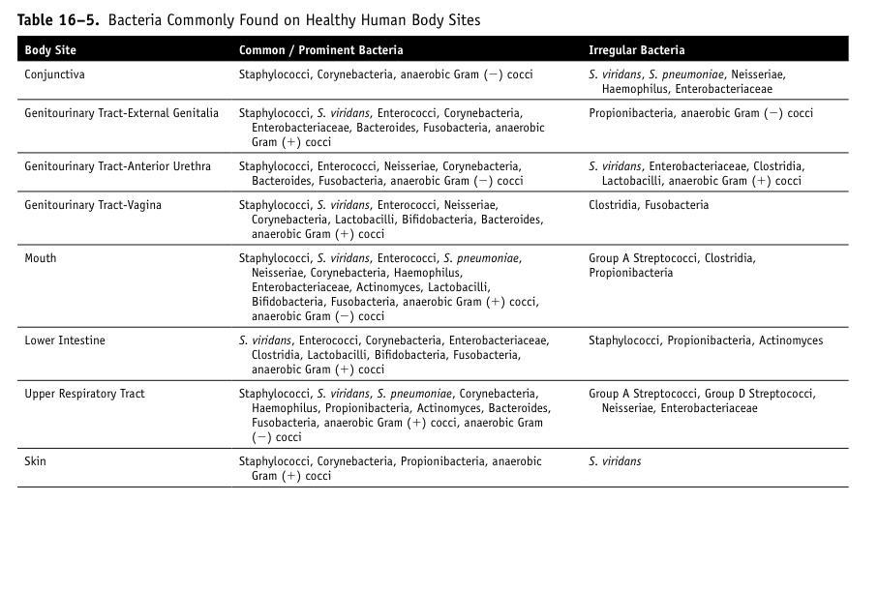

Slide 13
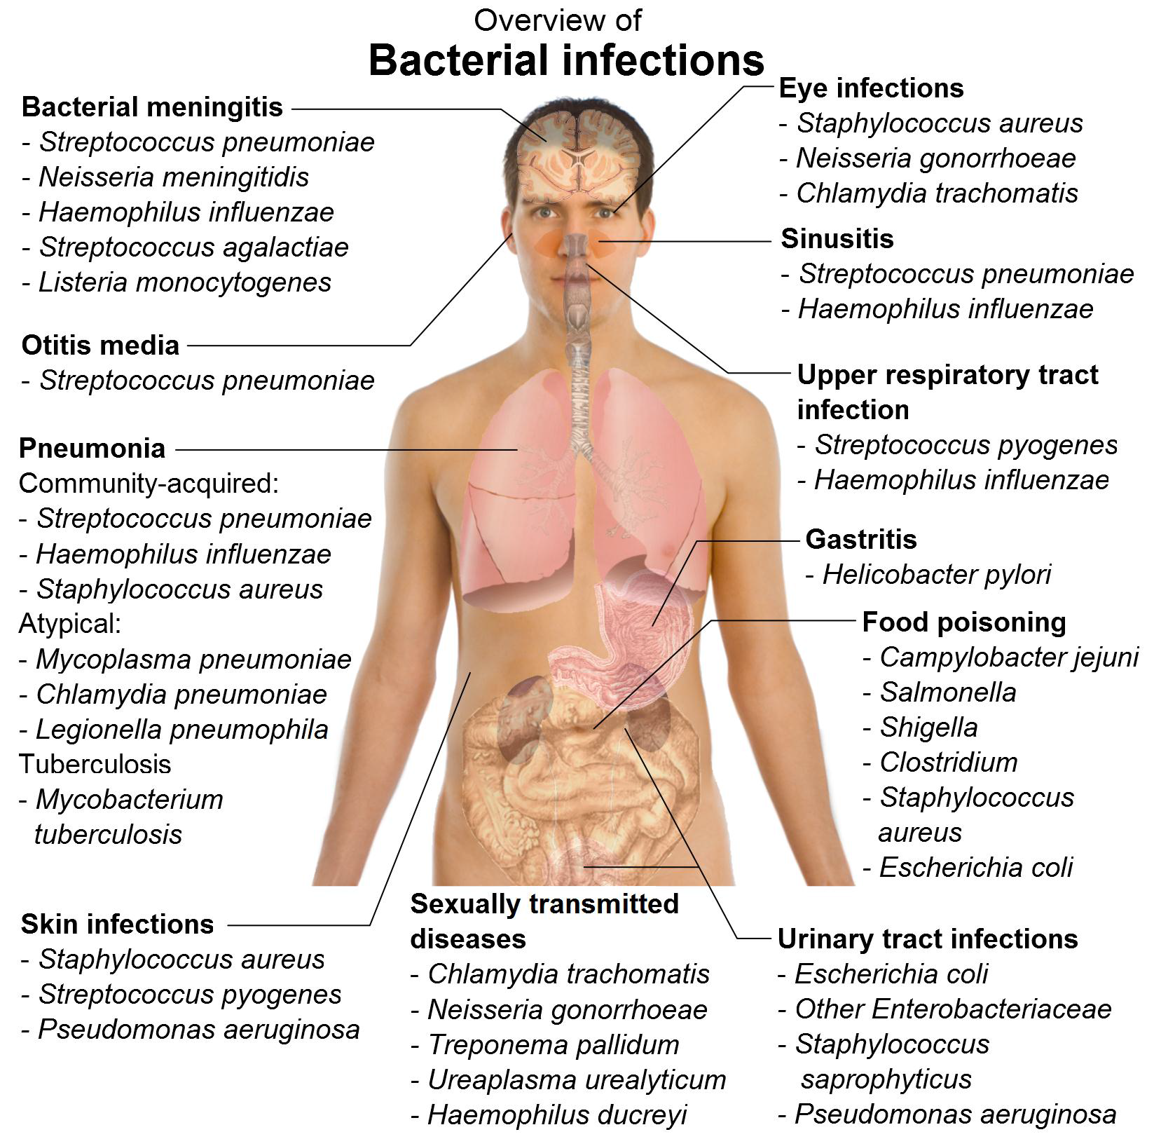

Slide 14
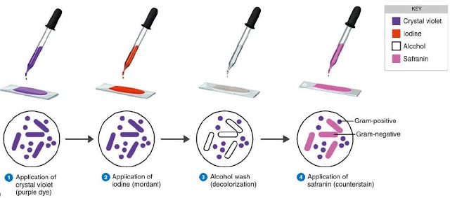
Gram Stain

Slide 15
Mechanism of Gram Stain
Crystal violet and iodine combine in the cytoplasm and color it PURPLE
IF the cytoplasm retains the color after attempted decolorization with alcohol it is gram positive
Bacteria that lose the purple color after decolorization are colored PINK by safarin and are gram negative

Slide 16
Explanation of Gram Stain
Gm (+) have a thick cell wall of amino acids and disaccharides
When the crystal violet and iodine enter this cell wall the two combine to form a crystal violet-iodine complex, which bigger molecule than when entering the cell wall
The molecule can not leave the thick cell wall of Gm(+) and is retained

Slide 17
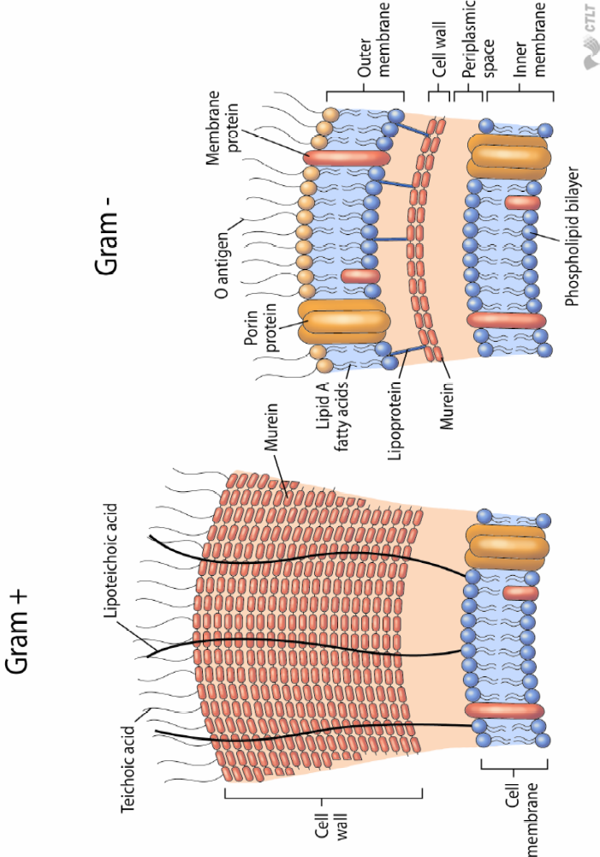
Cell Wall

Slide 18
Importance of Gram Stain
Preliminary information from direct clinical specimen or culture media
Identify the presence of bacteria in normally sterile body sites (CSF, blood)
Screen sputum specimens for acceptable culturing (>10 epithelial cells indicating saliva)
Useful in guiding initial antimicrobial therapy

Slide 19
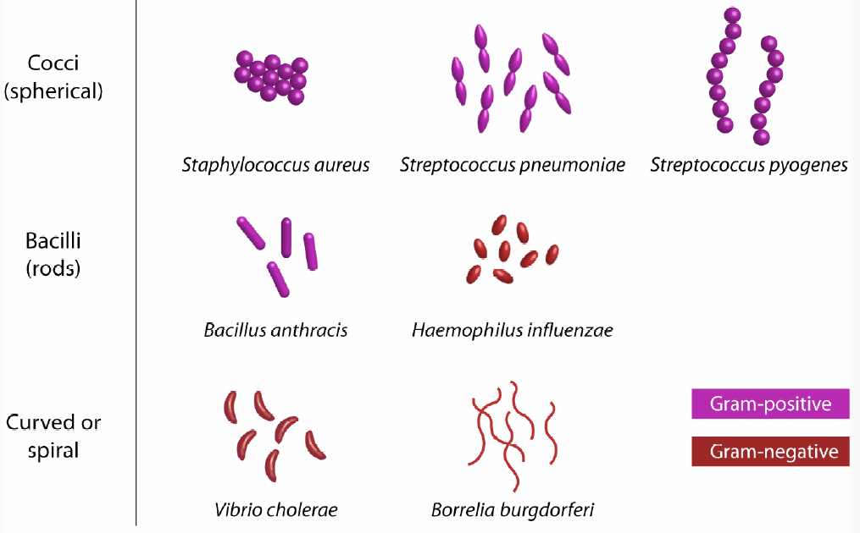
Gram Stain Classification

Slide 20
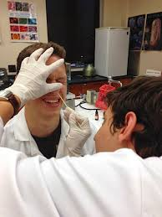
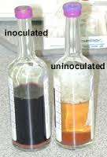
Proper Collection
Blood Culture Bottles
False Positive:
Inappropriate cleaning of skin
Palpitating after cleaning
False Negative
Less than 10 cc of volume per bottle
Obtain Good Sample

Slide 21
Growing Microbes
The Five I’s
Inoculation- producing a viable culture
Isolation-one kind of microbe on media, pure culture
Incubation-growing microbes under proper conditions
Inspection- observe the organisms characteristics(colony size, color, smell, hemolysis, gram stain)
Identification- set biochemicals for specific identification

Slide 22

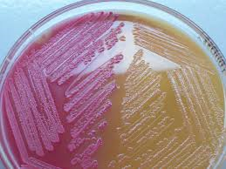
Inoculation Media
General Growth Media
Offers nutrients for most microorganisms to grow
Wide variety of gm (-) and gm(+)
Selective Differential Media
Has dyes, salts, inhibiting agents like antibiotics
Promotes growth of certain organisms and inhibits others

Slide 23
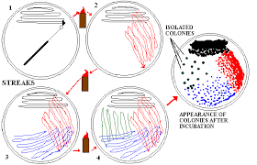
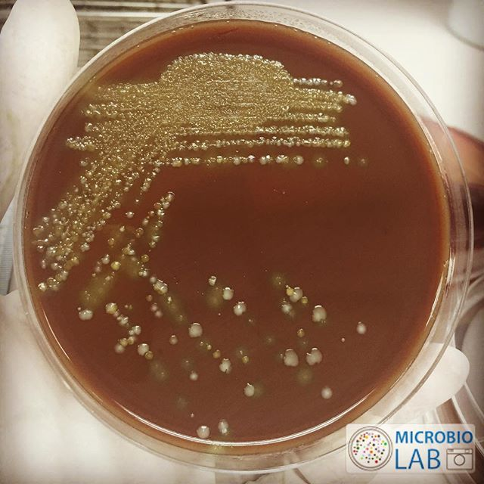
Inoculation and Isolation

Slide 24
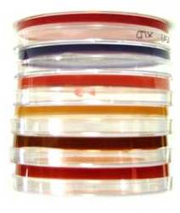
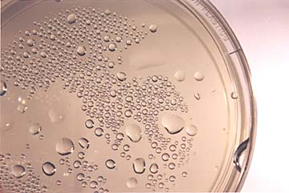
Incubation
Agar plates are stored upside down to prevent condensation and contamination
.

Slide 25
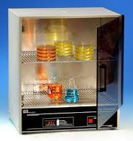
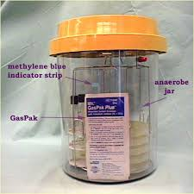
Incubation
Incubator
device used to grow and maintain cultures
temperature
humidity
carbon dioxide (CO₂)
oxygen

Slide 26
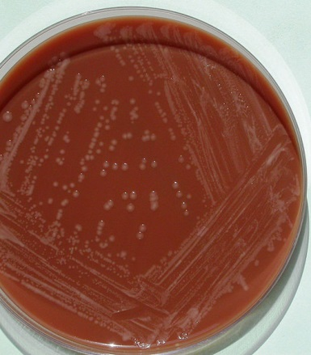
Isolation and Inspection

Slide 27
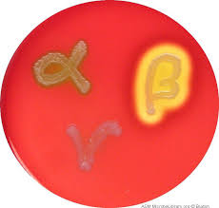
Inspection

Slide 28
Physiological/Biochemical Characteristics
Traditional mainstay of bacterial identification
Diagnostic tests for determining the presence of specific enzymes and assessing nutritional and metabolic activities
Examples
  Fermentation of sugars
  Capacity to metabolize complex polymers
  Production of gas
  Presence of enzymes
  Sensitivity to antimicrobic drugs

Slide 29
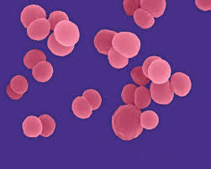
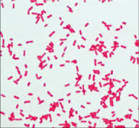
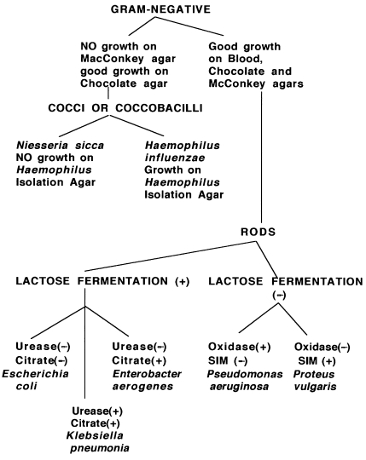
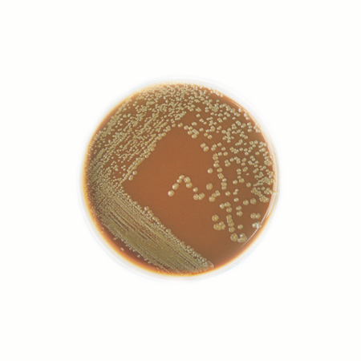
Identification Biochemicals

Slide 30
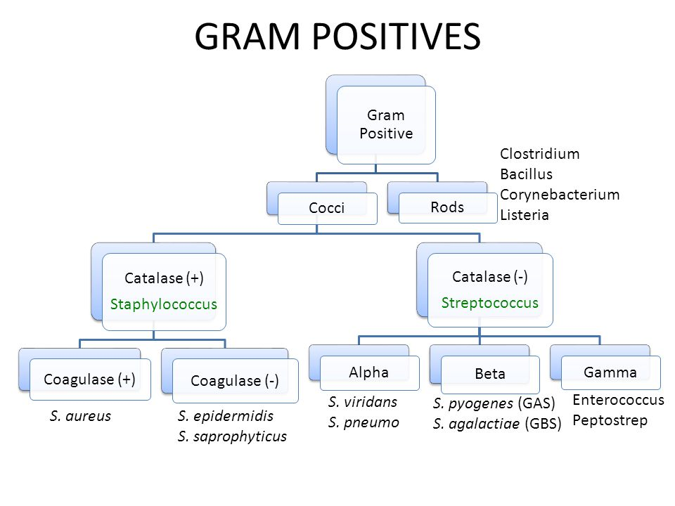

Slide 31
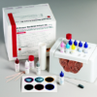
Direct Antigen Testing
Advantages:
Raid testing
Agents that may be difficult to grow
Very specific identification
Disadvantages:
Negative if microbe count is low
Subjective and often too specific
Non-culture method
Enzyme Immunoassay (EIA)
Direct Fluorescent Antibody (DFA)
Agglutination tests (Strep)
Uses know antibodies which react with a patient’s antigen
A visible reaction can be observed

Slide 32
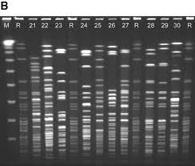
Pulse Field Gel Electrophoresis
Molecular typing technique
Used in epidemiological studies
Based upon the migration of large DNA fragments in an electronic field of alternating polarity
Good to compare isolates to see if they are the same strain (same source)

Slide 33
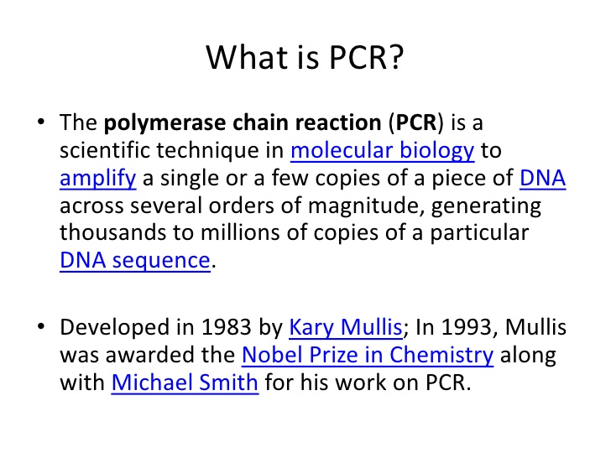
Polymerase Chain Reaction
PCR
Enzymatically amplifies the number of DNA or RNA molecules to the point that they can be detected
Expensive but fast
Does not allow for the testing of antimicrobial susceptibility

Slide 34
Respiratory Viral Detection by PCR
Influenza A virus (H1, H1-2009, H3)
Influenza B virus
Respiratory Syncytial Virus (RSV)
Metapneumovirus (MPV)
Parainfluenza virus (Types 1, 2, 3, 4)
Rhinovirus/Enterovirus*
* Due to the similarity of the conserved genetic region in Rhinoviruses and Enteroviruses, these viruses cannot be differentiated and are reported together
Coronavirus (229E, HKU1, NL63, OC43)
Adenovirus
Bordetella pertussis
Chlamydophilia pneumoniae
Mycoplasma pneumoniae

Slide 35
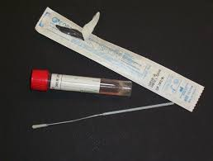
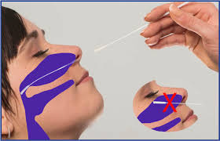
Have patient sit with head against a cushion as patients have a tendency to pull away during this procedure.
Insert swab into one nostril straight back (not upwards) and continue along the floor of the nasal passage for several centimeters until reaching the nasopharynx (resistance will be met).
Do not force swab, if obstruction is encountered before reaching the nasopharynx, remove swab and try the other side.
Rotate the swab gently for 5-10 seconds to loosen the epithelial cells. 5.
Remove swab and immediately inoculate viral transport media by inserting the swab at least ½ inch below the surface of the media.
Bend or clip the swab handle to fit the transport medium tube and reattach the cap securely. A dry swab is NOT acceptable for PCR testing.
Specimen should be transported at refrigerator temperature and received by laboratory as soon as possible and within 5 days from time o

Slide 36
Gastrointestinal Pathogen Panel by PCR, Feces
Campylobacter species
Clostridium difficile toxin A/B
Plesiomonas shigelloides
Salmonella species
Escherichia coli O157
Yersinia species
Shiga toxin
Shigella
Cryptosporidium species
Cyclospora cayetanensis
Entamoeba histolytica
Giardia
Adenovirus F 40/41
Astrovirus
Norovirus GI/GII
Rotavirus A
Sapovirus

Slide 37
Benefits of PCR Testing
Highly specific and sensitive
Offers accurate detection at a fraction of the time and effort invested in traditional, culture-based method.
Creates a significant advancement in the management of infectious diseases.
Reduce the number of patients isolated and the number of days on isolation
Improves appropriate antibiotic use based on clinically meaningful and statistically significant reductions in the time to microbiologic identification. On-demand PCR testing allows for a switch from empiric to directed therapy.

Slide 38
Susceptibility Testing
Used to determine which antimicrobials will inhibit the growth of a pathogen causing an infection
Result of Testing:
Susceptible – likely to inhibit the pathogenic organism and may be the appropriate chose for treatment
Intermediate- may be effective at higher doses, more frequent doses, or only in specific body sites where the antimicrobial penetrates to give significant coverage
Resistant- not effective in inhibiting the growth of the organism and not the appropriate for treatment

Slide 39
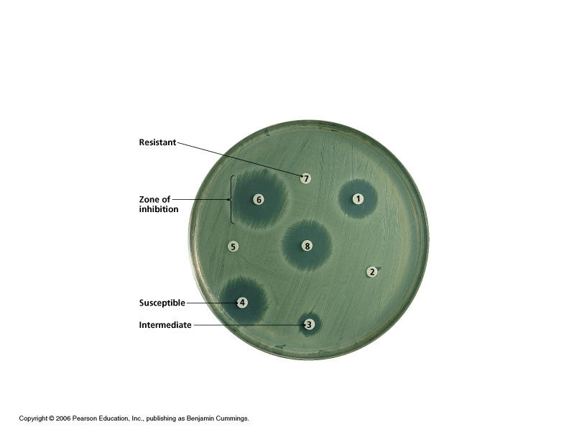
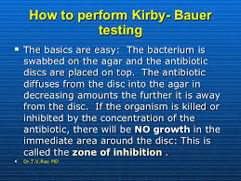
Susceptibility Testing
Kirby-Bauer

Slide 40
Minimum Inhibitory Concentration
MIC
The lowest concentation of an antibiotic that will be effective in inhibiting the growth of the organism
Lab will include in the report an interpretation of what the results mean
A sample for culture and susceptibility should be collected before antimicrobial therapy begins

Slide 41
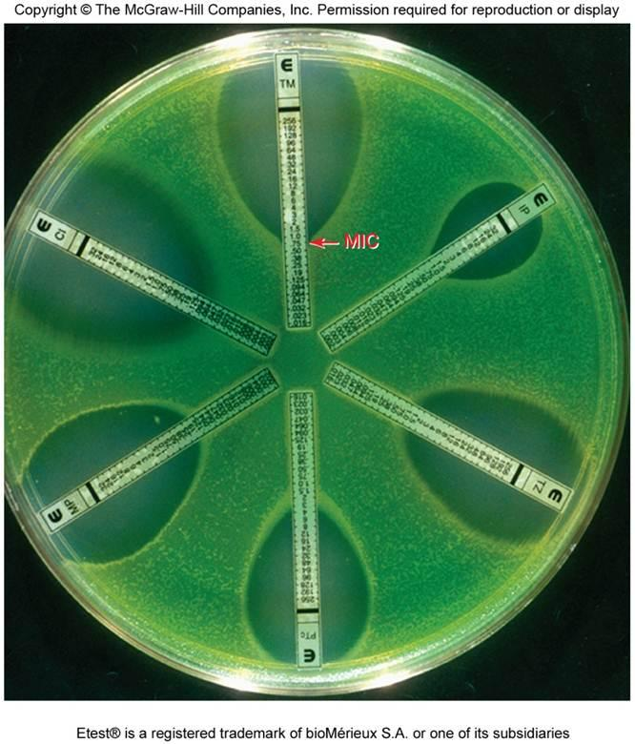
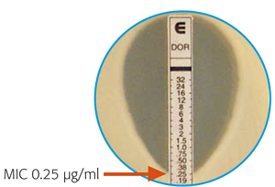
Susceptibility Testing
E- Test

Slide 42
Muli-Drug Resistant Organism
MDRO
Definition:
  microorganisms, predominantly bacteria, that are resistant to one or more classes of antimicrobial agents
Importance:
  Limited options for treatment
  Increase the length of stay and cost of hospitalization
  Increase admission to and stay in ICU
  High mortality rates

Slide 43
MDROs - Epidemiology
Transmission:
  Mainly person to person through hands of healthcare personnel
  Contact with contaminated environmental surfaces
  Transmission depends on:
    Availability of vulnerable patients
    Antimicrobial pressure
    Colonization pressure
    Adherence to infection control measures
    Frequent movement among healthcare facilities
Notes:
Colonization Pressure: It is defined as the proportion of patients colonized with a particular organism in a defined geographic area within a hospital/healthcare facility during a specified time period
Antimicrobial Pressure: Increased antimicrobial use leads to selective pressure on normal flora resulting in emergence of MDROs

Slide 44
Important MDROs
ESCAPE
    Enterococcus faecium (VRE)
    Staphylococcus aureus (MRSA)
    Clostridium difficile (C. Diff)
    Acinetobacter baumannii
    Pseudomonas aeruginosa
    Enterobacteriaceae (CRKP/CRE)
Notes:
Alert microorganisms should be agreed between microbiology laboratory and IP&C staff. The isolation and immediate report of an unusual microorganism (unusually pathogenic or unusually resistant) enables IP&C Team to take appropriate measures and stop it from spreading.

Slide 45
Prevention Strategies
(MDROs)
Administrative support
Surveillance
Protocol for lab notification
Patient placement
Patient/staff cohorting
Hand hygiene
Contact precautions
Dedicated equipment
Device use
Environmental measures
Monitor compliance
Education
Antimicrobial stewardship

Slide 46

Prevention Strategies
Antimicrobial Stewardship
A set of strategies to improve the use of antimicrobial medication.
Goals:
Enhance patient health outcomes
Reduce resistance to antibiotics
Decrease unnecessary costs
Examples:
Antibiotics given and not needed
Antibiotics given for longer than necessary
Antibiotics are not de-escalated
Failure to do “Antibiotic Time-Outs”

Slide 47


St. Mary’s Healthcare System for Children
Marianne Pavia MS, BS, MT(ASCP), CIC, FAPIC
Director of Infection Prevention, Employee Health and Laboratory Services
mpavia@stmaryskids.org
www.stmaryskids.org

