Slide 1
Managing Your Professional Reputation
Your message and brand as an Infection Preventionist

Slide 2
Your reputation and your message are your brand. Your brand is your mark on the world, and this organization. Cultivate it, Embrace it, Guard it.

Slide 3
What comes to mind when you hear:
Reputation?
Brand?
Messages?

Slide 4

  “Quote page with hanging quotation marks. Sentence case, 24pt Calibri, white.”
Remove hanging quotes by using “Decrease List Level” button.
Notes:
“Just do it!”

Slide 5

CDB8N-3GPKW-V9M47-BRWQ7-4CY2G
Notes:
“Think Different”

Slide 6

Notes:
“where dreams come true”

Slide 7

Notes:
“expect more, pay less”

Slide 8
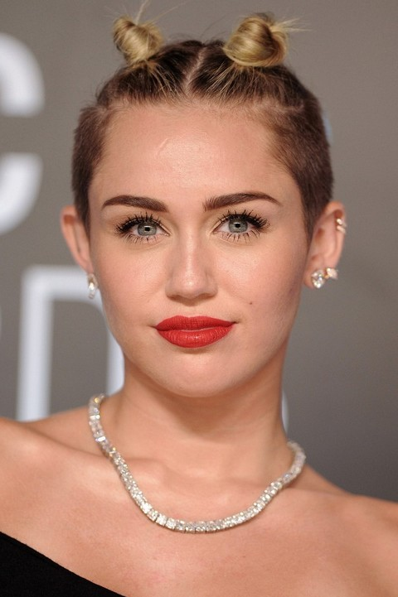
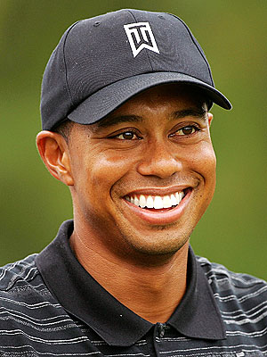

Slide 9
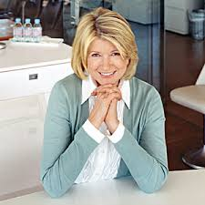
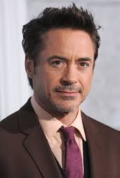

Slide 10



Slide 11
My Professional Reputation
What makes up our professional reputation, message, our brand?
  Communication
  Appearance
  Relationships
  Character
Notes:
Split into groups and talk about it-Group Activity

Slide 12
Communication
How we communicate sends a powerful message to the world about who we are.
  Verbal
  Written (email, text, social media)
  Non-verbal

Slide 13
Verbal Communication
Important Verbal Communication Tips:
  Tone
      It’s what you say AND how you say it
  Clarity
      Be clear and confident in your communication if you want others to understand your message. Stay away from “filler” words
  Positive
      Negative communication indicates negativity in outlook and personality
  Word Choice
      Use of slang, profanity or stereotypes can send a message about you that you didn’t intend
  Brevity
      The human brain can really only absorb four (4) things at a time, so make your communication brief and to the point

Slide 14
Verbal Communication
As Infection Preventionists, what is important to your verbal communication?
  Context?
  Experience?
  Knowledge Base/Evidence?
  Subject Matter Experts?
Notes:
Tone
“How can we help you”
Ineffective vs. Effective
“I don’t know if you noticed but I maybe saw that you talked to Emily and she looked kinda upset and confused and do you think maybe she wasn’t sure what you were asking and how would you feel??”
“I don’t think Emily appreciated being spoken to that way, she didn’t understand what you were asking of her, I think you should talk”
Negative vs. Positive
“Everything around here is so broken, they don’t understand how hard our job is. I would never send my kid here for health care”
We have great opportunities to make improvements in the way we deliver care.”
Word Choice
“This is total bulls**t, I never have the supplies I need when I need them”
“RN Manager, I’m finding it challenging to perform my duties when I can’t locate X, do you think we could increase our par level on the floor?”
Brevity
“I know we have a lot to accomplish, and we’ll prioritize together and get it done”
A lengthy list of all the deliverable items which is overwhelming and filed with other responsibilities and concerns

Slide 15

Non-Verbal Communication

Slide 16
Non-Verbal Communication
It's well known that good communication is the foundation of any successful relationship, be it personal or professional.
It's important to recognize, though, that it's our nonverbal communication—our facial expressions, gestures, eye contact, posture, and tone of voice—that speak the loudest.
The ability to understand and use nonverbal communication, or body language, is a powerful tool that can help you connect with others, express what you really mean, and build better relationships.
Notes:
After reviewing slide discuss what are some common non-verbal communication styles

Slide 17
Non-Verbal Communication
  Eye Contact
      Are you making eye contact? Is it overly intense or appropriate indicating someone has your full attention? Do you have your cell phone in hand while someone is talking?
  Facial Expression
      Does your facial expression match your words? Are you conveying with your face that you are present and interested, engaged and happy?
  Posture
      Are you sitting up straight, or slouched in the chair?
  Touch
      Is touch appropriate? What level of touch is acceptable and how do you know?
  Intensity
      Does it match the message?

Slide 18
Written Communication
Documents
What do you think when you see written communication with misspellings or grammatical errors?
What do errors in writing indicate to you about the author?
What do certifications on the signature indicate to you?
What are your examples?

Slide 19
Memo:
To: Employees of Distribution Dept. From: emily weisenbach, Manager
Re: New Requirements
____________________________________________
To all employees of the distribution department. As I’ve told you there are new requirement required to keep your jobs in the department. You have to meet these requirements by 2/30/16 or face consequences.
The expectation is you will get it done. If you have trouble, let us know.
Emily Weisenbach

Slide 20
Written Communication
Emails
Hi good day, I came into work didn't no I had to get clearance to return, I am sorry for any inconveniences I may have caused, am on my way to the doctor and then I will come in to occupational heath to my next clearance, I only returned to work today because I still wasn't feeling good the date the doctor told me to return, I did call Unum and the nursing office everyday until yesterday, I have all documents to show me being sick and letters from Unum also, I also have me intermittent leave letter to show am on FMLA, thanks again, I only got my cellphone back on Saturday, I hope you understand thanks.

Slide 21
Written Communication
How do you recover from written communication errors?
Send apology note or revised document
Perform in person service recovery
Don’t let the errors happen in the first place (read it through before you send and correct)
Never, but never send anything when angry
Resources:
  Books (The Elements of Style)
  Peer review-Have a coworker review
Notes:
When do you pick up the phone?

Slide 22
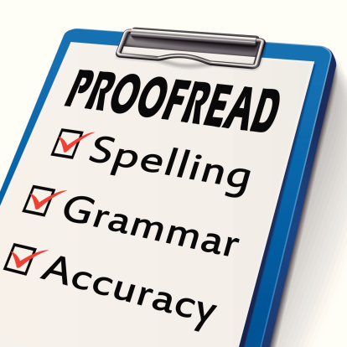
Written Communication

Slide 23
Written Communication/Social Media
You have the right to have a life on social media
You have the right to share what you wish on social media sites (Facebook, twitter, Instagram, etc.) BUT be responsible
Remember that social media lives forever and can be viewed by colleagues and potential employers
Be cautious

Slide 24
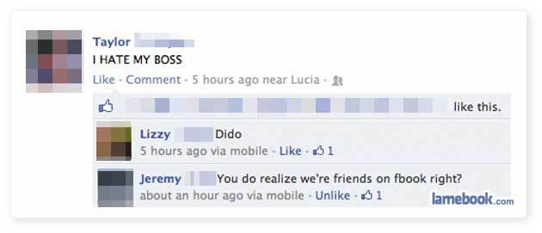
Social Media

Slide 25
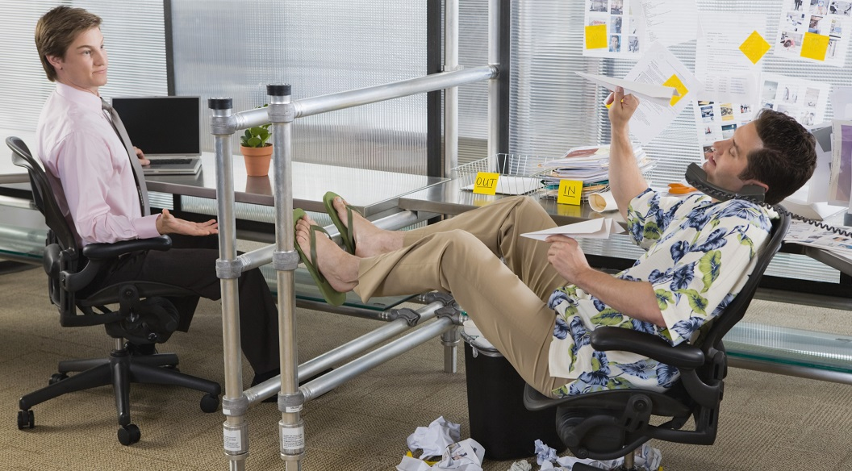
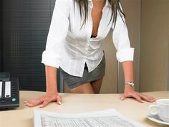

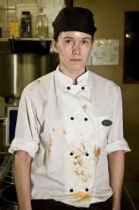
Appearance

Slide 26


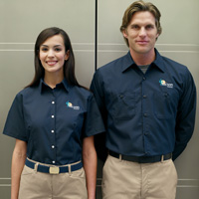
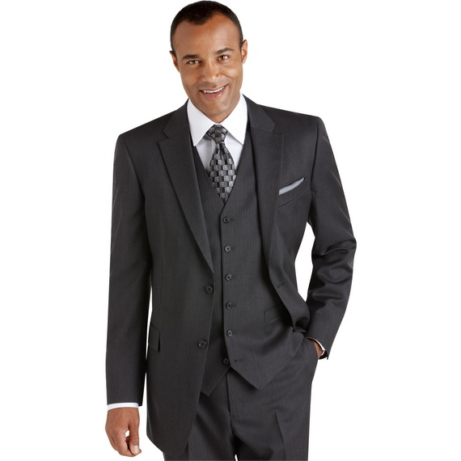
Appearance

Slide 27
Appearance
"How an individual dresses for work can be a powerful extension of his personal brand." Matthew Randall, executive director of the CPE (Center for Professional Excellence)
“What we wear shapes our behavior and prepares our body and mind for what we need to do.” Joe Navarro
Know our policy
Be modest
Be mindful of culture around you
Control festiveness
Err on the side of caution
Take care of yourself
Dress for the job you want!
Notes:
Does anyone disagree? Why?

Slide 28
Relationships
  Be Reliable
    Keep deadlines, say what you mean and mean what you say—being someone that is dependable is great for your professional reputation. You are counted on for timely work and honest feedback.
  No Whining
    Don’t be the person who complains all the time, it perpetuates a negative work environment. If you have an objection, voice it politely and move on, if able, offer a suggestion.
  No Gossip
    Gossiping at work is reckless, can create hard feelings among other employees and cause you to lose their trust. Gossip also may come back to haunt you some day.

Slide 29
Relationships
  Prioritize, be Prepared, do your Share
    Everyone knows at least one individual who doesn’t seem to carry his or her load and is unprepared. This is a big way you can damage your reputation. It can make you look uninterested, lazy or flighty, even though you have the best of intentions. Use a calendar, prioritize your responsibilities and ensure you aren’t taking on more than you can do.
  Be Honest about your mistakes, and apologize
    If you do something wrong or offend someone at work, apologize for it. A sincere apology can do a lot to raise yourself in the eyes of others. If you are late getting your work done or were in a hurry and brusque with someone, an apology can go a long way toward making amends.
  Show you care about others
    Smile, and be nice to people you see. Take a genuine interest in what other people are doing or thinking. People always appreciate someone who genuinely cares. You’ll find that people will be drawn to you, and less likely to talk badly about you.

Slide 30
Character
“Character is doing the right thing when nobody's looking. There are too many people who think that the only thing that's right is to get by, and the only thing that's wrong is to get caught.”
JC Watts
What role does character play in your reputation?
Notes:
Decide who you want to be, and be it!
Patience
Bravery
Trustworthiness
Stick to it, consistency is key
Don’t overcompensate
Honor the feeling, and let it go

Slide 31
As a result of this class I will:
Start…
Stop…
Continue…

Slide 32
Thank You for attending!
Questions?

