Slide 1

NHSN Reporting
James Marx, PhD, RN, CIC
Broad Street Solutions
October 2014

Slide 2
National Healthcare Safety Network
Lack of standardized assessment tool
MDS- quality or reimbursement?
NHSN
  Internet based
  Secure
  Standardized tools and methods
  Free
Type of facilities currently using NHSN
  Acute Care Facilities
  Long-term Acute Care Facilities
  Inpatient Rehabilitation Facilities
  Outpatient Dialysis Facilities
  Ambulatory Surgery Centers
Added LTC in 2012

Slide 3

NHSN Structure
Long-term
Care Facility
Healthcare
Personnel
Safety
Patient
Safety
Biovigilance
Components of NHSN
Notes:
3

Slide 4
Long-term
Care Facility
Healthcare
associated
infection
Laboratory
identified
(Lab ID) event
Prevention
process
measures
Modules of the LTCF Component
Notes:
4

Slide 5
NHSN modules
Urinary Tract Infections
  Catheter and non-catheter
Laboratory identified
  Multi-Drug Resistant Organisms (MDRO)
  Clostridium difficile infection (CDI)
Hand hygiene compliance
Glove and gown usage

Slide 6
Why participate?
Standardize measurement tools
Comparison to other providers
Demonstrate commitment to Quality Assessment and Performance Improvement (QAPI)
  Improve outcomes
  Reduce cost
Allows public health and payors to monitor and drive down costs
Creates transparency and improved public trust
Goal: 5% enrollment by 2018

Slide 7
Requirements
Data for at least one module must be submitted for a minimum of six months in the calendar year to maintain active status
Enter data with 30 days from the end of the reporting month (Ex. October 31 for September data)
Confer Rights

Slide 8
Facility Administrator
Review and Accept NHSN Rules of Behavior
Register Facility with NHSN
  Need CMS certification number
  Complete on-line training
Review and Accept SAMS Rules of Behavior
  Secure Access Management Services
Submit Identity Proofing Documentation- Notarized
  SAMS access has been approved
Access SAMS to Complete NHSN Facility Enrollment and Survey Information
  Must use Internet Explorer
Print, Sign, and Return Signed NHSN Agreement to Participate and Consent Form
Facility Contact Information and Survey

Slide 9

Setting up
Map locations
Create monthly reporting plan
Add users and assign rights

Slide 10
Mapping Locations
Inpatient Hospice Unit
  Area where palliative care and supportive care services are provided to individuals diagnosed with life limiting (terminal) conditions.
Long Term Dementia Unit
  Area where care is provided to individuals diagnosed with dementia or related conditions, included Alzheimer's syndrome.
Long Psychiatric Unit
  Area where care is provided to individuals diagnosed with psychiatric or behavioral-disorder.
Skilled nursing/Short-term rehab (subacute)
  Area where primarily short-term restorative care, including medical, skilled nursing, or rehabilitation services are provided to individuals following a recent hospitalization.
Long Term General Nursing Unit
  Area where primarily long-term support, including nursing, custodial, or rehabilitation services are provided to individuals with varying levels of chronic conditions or disabilities.
Ventilator Dependent Unit
  Area where nursing and respiratory care is provided to individuals who require mechanical ventilation.
Bariatric Unit
  Area where care is proved to individuals following recent bariatric surgery.

Slide 11
Annual Facility Survey
Ownership, Certification, Affiliation
Average daily census
Resident days and ALOS
  Short term
  Long term
Number of beds
Primary Service Types (Mapping)
IP staff hours
  Surveillance
  Other activities

Slide 12
Annual Facility Survey
Microbiology Laboratory Practices
  MRDO screening
  C. difficile testing method
Electronic Health Record Utilization

Slide 13

Lab ID
MRSA
MSSA
VRE
C. difficile
CephR-Klebsiella
CRE-E. coli
CRE-Klebsiella
MDR-Acinetobacter

Slide 14
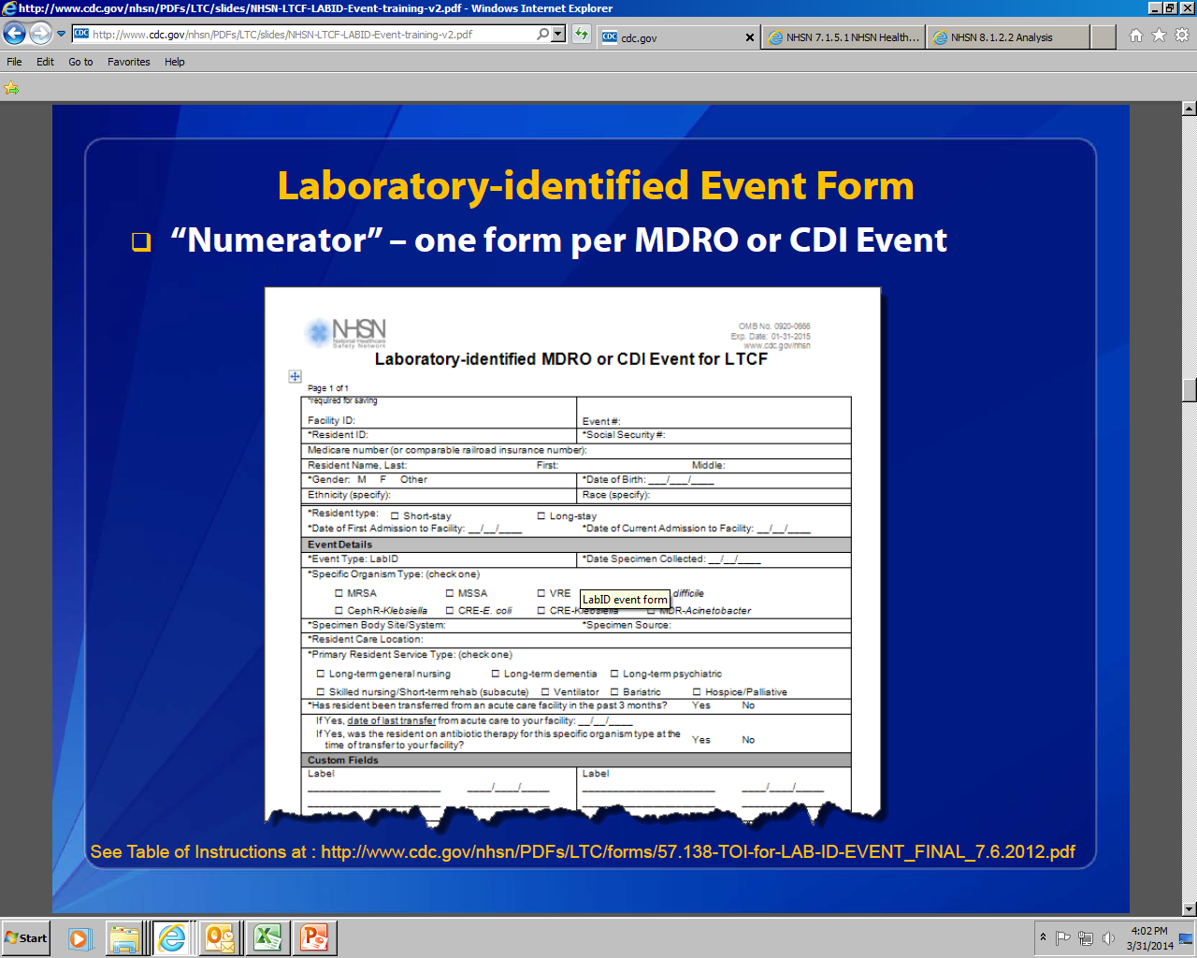
Form for Data Collection
One form per MDRO or CDI Event

Slide 15
Lab-ID Event Categorization
Based on data provided for the Lab-ID Event, each event is categorized by NHSN as
  Community-onset (CO) Lab-ID Event: Date specimen collected ≤ 3 calendar days after current admission to the facility (i.e., days 1, 2, or 3 of admission)
  Long-term Care Facility-onset (LO) Lab-ID Event : Date specimen collected > 3 calendar days after current admission to the facility (i.e., on or after day 4)

Slide 16
Lab-ID Event Categorization (continued)
LO Events are further sub-classified
  Acute Care Transfer-Long-term Care Facility-onset (ACT-LO): LTCF-onset (LO) Lab-ID event with specimen collection date ≤ 4 weeks following date of last transfer from an Acute Care Facility (Hospital, Long-term acute care hospital, or Acute inpatient rehabilitation facility only)
Categories are based on the date of current admission to facility and the date specimen collected

Slide 17
Hand Hygiene and PPE
Hand Hygiene
  Performed
  Indicated
Gown and Gloves
  Used
  Indicated

Slide 18
Urinary Tract Infection
Symptomatic UTI
  With catheter
  Without catheter
Asymptomatic bacteremia
  Urine and blood culture match AND
  Does not have clinical symptoms
Will need to collect catheter-days

Slide 19
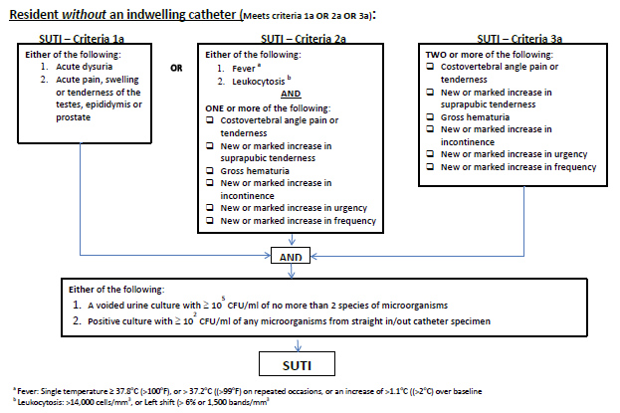

Slide 20
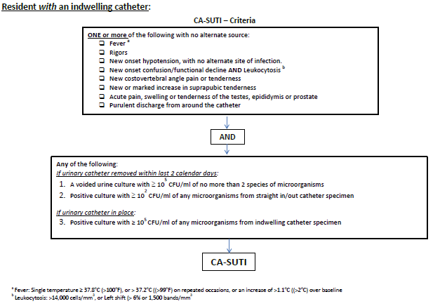

Slide 21
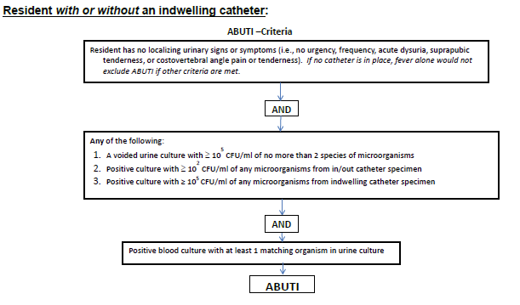

Slide 22
Clostridium difficile
Laboratory ID events
NHSN submission
Some problems with standardization of laboratory methods
Category called NH-onset (> 3 calendar days)
Goal: Pilot, evaluate variability, create goal by 2018

Slide 23


