Slide 1
APIC Greater NY Chapter 13
Journal Club Presentation
May 15, 2019
Angela Oparaiwu-Ukekweh RNC, MPH

Slide 2
Serratia marcescens Outbreak in a Neonatology Unit of a Spanish Tertiary Hospital: Risk Factors and Control Measures
Lidia Redondo, MD; Enrique-Gutierrez- Gonzalez, MD; Isabel San Juan-Sanz, MD; Ines Fernandez-Jimenez, MD, MRCGP; Guillermo Ruiz-Carrascoso, MD, PhD; Sara Gallego-Lombardo BScN, RN; Laura Sanchez-Garcia, MD; Dolores-Elorza-Fernandez, MD, PhD; Adelina Pellicer-Martinez MD, PhD; Felix Omenaca, MD, PhD; Anna Robustillo-Rodela, MD, PhD
American Journal of Infection Control, Marchg 2019
  Volume 47, Number 3, Pages 271–279

Slide 3
STUDY FOCUS
Investigations undertaken and resources adopted to, control an outbreak of Serratia marcescens in a neonatal unit of a tertiary hospital in Madrid, Spain
Prospective observational study - From June, 2016 to March 2017

Slide 4
BACKGROUND
Serratia marcescens is a gram-negative bacterium from the Enterobacteriaceae family
Occurs naturally in soil and water, produces red pigments at room temperature, can be found everywhere
Indicated in some infections like: urinary tract, respiratory, endocarditis, osteomyelitis, septicemia, wound, meningitis, and eye infections.
Known to cause outbreaks in Neonatal Intensive Care Units (NICUs), leading to significant infections and death.

Slide 5
METHODS
Prospective data collection of neonates’ characteristics, location, date of first positive sample as cases emerged by the Department of Preventive Medicine’s Infection Control team
Recording admission dates to calculate weekly incidence rates
Routine weekly screening via rectal and pharyngeal swabs to detect pathogen
NICU – October, 2016 & non NICU – December, 2016
An unmatched case-control study performed, (February, 2017) to identify potential external & internal risk factors related to S. marcescens colonization and infection
Collection of environmental samples – 318 samples
Dry surfaces & equipment, sink drains, and air samples
October, 2016 to February, 2017 – 278 samples
March, 2017 to April, 2017 – 40 samples – Post study

Slide 6
STATISTICAL ANALYSIS
Continuous variable (infinite # of possible values) compared with student t-test or Wilcoxon rank-sum test depending on normality of distribution
Categorical variables (qualitative/descriptive, variables are in categories) explored using χ2 test.
Risk estimates calculated using Multivariate Forward Logistic Regression
Variables introduced in model, if P-value <0.10 in univariate analysis, kept in model when P-value <.05
Software used were social science statistical package (SPSS, Chicago, IL), Stata14 (StataCorp, College Station, TX)

Slide 7
ETHICAL CONSIDERATIONS
Parents informed of all measures concerning them and their infants, through the phases of infection
Notification of hospital Board of Directors and hospital Ethical Committee
Ethical approval not needed – data not collected for research but for epidemiological surveillance in an outbreak, managed anonymously

Slide 8
  INTERVENTIONS
Creation of multi-disciplinary team
Enhancement of and training of staff on Contact Precautions and hand hygiene compliance
Assessment of H/H using WHO’s Hand Hygiene Observation Tool – used trained nurse from Dept. of Preventive Medicine
Cohorting for affected infants with dedicated personnel
Cleaning and disinfection
Environmental sampling

Slide 9
RESULTS
OUTBREAK EVOLUTION:
3 cases identified from January, 2016 to June, 2016, without epidemiological link
Index case 21 month old male – conjunctival sample
4 infants with S. marcescens conjunctivitis – July, 2016
Cases only in NICU – June, 2016 to October, 2016
New cases in intermediate care and standard section – last week October, 2016
59 cases identified: NICU – 42, Intermediate and Standard Care Units – 17

Slide 10
RESULTS
36 patients (61%) colonized; 23 patients (39%) infected
18 (78%) with conjunctivitis, 5 (22%) with bacteremia
End of outbreak:
Total of 1,111 admissions NICU – 375; Rest of the ward – 736)
26 neonates (44%) just colonized –(19 rectal, 4 pharyngeal, 2 bronchial, 1 umbilical)
28% of cases changed from asymptomatic to infected
(22 conjunctivitis, 9 sepsis, 2 pneumonia, 1 bacteremia, 1 encephalitis)
Some patients with >1 infection site
One death – 25 3/7 weeks, birth wt. 922 gms, with septicemia and septic shock
1.7% case fatality rate

Slide 11
RESULTS
Global cumulative incidence-for the entire period-June, 2016 to March, 2017
11.2 cases/100 cases at risk in NICU; 2.31 cases/100 neonates at risk in non-NICU wards
Incidence density 0.29 case/neonate- month at risk in the NICU; 0.06 case/neonate –month at risk non-NICU
Outbreak peaked January, 2017 – both NICU and non-NICU
February, 2017 – ward closed - abrupt decease in cumulative incidence
New increase in incidence after ward re-opened
March, 2017 – Last case discharged

Slide 12
RESULTS
All isolates of S. marcescens tested for antibiotic susceptibility were”
resistant to ampicillin, amoxicillin, cephalothin, cefuroxime, cefoxitin, amikacin, tobramycin
Susceptible to piperacillin/tazobactam, cefepime, ciprofloxacin, gentamicin, ertapenem, imipenem, meropenem, cotrimoxazole, tigecillin
25 available strains isolated. Clinical (n=22), environmental (n=3), identified 2 main lineage highly related to the outbreak
Out of 318 environmental samples taken:
3 positive for S. marcescens- corresponding to siphons from different sections
1 NICU sample obtained December, 2016
2 standard care pods- samples obtained January, 2017

Slide 13
RESULTS
CASE - CONTROL STUDY:
Total of 46 case and 63 controls
Univariate analysis showed: Predisposing factors
Higher use of corticosteroids prior to delivery, significant
History of maternal infection during pregnancy - higher
Lower gestational age & birth weight
Heart, hematologic, digestive and endocrine disorders in neonates
More frequent diagnostic therapeutic procedures
Multivariate logistic regressions shows: Risk factors identified as:
Receipt of parenteral nutrition significantly, increases risk for S. marcescens colonization/infection - [OR] 103.4; 95% [CI], 11.9-894.8
Radiography [OR] 15.3; 95% [CI], 2.4-95.6
Preterm birth [OR] 5.65; 95% [CI], 1.5-21.8

Slide 14
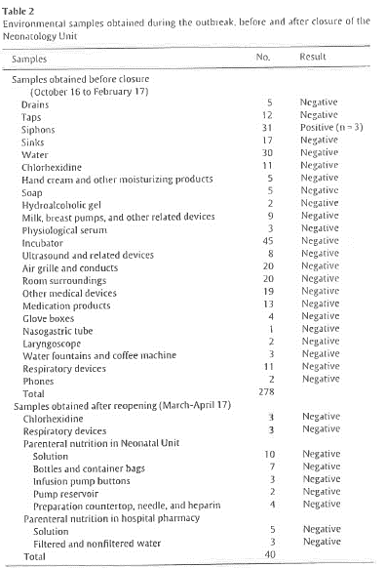

Slide 15
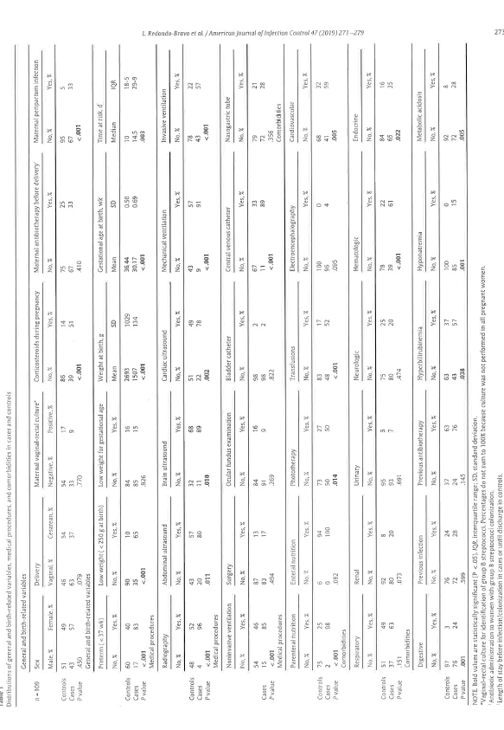

Slide 16
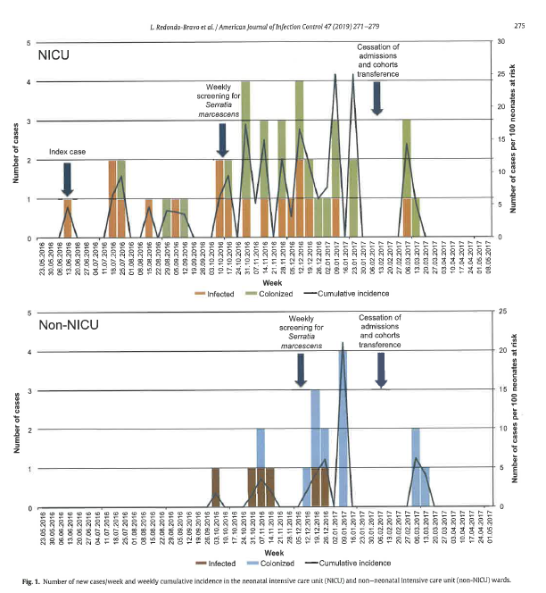

Slide 17
DISCUSSION
S. marcescens spreads fast, especially in wards with:
Immunocompromised patients
Many healthcare workers (HCWs)
Many therapeutic interventions
NICU ideal for outbreak
Rapid increase in cases (NICU & non-NICU)
deficiencies in infection control practices
Infected/Colonized infants were reservoir and main source
Multidisciplinary team helpful
Enforces adherence to precautionary measures, training of staff, held admissions, progressively discharged or transferred out infants – February, 2017

Slide 18
DISCUSSION
Cases reappeared after unit re-opened:
Cleaning and decontamination eliminated most environmental sources but not all
S. marcescens could have been re-introduced and rapidly spread by contaminated hands of HCWs
Infection could have been spread through the hands of HCWs, who came from other departments
Pharyngeal cultures of HCWs cultured to exclude other means of spread but all samples negative
Dedicating personnel to attend to various cohorts helped but difficult
Not always enough staff (need for highly trained HCWs and shift work)
Complaints from staff caring for colonized/infected patients/families – psychological issues
Placing patients in a different pods may be recommended to facilitate compliance
Partial/complete closure of the units may be needed to achieve complete control of outbreak
Active surveillance led to low fatality rate

Slide 19
DISCUSSION
Multivariate regression model identified risk factors:
Prematurity: Prone to infection - due to immature immune system, less effective skin and mucosal barrier - weakened by invasive procedures, underdeveloped microbiota, colonization of organism around
Parenteral Nutrition: favorable growth media for microorganism – samples sent late-3/2017, no growth
Radiography: Equipment/accessories could act as fomites – improved cleaning and disinfection during outbreak. Samples negative.
Contaminated sinks and drainages systems are stable reservoirs. Biofilm forming bacteria may form reservoirs in wet surfaces of pipes; water splashing, an aerosol effect from the sink drain may contaminate basin and surrounding surfaces
3 environmental samples positive
– obtained from siphons (drains) in different locations
– only 1 strain related to outbreak (molecular typing results)
– contamination by handwashing or contact with material in sink as cases appeared in other pods
– not clear how infants could have been infected

Slide 20
DISCUSSION
Environmental source not identified:
– more cases after pieces from sink and siphons (drains) were changed
– strain unrelated to outbreak, may be related to persistence of a different strain of S. marcescens inside the biofilm
– formation and establishment of microbial biofilm due to microbiota in wastewater and patients admitted in the unit over time could lead to different species or diverse bacterial strain of the same species.
Unit was kept under close surveillance to prevent easy spread due to:
Complexity of cases
Large number of HCWs
Large number of invasive procedures

Slide 21
LIMITATIONS
Possible underestimation of carriers.
– Initial screening, only in the NICU.
– Clinical data collection from medical records, exhaustive and possibly some variables registered incorrectly

Slide 22
CONCLUSIONS
Outbreak most probably from hands of many HCWs and procedures performed in the unit
Environmental investigation inconclusive, therefore an unlikely cause
S. marcescens outbreak in neonatology unit usually prolonged and hard to control
Typical control measures for nosocomial infections in other units may not work for neonatology
Multidisciplinary measures help to achieve rapid control
– Intensify universal precautionary measures and stricter measures like cohorting, closure of units, dedicated personnel
Close surveillance is very important because outbreaks spreads easily
– many HCWs
– vulnerable population
– several invasive procedures

Slide 23
Summary Report for Documents Reviewed at the APIC Greater NY Chapter 13 Journal Club |  |  |  |  |  |  |  | Date: 5/15/19 Reviewer: Angela Oparaiwu- Ukekweh Appraisal Score: III B
Article/Research Study Being Evaluated: Serratia marcescens Outbreak in a Neonatology unit of a Spanish Tertiary hospital: Risk Factors and Control Measures /AJIC February 2019. Vol 47, Number 3, pages 271-279
LEVEL OF EVIDENCE
REPORT OF A SINGLE RESEARCH STUDY? □ Yes □ No (if no go to summary)
SETTING: A Neonatology unit of La Pax hospital, Madrid, Spain
SAMPLE SIZE: An outbreak of S. marcescens in a Neonatology unit of a Tertiary hospital in Madrid, Spain, from June 2016 to March 2017. Weekly rectal and pharyngeal screenings were performed on the neonates as soon as the outbreak was detected. Environmental samples and samples from Health care Workers (HCWs), were obtained for microbiological analysis. An unmatched case- control study done to invest risk factors for infection. Fifty nine neonates affected, thirty six colonized, twenty three infected, mostly conjunctivitis and septicemia. Multivariate Logistic Regression identified Parenteral Nutrition, history of previous radiography and prematurity as risk factors. Various measures were taken to control the outbreak like daily multidisciplinary team meetings, contact precautions, cohorting, allocation of dedicated staff, unit cleaning and disinfection, and partial unit closure. Hands of HCWs were mostly suspected as the mode of transmission because Environmental investigations were inconclusive, and there was high level of procedures done in the unit as well as many HCWs.
COMPOSITION: 46 cases and 63 controls with at least 48 hours length of stay, selected. Cases are either infected -positive culture and has symptoms, or colonized –positive culture without symptoms and controls negative cultures, no symptoms.
INTERVENTION(S) □ Yes □ No |  | CONTROL□Yes□No |  | RANDOM ASSIGNMENT □ Yes □ No
YES to intervention, control and random assignment |  |  |  | □ LEVEL I Randomized Controlled Trial (RCT) or Experimental Study
YES to Intervention and either Control or Random Assignment |  |  |  | □ LEVEL II Quasi-experimental (no manipulation of independent variable; may have Random Assignment or Control
YES to intervention only OR NO to intervention, Control and Random Assignment |  |  |  | □ LEVEL III Non-experimental (no manipulation of independent variable; includes descriptive, comparative, and correlational studies; uses secondary data □ LEVEL III Qualitative (exploratory 〔e.g., interviews, focus groups〕) starting point for studies where little research exists; small samples sizes; results used to design empirical studies.
 | QUALITY OF EVIDENCE: STUDY
Does the researcher identify what is known and what is not known about the problem and how the study will address any gaps in knowledge? |  |  | □Yes □No |  |  | A HIGH | Consistent, generalized result Sufficient sample size Adequate control Definitive conclusions Consistent recommendations based on comprehensive literature review that includes thorough reference to scientific evidence
Was the purpose of the study clearly presented? |  |  | □Yes □No
Was the literature review current (most sources within last 5 years)? |  |  | □Yes □No
Was sample size sufficient based on study design and rationale? |  |  | □Yes □No
If there was a control group: Were the characteristics and/or demographics similar in both control and intervention groups? If multiple settings were used, were the settings similar? Were all groups treated equally except for the intervention group(s) |  |  | □Yes □No □NA □Yes □No □NA □Yes □No □NA |  |  | B GOOD | Reasonably consistent result Sufficient sample size for the study design Some control Fairly definite conclusions Reasonably consistent recommendations based on fairly comprehensive literature review that includes some reference to scientific evidence
Are data collection methods described clearly? |  |  | □Yes □No □NA
Was instrument validity discussed? |  |  | □Yes □No □NA |  |  | C Low Quality Or Major Flaws | Little evidence with inconsistent results Insufficient sample size for the study design Conclusions cannot be drawn
Was the instrument reliable (e.g. Cronbach’s α ≥ 0.70)? |  |  | □Yes □No □NA
If survey/questionnaire was used, was response rate ≥ 25% |  |  | □Yes □No □NA
If tables were presented, was the narrative consistent with the table content? |  |  | □Yes □No □NA |  |  | Additional Comments:
Were the results presented clearly? |  |  | □Yes □No □NA
Were conclusions based on results? YES |  |  | □Yes □No □NA
Were study limitations identified and addressed? YES |  |  | □Yes □No □NA
**This appraisal tool has been modified from AORN Research Evidence Appraisal tool – Ref: Sadahiro S., Suzuki T., Tanaka A., et al. AORN Journal, July 2014 Vol 100 No 1

