Slide 1
Shelter Project – Bronx
St. Luke’s Episcopal Church
Presented by
Carmel Boland-Reardon. Infection Preventionist
Grace Robinson, Infection Preventionist

Slide 2
Shelter Project – Bronx
Background
St. Luke’s Food Pantry and Soup Kitchen has been in operation since 1985
Board of Directors – St. Luke’s Church Vestry
Director and Site administrator on site
Volunteers x 12 people
Funding: NYS & NYC, Food Bank of NYC, United Way, Church congregation

Slide 3
Shelter Project – Bronx
Background
Caters to 300 people in the community
Food Pantry distribution occurs 2/month ( Last names A-M and N-Z ) that includes canned foods, fruit, vegetables etc.
Provides lunch 5 days a week ( 10:00AM to 1:00PM)
Caters a full Thanksgiving and Christmas meals every year.

Slide 4
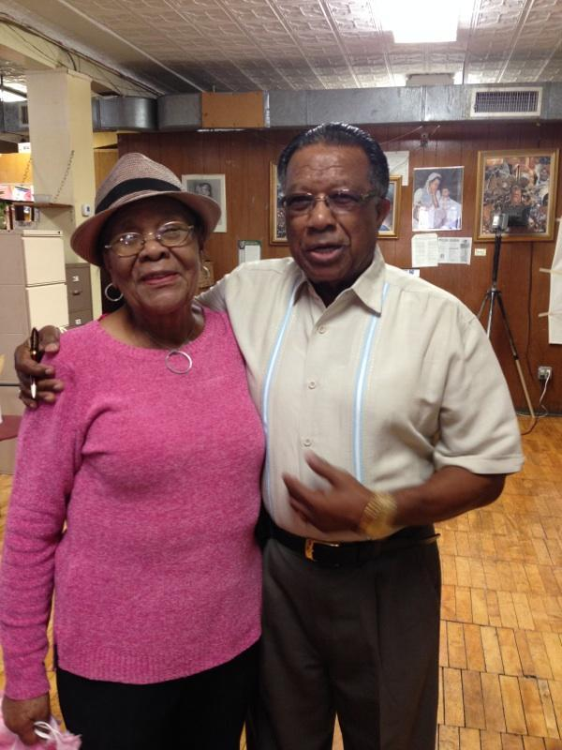
Mr. Bookal, Director
Alice Britton, Site Coordinator

Slide 5
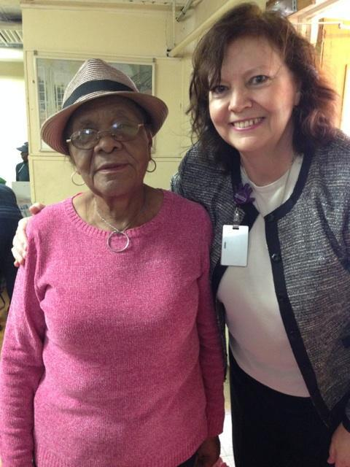
Alice Britton, Site Coordinator
& Carmel

Slide 6

Shelter Project – Bronx
Care Packages

Slide 7


Shelter Project – Bronx
Care Packages
APIC Greater New York Chapter 13 is an official chapter of the Washington, DC – based national organization Association for Professionals in Infection Control & Epidemiology. We are based in New York City. One of our main purposes is to spread knowledge in order to prevent infections. We work in many settings such as hospitals, nursing homes, shelters, rehabilitations centers just to name a few. Our members are healthcare professionals - registered nurses, microbiology technologists, physicians and those with public health degrees.
As one of our projects this year, we decided to choose an organization which we felt could use a special gift from us.
St. Luke’s Episcopal Church was one of the organizations chosen to receive a gift package of items which we hope will keep you healthy and free from infection.

Slide 8
Shelter Project – Bronx
Care Packages
We hope that 2014 will be a fresh start for you and wish you an infection - free year of hope, health, success and happiness.
Sincerely,
The Members of APIC Greater New York Chapter 13
www.apicnyc.org

Slide 9
Shelter Project – Bronx
Care Packages
Tips for Staying Healthy & Infection Free
Wash your hands frequently with soap and water for at least 20 seconds.
Don’t share personal items such as toothbrush, razors, or nail clippers.
Cover that cough and sneeze – use tissue or cough into your sleeve.
Get the flu vaccine every year – the flu is different each year.
Practice safe sex – always use condoms to prevent sexually transmitted diseases.
Be careful around animals because they can spread disease. Wash hands after touching them.
Don’t touch your mouth or eyes or pick you nose – it is a way for germs to get into your body.
Be safe with food – always refrigerate foods within 2 hours after preparation and don’t prepare raw meat or vegetables on the same surface.

Slide 10
Shelter Project - Bronx
Care package:
women's
Care package:
men's
Toothpaste/Brush
Lotion
Deodorant
Tissues
Hand Sanitizer
Chap stick
Halloween candy treat
Toothpaste/Brush
Shaving Cream
Deodorant
Tissues
Hand Sanitizer
Chap stick
Halloween candy treat

Slide 11
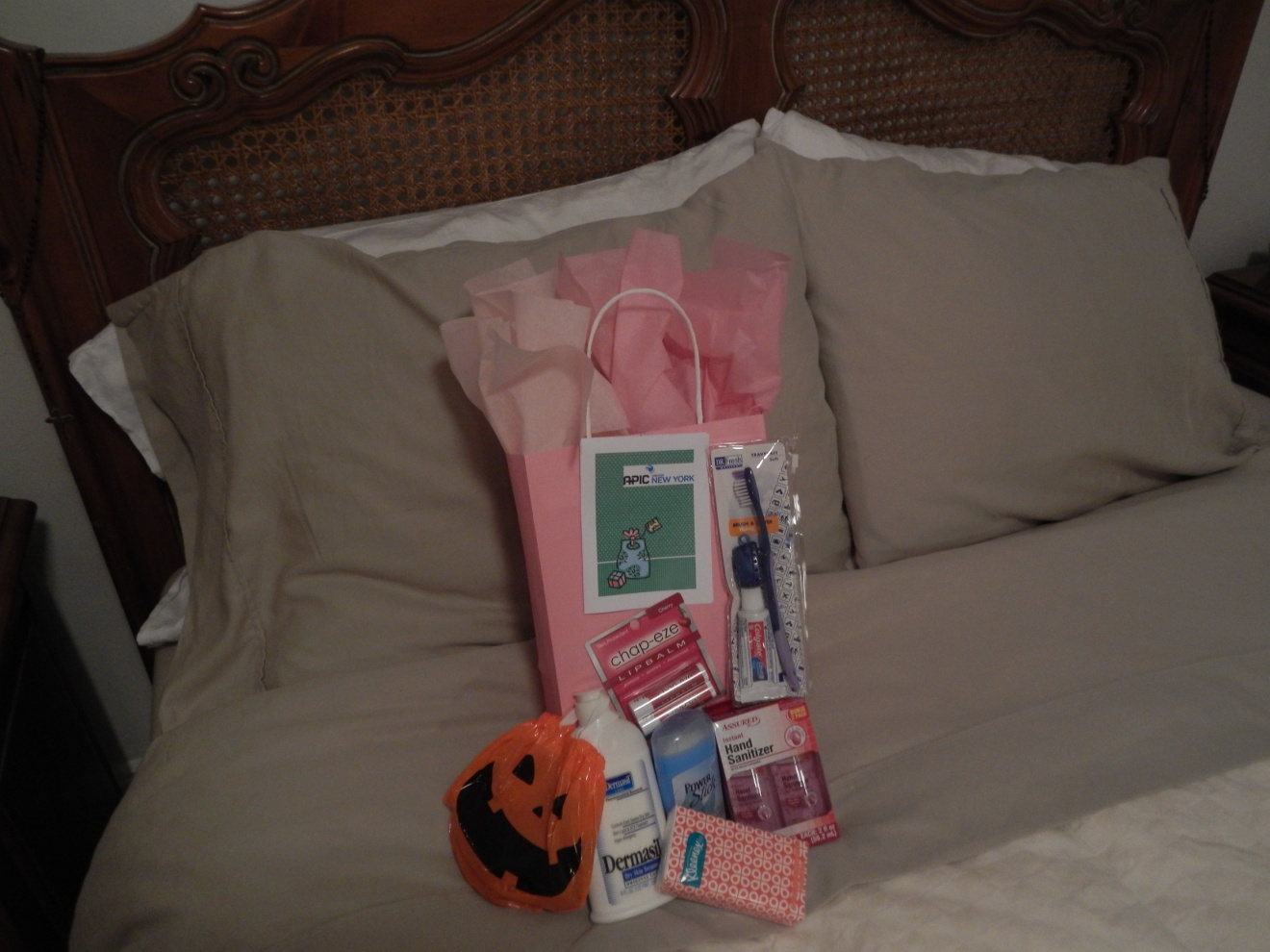
Shelter Project - Bronx
Care Package – Women’s

Slide 12
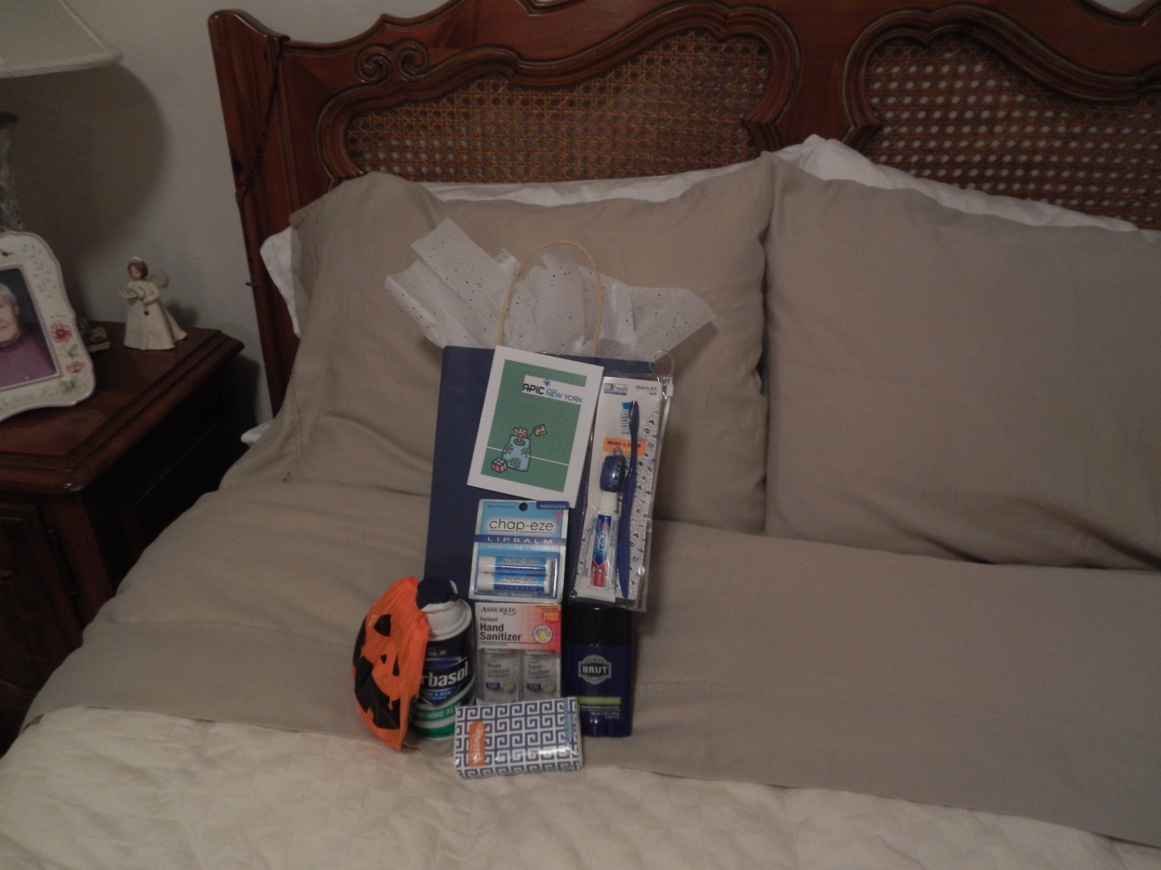
Shelter Project – Bronx
Care Package – Men’s

Slide 13
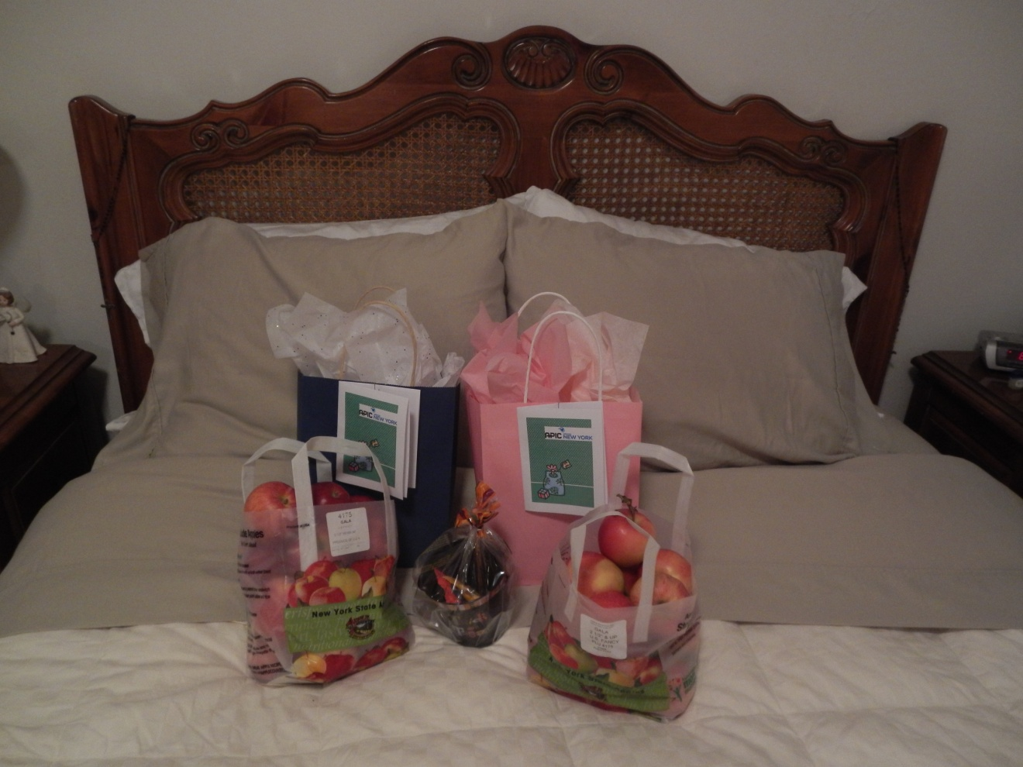
Shelter Project – Bronx
Care Packages, Trick or Treat Bag (kids), Apples.

Slide 14
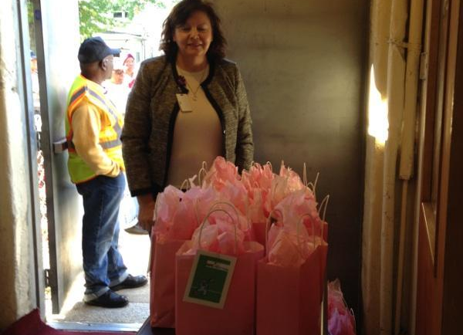
Shelter Project – Bronx
Presentation Table - Carmel

Slide 15
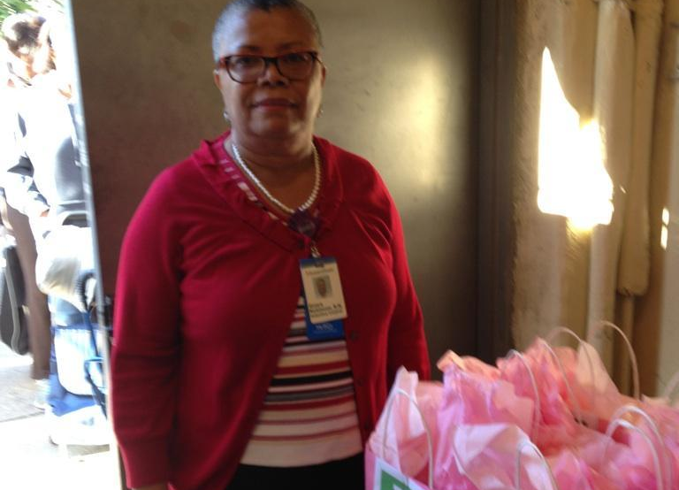
Shelter Project – Bronx
Presentation Table – Grace

Slide 16
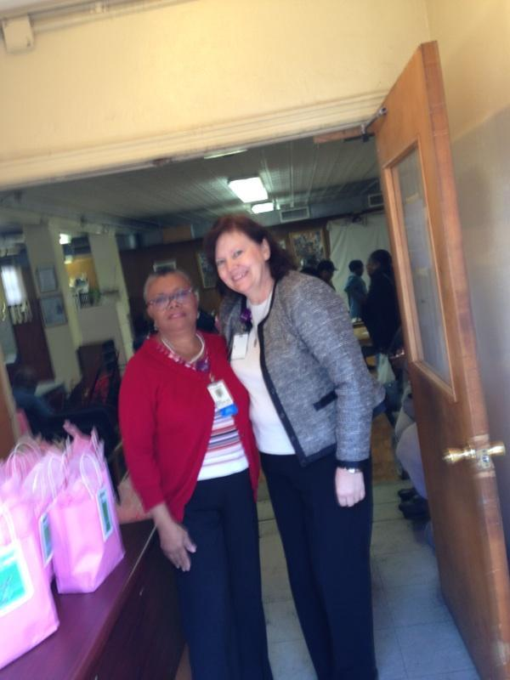
Shelter Project – Bronx
Summary
Shelter project occurred on 10/8/14
Education (Side Walk ) : Breast Cancer Awareness, Hand Hygiene, Flu Vaccine / Cover your cough, etc.
Food Pantry distribution (A-M)
Total # of people present = 130
Total # of Care Packages = 100 ( 80 Ladies, 20 Men’s , Trick or Treat Bags = 5)
Food Pantry distribution (N-Z) scheduled on 10/15/14
Future community projects for 2015 by APIC Chapter 13 ????

Slide 17
Shelter Project - Bronx
St Luke’ Episcopal Church Bulletin
Special thanks to APIC Greater New York Chapter 13 - an official chapter of the Washington DC based national organization Association for Professionals in Infection Control and Epidemiology. Representatives – Carmel Boland-Reardon R.N. and
Grace Robinson R.N. both visited our Food Pantry on Wednesday, October 8th and
educated recipients on how to prevent the spread of infections.
Care packages were also issued

