Slide 1
APIC JOURNAL CLUB
Veronica Mataprasad MT. MPH. CIC
Infection Preventionist
Lenox Hill Hospital
Northwell Health

Slide 2
Assessment of operating room airflow using air particle counts and direct observation of door openings
Jonathan Teter, MS, CIC, Isabella Guajardo, BA, Tamrah Al-Rammah, MD, Gedge Rosson, MD, Trish M. Perl, MD, MSc, Michele Manahan, MD
American Journal of Infection Control
Volume 45, Issue 5, Pages 477-482 (May 2017)
DOI: 10.1016/j.ajic.2016.12.018

Slide 3
BACKGROUND
The Operating Room (OR) environment believed to contribute to SSI rates. (Quality of OR air, disruption of air flow)
Prevention of SSI's involve many interventions
Colony forming units (CFU's) increase as OR door openings increase
Correlations between APC and microbial contamination

Slide 4
OBJECTIVE
Assess the relationship between the Air Particulate Counts (APC), OR traffic, door openings, and other common activities
Incorporate findings into interventions to enhance OR safety.

Slide 5
METHODS
Large academic center with active surgical service (1192 beds)
Focus on plastics and reconstruction surgery (factors leading to high APC in this setting lacking)
Routine perioperative and infection control practices in place
OR air pressure positive in relation to core areas (routinely measured)

Slide 6
METHODS
One week; clean non emergent cases,
Particulate counter used (performance in OR validated, baseline readings done in empty rooms).
Location of APC counter determined by preliminary assessment of various positions in room correlated with presumed clinical impact in various locations. Reference/ baseline samples also done in sterile core/ outer corridor/ front desk.
Trained observers to observe traffic and activity . Documentation of when and who opened the door and why,
Seven (7) cases; recordings done from a single location in the room every five (5) minute.
Each recording consists of three (3) readings approximately one(1) minute apart.

Slide 7
METHODS
Door openings classified in one of three categories (time related). Attempt to replicate common clinical timing (anecdotal breakpoints)
Pre / early case / 1st 30 mins of case. Patient entry, anesthesia, surgical start
Post / late case / last 30 mins of case. Ongoing surgical intervention
Intermediate / activity in the intervening time. Closing, dressing of wound, exit from room.
Data analyzed using different statistical tests.

Slide 8
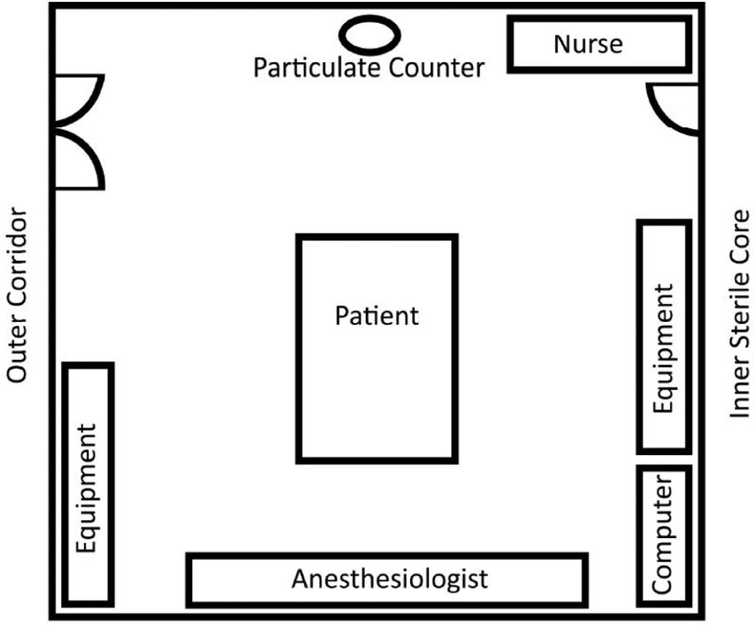
OR layout

Slide 9
RESULTS
660 measurements (602 study, 58 reference)
Average APC 9238 during baseline (95%CI , 5494-12982)
Average APC 14.292 during time of surgery (95%CI , 12382-16201)
APC increased 13% when either door was opened (P<.152), not statistically significant.
In particle size analysis ,Particle groups >.5µ had significant elevation from baseline. (P<.001). Size consistent with size of bacteria, and other wound pathogens

Slide 10
RESULTS
Counts rose over the course of the day for 3 days and dropped on 2 days
APC’s in general were lower between cases than during cases.
One or both OR doors open for 47% of the readings (309/360)
Both doors open concurrently 7% of readings (45/660).

Slide 11
RESULTS
Average 13.4 door opening per hour. Not statistically significant between cases.
Door opening rates did not differ significantly for the three time periods. (P=.108)
Mean number of personnel per door opening was 2.3 per each opening (95%CI, 2.1-2.5).
Recorded APC’s not associated with number of people entering or leaving room, or particle size

Slide 12
WHY OPEN THE DOOR
Obtain case equipment (30%)
Case status update (12%)
Work related / social conversations (8%)
Unknown (10%)

Slide 13
WHO IS OPENING THE DOOR
311 Occurrences. Range 28-73, Median 39 per case
Circulating nurses (1/3 of openings).
Individuals who should be scrubbed for most of the case (25% of openings)
Anesthesiology team (12%)

Slide 14
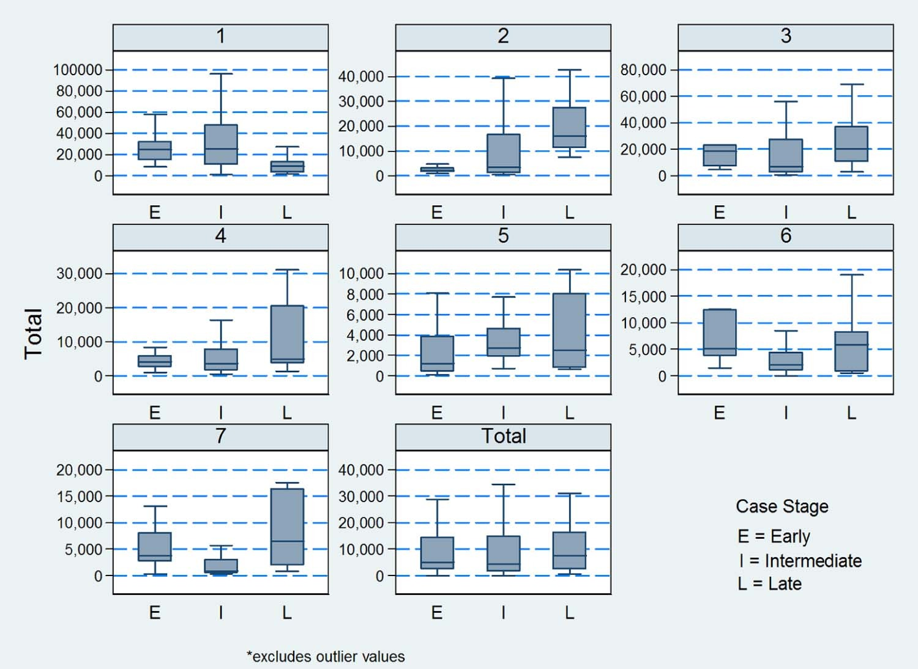

APC SUMMARY COMPARISON
Fig 3
American Journal of Infection Control 2017 45, 477-482DOI: (10.1016/j.ajic.2016.12.018)
Copyright © 2017 Association for Professionals in Infection Control and Epidemiology, Inc. Terms and Conditions
Notes:
Summary comparison of air particulate counts for individual cases and interoperative time frames. Summary air particulate count (APC) divided by state in the case (Early, Intermediate, or Late). Each panel represents a separate case labeled 1-7. The overall summary counts are seen in the panel labeled “total.” Comparison is APC for each case broken by interoperative timeframe. Early = first 30 minutes; Late = last 30 minutes; Intermediate = time period between early case and late case stages. Defined using anecdotal clinical breakpoints for surgery types.

Slide 15
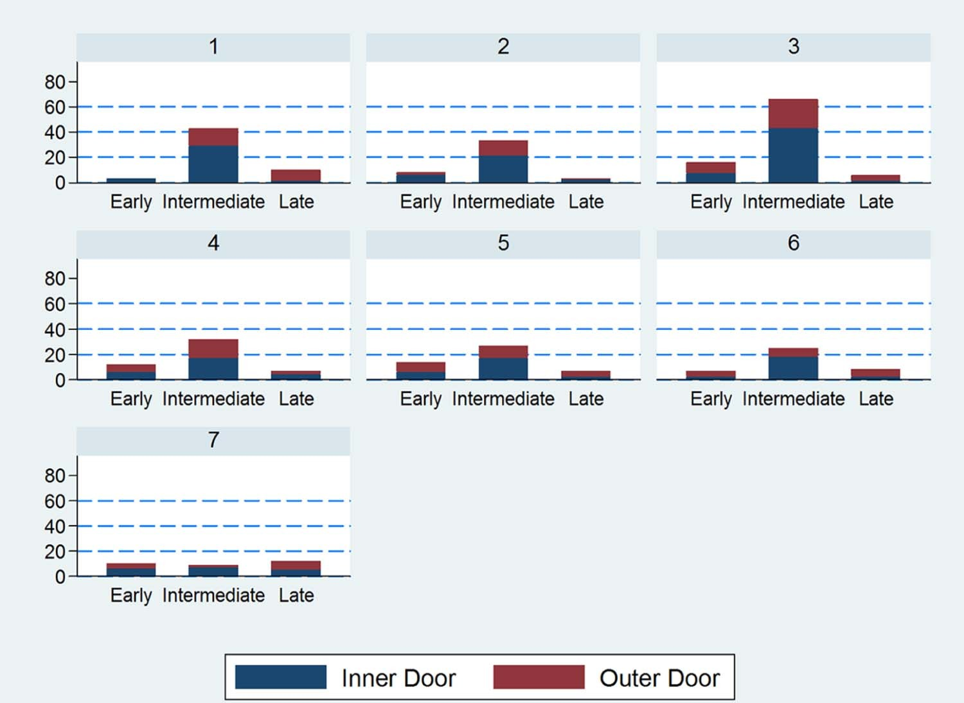
DOOR OPENING BY CASE STAGE
Fig 4
American Journal of Infection Control 2017 45, 477-482DOI: (10.1016/j.ajic.2016.12.018)
Copyright © 2017 Association for Professionals in Infection Control and Epidemiology, Inc. Terms and Conditions
Notes:
Door openings by case stage. Distribution of the number of door openings in each case by interoperative timeframe. The number of door openings is shown on the Y-axis and the period is displayed on the X-axis. Each panel represents a separate case. Early case = first 30 minutes; Late case = last 30 minutes; Intermediate = period between early case and late case stages. Defined using anecdotal clinical breakpoints for surgery types.

Slide 16
DISCUSSION
Most openings in the middle of the case, (unlike previous studies). Distribution across time periods not statistically significant.
A door was open for nearly half the time observations took place
Larger particles had a stronger association with door openings than smaller particles. Smaller particles persisted in the air longer.
Need for better process engineering in the OR
observed did not yield change of practice.

Slide 17
DISCUSSION
Need for increased awareness among OR personnel
Numerous cases of verbal communication which do not necessarily require entry in the room. (use technology)
Several openings for equipment could have been consolidated into one trip.
OR culture. Awareness of monitor, but not of reason. Being observed did not yield change of practice

Slide 18
LIMITITATIONS
Duration of door opening not analyzed
Duration of study short and small
Only one (1) particle counter used. Limits analysis of air flow patterns in different parts of the room
Did not account for possible variations in room pressure in different areas of room.
No direct correlation between particulate matter and microbial contamination explored
APC was not linked to the surgical outcome of the patient. Patient level factors not included in analysis

Slide 19
Recommendations
Further studies in multiple settings, across surgical disciplines, multiuse OR’s to examine possible links between APC, microbiological sampling and outcome data.
Use studies to establish risk factors and effects of personnel movement on surgical outcome.
Additional studies needed to demonstrate and refine previous findings to allow implementation of OR discipline and limit traffic.

Slide 20
My concerns
Only one type of surgery was observed. This may have involved the same staff (for that service), with the same types of movements.
Only 7 cases observed over a period of 5 days. How many "in between case" observations were there. How were cases spread out across days.
How long were the "intermediate" periods.
Is it practice to store equipment in the inner sterile core. (1/3 of door openings were associated with need for equipment)

Slide 21
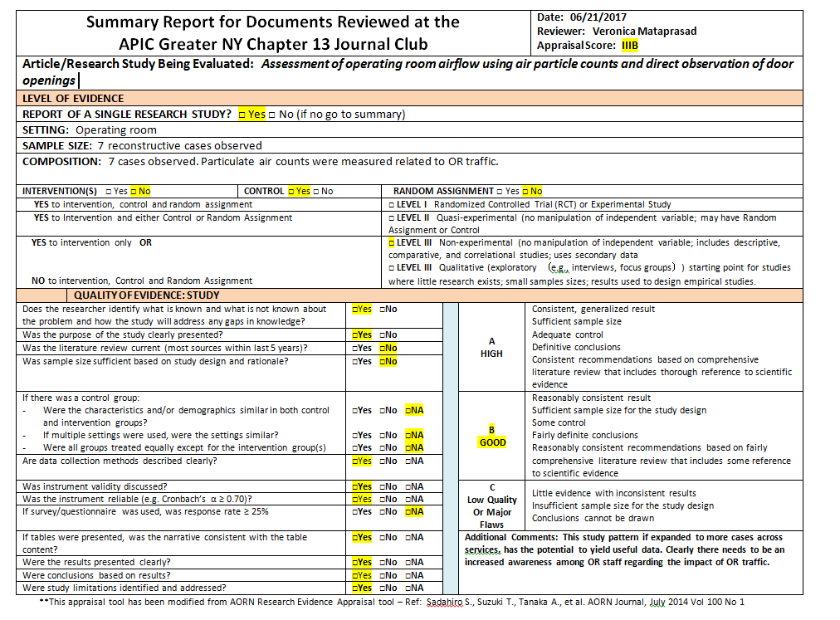

Slide 22
THANK YOU
for listening

